Slide 1
Mechanistic study of CAL-B catalyzed ring-opening polymerization of β-lactam: First results of the hybrid MC/MD simulation study
Chantal Barberot, Ikuo Kurisaki, Yuichi Suzuki, Masataka Nagaoka
Nagaoka Laboratory, Graduate School of Information Science, Nagoya University

Slide 2
Polyamides
Polyamides are one of the most used polymers, found in several applications in industry, e.g., plastics, fibers.
Among polyamides, nylon 3 is composed of a β-alanine monomeric unit and is widely used in industry .e.g.;
the manufacturing of nano-composites [1]
cosmetic [2]
water purification [3]
Nylon 6, 6
Nylon 6 or PA6
monomer unit
Nylon 3, poly(β-alanine)
[1] Itagaki, T.; Komori, Y.; Sugahara, Y.; Kuroda, K. J. Mater. Chem. 2001, 11, 3291–3295.
[2] Grollier, J. F.; Fourcadier, C.; Courtois, M. Detergent and foaming cosmetic composition delaying the regreasing of hair. US4851154, 1989.
[3] Huang, S. Y.; Fisher, M. M. Water purification employing poly(beta-alanine). US4247432, 1981.

Slide 3
Poly(β-alanine) synthesis
There are several ways to synthesize poly(β-alanine)
Anionic polymerization of acrylamide in the presence of a strong base [4].
Polymerization through group (IV) metal alkoxides [5].
Polycondensation of β–alanine in ionic liquid [6].
Enzymatic polymerization [7].
In order to apply this strategy for an industrial use, it seems important to optimize the reaction conditions or improve the enzymatic function of the CAL-B itself.
 | Reactant | Catalyzer | Yield (%) | DP | DPmax
Entry 1 | acrylamide | t-Butyl-ONa | 65%
Entry 2 | β-alanine | No catalyzer | 74 | 10 | 24
 |  | Metal alkoxides = Zr(Ot-Butyl)₄ | 81 | 15 | 53
 |  | Metal alkoxides = Hf(Ot-Butyl)₄ | 75 | 24 | 58
Entry 3 | β-alanine | Ionic liquid = [MMlm]Cl | 83 | 49.5
 |  | Ionic liquid =[MMlm](MeO)₂PO₂ | 94 | 27.8
Entry 4 | β-lactam | CAL-B | 73 | 8 | 18
It can lead to branched polymer
It is not environmental friendly reaction conditions
[4] Breslow, D. S.; Hulse, G. E.; Matlack, A. S. J. Am. Chem. Soc. 1957, 79, 3760–3763.
[5] Steunenberg, P.; Könst, P. M.; Scott, E. L.; Franssen, M. C. R.; Zuilhof, H.; Sanders, J. P. M. Eur. Polym. J. 2013, 49, 1773–1781.
[6] Zhang, S.; Dias Goncalves, L.; Lefebvre, H.; Tessier, M.; Rousseau, B.; Fradet, A. ACS Macro Lett. 2012, 1, 1079–1082.
[7] K. Loos et al. Macromol Rapid. Commun. 2008, 29, 794-797.

Slide 4
Research project
To optimize the reaction, a deep understanding of the mechanism is necessary.
Currently, a mechanism was already proposed [8]. Unfortunately, no reaction energies were given.
The rate-determining step of the reaction is still elusive
As a first step to produce longer Nylon 3 polymer, we investigated the mechanism of the polymerization reaction with QM and QM/MM calculations.
During a second stage, we will perform hybrid MC/MD simulations [9] to consider the effects of the system dynamic on our proposed mechanism.
[8] G. Fels et al. ACS Catal. 2011, 1, 323-336.
[9] Nagaoka, M.; Suzuki, Y.; Okamoto, T.; Takenaka, N. Chem. Phys. Lett. 2013, 583, 80–86.

Slide 5
QM and QM/MM studies

Slide 6
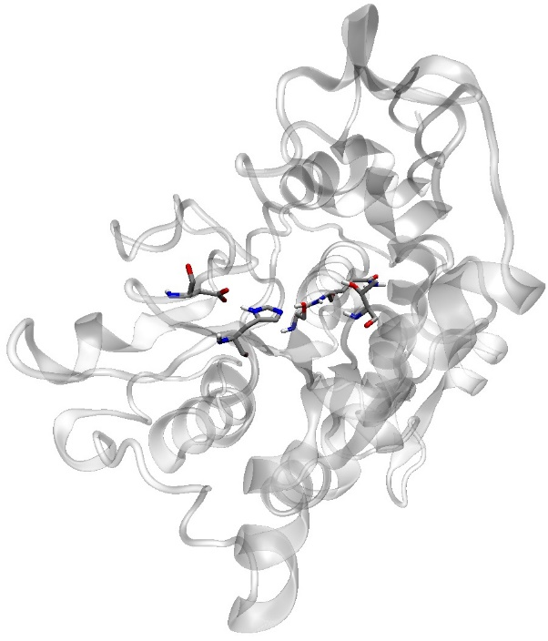
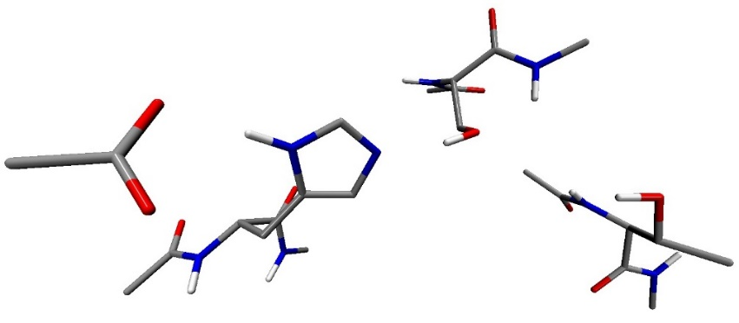
Methodology
1. System description
Crystal structure: 4K6G
Solvent: 2770 toluene molecules + 92 water molecules
2. Procedure
Force field parameters:
Organic molecules: general AMBER force field
Protein: Amber force field ff99SB
Water molecules: TIP3P model
Na⁺: JC ion parameters
QM Calculation level: B3LYP/6-31G(d,p)
active site
•
MD
pick-up a snapshot structure and minimized by MM
extract the active site
QM calculations in gas phase with Gaussian
QM/MM calculations with Amber Gaussian interface (AG-IF) [10]
¹⁰⁴Trp
¹⁰⁶Gln
¹⁰⁵Ser
⁴⁰Gly
⁴¹Thr
¹⁸⁸Asp
²²⁴His
²²⁵Ala
^{Catalytic triad}
⁴²Gly
²²³Asp
^{Oxyanion hole}
Model system and QM part
[10] Nagaoka, M.; et al. J. Comput. Chem. 2011, 32 (5), 932–942. Nagaoka, M.; et al. Bull. Chem. Soc. Jpn. 2013, 86 (2), 210–222.

Slide 7
Results and Conclusion
Monomer activation
The initiation process is not performed through the in situ β–lactam opening.
Water molecules should play two roles in the polymerization reaction.
Linear condensation process seems is the rate-determining step.
21.71
[kcal/mol]
Elongation
Initiation
path A
path B
19.82
[kcal/mol]
Termination
41.56 [kcal/mol]
33.70 [kcal/mol]
19.82
[kcal/mol]
15.23 [kcal/mol]
not favorable
Reaction initiation
polymer release

Slide 8
MC/MD simulations

Slide 9
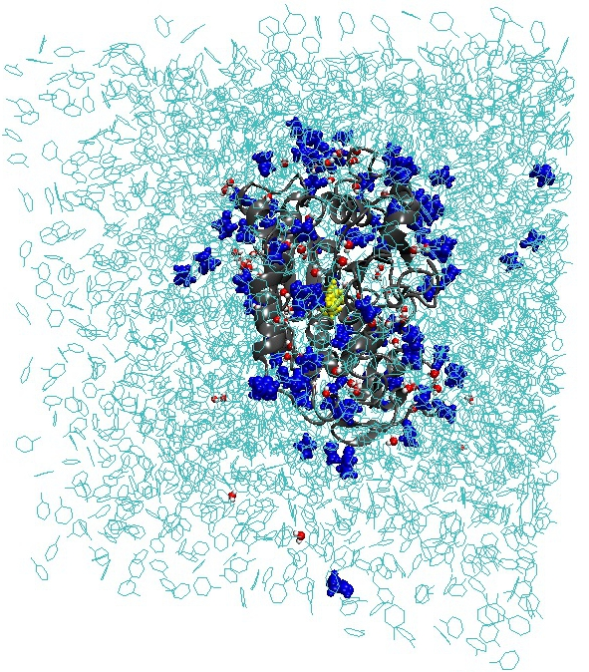
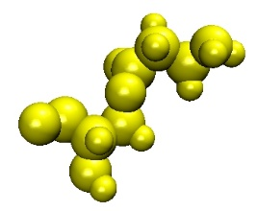
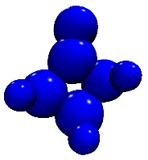
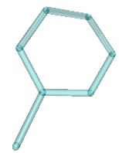
Computational details
The acylated CAL-B is solvated in a toluene box.
92 water molecules are added to the system corresponding to an enzyme water content of 1 % (w/w).
The β-lactam concentration corresponds to the experimental one (0.285 mol.L⁻¹), 92 β-lactam molecules.
Periodic boundaries conditions are applied.
SHAKE method is used to constrain bond involving hydrogen atoms.
To equilibrate the system, a series of MD are performed at 363K and 1 atm.
First, 2000 MC/MD cycles are performed
The NVT-MD (363K) simulation time in one MC/MD cycle is set to 10 ps.
Force field parameters:
Organic molecules: general AMBER force field
Protein: Amber force field ff99SB
Water molecules: TIP3P model
Na⁺: JC ion parameters
82 Å
96 Å
76 Å
Acylated ¹⁰⁵Ser
β-lactam
Water
Toluene

Slide 10
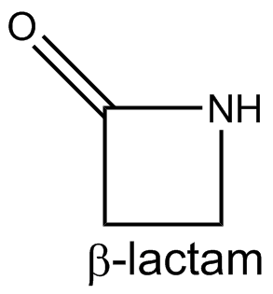
Reaction scheme
The chemical reactions are selected based on the distance criteria and their activation energy.
Ligand binding should occur less often than chemical reaction. A correct parametrization is necessary.
In addition, analysis of active site is important to decided if the ligand binding can occur or not.
Ligand
binding
Termination
Monomer activation
Elongation
Initiation

Slide 11
Docking reaction selection
Before the reaction selection, a reaction weight is given for the docking process depending of few criteria.
No β–lactam present in the active site?
no
yes
Catalytic serine acylated?
no
yes
Current cycle - last accepted docking cycle
< i cycles
no
yes
Docking reaction weight << chemical reaction weight
Docking reaction weight=0
But the selection condition for docking process is more often satisfy that for chemical reaction.
To decrease the probability of selection, another criteria is considered (TRIAL).
First test with i=10 MC/MD cycles and i=20 MC/MD cycles for 4 initial configurations

Slide 12
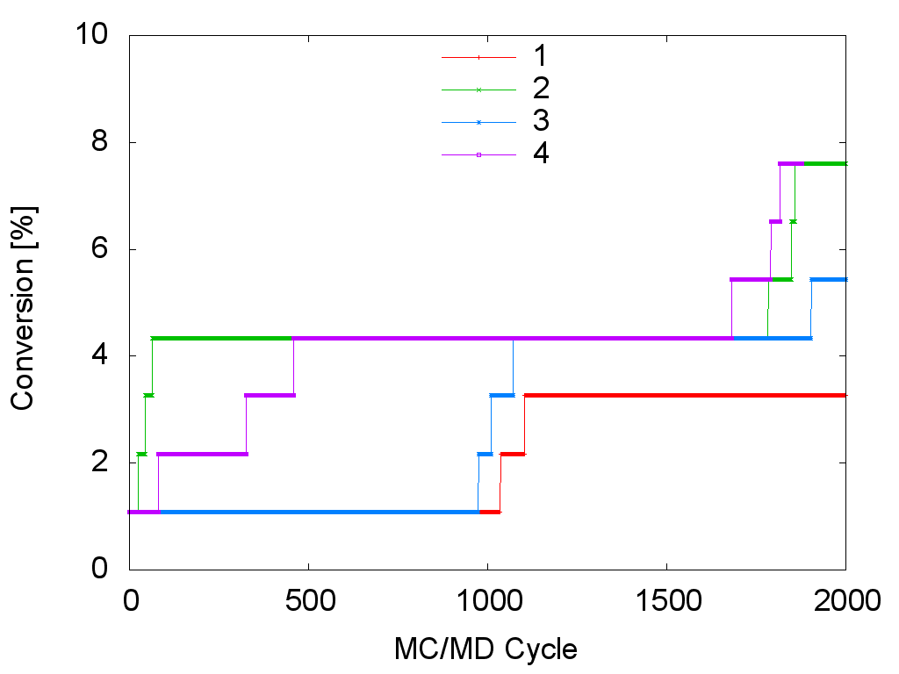
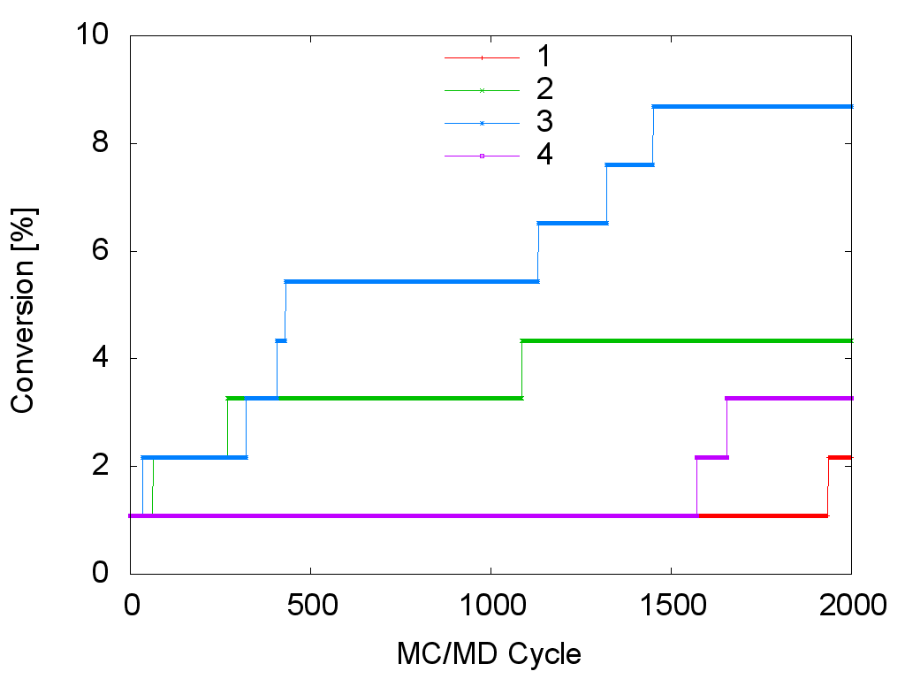
β-lactam conversion
The β–lactam conversion corresponds to the percentage of β–lactam which already reacts.
It is calculated at each MC/MD cycle i as follow: $\%Conversion=\frac{Number of β−lactam molecule at cycle i}{initial number of β−lactam}×100$
Docking frequency: 10 MC/MD cycles
Docking frequency: 20 MC/MD cycles
After 2000 MC/MD cycles, the maximum conversion observed is only equal to 8.7% was observed.
Some differences can be observed by varying the docking frequency.

Slide 13
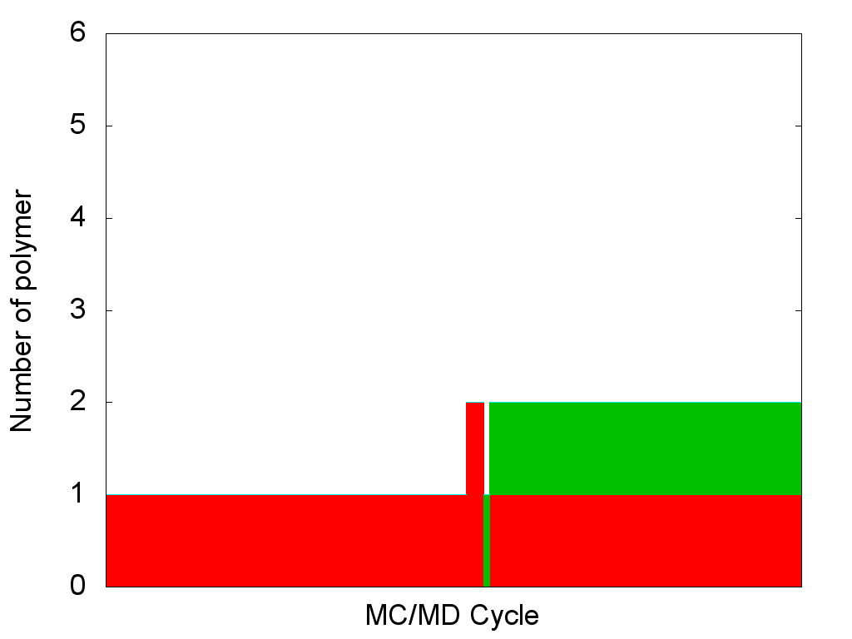
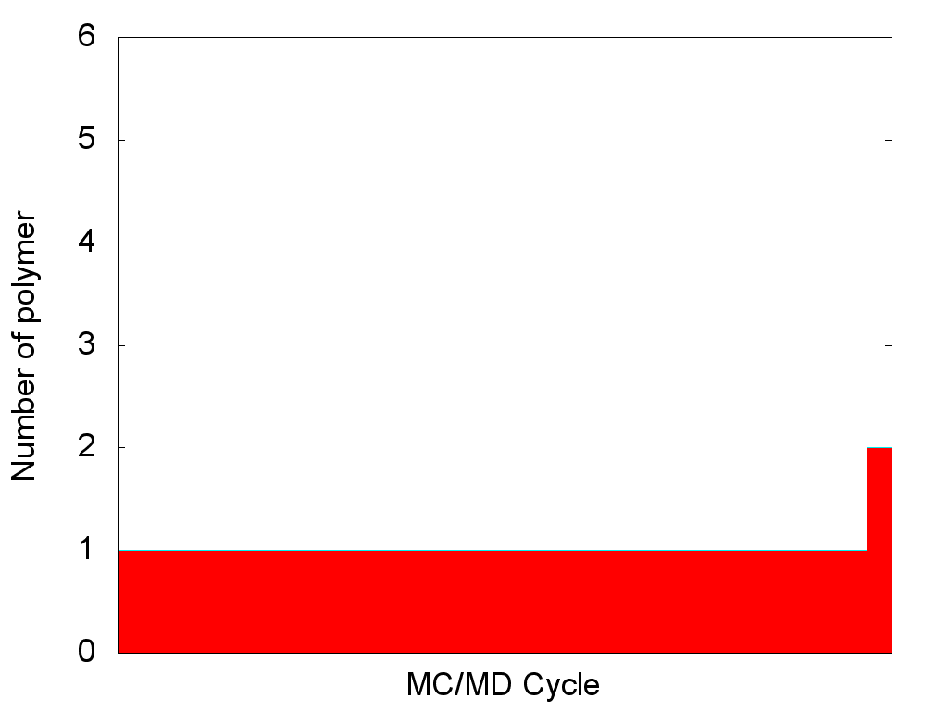
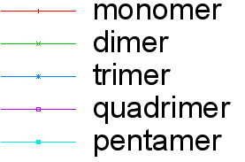
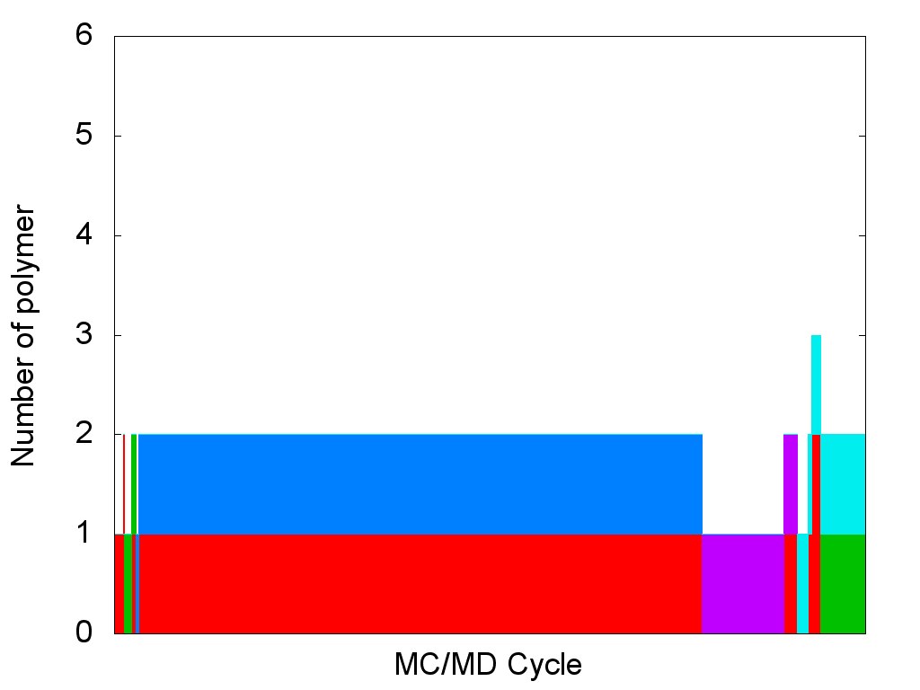
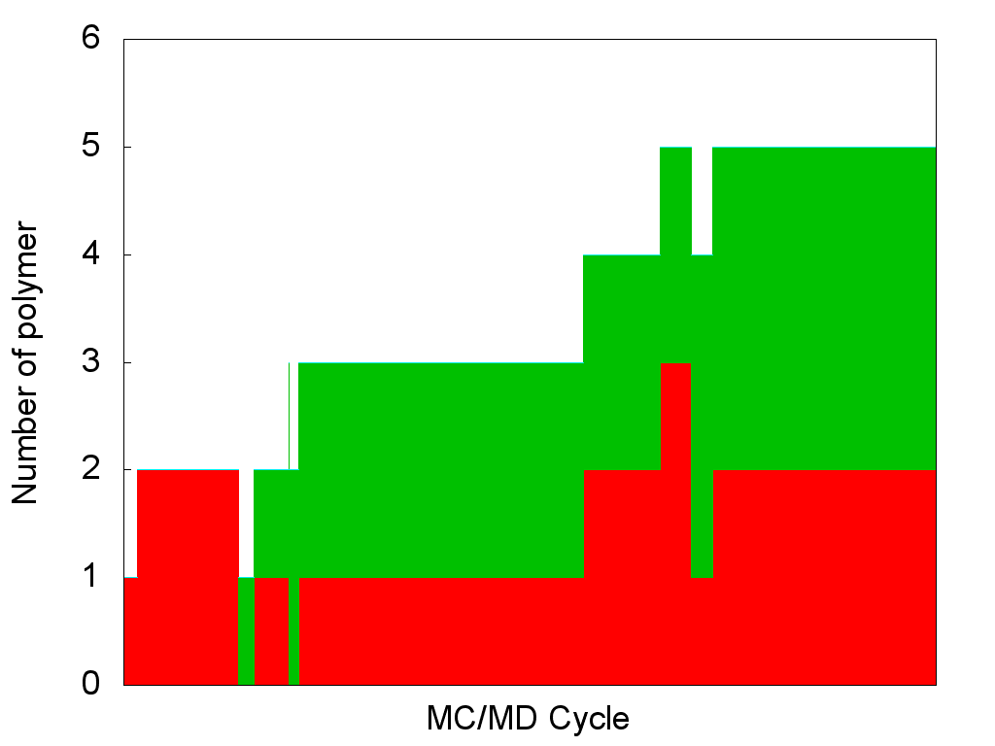
Number of polymer
Docking frequency: 10 MC/MD cycles
Docking frequency: 20 MC/MD cycles
low conversion
Last cycle: 1 monomer
1 dimer
Last cycle: 2 monomers
high conversion
Last cycle: 1 dimer
1 pentamer
Last cycle: 2 monomers
3 dimers

Slide 14
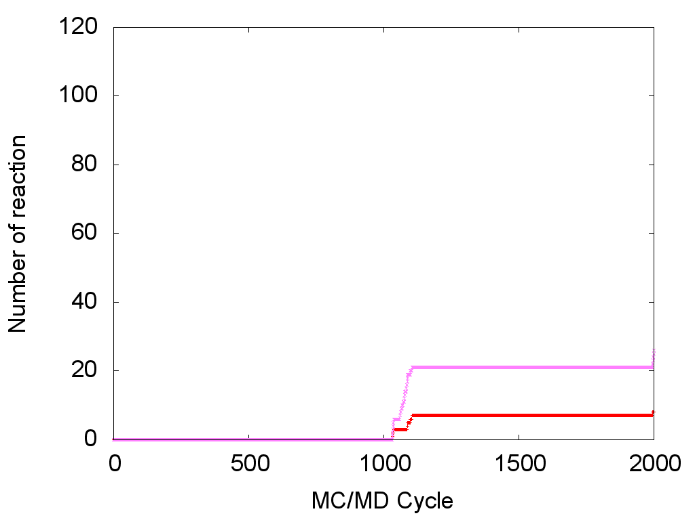
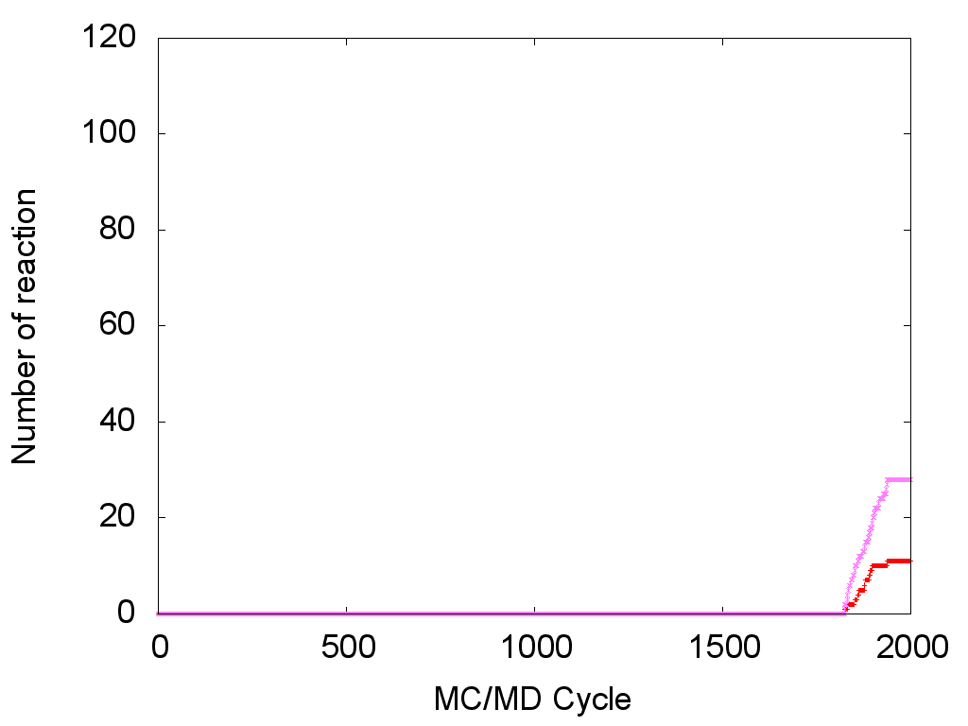
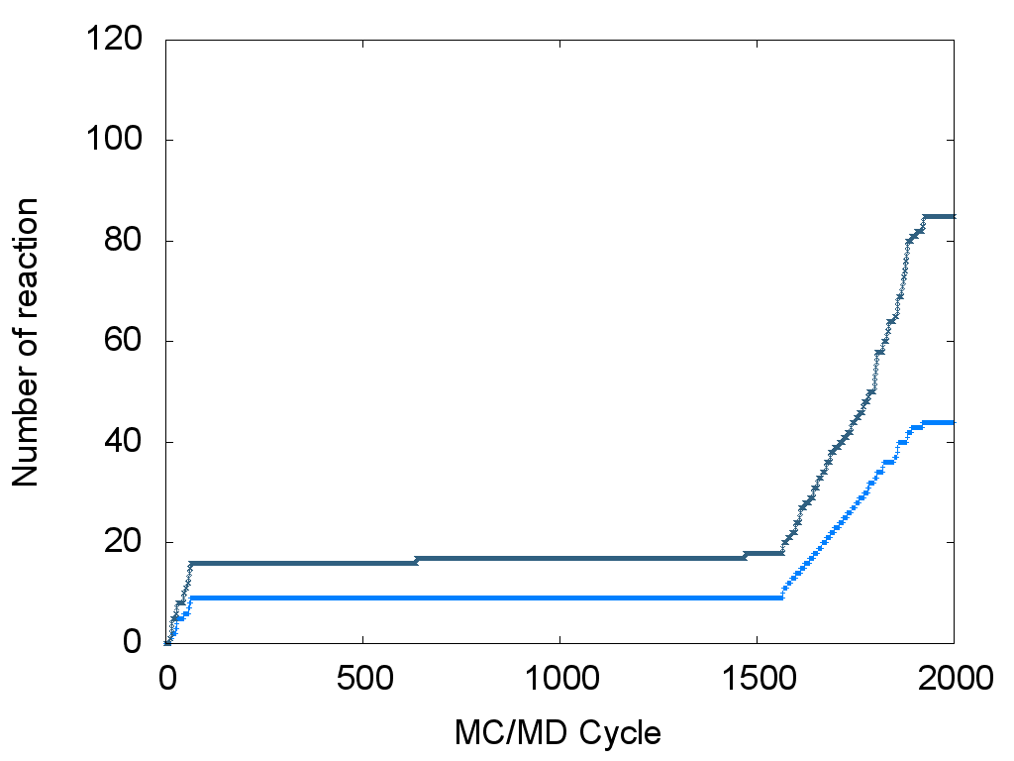
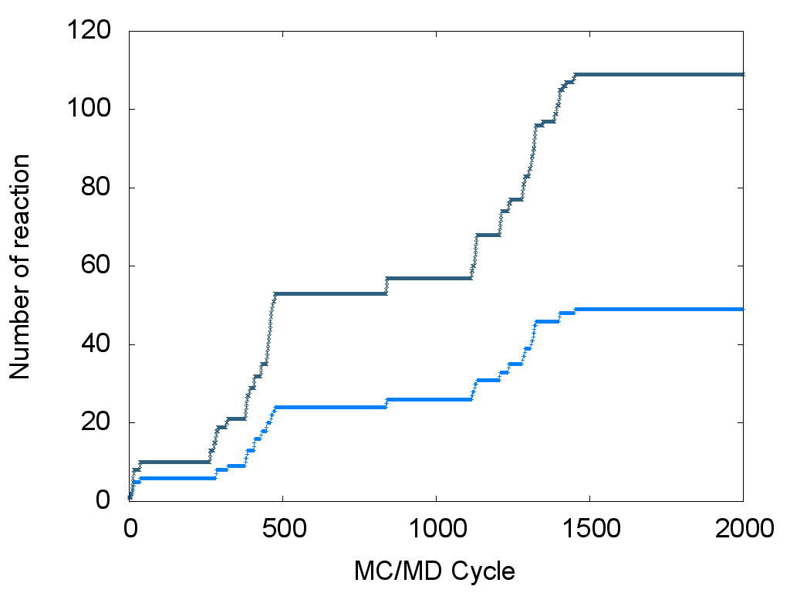
Number of reactions
Docking frequency: 10 MC/MD cycles
Docking frequency: 20 MC/MD cycles
low conversion
1031 MC/MD cycles
1823 MC/MD cycles
high conversion
834 MC/MD cycles

Slide 15
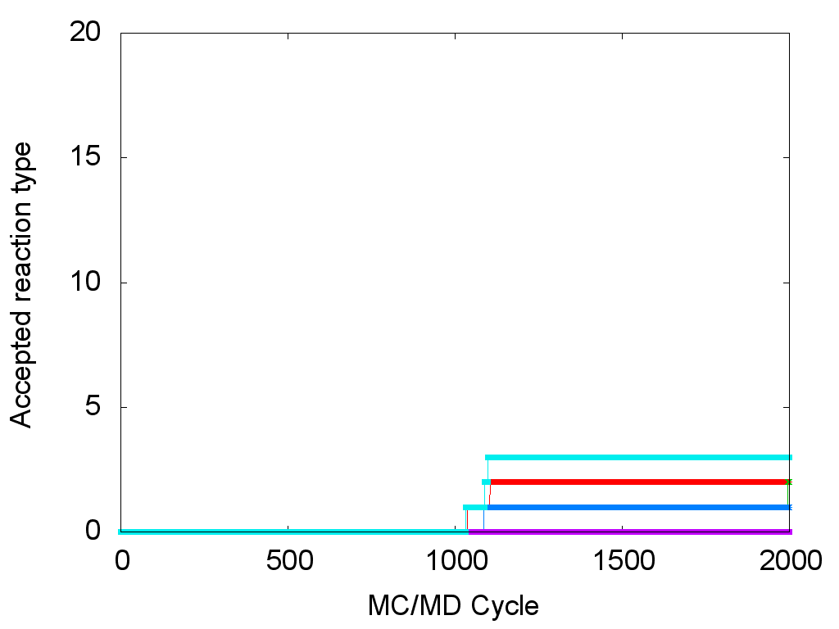
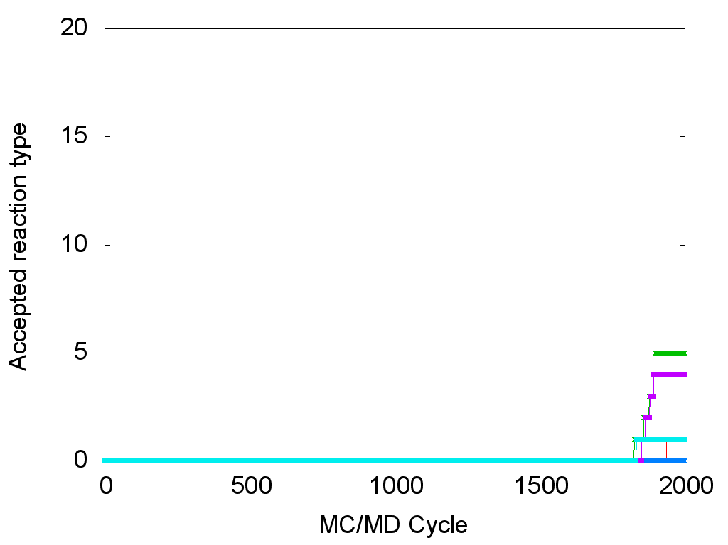
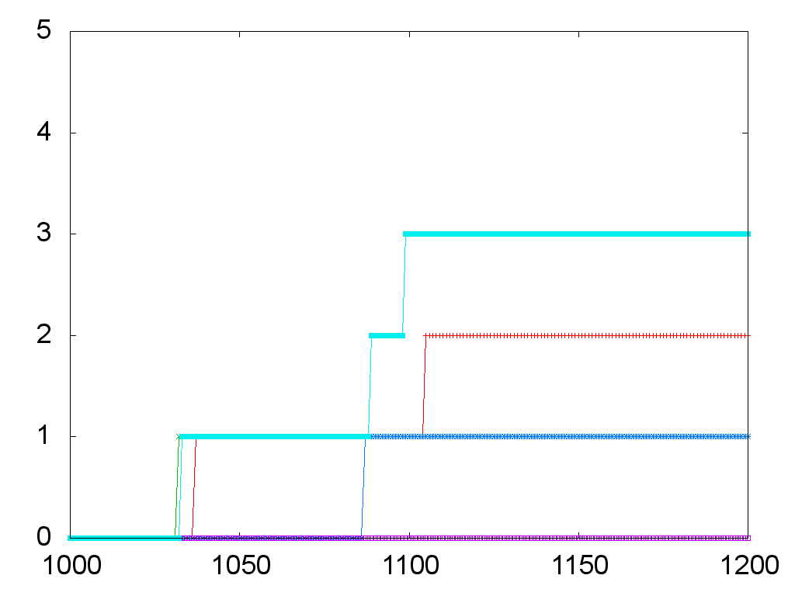
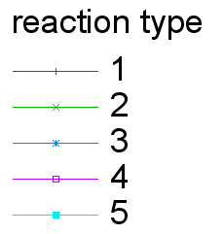
Type of accepted reactions
Docking frequency: 10 MC/MD cycles
Docking frequency: 20 MC/MD cycles
low conversion
Acylation
Acylated Serine
Acylated Serine
Acylated Serine
5
1
4
2
3
2

Slide 16
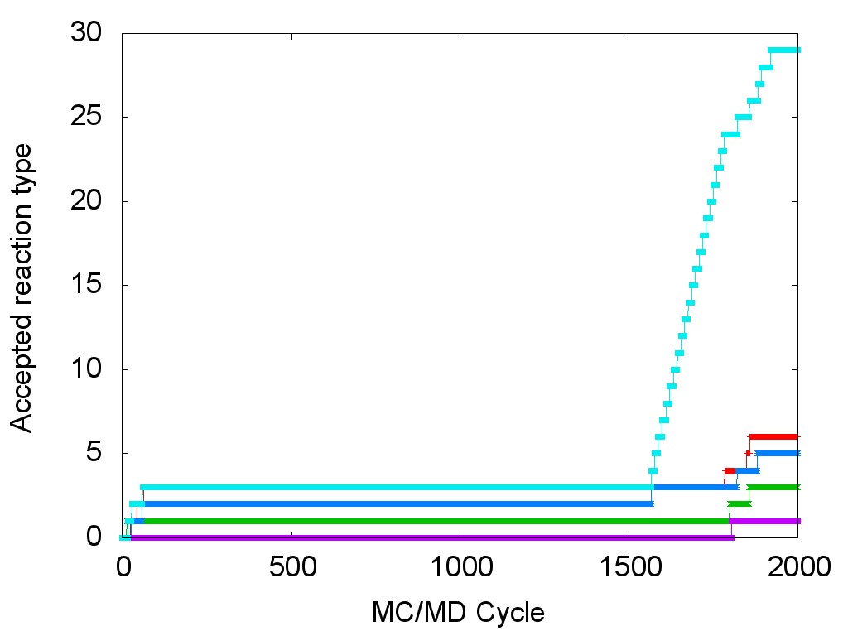
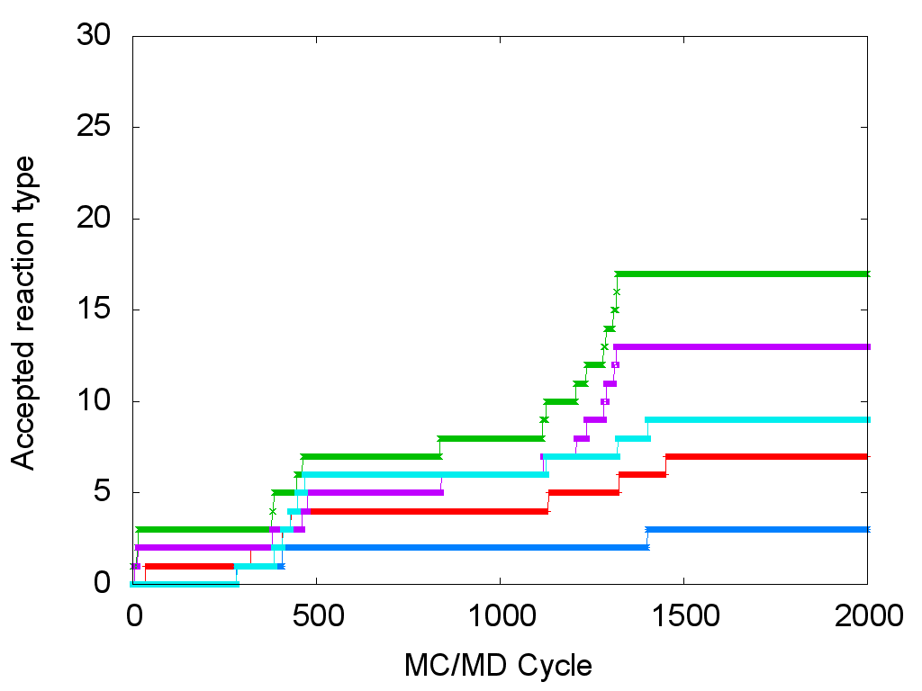
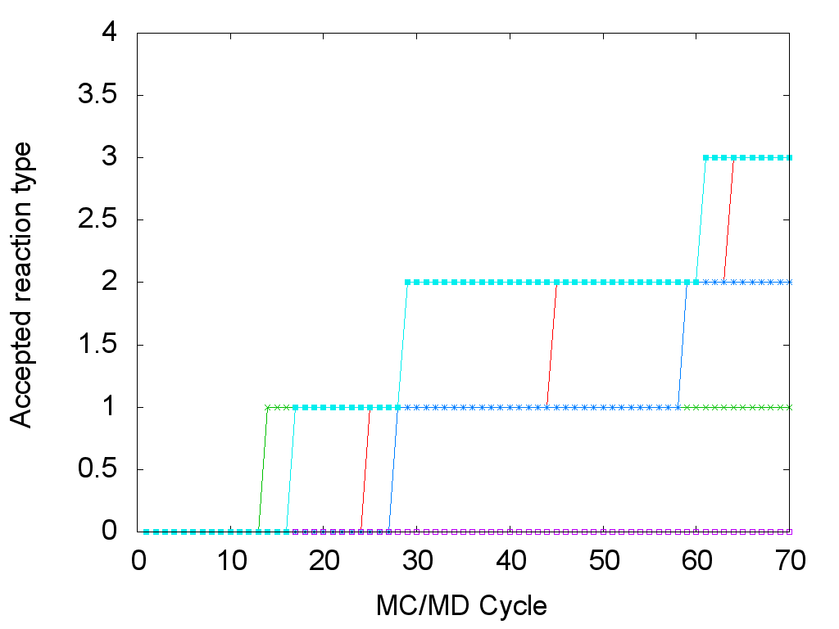
Type of accepted reactions
5
1
4
2
3
2
Docking frequency: 10 MC/MD cycles
Docking frequency: 20 MC/MD cycles
high conversion
Acylated Serine
Acylated Serine

Slide 17
Next improvements
The docking process can influence the polymerization results.
A distance criteria will be used (More realistic).
No β–lactam present in the active site?
no
To accelerate the polymerization process simulation, water binding will be also considered.
yes
Catalytic serine acylated?
no
If the both process is selected at the same type, the probability of selection of each will be weighted by their diffusion constant.
yes
Docking reaction weight << chemical reaction weight
Docking reaction weight=0
β–lactam is
located < d of the active site
no
yes
Docking reaction can be selected
Docking reaction can not be selected

Slide 18
Elongation process (1)
Based on our electronic state calculation, we showed that the initiation process is performed through path A.
In this case, the oligomer has to be stored in the active site or outside the active site to be used later during the elongation process.
Because of the low diffusion of the oligomer in the solvent media, G. Fels proposed the path B.
Monomer activation
21.71
[kcal/mol]
Elongation
path A
Initiation
path B
19.82
[kcal/mol]
Termination
41.56 [kcal/mol]
33.70 [kcal/mol]
19.82
[kcal/mol]
15.23 [kcal/mol]
not favorable

Slide 19
Elongation process (2)
The monomer or dimer units can be stored in the active site and be used later for the elongation process.
It is support our proposed mechanism where the oligomer can come from the hydrolysis of the acyl complex.
Dimer formation
Trimer formation

Slide 20
Conclusion
QM and QM/MM calculations
A new mechanism was proposed where the initiation reaction occurs thought the acylated complex hydrolysis.
The elongation process is the rate-determining step of the polymerization reaction. It can explain why only short polymer length are observed experimentally.
MC/MD trial
A better parametrization for the ligand binding process and add the possibility to simulate the entrance of the water into the active site are necessary.
The simulation of the elongation process support our proposed mechanism.

Slide 21
Thank you for your attention

