Slide 1
Thur. Oct. 23th
The 3nd, CREST Workshop
Hybrid MC/MD Reaction Simulation of the HI Formation Process from H₂ and I₂ Molecules
Yuichi Suzuki
Graduate School of Information Science, Nagoya University
Notes:
I’m going to talk about the hybrid MC/MD reaction simulation of the HI formation process from H2 and I2 molecules.

Slide 2
Purpose of the present study
Atomistic reaction simulation of the HI formation process from H₂ and I₂ molecules with hybrid MC/MD reaction method in order to reproduce the temperature dependence of equilibrium constants (K_{eq}).
Convert the “MC/MD cycle” into time for one chemical reaction event.
Notes:
First, I’ll explain the purpose of the present study.
I performed the atomistic reaction simulation of the HI formation process from H2 and I2 molecules with hybrid MC/MD reaction method in order to reproduce the temperature dependence of equilibrium constants.
And, I want to convert the “MC/MD cycle” into time for one chemical reaction event.
I’ll explain what the MC/MD cycle is later.

Slide 3
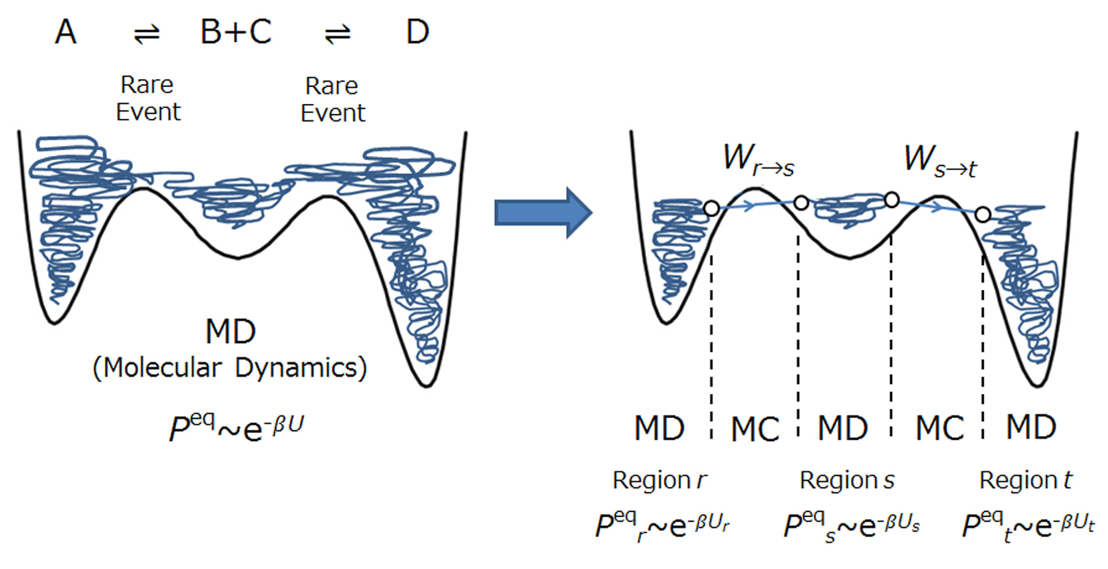
Concept of the hybrid MC/MD reaction method
Figure. Schematic representation of the hybrid MC/MD reaction method.
For spatial moves not involving a chemical reaction (or its analogue) in a stable phase space region, we simply execute the usual NVT-MD simulation until some pair of atoms meets the necessary conditions. An MC procedure is then applied to drive the rare event to occur in a manner that is statistical-mechanically reasonable with an MD relaxation process after the spatial move due to chemical reaction.
M. Nagaoka, Y. Suzuki, T. Okamoto, N. Takenaka, Chem. Phys. Lett. 583 (2013) 80.
N. Takenaka, Y. Suzuki, H. Sakai, M. Nagaoka, J. Phys. Chem. C 118 (2014) 10874.
Notes:
In this slide, I’ll show the concept of the present hybrid MC/MD reaction method.
Figure shows the schematic representation of the hybrid MC/MD reaction method.
“~”

Slide 4
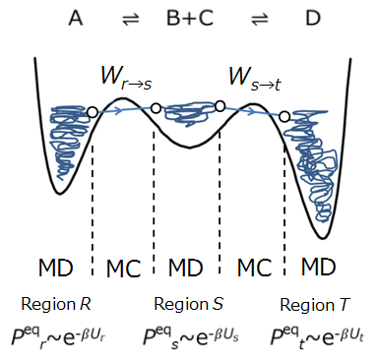
Hybrid MC/MD Reaction Method
①Run MD simulation in the region R
until some pair of atoms meets the
necessary conditions and select
configuration state r.
②Virtually react it to generate a confi-
guration state s, relaxing the whole
system through MD simulation.
③Compute ΔU_{rs} (= U_{s} - U_{r}) and accept
(or reject) the reaction step accord-
ing to the transition probability
under the Metropolis scheme.
The change of state due to chemical reactions is realized by repeating the MC/MD cycle.
Notes:
This slide shows the processes of the method.
This method consists of these three processes.
First, “”.
Second, “”.
Third, “”.
“The change of state due to chemical reactions is realized by repeating” this combined cycle of a couple of MC and MD treatment.
And, we call it an MC/MD cycle.

Slide 5
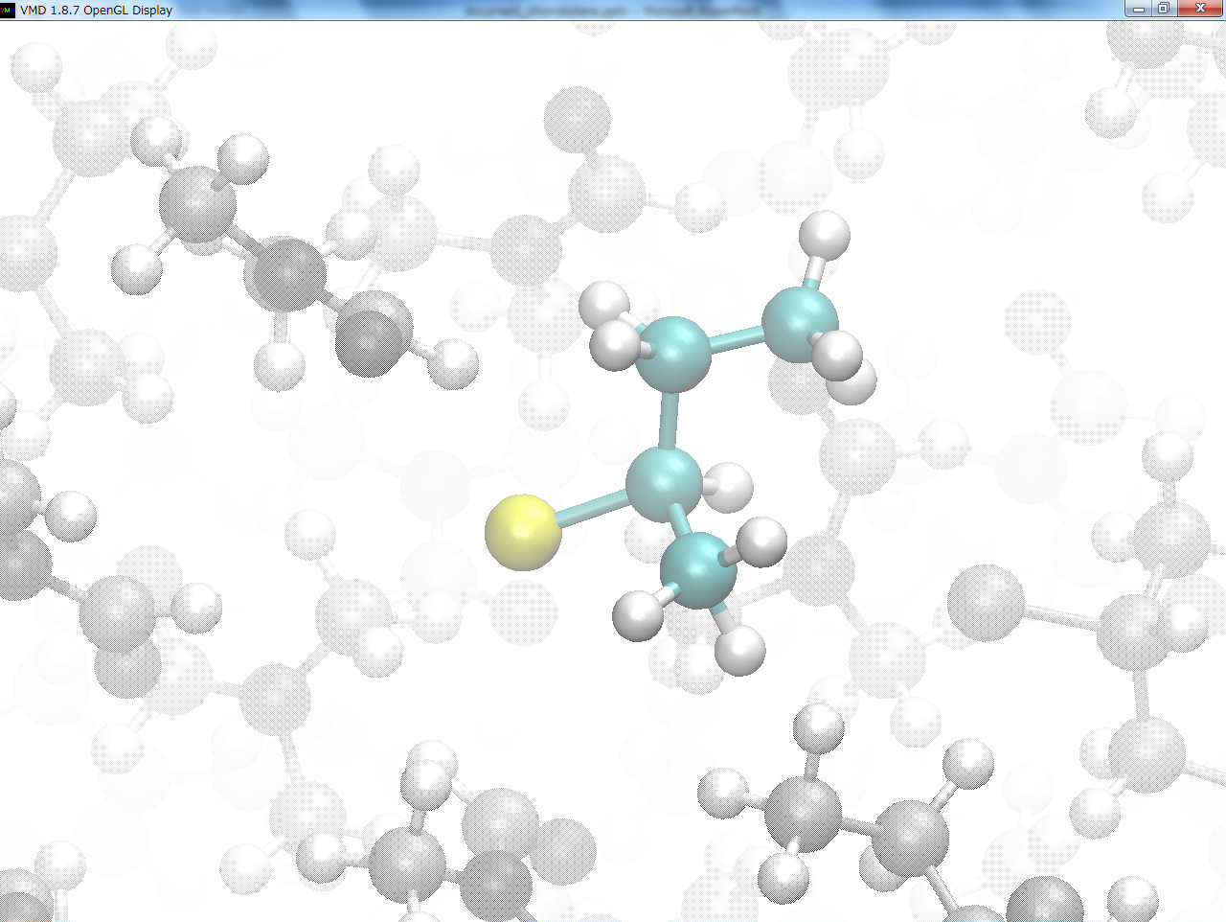
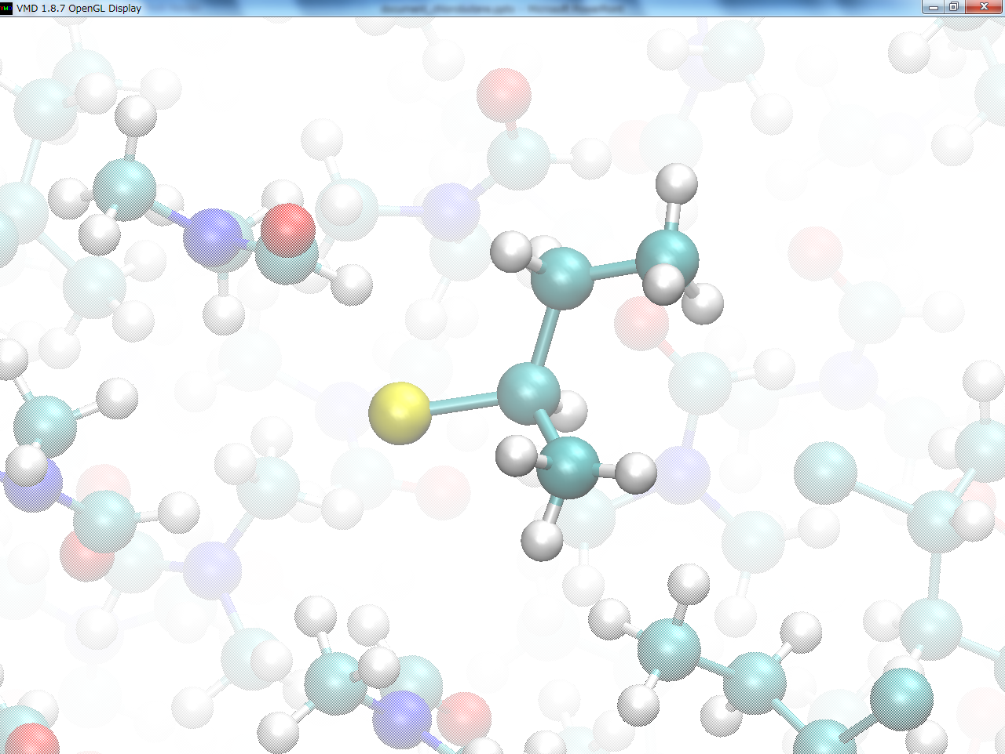
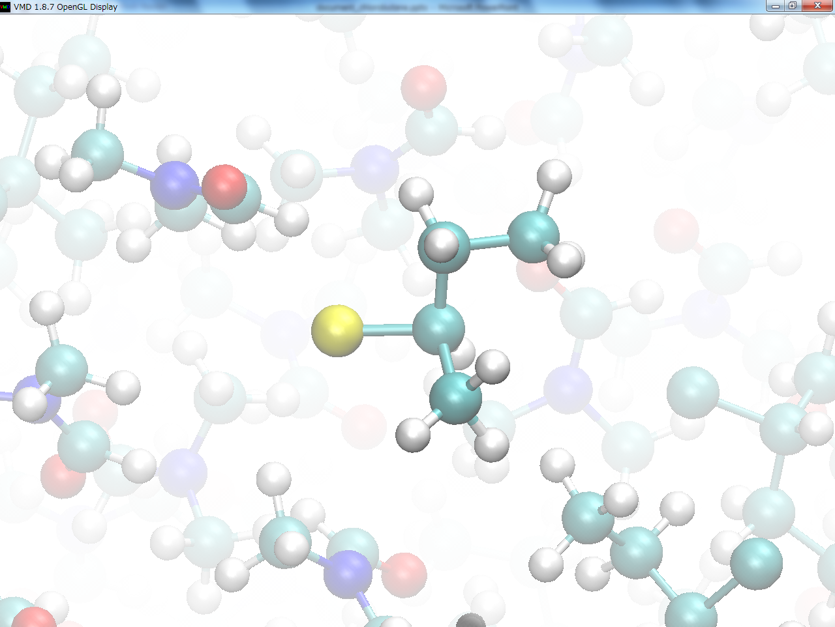
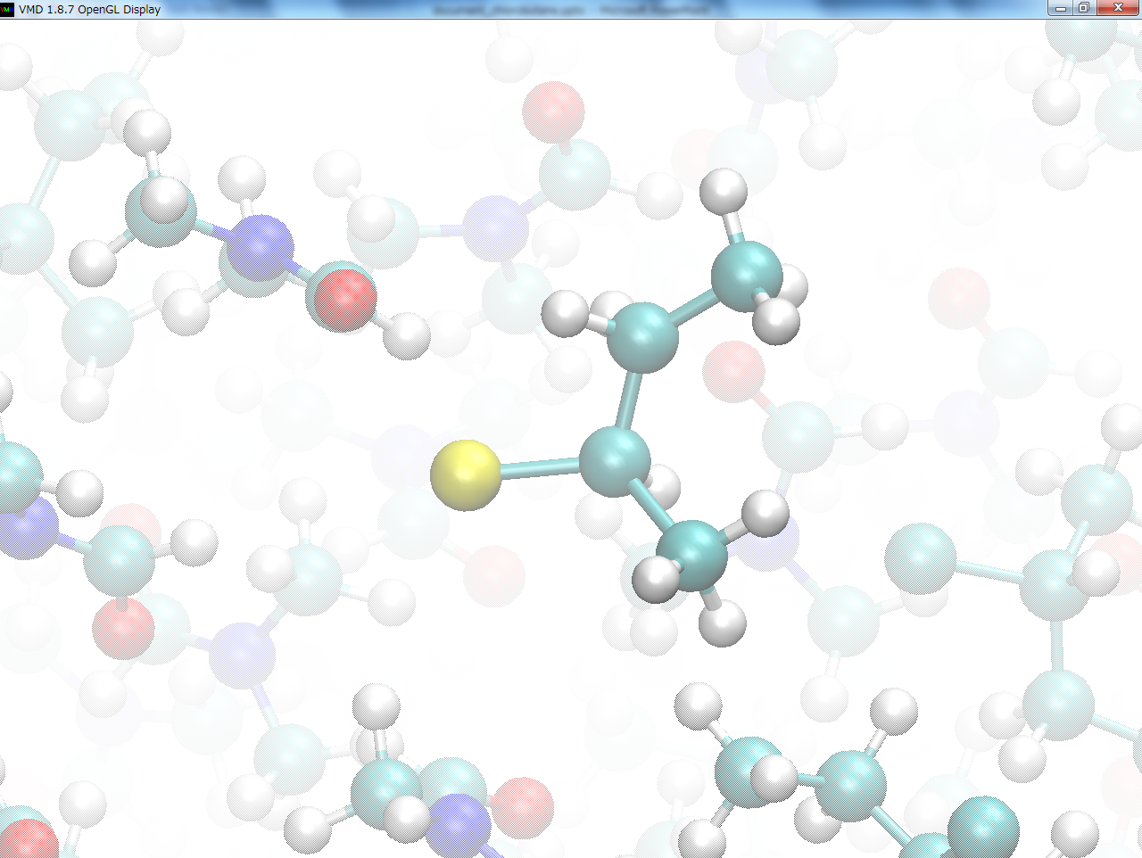
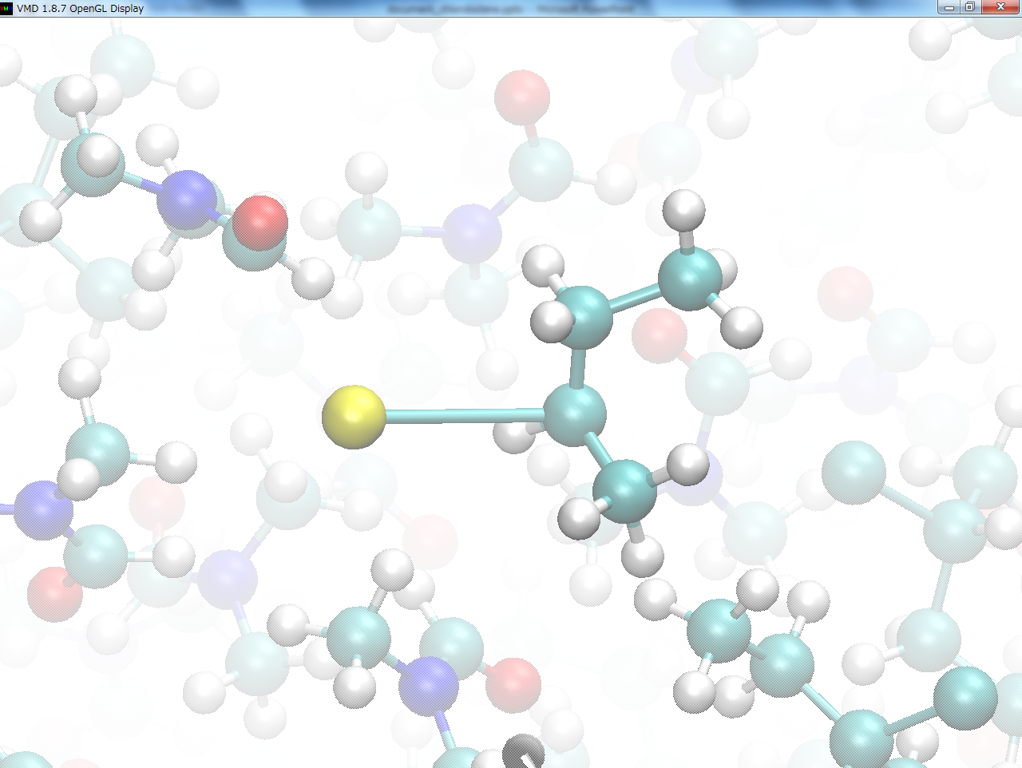
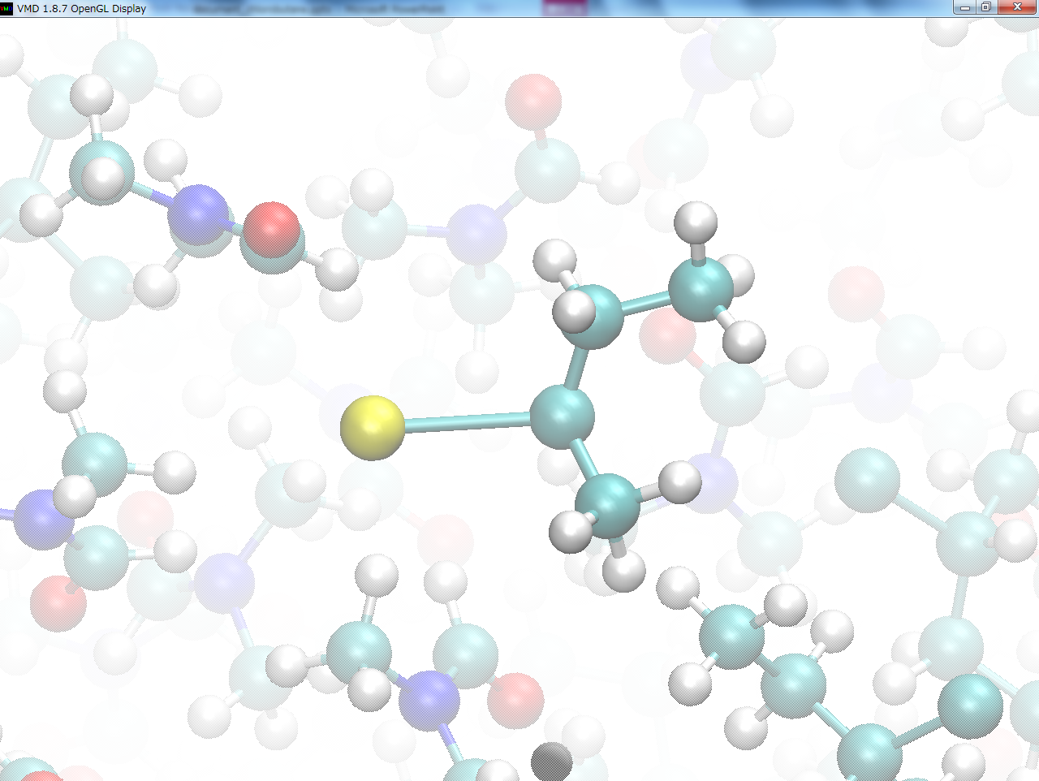
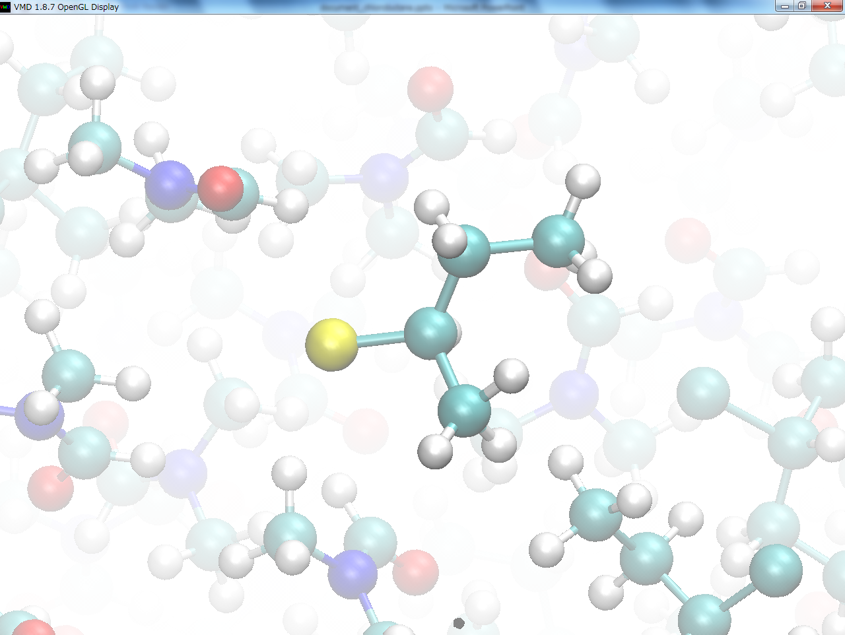
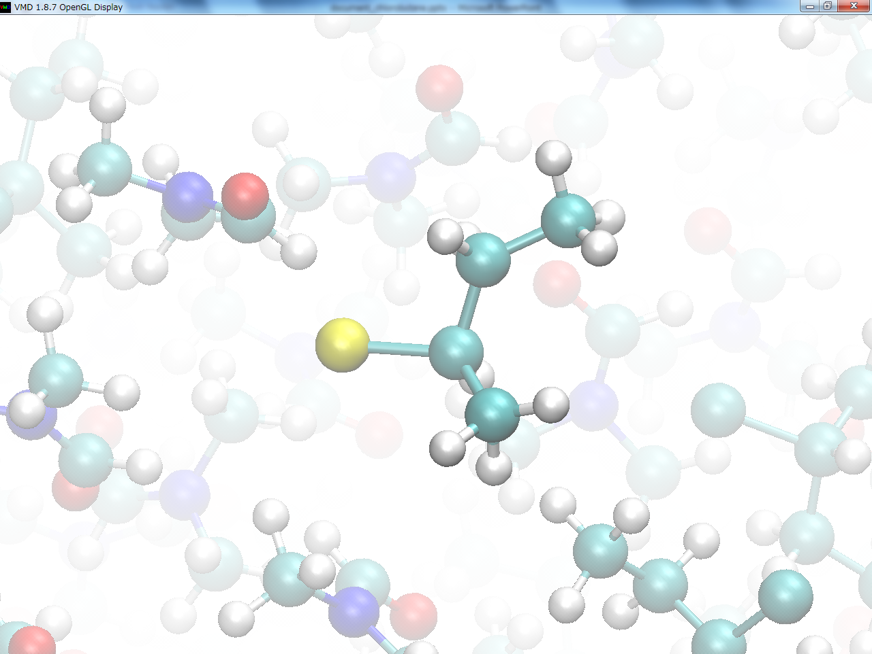
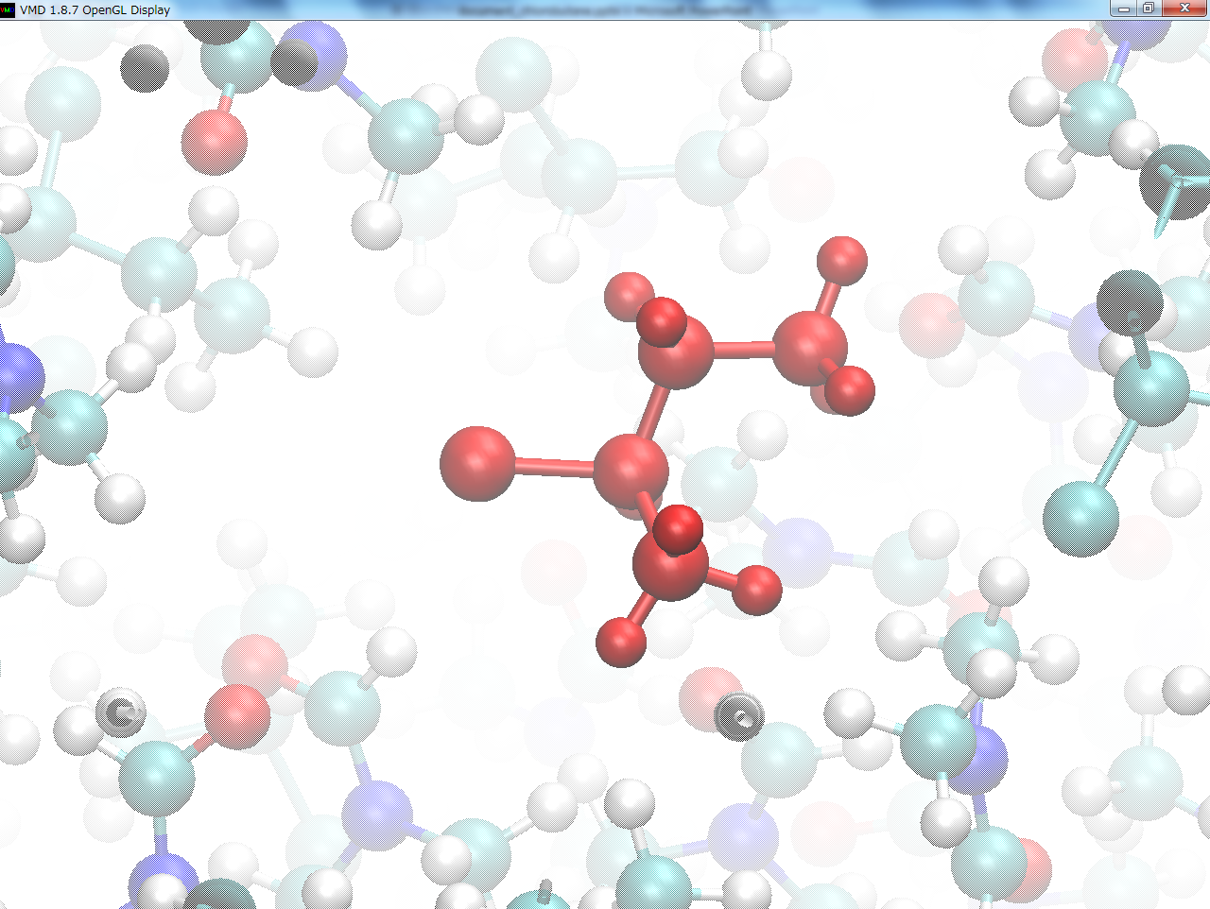
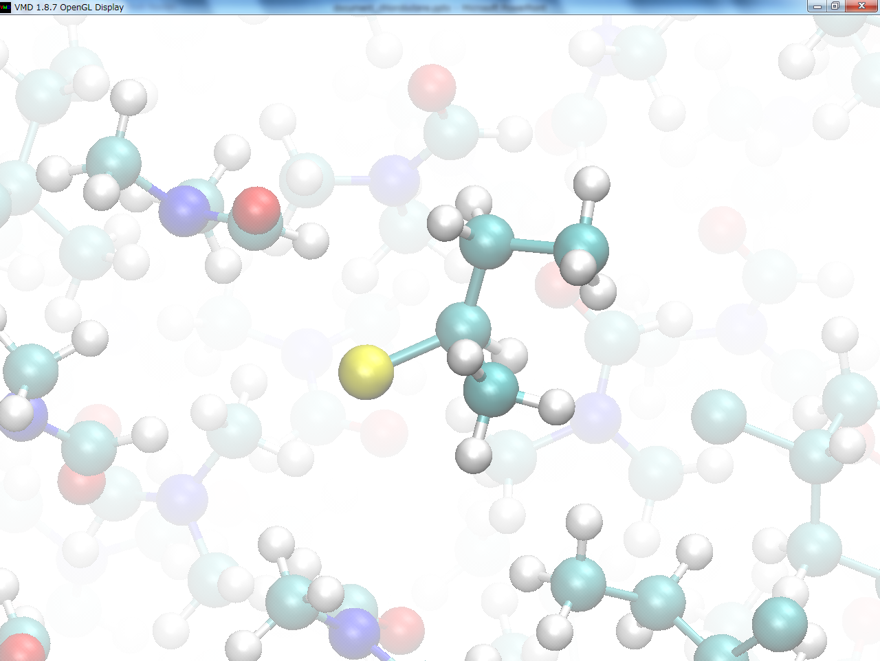
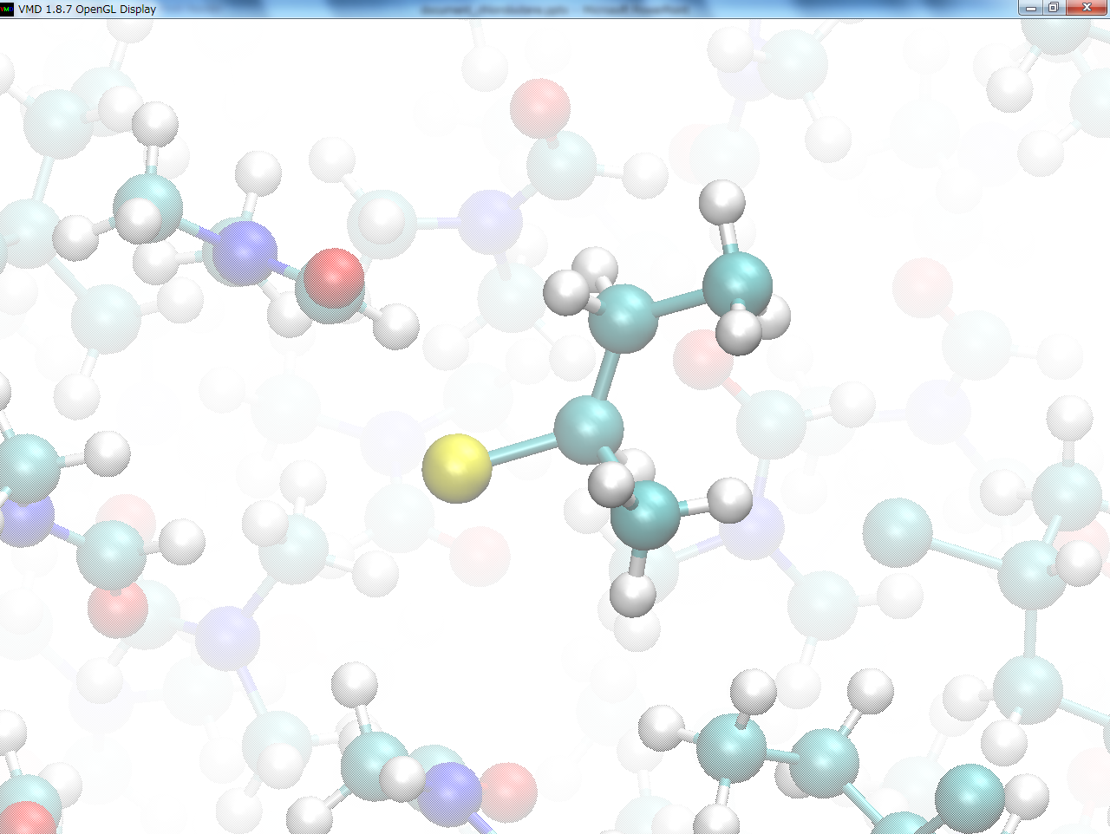
Hybrid MC/MD Reaction Simulation
①Run MD simulation
until some pair
of atoms meets
the necessary
conditions.
②Virtually react it,
relaxing the whole
system.
③Accept (or reject)
the reaction step
under the Metro-
polis scheme.
①Run MD simulation
until some pair
of atoms meets
the necessary
conditions.
②Virtually react it,
relaxing the whole
system.
③Accept (or reject)
the reaction step
under the Metro-
polis scheme.
①Run MD simulation
until some pair
of atoms meets
the necessary
conditions.
②Virtually react it,
relaxing the whole
system.
③Accept (or reject)
the reaction step
under the Metro-
polis scheme.
MD trajectory for a chemical bond
of Bu⁺ and Cl⁻ to (R)-2-chlorobutane
Notes:
In this slide, I’ll explain simply the reaction processes of the method,
showing “MD trajectory for a chemical bond of Bu⁺ and Cl⁻ to (R)-dhi-chlorobutane”.
First,
we “run MD simulation until some pair of atoms meets the necessary conditions”.
*click
In the present study,
the criterion for a candidate pair was taken to be
whether the interatomic distance is less than the sum of their van der Waals radii.
Next,
*click
we make a chemical bond between these atoms and “virtually react it, relaxing the whole system”.
Finally,
*click
after finishing the relaxation,
we “accept (or reject) the reaction step under the Metropolis scheme”.

Slide 6
HI Formation from H₂ and I₂ molecules
Equilibrium constant:
41.23 kcal/mol
H
H
$K_{eq}$=$\frac{{\left[HI\right]}^{2}}{\left[H_{2}\right]\left[I_{2}\right]}$
+
H
I
I
I
+
H
I
2.93 kcal/mol
$$→$$
k₂
H₂ + I₂
$$←$$
2HI
k₋₂
Treat reversible reaction for the targeted system.
Select a chemical reaction according to a relative weight
W ~ exp(-E_{a}/kT), if the both candidate pairs would be found.
W(→) : W(←)＝ 1 : 0.0073
Notes:
Next, I’ll explain the HI formation from H₂ and I₂ molecules.
The formation energy is 2.93 kcal/mol, and the activation energy from H2 and I2 molecules to two HI molecule is 41.23 kcal/mol.
Chemical reaction for the targeted system is reversible.
Therefore, we selected a chemical reaction according to a relative weight “this”, if the both candidate pairs would be found.
The calculated relative weights by using the activation energy are shown. W示す

Slide 7
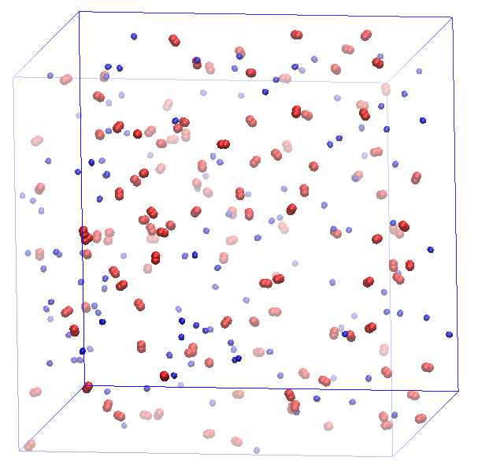
Computational Details
125 H₂ (blue) and 125 I₂ (red) molecules.
Force fields for H₂ and I₂ molecules were used referred to the articles.
Force field for HI molecule were obtained from that of H₂ and I₂ molecules by using Lorentz-Berthelot combining rules.
Atomic charges for HI molecule obtained by MO calculation.
Periodic boundary condition.
NVT-MD for 1 ns (300 K) for a relaxation.
The NVT-MD (300 K) simulation time in one MC/MD cycle was set to 5 ps.
For 1300 MC/MD cycles.
250.0 Å
250.0 Å
250.0 Å
Fig. Initial structure
Notes:
Next, about computational details.
The whole system includes “125 H₂ and 125 I₂ molecules”.
We used the force fields for H₂ and I₂ molecules referred to the previous studies.
And, For HI molecule we obtained the force field from that of H₂ and I₂ molecules using Lorentz-Berthelot combining rules.
Atomic charges for HI molecule obtained by MO calculation.
Under the periodic boundary condition, a relaxation NVT-MD simulation for 1ns at 300 K was executed, and yielding a periodic box size like this.
“The NVT-MD simulation time in one MC/MD cycle was set to 5 ps.”
I performed the NVT-hybrid MC/MD reaction simulation at 300 K “for 1300 MC/MD cycles.”

Slide 8
Number changes of molecules as a function of MC/MD cycle
H₂ or I₂ molecule
HI molecule
The whole system was reached at the equilibrium state until 1300 MC/MD cycles.
Their equilibrium numbers, estimated as averages over the last 200 MC/MD cycles, were 232.2 and 8.9, respectively.
The calculated K_{eq} was 680.7(=(232.2/8.9)²), which is in good agreement with the experimental one (912).
Notes:
From this slide, I’ll discuss the simulation results.
This figure shows the number changes of molecules as a function of MC/MD cycle.
“~”
“~”
Then, “~”

Slide 9
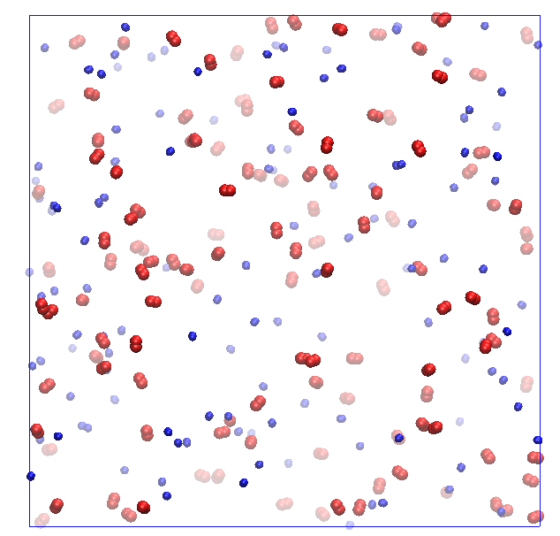
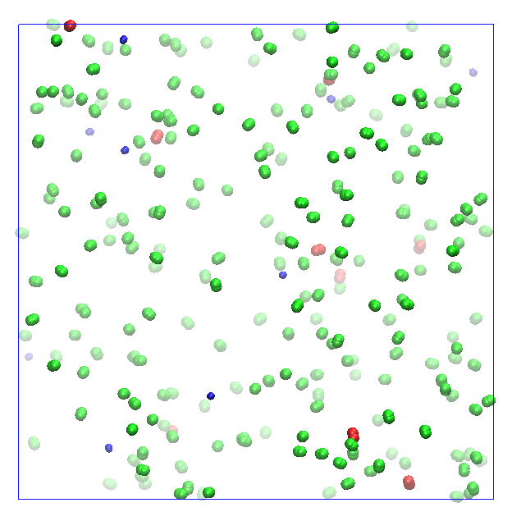
Initial and equilibrium states after 1300 MC/MD cycles
Fig.(a) Initial state (0 MC/MD cycle)
Fig.(b) Equilibrium state (1300 MC/MD cycles)
The whole system became equilibrium state, and H₂, I₂ and HI distribute homogeneously after 1300 MC/MD cycles.
The present method worked well to reproduce a equilibrium state of gas molecules mixing system.
Notes:
Next, I showed the snapshots of initial and equilibrium states in these Figure.
“~”
Therefore, “”

Slide 10
Convert the MC/MD cycle into time (T_{MC/MD})
$$→$$
k₂
H₂ + I₂
$$←$$
2HI
k₋₂
Estimation of time for chemical reaction
T_{MC/MD} = T_{MC} + T_{MD} (T_{MD} << T_{MC})
≈ T_{MC}
= T_{ave}
T_{ave}(→) = 1/k₂
T_{ave}(←) = 1/k₋₂
T_{ave} is the average time for one chemical reaction event, and k₂ and k₋₂ are the rate constants.
MD simulation time is neglected since it is very shorter than that for one chemical reaction event (T_{MD} << T_{MC}).
Notes:
I’ll explain how to convert MC/MD cycle into time.
The time for one chemical reaction event is estimated by these equations.
{
Where “T_{ave}~”.
“MD simulation~”
Consequently, T_{MC/MD} is obtained like this.

Slide 11
Future Work
Perform atomistic reaction simulations of HI formation process from H₂ and I₂ molecules at other different temperatures (500K and 700K) to discuss qualitatively temperature dependence of equilibrium constants.
Obtain the average equilibrium constants at three different temperatures (300K, 500K and 700K) by performing atomistic reaction simulations using the different initial structures.
Notes:
We perform atomistic reaction simulations of HI formation process from H₂ and I₂ molecules at other different temperatures (500K and 700K) to discuss qualitatively temperature dependence of equilibrium constants.
And, we want to obtain the average equilibrium constants at three different temperatures (300K, 500K and 700K) by performing atomistic reaction simulations using the different initial structures.

Slide 12
Thank you for your attention

