Slide 1
Tue. Nov. 20th
FY2018’s 3th, CREST Workshop
Microscopic Structural Analyses of Hydrate Melt Electrolyte on Electrode Surface
Norio Takenaka^{1,2}
Graduate School of Information Science, Nagoya University¹,
Elements Strategy Initiative for Catalysts and Batteries (ESICB), Kyoto University²

Slide 2
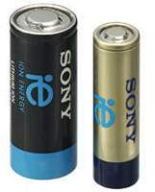


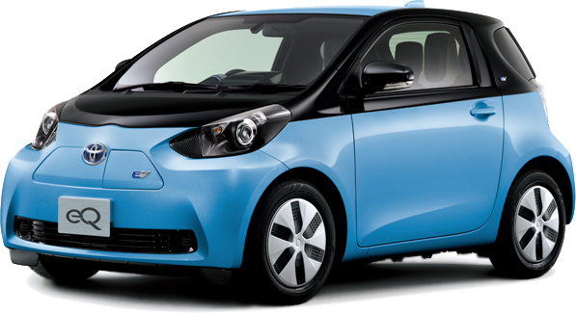
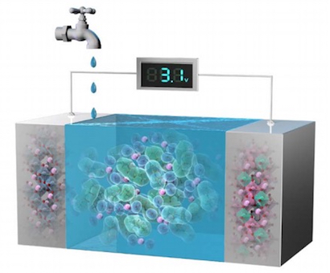
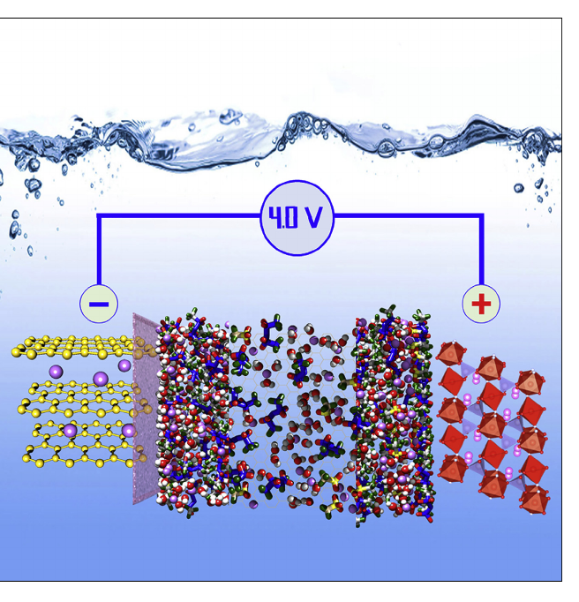
Introduction
Portable electronic device
Electric vehicle
Lithium-ion battery (LIB)
Next-generation battery
● Non-flammable
● Non-toxic
● Low-price
Aqueous lithium-ion battery

Slide 3
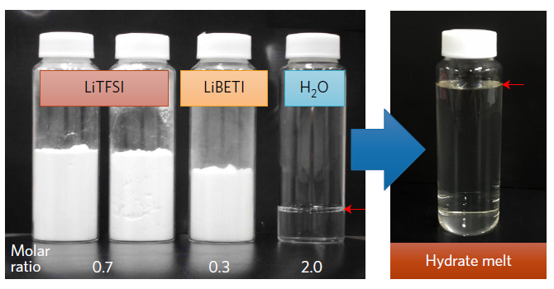
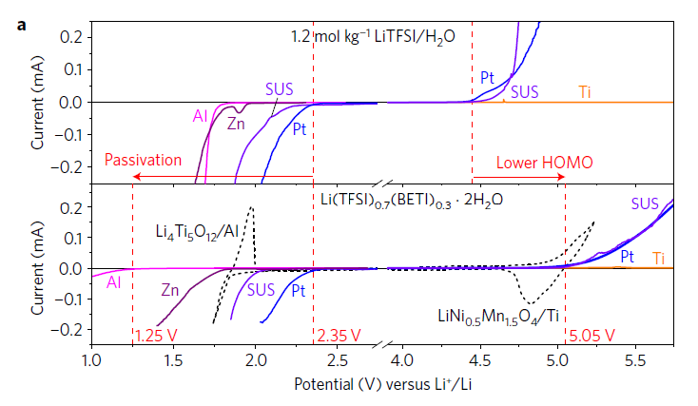
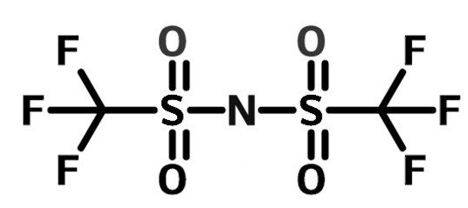
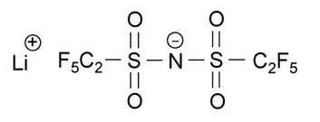

Hydrate Melt
2.0 V
3.8 V
Fig. Potential window [1]
LiTFSI
LiBETI
By using a Li salt hydrate melt, Li(TFSI)_{0.7}(BETI)_{0.3}・2H₂O, the high voltage aqueous Li-ion battery has been developed [1].
[1] Y. Yamada, K. Usui, K. Sodeyama, S. Ko, Y. Tateyama and A. Yamada, Nature energy, 16129 (2016).
3

Slide 4
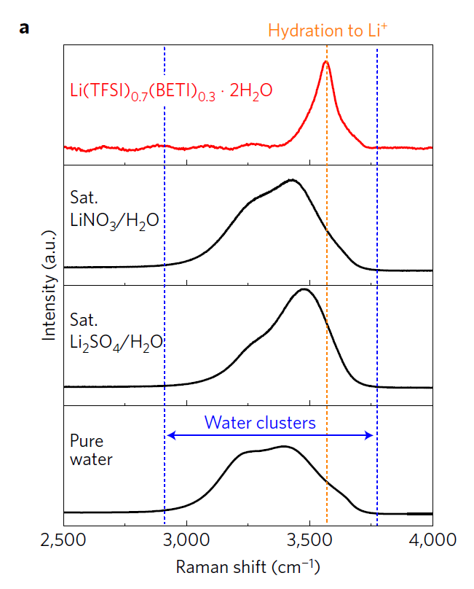
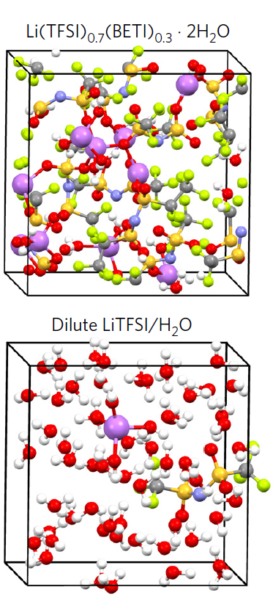
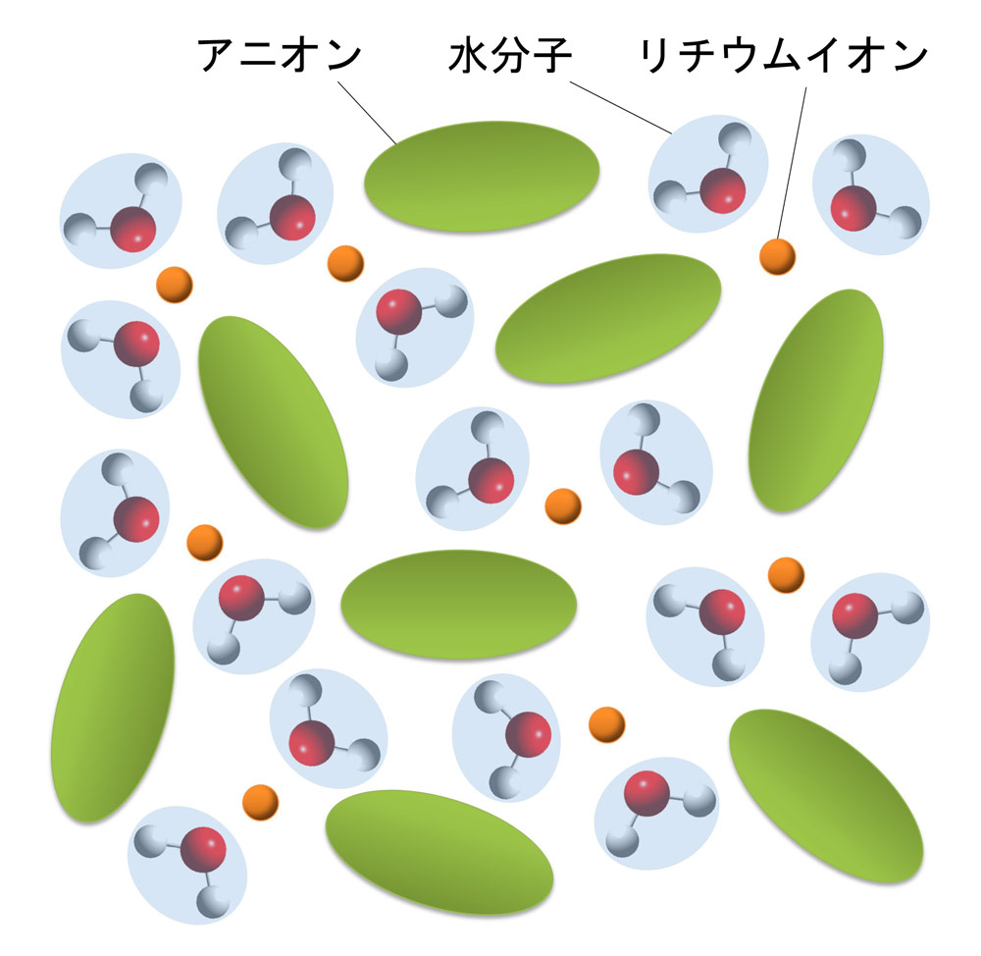
Presence of “Isolated Water” in Hydrate Melt
anion
water
Li⁺
Raman Spectroscopy
DFT-MD
The experimental and theoretical studies indicated the presence of “isolated water” that water molecules (i.e., oxygen atoms) coordinate with Li⁺.
4

Slide 5
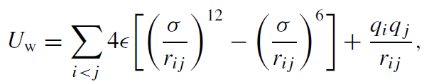
Calculation Condition
Temperature: 298 K
Force filed: GAFF, TIP3P water, Pt(111) [1,2], graphite [3]
Constant potential method developed by Inagaki-san
Effective Lennard-Jones parameters of Pt were obtained by DFT calculations [2]
Non-bond interaction
Table. Lennard-Jones parameters
 | σ [Å] | ε [kcal/mol]
Pt | 1.205 | 4.645
C (graphite) | 1.70 | 0.0556
O (water) | 1.58 | 0.152
[1] S. Duan, X. Xu, Z. Tian, Y. Luo, Phys. Rev. B, 86, 045450 (2012).
[2] S. Y. Liem, K-Y. Chan, Molecular Physics, 86, 939 (1995).
[3] C. Li, T-W. Chou, Int. J. Solids Struct., 40, 2487 (2005).
5

Slide 6
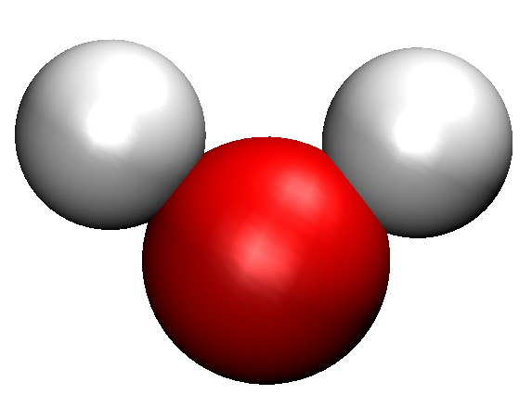
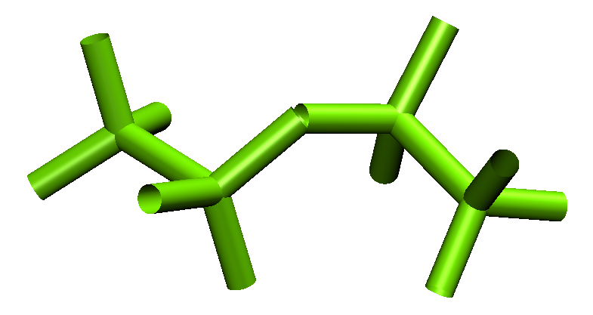
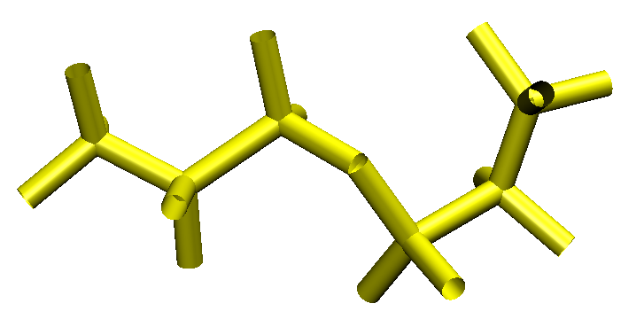
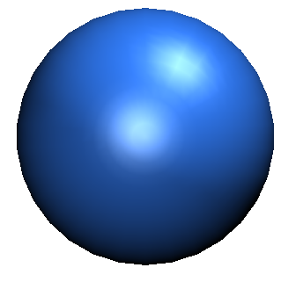
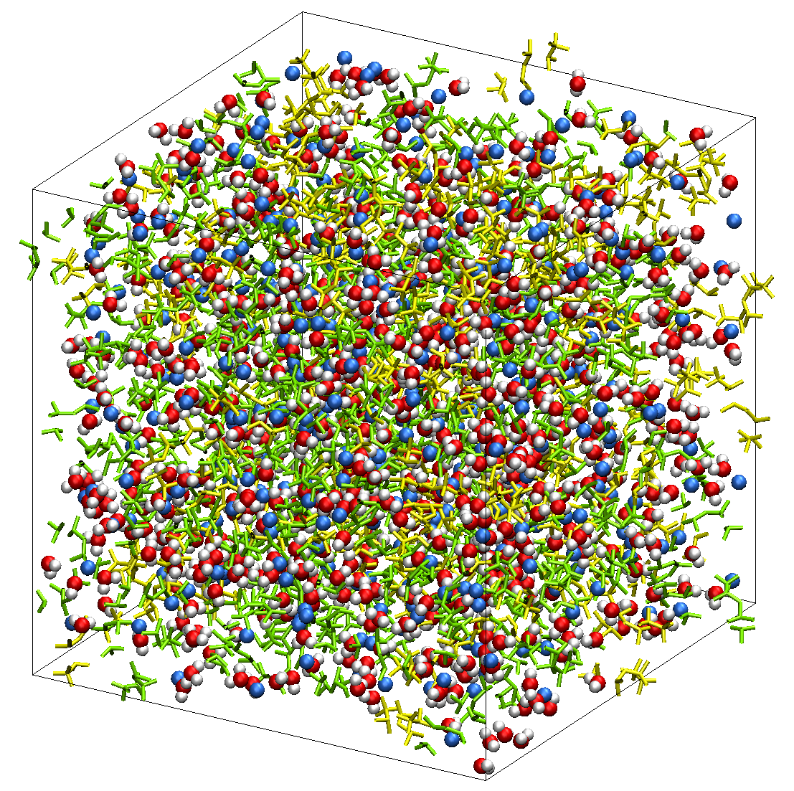
MD Simulations in Bulk Hydrate Melt
: TFSI
: Li⁺
: H₂O
: BETI
Pure water
10 ns NPT MD
Hydrate melt
2.3 Å
G(R)
(TFSI)_{0.7}(BETI)_{0.3}(H₂O)₂
R(O-H), Å
W. Jorgensen et al., J. Chem. Phys., 79, 926 (1983)
TFSI: 280
BETI: 120
H₂O: 800
Li⁺: 400
Figures. O-H radial distribution function
Number of molecules
Integrated value in first solvation shell: 0.14
(pure water: 2.0)
6

Slide 7
Number of “Isolated Water”
: TFSI
: Li⁺
: H₂O
: BETI
10 ns NPT MD
r ≦ 2.3 Å
not isolated
r
r > 2.3 Å
isolated
By checking all water molecules whether they satisfy the criteria, the number of isolated water molecules was estimated.
(TFSI)_{0.7}(BETI)_{0.3}(H₂O)₂
Number of isolated water: 722.6
TFSI: 280
BETI: 120
H₂O: 800
Li⁺: 400
Number of molecules
(90.3 %)
7

Slide 8
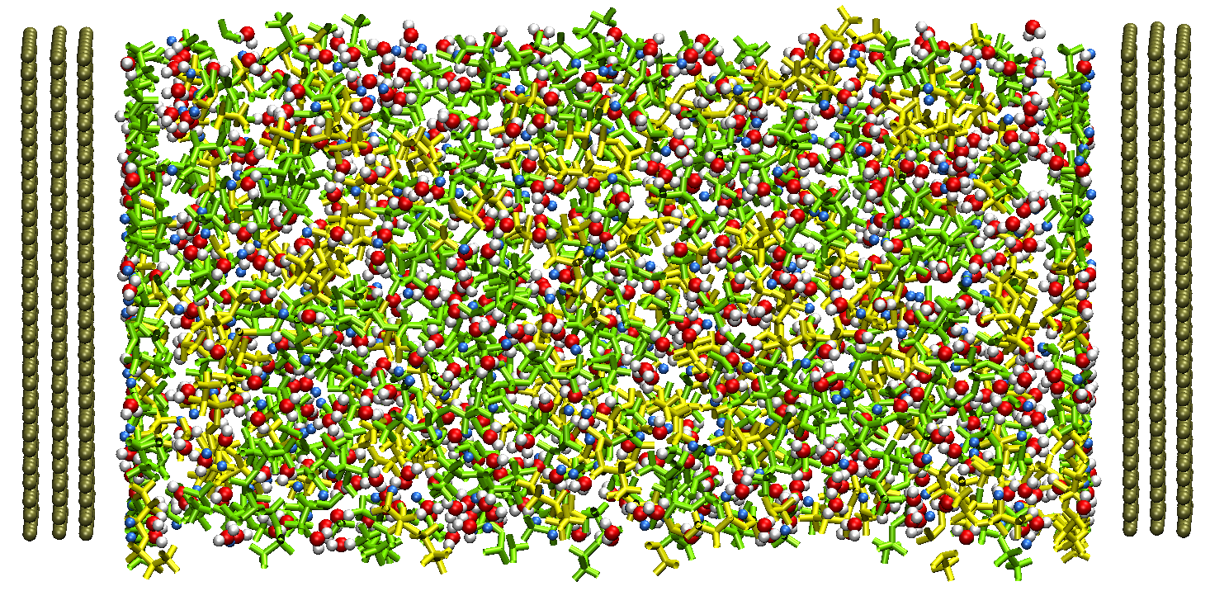
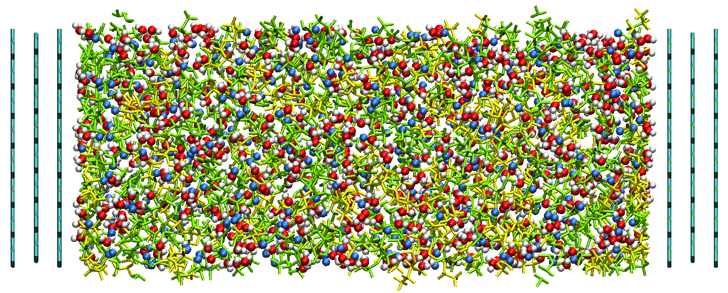
MD Simulations with Hydrate Melt on Electrode
The two types of electrode materials were employed.
By using the constant potential method, the voltage dependency of the hydrate melt structures was investigated.
Pt(111)-hydrate melt
graphite-hydrate melt
TFSI: 280, BETI: 120, H₂O: 800, Li⁺: 400
TFSI: 280, BETI: 120, H₂O: 800, Li⁺: 400
Total simulation time: 50 ns NVT MD (time step: 0.2 fs)
Fictitious mass of charge: 1519 fs²V/e
8

Slide 9
Potential Change of Electrode near Pt Surface
0 V (PZC)
-1 V versus PZC
Potential [V]
Figure. potential window
Y. Yamada, K. Usui, K. Sodeyama, S. Ko, Y. Tateyama, A. Yamada, Nature Energy, 16129 (2016).
z [Å]
The potential difference between the electrode and electrolyte became 0.4 V at potential of zero charge (PZC) condition.
By considering the open-circuit voltage of 3.3 V versus Li⁺/Li, the lower limit of potential window on Pt almost corresponds to -1 V versus PZC.
9

Slide 10
Number Density Distribution on Graphite
-1 V versus PZC
0 V (PZC)
+1 V versus PZC
Li⁺
Li⁺
Li⁺
H₂O
H₂O
H₂O
TFSI
TFSI
TFSI
ρ/ρ_{bulk}
BETI
BETI
BETI
z [Å]
z [Å]
z [Å]
Figures. Number density profiles of molecules (center of mass)
On the graphite surface, the peak height of water molecules decreased with increasing electrode potential, while that of anions increased.
10

Slide 11
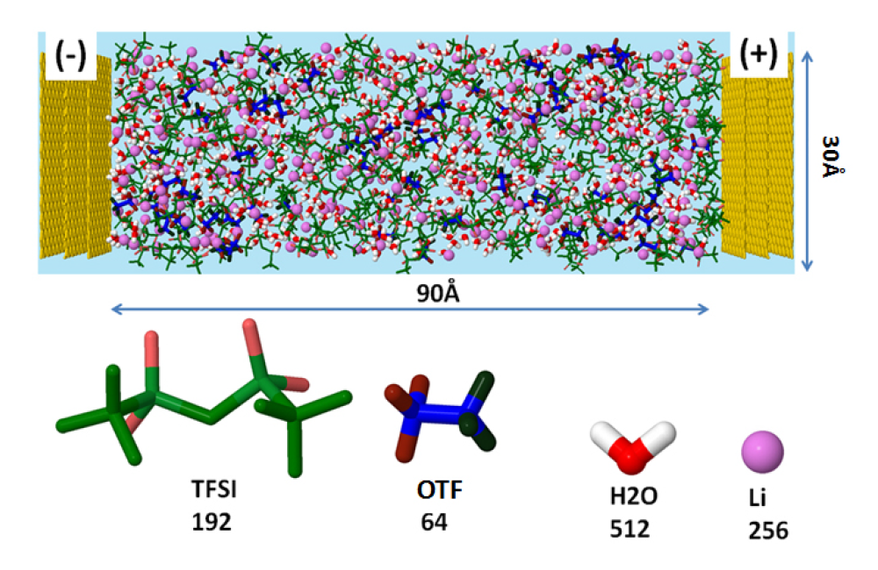
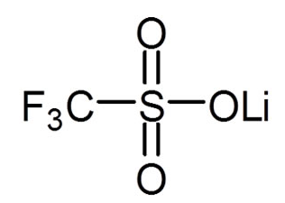
Comparison with Previous Theoretical Research
[*] J. Vatamanu, O.Borodin, J. Phys. Chem. Lett., 8, 4362-4367 (2017).
Electrode: Graphite surface
Calculation condition
z
Temperature: 363 K
Force filed: APPLE&P
Simulation time: 7 ns
constant potential method [2]
[2] S. K. Reed, O. J. Lanning, P. A. Madden, J. Chem. Phys. 126, 084704 (2007).
OTF
trifluoromethanesulfonate

Slide 12
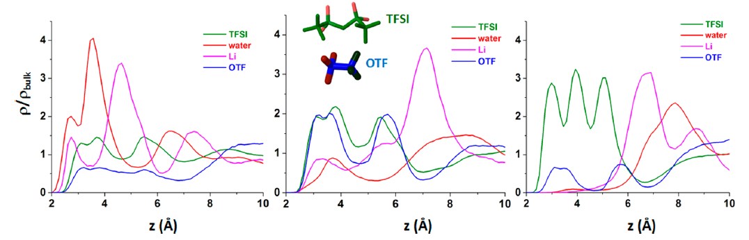
Comparison with Previous Theoretical Research
-2 V versus PZC
0 V (PZC)
+2 V versus PZC
Figures. Cumulative atom number density profiles on graphite [*]
[*] J. Vatamanu, O.Borodin, J. Phys. Chem. Lett., 8, 4362-4367 (2017).
The present simulation results showed the similar tendency as the previous study where the number of water molecules decreases with the increase in the electrode potential.

Slide 13
Number Density Distribution on Pt
-1 V versus PZC
0 V (PZC)
+1 V versus PZC
Li⁺
Li⁺
Li⁺
H₂O
H₂O
H₂O
TFSI
TFSI
TFSI
ρ/ρ_{bulk}
BETI
BETI
BETI
z [Å]
z [Å]
z [Å]
Figures. Number density profiles of molecules (center of mass)
On the Pt surface, the Li⁺ cations adsorbed due to the strong van der Waals attractive interaction in comparison to the graphite.
As the electrode potential increases, the Li⁺ cations were expelled due to the repulsive electrostatic interaction.

Slide 14
Integrated Number of Electrolyte Molecules
The integrated number was estimated from 0 to 6 Å.
Li⁺
Li⁺
H₂O
H₂O
TFSI
TFSI
Number of molecules [nm⁻²]
BETI
BETI
Number of molecules [nm⁻²]
Electrode potential [V]
Electrode potential [V]
(a) Pt
(b) Graphite
In the interfacial region near the graphite surface, the number of water and Li⁺ lineally decreased with the increase in the electrode potential.
On the Pt surface, water molecules showed a peak at 1 V.

Slide 15
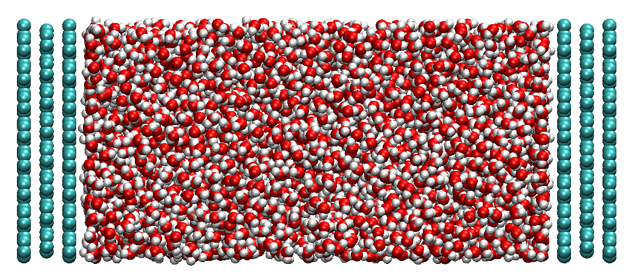
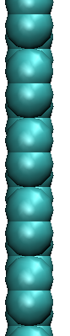
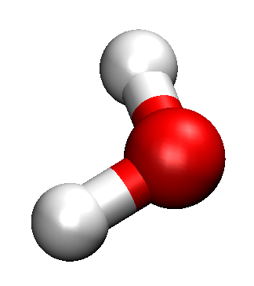
Angle Distributions in Pure Water
The values were estimated within 4 Å from the surface.
Perpendicular
Parallel
Pt
Normal vector
Graphite
ρ_{angle}
Normal vector
θ
Angle between two vectors
cosθ
The water plane mainly took the parallel orientation to the surface.
15

Slide 16
Angle Distributions of Water in Hydrate Melt
Perpendicular
-1 V
-1 V
Parallel
0 V
0 V
ρ_{angle}
1 V
ρ_{angle}
1 V
Perpendicular
Parallel
cosθ
cosθ
(a) Pt
(b) Graphite
On the Pt, the water plane showed the perpendicular orientation, while it took parallel orientation on the graphite.
16

Slide 17
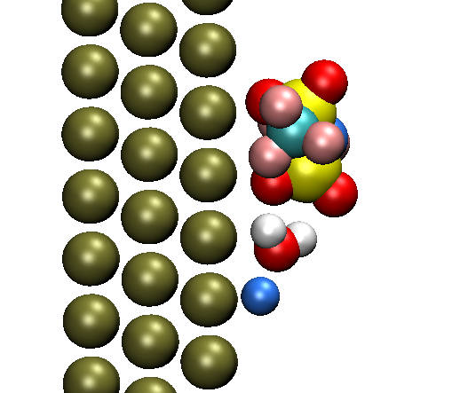
Orientation of Water on Pt(111) Surface at PZC
Pt
O
H
TFSI
ρ/ρ_{bulk}
z [Å]
Li⁺
H₂O
H₂O
TFSI
Li⁺
ρ/ρ_{bulk}
BETI
On Pt surface, the water molecules formed the bridge by coordinating with both Li⁺ and anions.
z [Å]
Figures. Atom density profile of water (upper) and number density profile (lower) at PZC
17

Slide 18
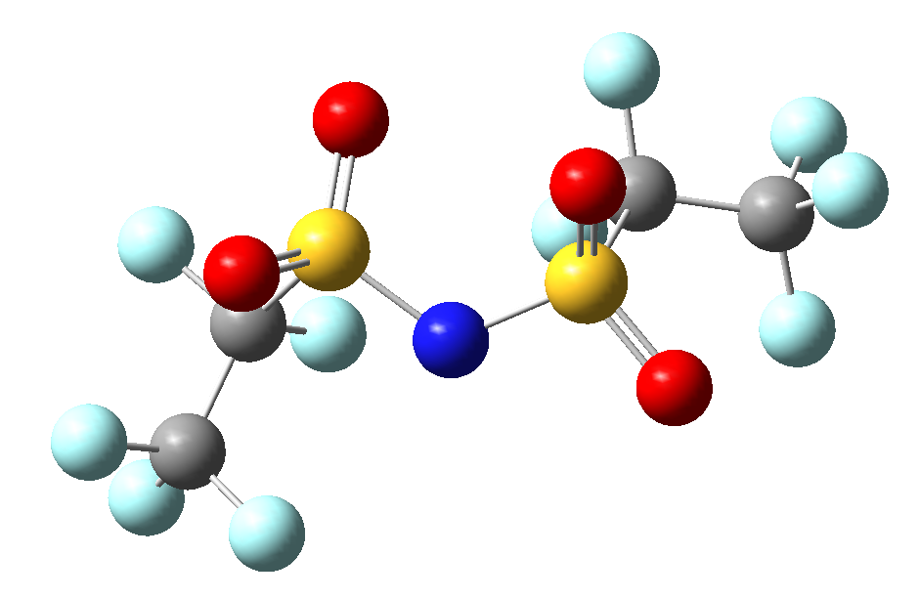
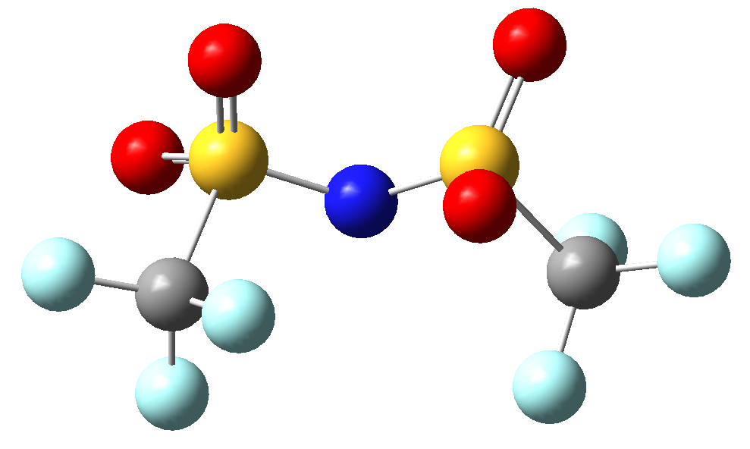
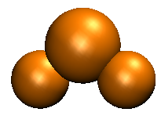

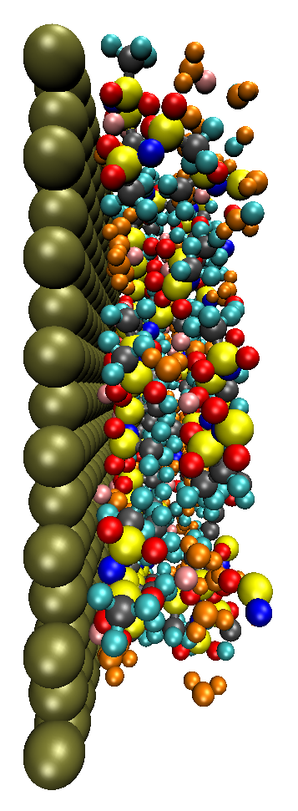
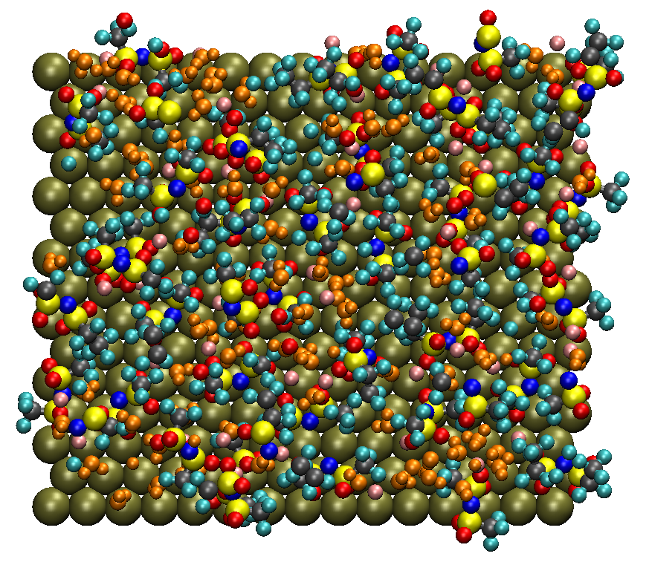
Configuration of Anions on Pt at -1 V
-0.49 e
-0.48 e
-0.11 e
-1 V vs. PZC
-0.13 e
-0.60 e
-0.56 e
water
Li⁺
TFSI
BETI
Typical structure
The molecules are visualized within the region from 0 Å to 10 Å.
18

Slide 19
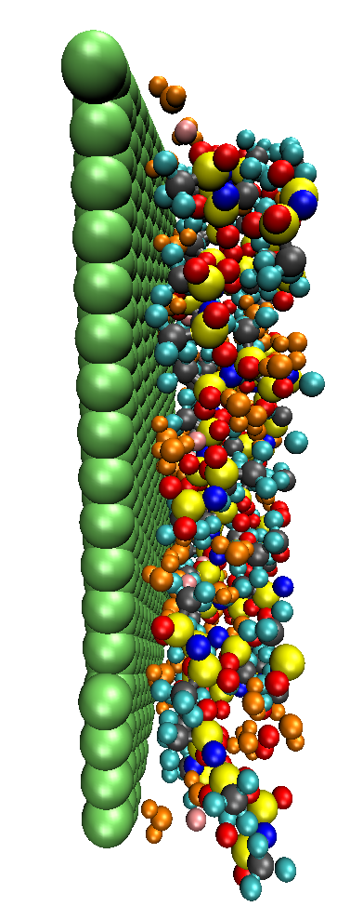
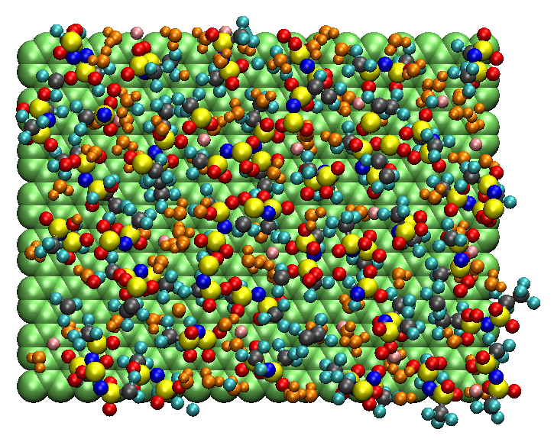
Configuration of Anions on graphite at -1 V
-0.49 e
-0.48 e
-0.11 e
-1 V vs. PZC
-0.13 e
-0.60 e
-0.56 e
water
Li⁺
TFSI
BETI
Typical structure
The molecules are visualized within the region from 0 Å to 10 Å.
19

Slide 20
Atomic Distributions of Anions at -1 V
O (TFSI)
O (TFSI)
F (TFSI)
F (TFSI)
O (BETI)
O (BETI)
ρ/ρ_{bulk}
ρ/ρ_{bulk}
F (BETI)
F (BETI)
z [Å]
z [Å]
(a) Pt(111)
(b) Graphite
The anions were localized near the Pt surface, while they were delocalized near the graphite.
On the graphite surface, the fluorine atoms oriented to the surface. Such orientation should enhance the formation of LiF which is the main component of SEI film.
20

Slide 21
Conclusion
In the hydrate melt, most of water molecules were found to present as the isolated form without hydrogen-bond.
The interfacial structures of hydrate melt strongly depend on not only the electrode potential but also the material (i.e., Pt or graphite).
On the Pt surface, the water molecules took the perpendicular orientation by forming the bridge between Li⁺ cations and anions.
The weak van der Waals interactions between the anions and electrode could be favorable to form the LiF layer which is the main component of SEI.
21

Slide 22
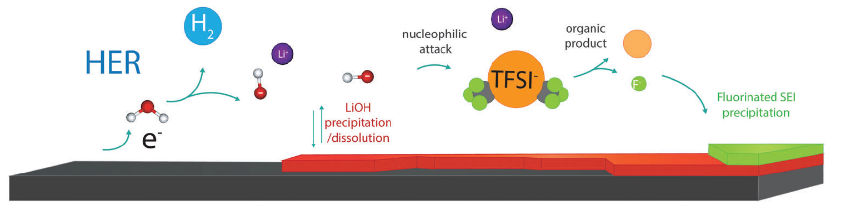
Future Perspective
To understand the SEI formation mechanism in the concentrated water system,
the important key factors are
Electronic properties of “isolated water”
Solubility of reduction products as a function of electrode potential
Reduction mechanism of water and salts
H₂O + e⁻ → H(ad) + OH⁻
OH⁻ + Li⁺ → LiOH
H(ad) + H(ad) → H₂
Nucleophilic attack of LiOH
⇒ Decomposition of TFSI anions
N. Dubouis et al., Energy & Environ. Sci. 2018, Doi: 10.1039/c8ee02456a.
22

