Slide 1
FY2016 5th CREST WS
Sep. 29, 2016
Examining Reproduction of Hexamer Formation in MC/MD Simulation for CALB-catalyzed Polymerization Reaction
Ikuo KURISAKI

Slide 2
Today’s contents
Research background
Extend MC/MD simulation which shows pentamer formation
Examine effects of initial atomic coordinates on elongation reaction
Perspective for the next 2 month

Slide 3
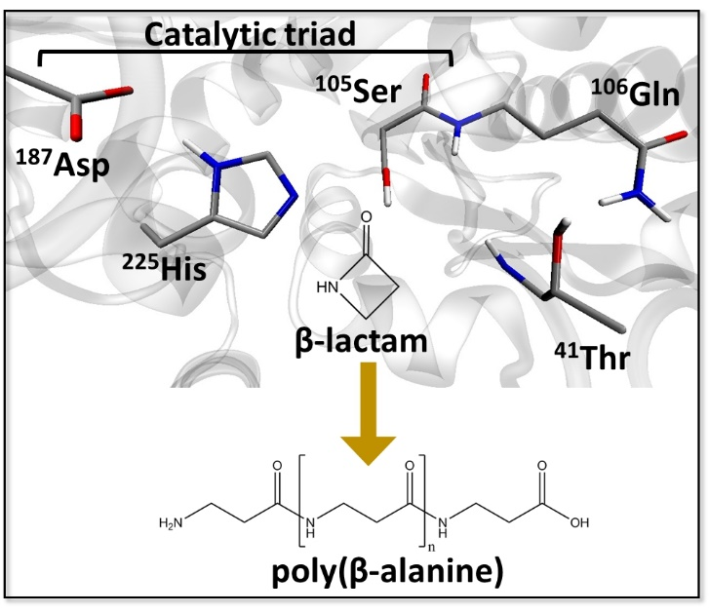
Research background
Enzyme catalyzed polymerization reaction has drawn attention in the field of green chemistry
Candida Antarica Lipase B (CALB) has long been studied in this purpose
This enzyme catalyzes polymerization of β-lactam to generate poly(β-alanine), nylon-3
However, this reaction system has rooms to be improved because the product do not satisfy industrial quality, as for the length and yield
From FY2015 4th CREST WS
The illustration is gifted from Dr. Barberot.

Slide 4
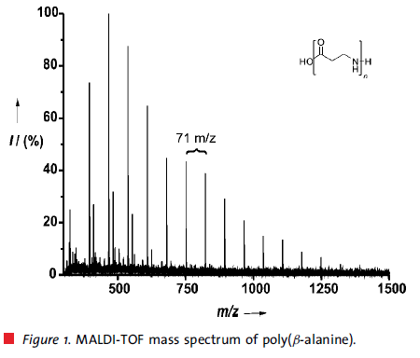
Research background
Degree of polymerization (DP) is insufficient for industrial usage
6-mer
CALB catalyzed poly(β-alanine) synthesis:
Average DP: 8 mer; Maximum DP: 18 mer
Conventional methods:
Average DP: 24 mer; Maximum DP: 58 mer
➔ Polymer generated by using CALB is still shorter by three times.
Toward the industrial usage of CALB
Optimizing reaction condition
Redesigning CALB as biocatalyst
are indispensable.
Insights into the reaction mechanism would provide strategies to address the problems.
8-mer (average)
18-mer (maximum)
Ref. Schwab L. et al., Macromol. Rapid Commun., 2008, 29, 794-797:

Slide 5
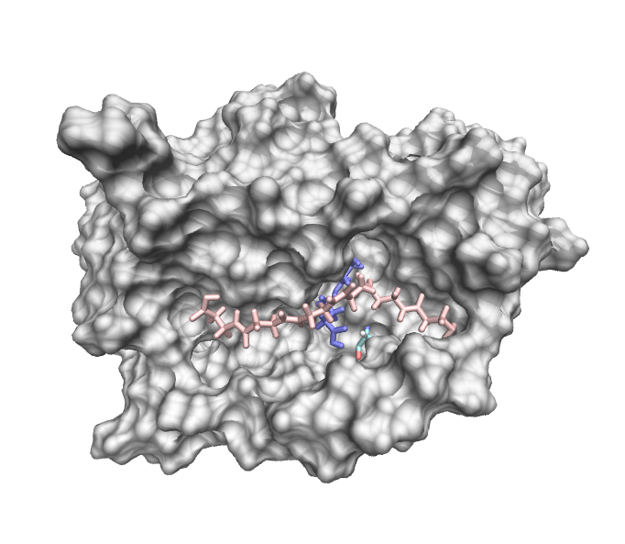
Using MC/MD simulation, hexamer is generated so far
Ser105 behind the surface
15 Å
2916th cycle
N-terminal
Snapshot structure at the last cycle
Polymer elongation would not continue in this simulation, because the N-terminal of the hexamer is distant by 15 Å from Ser105. It suggests that the polymer would not elongate if the N-terminal does not come back to the vicinity of Ser105.

Slide 6
Polymer length distributes in range from 1-mer to 5-mer
annotation | the number of MC/MD cycle | polymer length (the number)
Traj-A | 2986 | 1-mer (2), 5-mer (1)
Traj-B | 4000 | 1-mer (1), 2-mer (1), 3-mer (2)
Traj-C | 3367 | 1-mer (3), 3-mer (1)
Traj-D | 8000 | 1-mer (2), 2-mer (1)
Traj-E | 4293 | 1-mer (3)
Traj-F | 2244 | 1-mer (2)
Hexamer did not appear so far. Pentarmer is the longest among the 6 MC/MD trajectories.

Slide 7
Perspective given in the last CREST WS
Extend the pentamer trajectory and examine whether the polymer elongation occurs
With no regard to hexamer formation, the simulation would provide observation for how polymer elongation is stopped.
Continue to analyze these MC/MD trajectories focusing on reactions chosen during simulations
This might provide alternative insights into shorter polymer generation.
Try to get insights into the role of α10 helix for polymer elongation
Although this is optional, it is expected that we find a strategy to improve short polymer generation by modifying the active site pocket

Slide 8
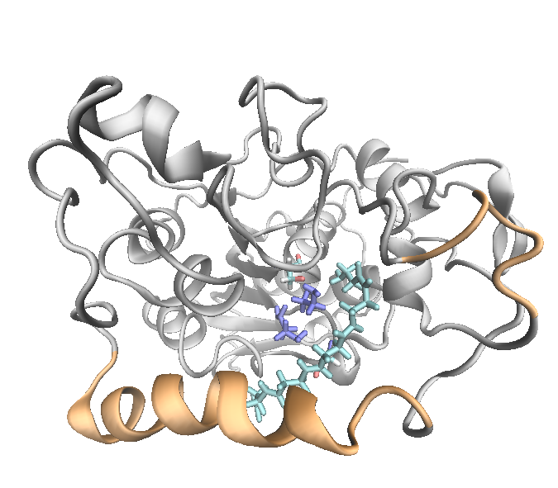
Is it possible that polymer elongation still continue?
Possibly, because the N-terminal is close to Ser105 by ca 4 Å.
It is worth extending the trajectory.
Ser105 behind the surface
Polymer elongation would stop similarly to the case of hexamer.
4 Å
N-terminal

Slide 9
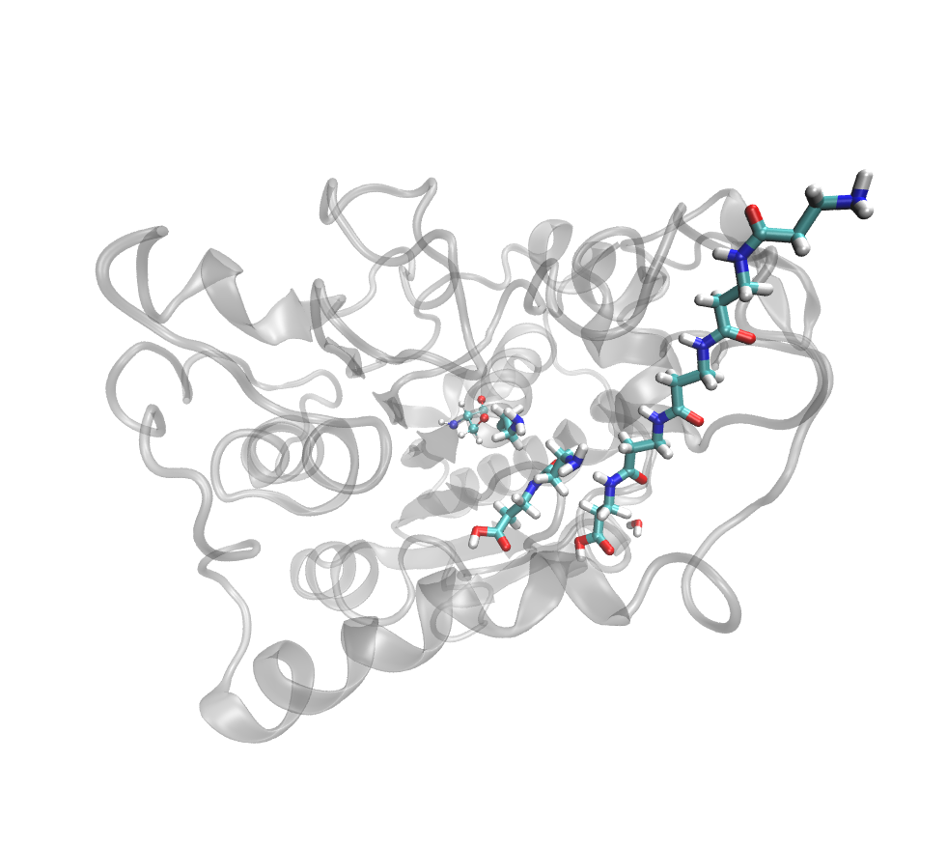
Would the hexamer continue to elongate?
➔ Unfortunately, No...
The MC/MD simulation was extended from 2987 cycle to 4000 cycle.
@4000 cycle
Ser105
N-terminal of this pentamer gets away from Ser105
Newly generated dimer, which could push pentamer to outside

Slide 10
A new dimer was generated, and it pushed the pentamer out
This dimer could prevent pentamer to access Ser105 again, thus stopping further elongation
MC/MD is extended from this period

Slide 11
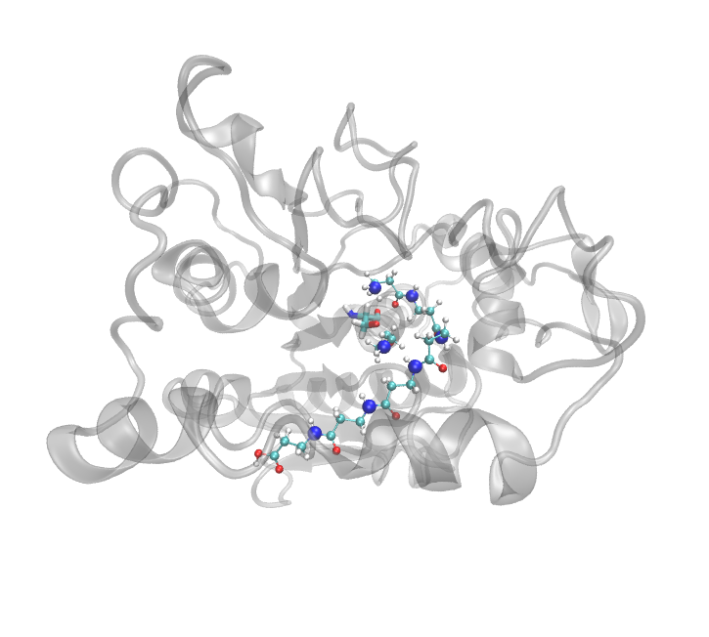
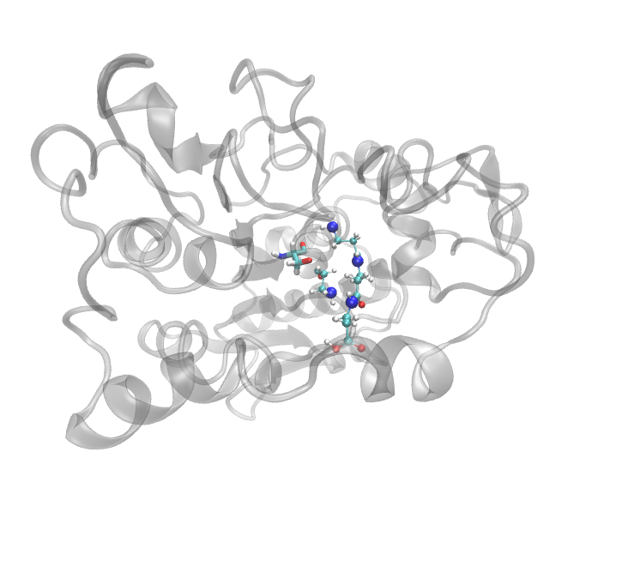
Snapshot with trimer resulted in hexamer formation
Initial⬅ Picked up from the same trajectory but it has trimer, not pentamer
Final ⬅ after 1013 cycle
Ser105
trimer
hexamer
During the simulation, N-terminal of polymer is located in the vicinity of Ser105.

Slide 12
Polymer elongation occurs ‘immediately’
Once Ser105 is acylated, polymer elongation reaction occurs within 400 MC/MD cycle.
➔ The elongation seems to occur ‘immediately’. Is it possible to explain the reason due to structural property?
quadramer
hexamer
pentamer

Slide 13
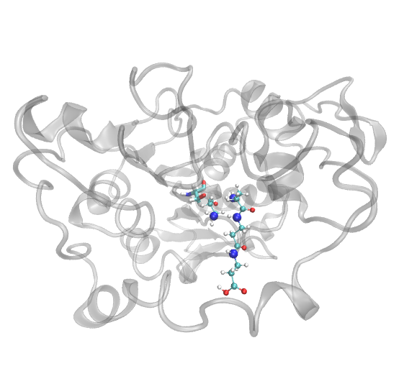
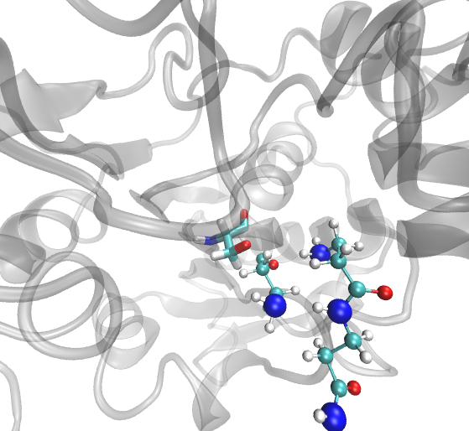
N-terminal is close to Ser105
Just before 4-mer formation
acylated Ser105

Slide 14
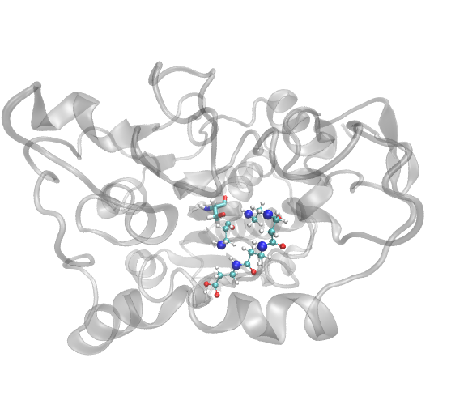
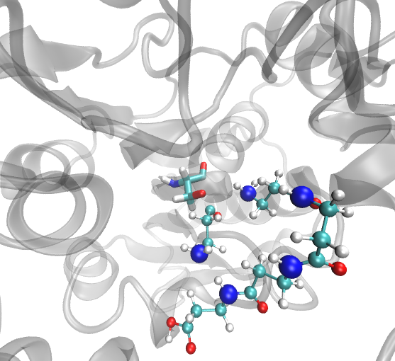
N-terminal is close to Ser105
Just before 5-mer formation
acylated Ser105

Slide 15
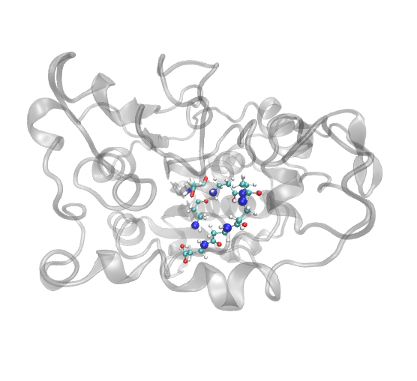
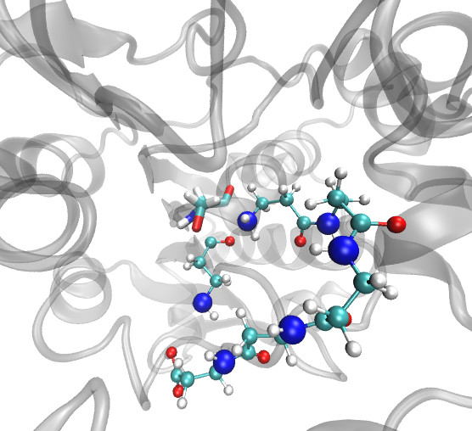
N-terminal is close to Ser105
Just before 6-mer formation
acylated Ser105

Slide 16
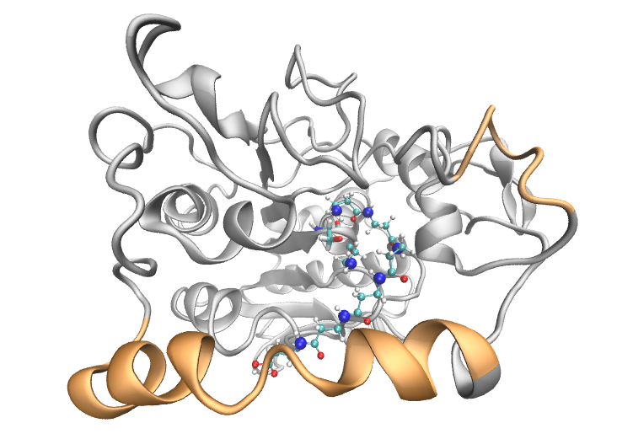
The hexamer is similar to the pentamer given in the previous simulation, in contact with CALB
Pentamer derived from the previous simulation
Hexamer derived from the extended simulation
C-terminal makes contact with α10 helix

Slide 17
Does selection of Initial atomic coordinates affect MC/MD simulation?
Preparation of initial atomic coordinates:
1 ns NPT simulation for Ser105 Acylated-CALB
Pick up the snapshot structure at 1 ns
This procedure is repeated 10 times. (Exactly, 7 snapshots were tried so far)
Problem setting: Since β-lactam and water molecules are diffused under thermal fluctuation, their positions might affect the following polymerization reaction: good substrate positions accelerate substrate binding

Slide 18
Initial atomic coordinates could not have critical impact on MC/MD simulation
annotation | the latest update of MC/MD cycle (Sep. 28, 2016) | polymer length (the number) at the indicated MC/MD cycle
 |  | this time | previous
Traj-A | 1157 | 1-mer (1) | 2-mer (1)
Traj-B | 1365 | none | 2-mer (1), 3-mer(1)
Traj-C | 1082 | 1-mer (1) | 1-mer (3)
Traj-D | 524 | none | 1-mer (1)
Traj-E | 1478 | 2-mer (1) | 1-mer (3)
Traj-F | 946 | 1-mer (2) | 1-mer (1)
Traj-G | 351 | none | not tried
Could this dimer be elongated if simulation is extended?

Slide 19
Summary
Initial atomic coordinates might be not important for polymer elongation
Rather, location of N-terminal in the active site would be critical for successful elongation
Besides, C-terminal might have to make contact with α10 helix, which regulates the location of polymer to allow further elongation
A snapshot satisfying the above condition would have potential to continue elongation reaction

Slide 20
The next 2 months
Try to get insights into the role of α10 helix for polymer elongation
Also, consider to introduce mutation on CALB, which could stabilize CALB structure locally or globally
Continue to analyze these MC/MD trajectories focusing on reactions chosen during simulations (taken over from CREST WS3)
This might provide alternative insights into shorter polymer generation.

Slide 21
Thank you for your attention

Slide 22
Supporting Materials

Slide 23
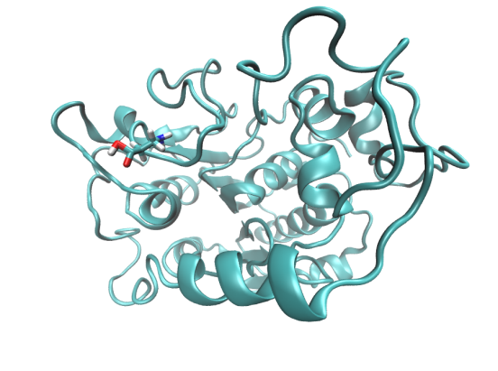
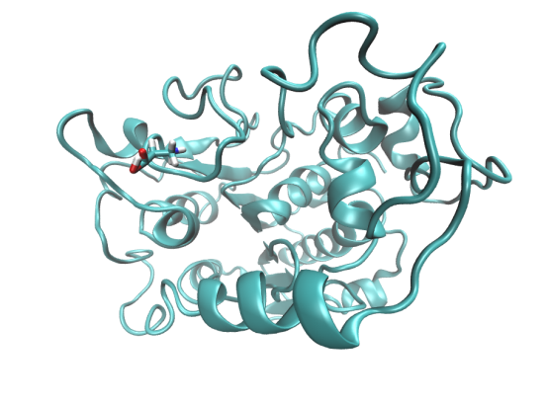
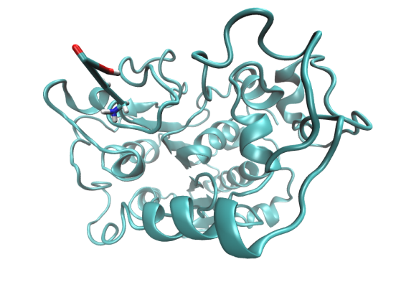
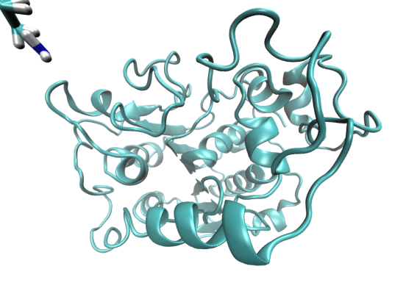
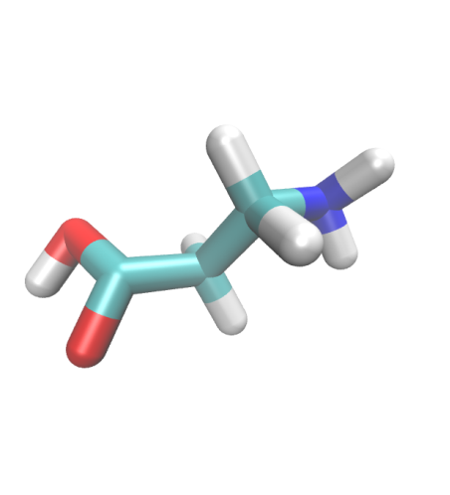
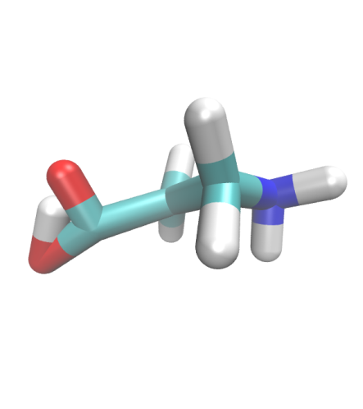
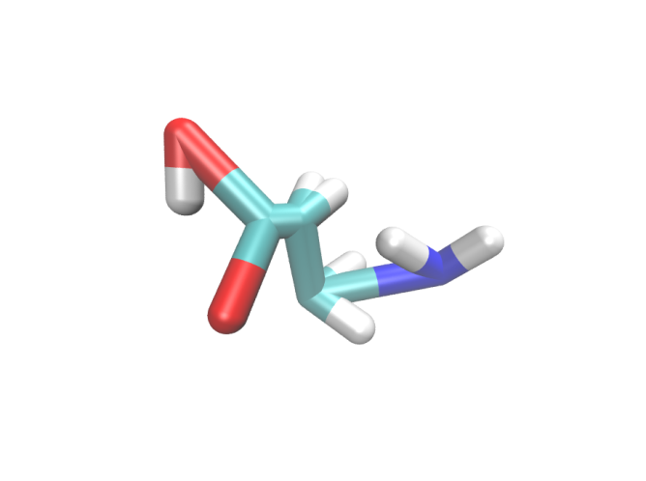
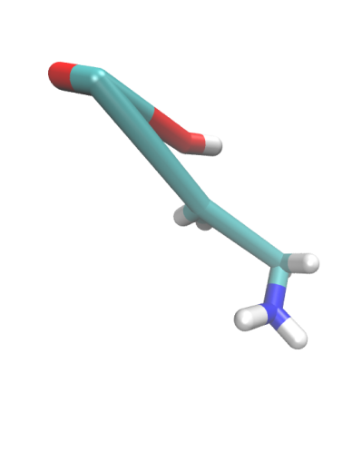
シミュレーション中で生成されたβ-alanineが異常な構造をとる
4292サイクル目、 “tleap_NoCand_Cyc4292.mdcrd”よりスナップショット構造を取得
Step 61
Step 62
Step 64
Step 65
* このβ-alanineはタンパク質表面に滞在している。但し、活性部位ではない
*データは以下に格納: /share4/barberot/MC_MD/2015_11/2_calculation/2_Sys

Slide 24
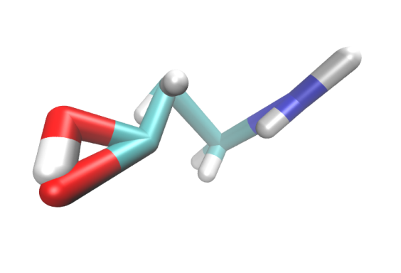
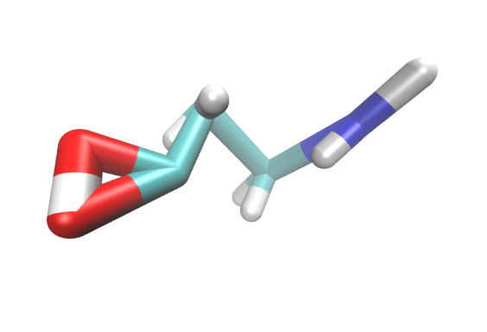
MM計算を行っても、構造の異常が改善できない
4292サイクル・100ステップ目のPDBファイルから、異常な構造をとるβ-alanineを取り出して、PDBとして保存
パラメータファイルを作成して、真空中でMM計算を実行。しかし、53ステップ目で計算が止まってしまう*
*/share4/kurisaki/Project_EnzymaticPolymerization/_Analyze_MCMD_Traj/_Check_Anomalous_b-alanine/normal_mol_Aug26/Annomalous_bAla_Cycle-4293/pdb.out
“The system has extended beyond the extent of the virtual box.”というエラーが出力された。構造が多きく引き延ばされたことで、座標がオーバーフローしたのだろうか？
Minimize cycle 1
Minimize cycle 53
Tot Ene = 1.5518E+03
1-4 EEL = -4.4015E+02
Tot Ene = -1.2946E+06
1-4 EEL = -1.2962E+06
1-4EEL由来の安定が以上に大きい

Slide 25
このようなβ-alanieの異常な構造は、他のMC/MDシミュレーションでは確認されていない
異常な構造に変化することは、頻繁に起こるのでは、ないらしい
(7本中1本)
長く計算をすれば起こる、ということでもないようだ
(Traj. Dは8000 cycleの時点でも、異常な構造は現れなかった)
annotation | the number of MC/MD cycle | the cycle number supposed | polymer length (the number)
Traj-A | 2986 | 4000 | 1-mer (2), 5-mer (1)
Traj-B | 4000 | 4000 | 1-mer (1), 2-mer (1), 3-mer (2)
Traj-C | 3367 | 6000 | 1-mer (3), 3-mer (1)
Traj-D | 8000 | 8000 | 1-mer (2), 2-mer (1)
Traj-E | 4293 | 6000 | 1-mer (3)
Traj-F | 2244 | 4000 | 1-mer (2)
経験的ポテンシャルの限界だと思って、そのまま使うことにするか？

