Slide 1
Mechanistic study of CAL-B catalyzed ring-opening polymerization of β-lactam
Crest Meeting:
“Establishement of Computational Molecular Technology towards Macroscopic Chemical Phenomena”
Chantal Barberot, Yuichi Suzuki, Ikuo Kurisaki, Masataka Nagaoka
Nagaoka Laboratory, Graduate School of Information Science, Nagoya University

Slide 2
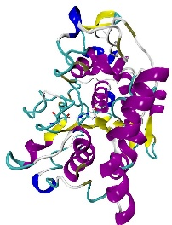
Enzymatic polymerization
The last 20 years, there is an increasing interest in in vitro enzyme-catalyzed organic reaction
This methodology has several advantages:
High catalytic activity
Mild reaction conditions (solvent, temperature, pressure, pH)
Regio, stereo and enantio-selectivity
Non-toxic natural catalyst
Many kinds of enzyme have been examined as catalyst. Interestingly, they often show catalytic activity for unnatural compounds. This mean that such enzymes can be used for variety of chemical reaction
Among such enzymes, one of the most commonly biocatalyst used for polymerization reaction is Candida Antartica Lipase B (CAL-B)
CALB
Poly-acrylate resin

Slide 3
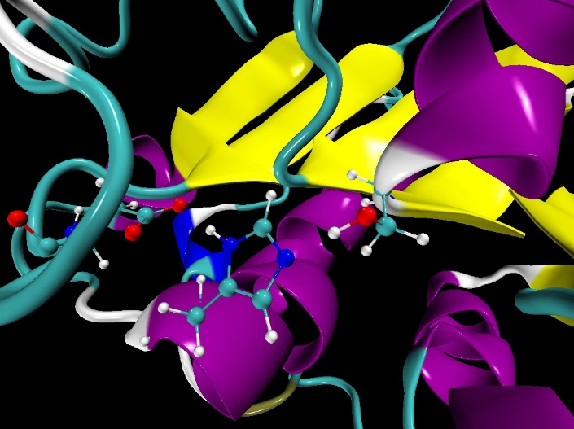
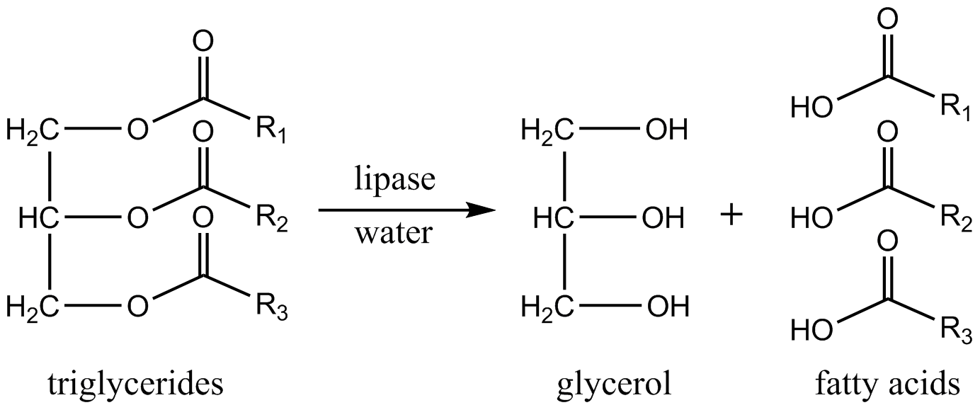
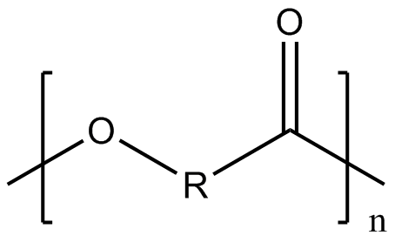
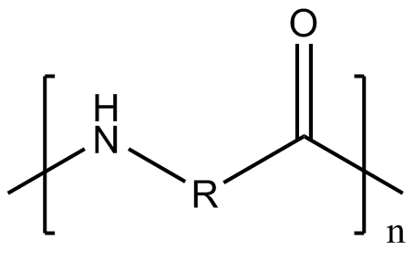
Enzymatic polymerization
Candida Antarica Lipase B (CAL-B) enzyme is an α/β-hydrolase with a catalytic triad (Asp-His-Ser)
In the cell, CAL-B hydrolyzes triglycerides
On the other hand, this lipase can generates polyesters or polyamides
Catalytic site
Asp187
Ser105
His224
PDBID: 4K6G
polyester
polyamide
3

Slide 4
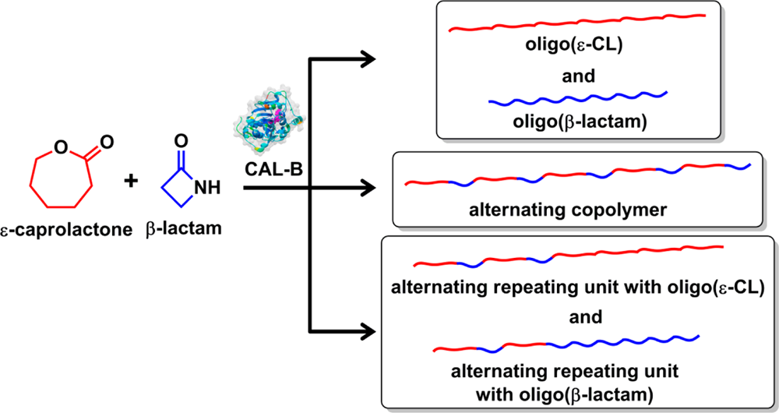
Enzymatic polymerization
For example, CAL-B catalyzed ring-opening copolymerization of ε-caprolactone (ε-CL) and β-Lactam²
The obtaining of different Poly(ε-CL-co-β-lactam) was detected as alternating and random copolymer
9 different structures of poly(ε-CL-co-β-lactam) was observed with a ratio of 50:50 ε-CL/β-lactam
The degree of polymerization maximum (DPmax) observed was 12 monomeric unit
By a better understanding of the copolymerization process, the control of the copolymer structure may be proposed
In this purpose, the use of the hybrid MC/MD reaction method seems interesting
Feed ratio |  | Conversion
ε-CL | β-lactam | ε-CL | β-lactam | Yield
0 | 100 |  |  | 37
25 | 75 | 72 | 57 | 12
50 | 50 | 73 | 90 | 50
75 | 25 | 78 | 95 | 44
100 | 0 |  |  | 65
2. K. Loos et al. Biomacromolecules 2014, 15, 234-241

Slide 5
Enzymatic polymerization
CAL-B catalyzed ring-opening polymerization of β-Lactam³
Maximum degree of polymerization (DP) is 18 monomeric units
Average DP is 8 monomeric units
However, the catalytic efficiency and the maximum length of the polymer should be improved to satisfy industrial use
For this purpose, it is indispensable to understand the mechanism of the polymerization reaction and the rate determining step
To address this issue, we apply the new hybrid MC/MD method on this system⁴
3. K. Loos et al. Macromol Rapid. Commun. 2008, 29, 794-797
4. M. Nagaoka et al. Chem. Phys. Letters 2013, 583, 80-86

Slide 6
The hybrid MC/MD reaction method
For the hybrid MC/MD reaction method a reaction scheme is needed
The reaction scheme consist of a list of elementary reaction process necessary and sufficient to simulate the polymerization reaction
Then, the polymerization reaction are simulated by repeating the MC/MD cycle
One MC/MD cycle involves several step
Run a MD simulation until satisfying necessary condition (search a pair of “reactive” atom)
Randomly select a pair with one of those possible chemical reactions assuming that each has a corresponding relative weight of selection equal to R ~exp(-β/Ea)
Virtually react and relax the whole system
Compute the reaction energy
Accept or reject the reaction under the Metropolis scheme
Notes:
My presentation will be articulated into two part.
…

Slide 7
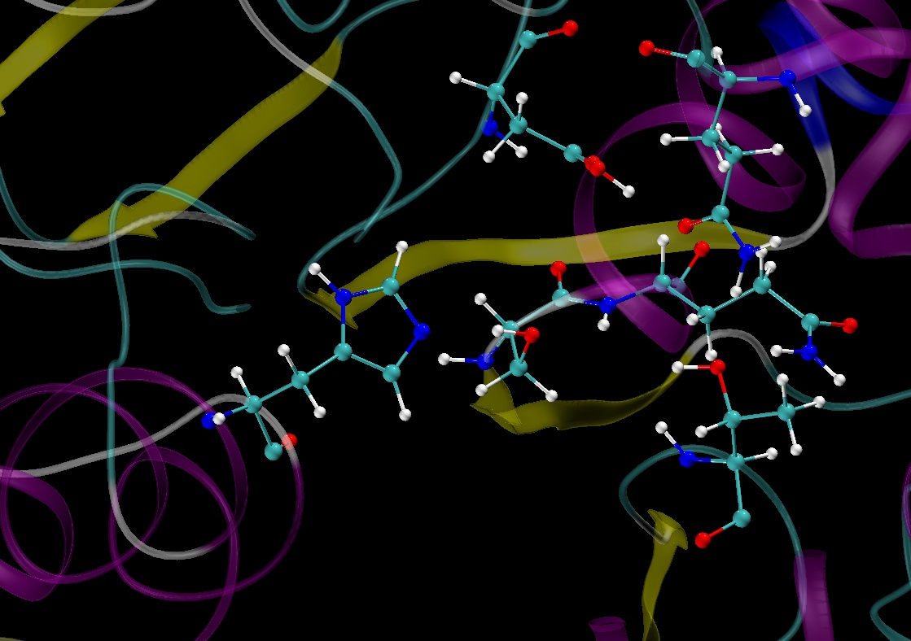
Proposed mechanism
G. Fels⁵ reported the CAL-B catalyzed ring-opening polymerization of β-lactam using Quantum Mechanics/Molecular Mechanics (QM/MM) study
They used the residues listed below as part of the QM region:
Catalytic residue (Ser105, His224)
Oxyanion hole (Gln106, Thr40), a substrate recognition site
β-lactam (or polymer chain) and water molecule
Residue important for the stabilization of the oxyanion hole (Asp134, Gln157)
Asp134
Gln157
Gln106
Ser105
His224
Oxyanion hole
Thr40
*QM/MM calculation: B3LYP (Ahlrichs-p-VDZ)/amber99FF
5. G. Fels et al. ACS Catal. 2011, 1, 323-336

Slide 8
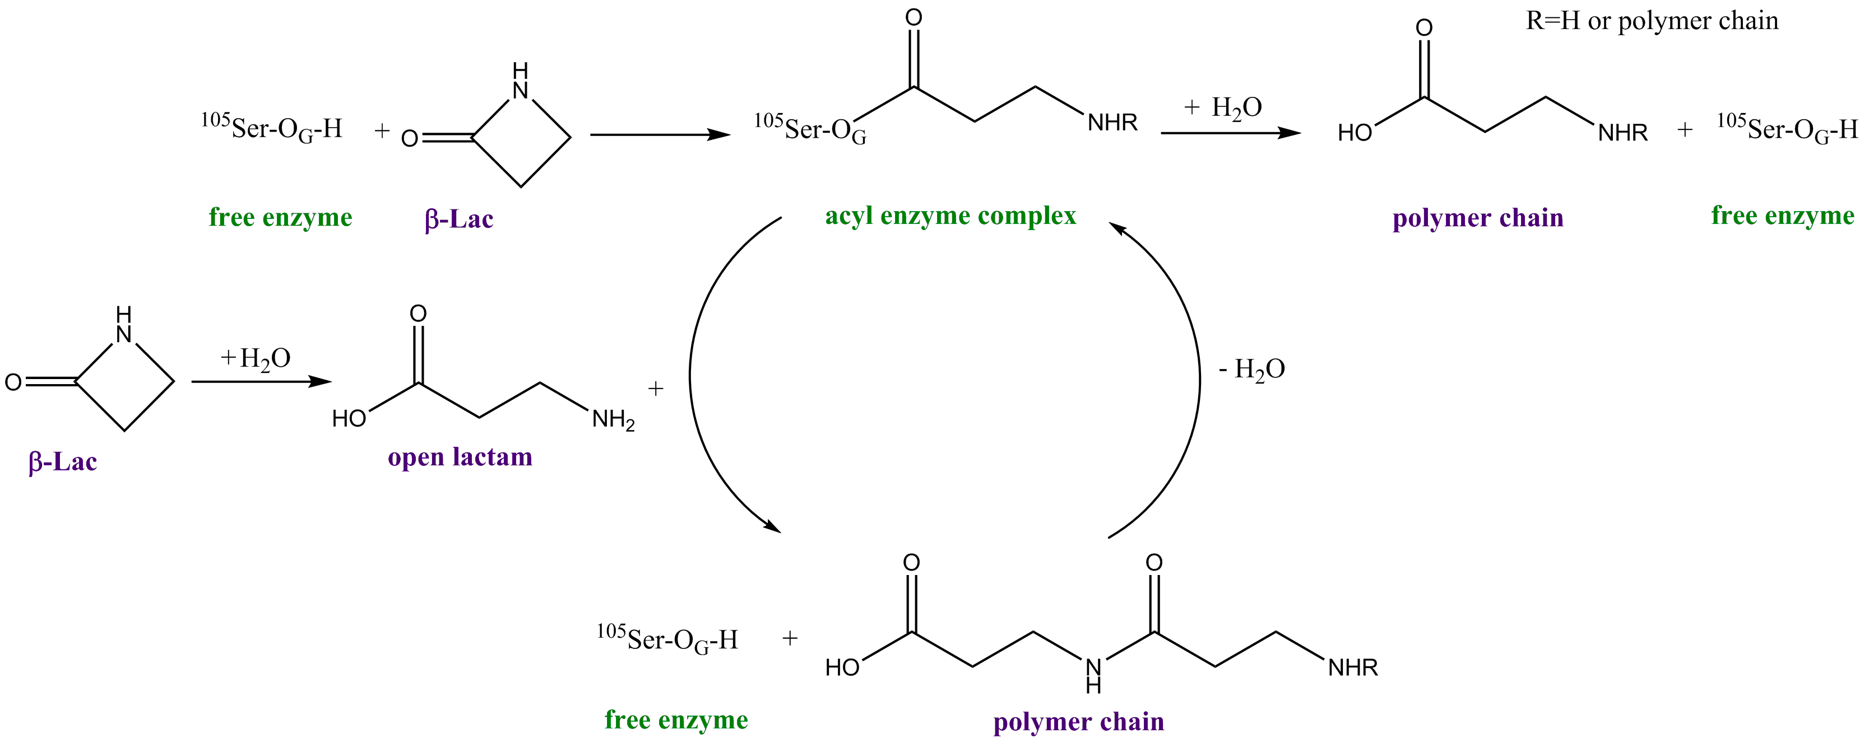
Proposed mechanism
Sequential mechanism proposed by G. Fels⁵
Formation of an acyl complex
Active site
Elongation of the polymer chain
Formation of an acyl complex
In situ β–lactam ring opening
5. G. Fels et al. ACS Catal. 2011, 1, 323-336

Slide 9
Proposed mechanism
Sequential mechanism proposed by G. Fels⁵
Formation of an acyl complex
Release of the polymer chain
Active site
Elongation of the polymer chain
Formation of an acyl complex
In situ β–lactam ring opening
H
H
O
H
N
C
O
- two bond breaking
- two bond formation
5. G. Fels et al. ACS Catal. 2011, 1, 323-336

Slide 10
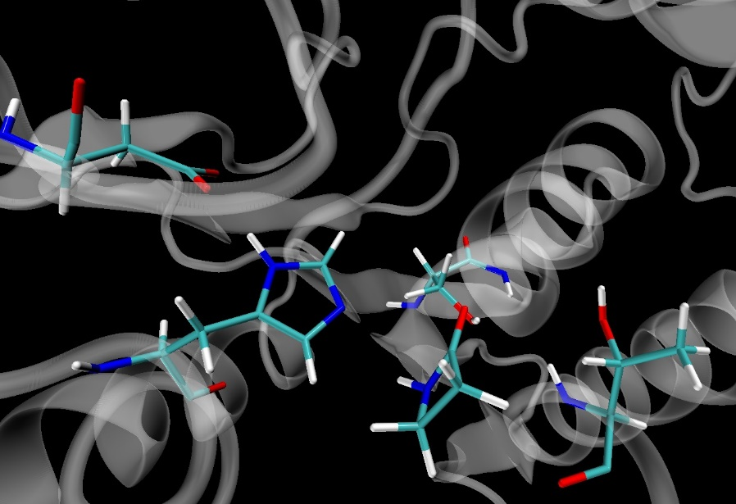
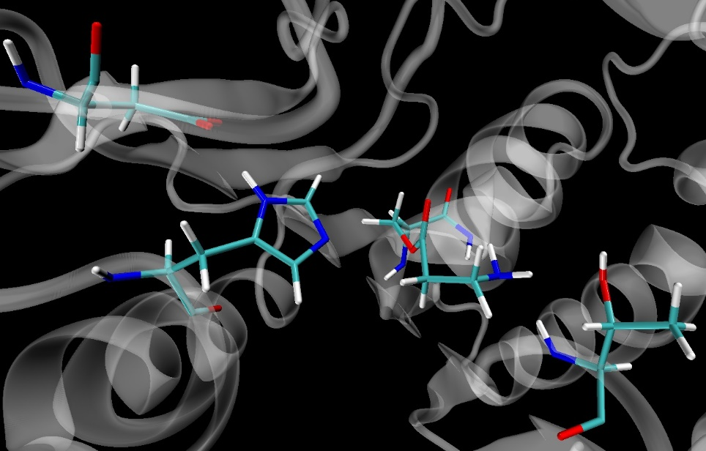
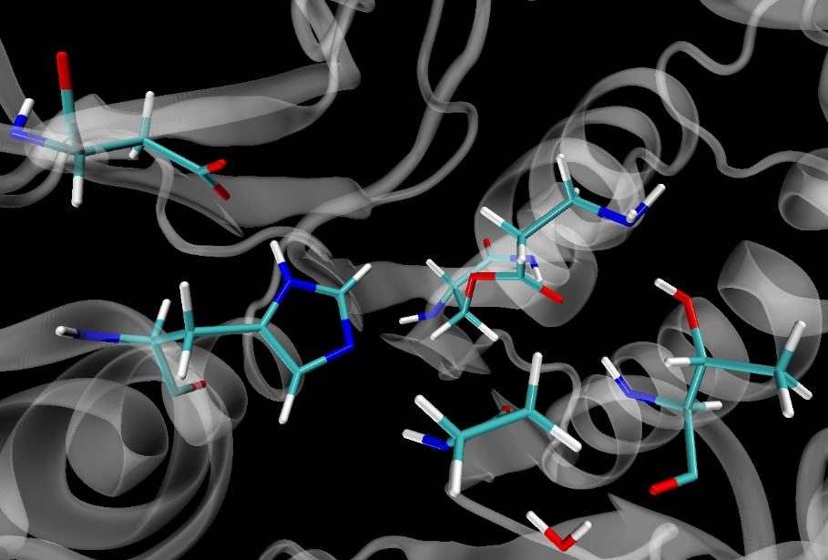
Modification of the hybrid MC/MD method
To continue the reaction, we have to add a new β-lactam molecule inside the active site
However, lactam rarely binds to the active site within usual MD simulation time period
Then, a docking procedure is combined with the conventional hybrid MC/MD method
Ser105
acylated
Asp187
Asp187
Ser105
Gln106
Gln106
His225
Solvent
His225
β-lac
Thr41
Thr41
Active site
Ser105
acylated
Asp187
His225
Thr41
β-lac

Slide 11
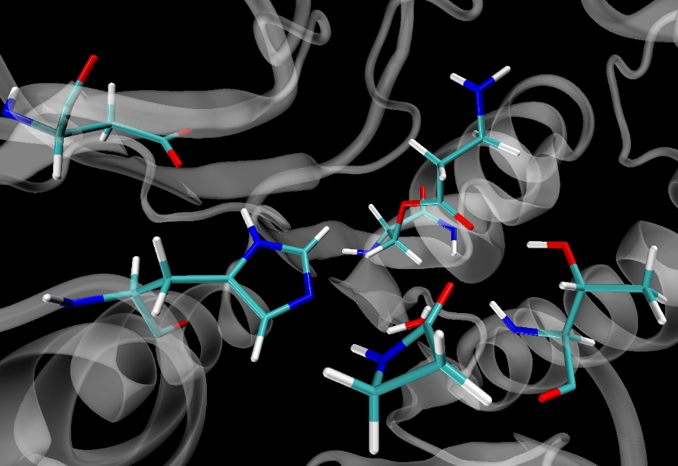
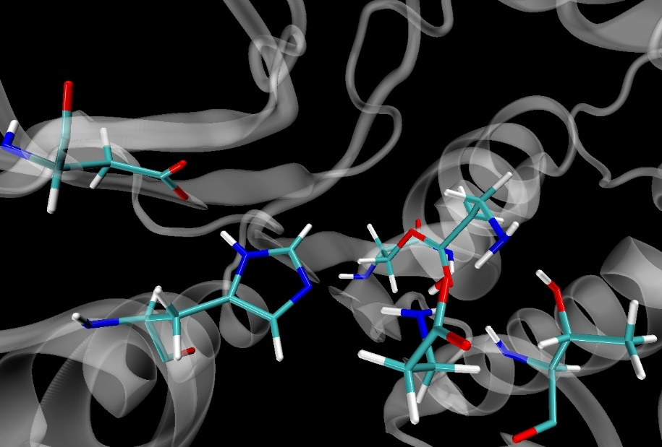
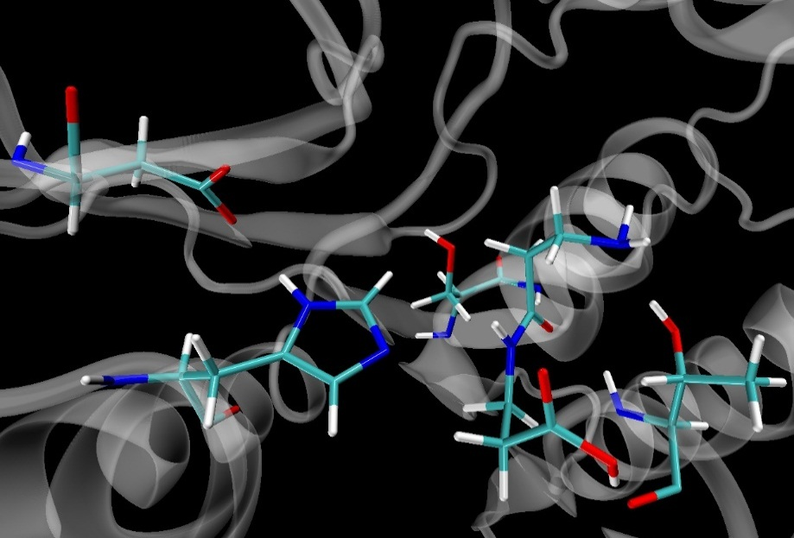
Modification of the hybrid MC/MD method
Ser105
acylated
Ser105
acylated
Asp187
Asp187
His225
Wat
His225
Thr41
β-lac
in situ β-lac
opened
Thr41
Active site
Ser105
Asp187
His225
dimer
Thr41

Slide 12
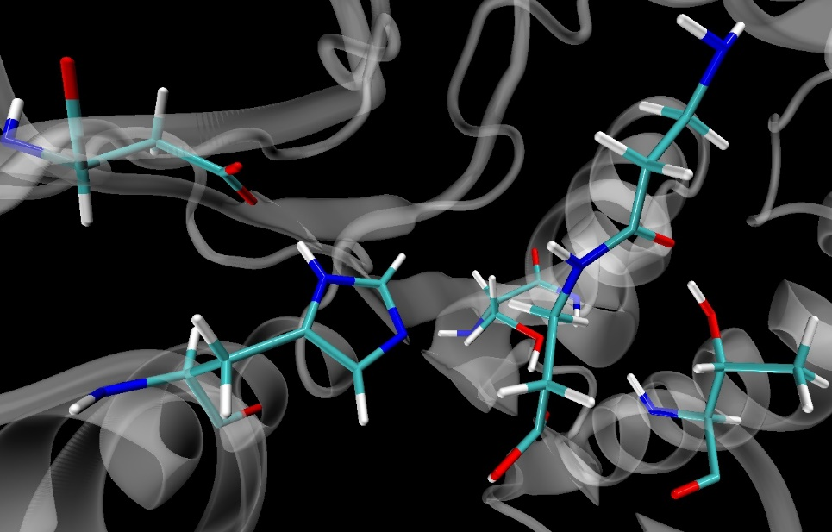
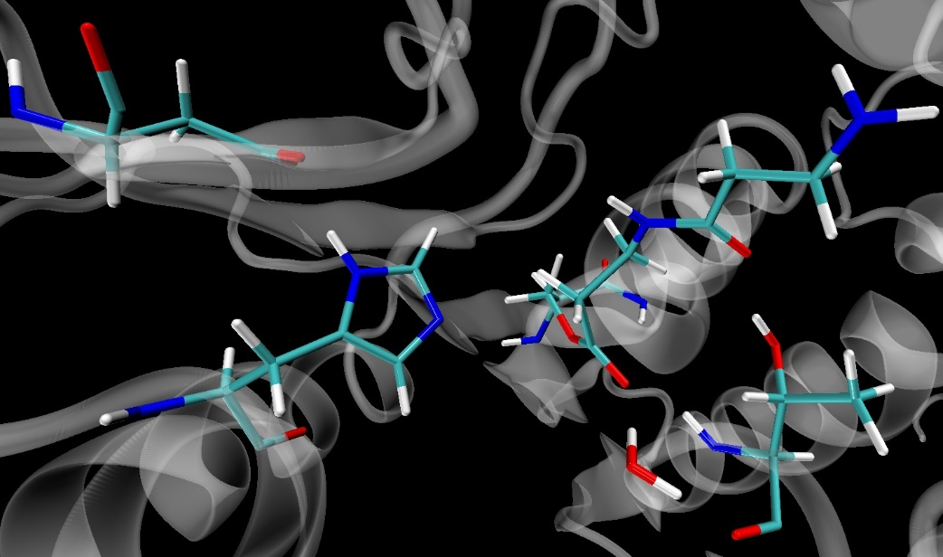
Modification of the hybrid MC/MD method
Ser105
acylated
Asp187
Ser105
Asp187
His225
His225
Thr41
Thr41
Wat
dimer
Acyl complex formation
Acyl complex hydrolysis

Slide 13
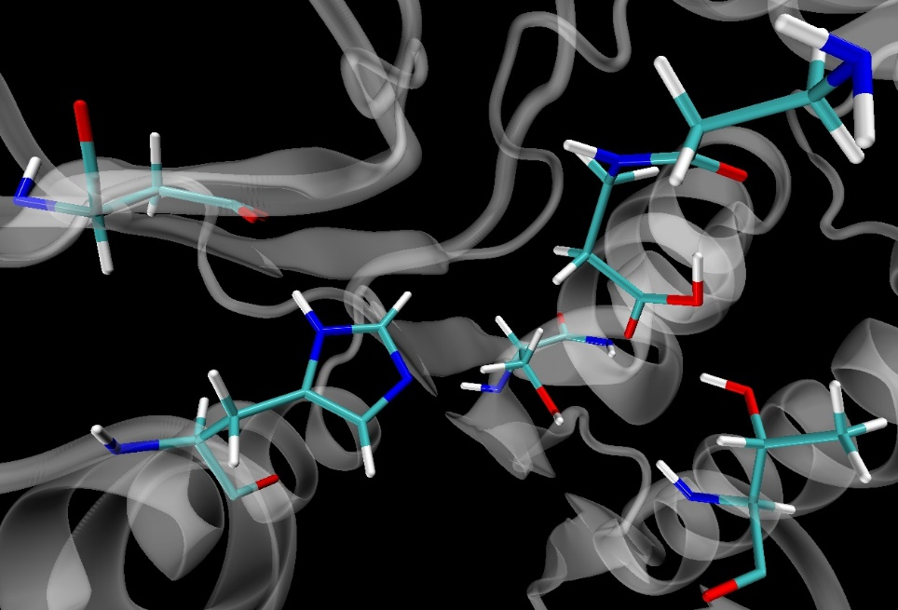
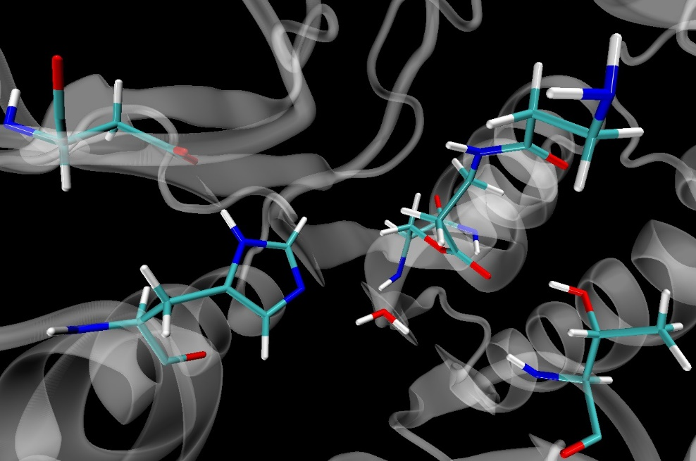
Modification of the hybrid MC/MD method
Ser105
acylated
Asp187
Ser105
Asp187
His225
His225
Thr41
Thr41
Wat
dimer
Acyl complex formation
dimer
Ser105
acylated
Ser105
Asp187
Asp187
His225
His225
Wat
Acyl complex hydrolysis
Thr41
Thr41

Slide 14
Modification of the hybrid MC/MD method
By employing the hybrid MC/MD reaction method, we are now able to simulate each step of the CAL-B catalyzed polymerization process
When different reaction can be selected at the same time by the hybrid MC/MD method, the activation energy is used to weight each reaction
However, we cannot get activation energies from the reaction scheme proposed by G. Fels et al.⁵
Formation of an acyl complex
Release of the polymer chain
Active site
Elongation of the polymer chain
Formation of an acyl complex
In situ β–lactam ring opening
5. G. Fels et al. ACS Catal. 2011, 1, 323-336

Slide 15
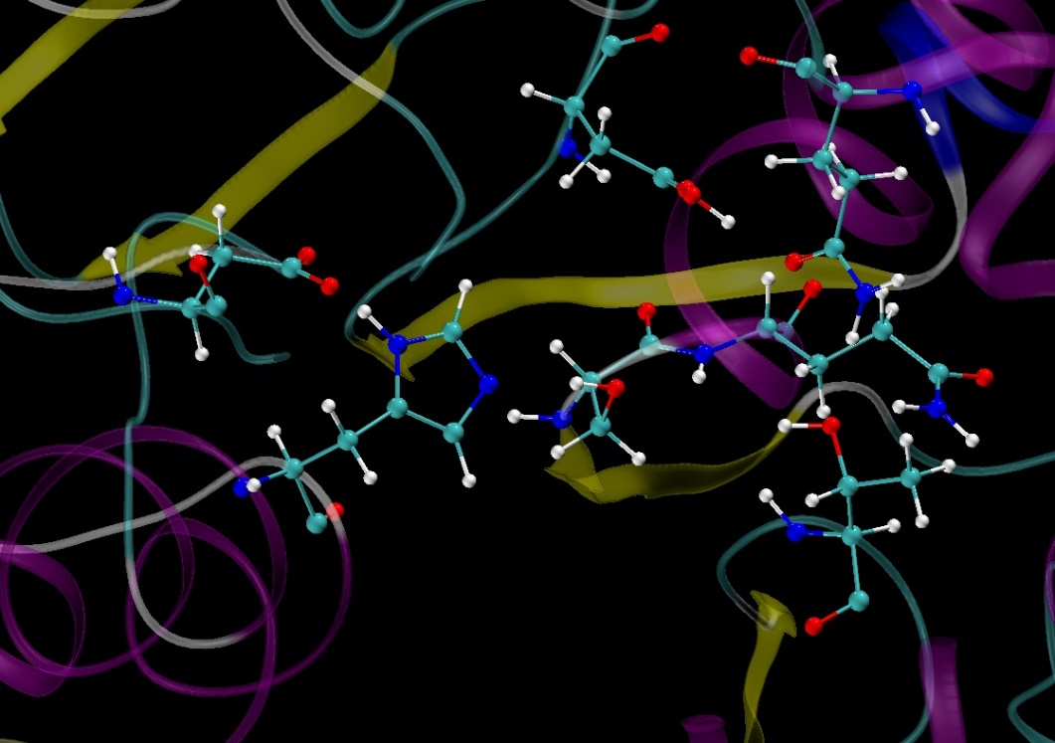
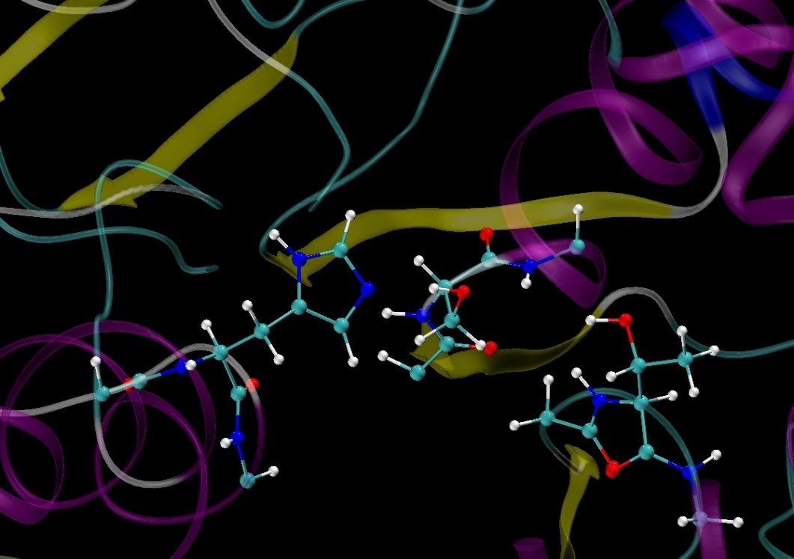
Computational details
We extracted snapshot structures from a MD simulation and prepared the model system for QM calculations
This model is composed by some key residues listed below
Catalytic residue (His224 and Ser106)
Oxyanion hole (Thr40 and a part of Gln106)
β-lactam (or polymer chain) and water molecule
*We examined both models with and without Asp187 (catalytic triad)
Asp134
Gln157
Asp187
Gln106
Ser105
His224
Oxyanion hole
Thr40
*QM calculations: B3LYP/6-31G(d)

Slide 16
Formation of the acyl complex
Formation of an acyl complex
Release of the polymer chain
Active site
Elongation of the polymer chain
Formation of an acyl complex
In situ β–lactam ring opening

Slide 17
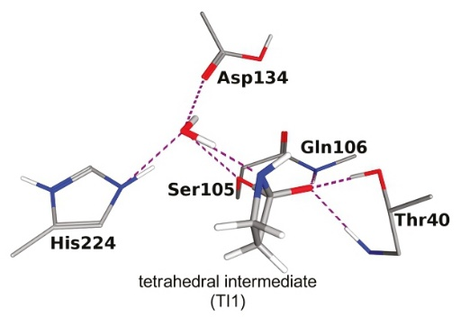
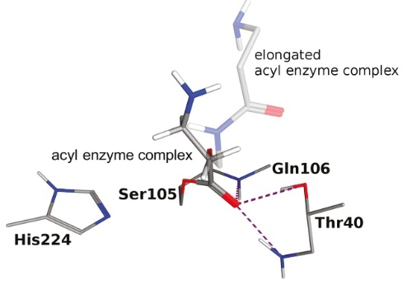
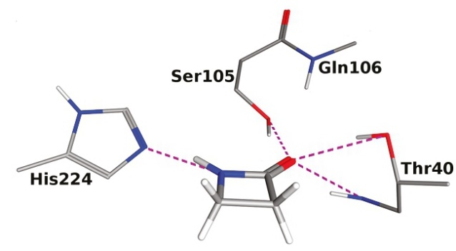
Formation of the acyl complex
The mechanism proposed by G. Fels⁵
As for the formation of the acyl complex
The R conformation of the tetrahedral intermediate is essential for continuing the reaction
A water molecule plays a critical role in proton-relay between the histidine to the formatted β-lactam complex^{6,7}
free enzyme
tetrahedral intermediate
acyl enzyme complex
5. G. Fels et al. ACS Catal. 2011, 1, 323-336
6. S. Parks et al. Adv. Synth. Catal.2003, 345, 986-995
7. I. Lavandera et al. ChemBioChem.2006, 6, 1381-1390

Slide 18
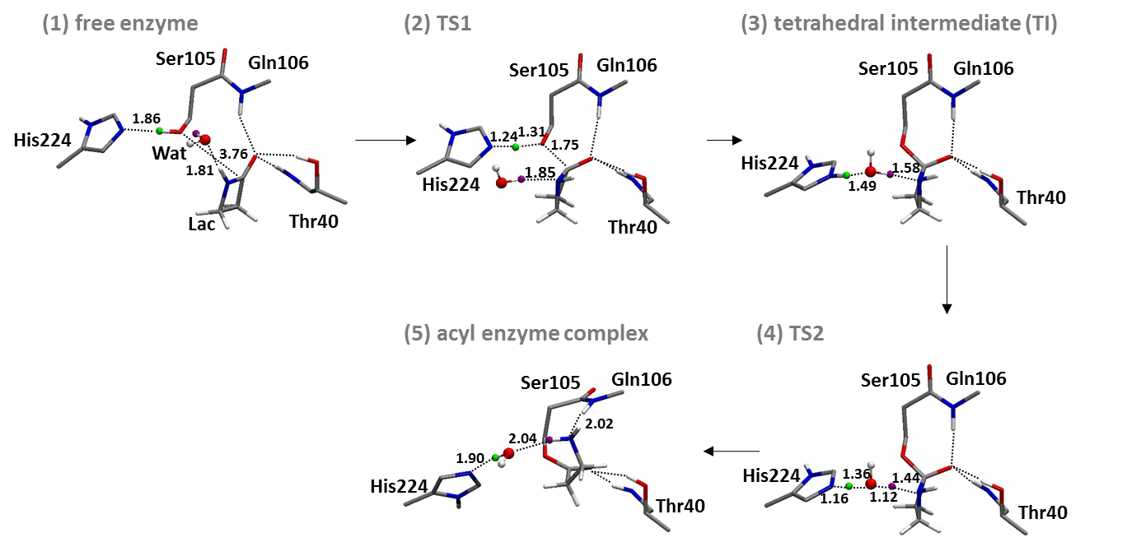
Formation of the acyl complex
Reaction scheme without Aspartate Residue
The distance are reported in Å

Slide 19
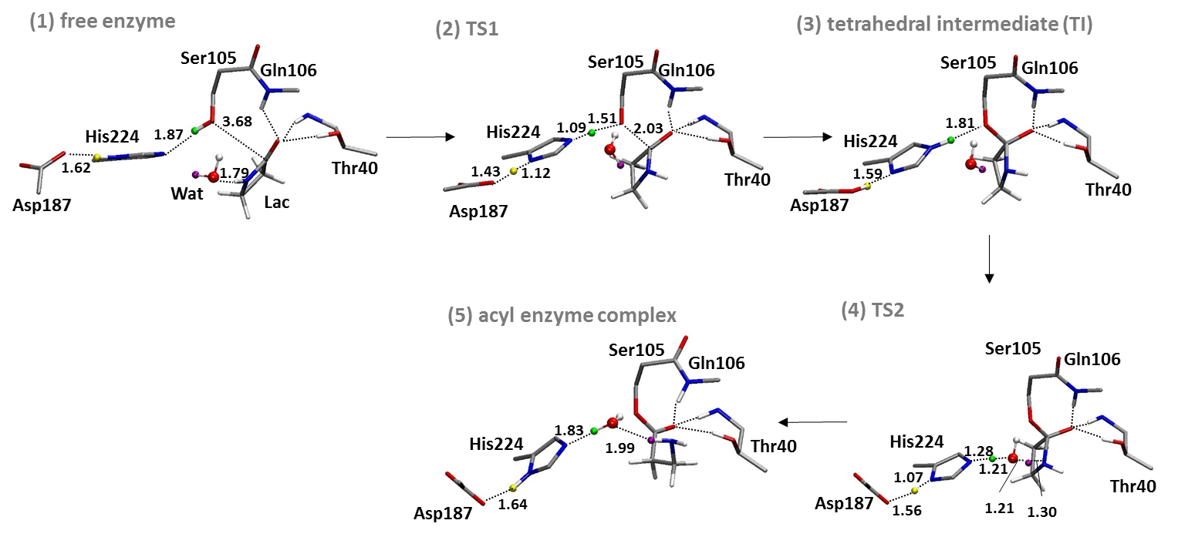
Formation of the acyl complex
Reaction scheme with Aspartate Residue
The distance are reported in Å

Slide 20
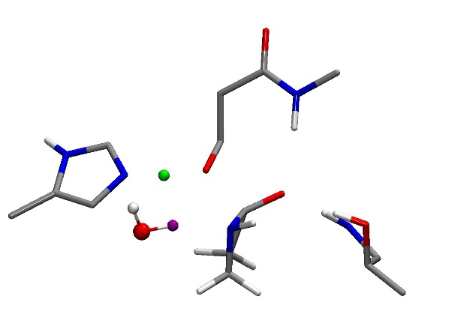
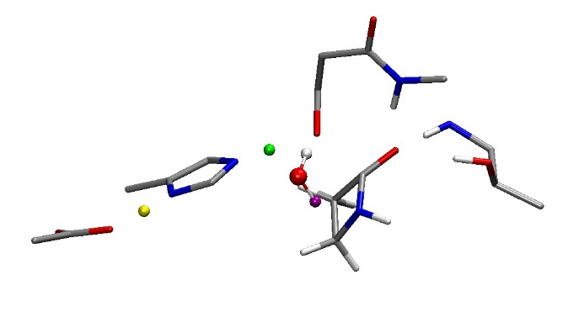
Formation of the acyl complex
Transition state 1
Without Asp
With Asp
Ser105
Gln106
Ser105
Gln106
1.31
1.51
1.24
1.75
His224
1.09
2.03
His224
1.85
1.43
1.12
Thr40
Thr40
Asp187
 | TI – Oxyanion hole
 | O(TI) – NH (Gln106) |  | O(TI) – NH (Thr40) |  | O(TI) – OH (Thr41)
 | Without | With | Without | With | Without | With
Distance (Å) | 2.89 | 2.95 | 2.90 | 2.96 | 2.75 | 2.80
Angle (deg.) | 178.3 | 165.7 | 163.4 | 162.0 | 170.6 | 168.1
 | β-lactam
 | C(Lac)-O(Lac) |  | C(Lac)-N(Lac) |  | Charge O(Lac) MK
 | Without | With | Without | With | Without | With
Distance (Å) | 1.29 | 1.25 | 1.46 | 1.42 | -0.662 | -0.589

Slide 21
Formation of the acyl complex
Energetic profile of the two model systems:
The aspartate residue reduces the activation energy of TS1
The tetrahedral intermediate is energetically stabilized
The two model system are similar in the structure of the TS2
Finally, we concluded that the aspartate residue is important and should be included in the model system
 | Relative Free Energy (kcal.mol⁻¹) in Gas Phase B3LYP/6-31G(d)
State | Without Asp 187 | With Asp187
(1) RC (Free enzyme) | 0.00 | 0.00
(2) TS1 | 38.06 | 30.73
(3) TI | 27.57 | 21.82
(4) TS2 | 27.09 | 27.05
(5) PC (Acyl enzyme complex) | -13.53 | 3.23

Slide 22
Formation of the acyl complex
Basis set comparison (single calculation on the B3LYP/6-31G(d) optimized structure)
Effect of the protein environment (single calculation on the B3LYP/6-31G(d) optimized structure)
 | Relative electronic energy (kcal.mol⁻¹) in gas phase B3LYP
Basis set | B3LYP/6-31G(d) | B3LYP/6-31G(d,p) | B3LYP/6-31+G(d)
(1) RC (Free enzyme) | 0.00 | 0.00 | 0.00
(2) TS1 | 27.81 | 27.69 | 26.68
(3) TI | 18.64 | 18.62 | 19.70
(4) TS2 | 26.49 | 26.14 | 26.30
(5) PC (Acyl enzyme complex) | -2.58 | -0.97 | -0.48
 | Relative electronic energy (kcal.mol⁻¹) B3LYP/6-31G(d)
 | Gas phase | PCM (ε=4)
(1) RC (Free enzyme) | 0.00 | 0.00
(2) TS1 | 27.81 | 26.73
(3) TI | 18.64 | 18.29
(4) TS2 | 26.49 | 27.27
(5) PC (Acyl enzyme complex) | -2.58 | -5.68
Notes:
We test basis set effect by augmented the number of basis functions
I also took in account the effect of the protein environment by using polarizable conituum with a dielectric constante equal to 4

Slide 23
Formation of the acyl complex
Structure optimization with different basis set and with PCM model
The tendency of energetic profile is similar among the calculation method
Also, the structure are basically similar (the difference in interatomic distance is less than 0.1 Å and the difference in angle value is less than 5°)
However, a polarization function for the hydrogen atom affect the TS1 structure
 | Relative Free Energy (kcal.mol⁻¹) in Gas Phase |  |  | Relative Free Energy (kcal.mol⁻¹) with PCM model (ε=4)
Basis set | B3LYP/ 6-31G(d) | B3LYP/ 6-31G(d,p) | B3LYP/ 6-31+G(d) | B3LYP/6-31G(d)
(1) RC (Free enzyme) | 0.00 | 0.00 | 0.00 | 0.00
(2) TS1 | 30.73 | 29.12 | 33.16 | 27.53
(3) TI | 21.82 | 22.13 | 28.71 | 21.90
(4) TS2 | 27.05 | 27.19 | 36.07 | 30.06
(5) PC (Acyl enzyme complex) | 3.23 | 4.92 | 8.73 | 3.29

Slide 24
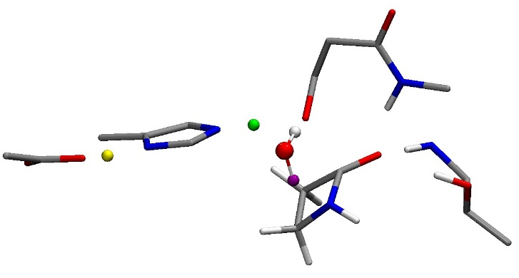
Formation of the acyl complex
Polarization functions on the hydrogen atom changes the structure of the TS1 (interaction Asp187-His224)
Atom pair | 6-31G(d) | 6-31G(d,p) | 6-31+G(d)
O(Asp186)-HN(His224) (Å) | 1.43 | 1.07 | 1.47
H (His224)-N(His224) (Å) | 1.12 | 1.50 | 1.10
6-31G(d) TS1
Ser105
6-31G(d, p) TS1
Ser105
Gln106
Gln106
1.51
His224
1.08
1.54
His224
1.09
2.03
2.05
1.07
1.50
1.43
1.12
Thr40
Asp187
Asp187
Thr40
The system was energetically optimized by employing DFT method (B3LYP/6-31G(d,p)) in gas phase with the model system containing the aspartate residue

Slide 25
In situ β-lactam hydrolysis
Formation of an acyl complex
Release of the polymer chain
Active site
Elongation of the polymer chain
Formation of an acyl complex
In situ β–lactam ring opening

Slide 26
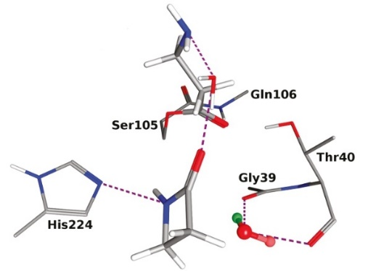
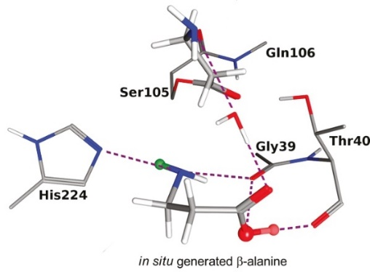
In situ β-lactam hydrolysis
The reaction mechanism proposed by G. Fels⁵
Reaction scheme proposed by our calculation
5. G. Fels et al. ACS Catal. 2011, 1, 323-336
The distance are reported in Å

Slide 27
In situ β-lactam hydrolysis
Energetic profile of the reaction
Reaction scheme proposed by our calculation
State | Relative Free Energy (kcal.mol⁻¹) in gas phase B3LYP/6-31G(d,p)
(1) β-lactam | 0.00
(2) TS | 47.37
(5) open lactam | -10.00
The distance are reported in Å

Slide 28
Elongation of the polymer chain
Formation of an acyl complex
Release of the polymer chain
Active site
Elongation of the polymer chain
Formation of an acyl complex
In situ β–lactam ring opening

Slide 29
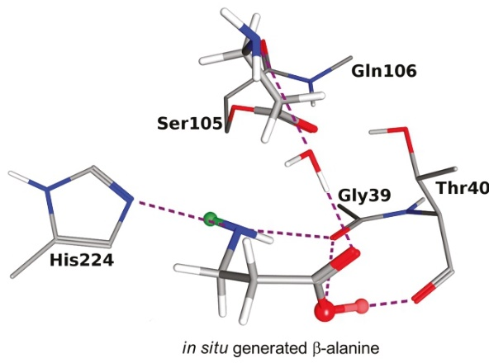
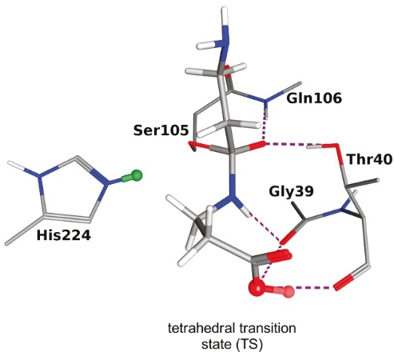
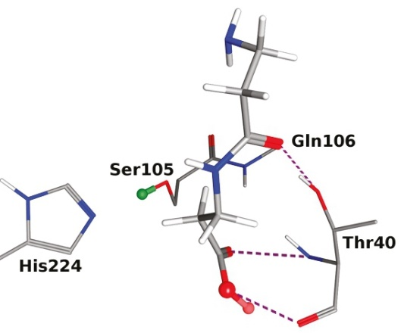
Elongation of the polymer chain
The reaction mechanism proposed by G. Fels⁵
Reaction scheme proposed by our calculation
5. G. Fels et al. ACS Catal. 2011, 1, 323-336
The distance are reported in Å

Slide 30
Elongation of the polymer chain
Energetic profile of the reaction
Reaction scheme proposed by our calculation
State | Relative Free Energy (kcal.mol⁻¹) in gas phase B3LYP/6-31G(d,p)
(1) Acyl enzyme complex | 0.00
(2) TS | 41.89
(5) Free enzyme + polymer | 1.20
The distance are reported in Å

Slide 31
Hydrolysis of the acylated serine
Formation of an acyl complex
Release of the polymer chain
Active site
Elongation of the polymer chain
Formation of an acyl complex
In situ β–lactam ring opening

Slide 32
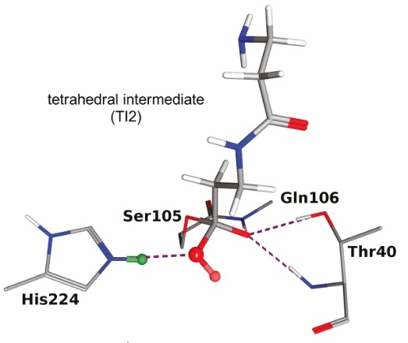
Hydrolysis of the acylated serine
The reaction mechanism proposed by G. Fels⁵
A two-step reaction was observed, where a tetrahedral intermediate is a stable conformer
HOH
Release of the polymer chain
5. G. Fels et al. ACS Catal. 2011, 1, 323-336

Slide 33
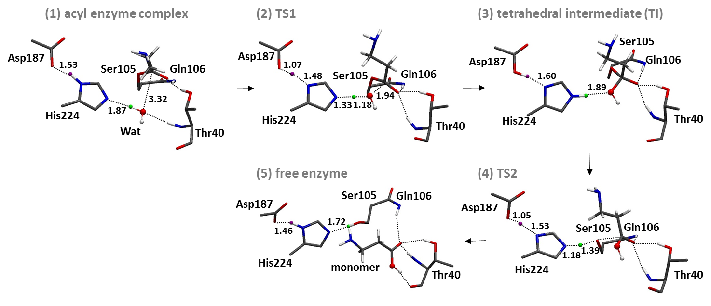
Hydrolysis of the acylated serine
Reaction scheme proposed by our calculation
The distance are reported in Å

Slide 34
Hydrolysis of the acylated serine
The formation of the acyl complex and the hydrolysis are similar in the activation energy
14.19
13.17
State | Relative Free Energy (kcal.mol⁻¹) in gas phase B3LYP/6-31G(d,p)
(1) acyl enzyme complex | 0.00
(2) TS1 | 14.19
(3) TI | 4.29
(4) TS2 | 17.58
(5) free enzyme | 4.41
Notes:
One both side

Slide 35
Conclusion
29.11 kcal.mol⁻¹
14.19 kcal.mol⁻¹
Active site
41.89 kcal.mol⁻¹
13.17 kcal.mol⁻¹
47.37 kcal.mol⁻¹
14.19 kcal.mol⁻¹
*computed with DFT method (B3LYP/6-31G(d,p)) in gas phase

Slide 36
Conclusion
Addition of Asp187 in the QM model system results in:
decrease of the activation energy for the first step of the acylation process
stabilization of intermediate states
influence on the structure of the transition state
As for the CAL-B ring-opening polymerization of β-lactam were computed
These activation energy will be used for the hybrid MC/MD reaction method study
The next step is to perform the hybrid MC/MD reaction method on this system to understand the limitation of this polymerization reaction
Study the β-lactam access to the active site of the CAL-B depending of the acyl enzyme complex length
Perspectives
Notes:
To conserve -> we should keep the aspartate

Slide 37
Thank you for your attention

