Slide 1
FY2015 6th CREST WS
Nov. 9th, 2015
Role of Non-site Specific Interaction in Biocatalyzed Reaction: Optimizing simulation condition of Replica Exchange Molecular Dynamics
Ikuo KURISAKI

Slide 2
Outline
Research background (P. 3)
Problem setting (P. 4)
(Earlier) REMD simulation (P. 5)
Suggestions at 4nd CREST WS (P. 6)
Explicit REMD simulation (P. 8-15)
Comparison between explicit and implicit solvent effect on REMD (P. 16-17)
Research plan for the next two months (P. 18)

Slide 3
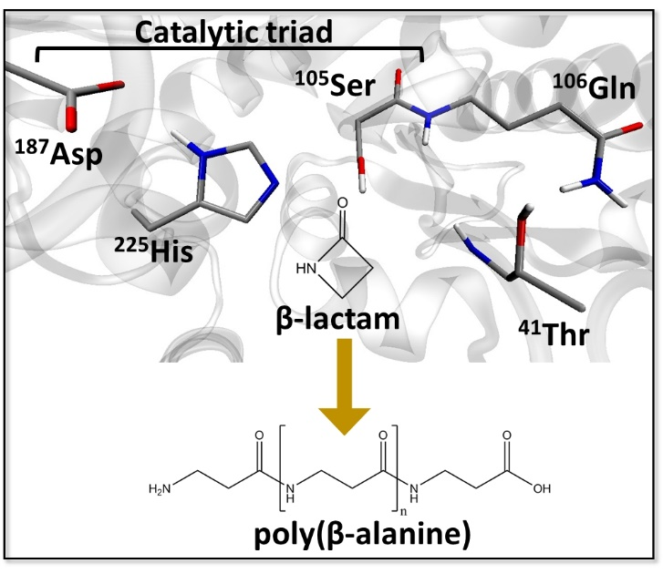
Research background
Enzyme catalyzed polymerization reaction has drawn attention in the field of green chemistry
Candida Antarica Libase B (CALB) has long been studied in this purpose
This enzyme catalyzes polymerization of β-lactam to generate poly(β-alanine), nylon-3
However, this reaction system has rooms to be improved because the product do not satisfy industrial quality, as for the length and yield
From 4th CREST WS
The illustration is gifted from Dr. Barberot.

Slide 4
Problem setting
Polymer length must influence polymer elongation reaction.
From 4th CREST WS
with modification
CALB
water
Ser¹⁰⁵-OH
Ser¹⁰⁵-O
Poly(β-alanine)
β-lactam
We can examine the effect of polymer length on the reaction by analyzing conformation of the polymer.

Slide 5
REMD simulation in implicit solvent
Representative conformations of 8-mer@300K
Annotation: extended
Distance: 36.6 Å
# HB: 0
From 4th CREST WS
with modification
Carbon atom in CH₃^{ACE}
Carbon atom in CH₃^{NME}
Annotation: bent
Distance: 25.4 Å
# HB: 0
Annotation: turn
Distance: 5.1 Å
# HB: 1
Annotation: twist
Distance: 16.8 Å
# HB: 1
Averaged # of HB: 0.06
(total 20,000 conf.)

Slide 6
Suggestions at 4th CREST WS
Takenaka-san
➔ GB does not include entropic effect, explicitly, in other words, microscopic solvation effect, is not taken into account. Peptide changes the conformation under the balancing with microscopic solvation structure, so that this should affect both dynamics and conformation ensemble obtained.
Finally, we had better to examine the effect of GB on conformational sampling. We should find earlier studies that address to compare GB and explicit solvent in the context of REMD. Thus, first, we will check them, and reconsider how to evaluate REMD with GAFF.

Slide 7
Contents
REMD simulation in explicit solvent (P. 8-15)
Comparison between the effects of implicit and explicit solvent (P. 16-17)
Perspective to the next two months (P. 18)

Slide 8
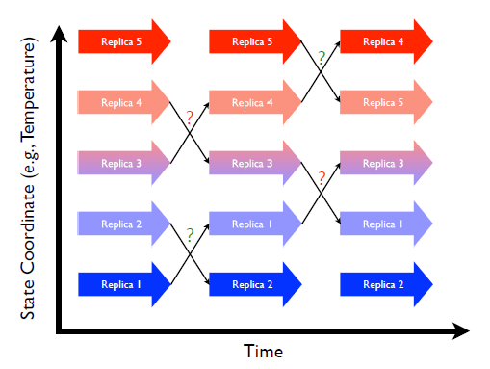
Optimization strategy
Exchange probabilities between adjacent replicas have to be similar between replica pairs.
In earlier studies, exchange probability is chosen to be around 30-40%.
Figure 21. 1.: Replica exchange schematic showing 5 replicas combined in an expanded ensemble. Large arrows represent MD trajectories of sub-ensembles while the smaller arrows represent attempted swaps between replicas in state space. Question marks represent Monte Carlo exchange attempts (green for successful, red for failed)².
[1] A. Mitsutake et al. Biopolymer, 2001, 60, 96-123; [2] Amber 14 manual.

Slide 9
Setup of temperatures REMD
In this present simulation, 54 replicas are employed for explicit solvent REMD. Each replica simulation consists of 50000 x 1ps MD run.
temperature pair | exchange probability |  | temperature pair | exchange probability |  | temperature pair | exchange probability |  | temperature pair | exchange probability
268.00 ↔ 272.00 | 0.261 |  | 324.00 ↔ 328.00 | 0.39 |  | 392.00 ↔ 398.00 | 0.326 |  | 484.00 ↔ 492.00 | 0.362
272.00 ↔ 276.00 | 0.242 |  | 328.00 ↔ 332.00 | 0.404 |  | 398.00 ↔ 404.00 | 0.343 |  | 492.00 ↔ 500.00 | 0.376
276.00 ↔ 280.00 | 0.26 |  | 332.00 ↔ 336.00 | 0.413 |  | 404.00 ↔ 410.00 | 0.359 |  | 500.00 ↔ 508.00 | 0.389
280.00 ↔ 284.00 | 0.27 |  | 336.00 ↔ 340.00 | 0.428 |  | 410.00 ↔ 416.00 | 0.377 |  | 508.00 ↔ 516.00 | 0.413
284.00 ↔ 288.00 | 0.281 |  | 340.00 ↔ 344.00 | 0.441 |  | 416.00 ↔ 422.00 | 0.388 |  | 516.00 ↔ 526.00 | 0.288
288.00 ↔ 292.00 | 0.29 |  | 344.00 ↔ 349.00 | 0.313 |  | 422.00 ↔ 428.00 | 0.406 |  | 526.00 ↔ 536.00 | 0.304
292.00 ↔ 296.00 | 0.305 |  | 349.00 ↔ 354.00 | 0.328 |  | 428.00 ↔ 435.00 | 0.324 |  | 536.00 ↔ 546.00 | 0.333
296.00 ↔ 300.00 | 0.311 |  | 354.00 ↔ 359.00 | 0.345 |  | 435.00 ↔ 442.00 | 0.337 |  | 546.00 ↔ 556.00 | 0.345
300.00 ↔ 304.00 | 0.334 |  | 359.00 ↔ 364.00 | 0.358 |  | 442.00 ↔ 449.00 | 0.361 |  | 556.00 ↔ 566.00 | 0.359
304.00 ↔ 308.00 | 0.338 |  | 364.00 ↔ 369.00 | 0.383 |  | 449.00 ↔ 456.00 | 0.366 |  | 566.00 ↔ 576.00 | 0.385
308.00 ↔ 312.00 | 0.353 |  | 369.00 ↔ 375.00 | 0.272 |  | 456.00 ↔ 463.00 | 0.384 |  | 576.00 ↔ 588.00 | 0.305
312.00 ↔ 316.00 | 0.357 |  | 375.00 ↔ 381.00 | 0.291 |  | 463.00 ↔ 470.00 | 0.393
316.00 ↔ 320.00 | 0.371 |  | 381.00 ↔ 387.00 | 0.304 |  | 470.00 ↔ 476.00 | 0.505
320.00 ↔ 324.00 | 0.38 |  | 387.00 ↔ 392.00 | 0.438 |  | 476.00 ↔ 484.00 | 0.337
Discarding initial 5 ns MD trajectories, 45,000 snapshot structures at 300 K are classified using the clustering method*.
*Algorism: K-means; Cluster number: 5

Slide 10
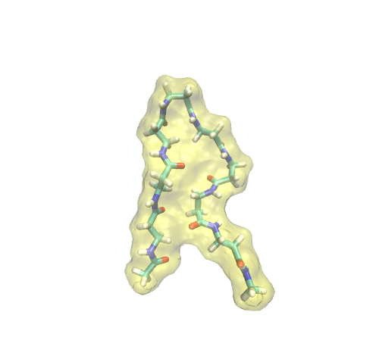
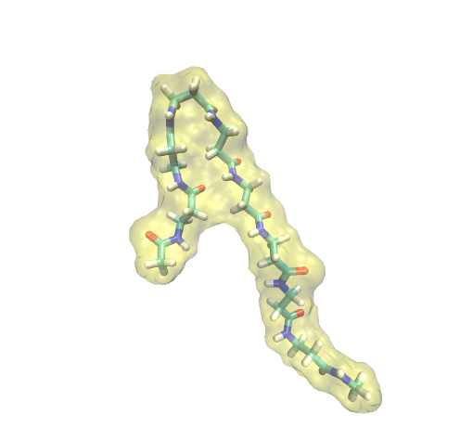
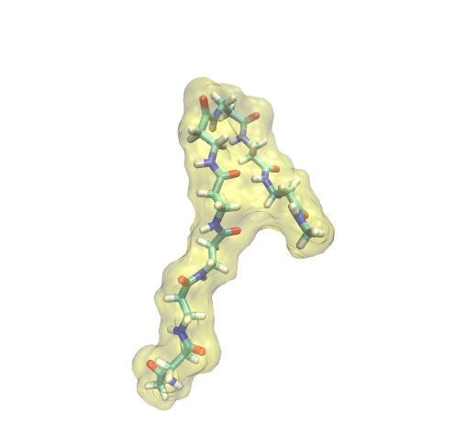
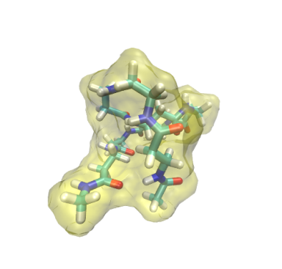
Representative conformations derived from explicit REMD
extended
hairpin
turn@βAla3
turn@βAla6
globule
Averaged # of HB: 0.07
(total 45,000 conf.)
➔ Supported by the earlier experimental study¹
[1] J. D. Glickson and J. Applequist. J.A.C.S., 1971, 93, 3276-3286

Slide 11
Summary for representative conformations
Extended conformation occupies > 80% of the conformation ensemble.
conformation | frequency [%]
extended | 86.9
hairpin | 6.2
turn@βAla3 | 4.3
turn@βAla6 | 2.5
globule | 0.1
extended

Slide 12
Summary for representative conformations
Meanwhile, bending and twisting are observed in Poly β-alanine (i.e., hairpin, turns and globule).
Such structural flexibility could be mainly attributed to rotation of Cα-Cβ (see the panel below).
hairpin
turn@βAla3
turn@βAla6
globule
β-alanine
Cα
N
O
H
H
H
n
Cβ
O

Slide 13
Summary for representative conformations
5 representative conformations were obtained using explicit solvent REMD.
However, it remains elusive weather this REMD simulation is converged.
It should be noted that fractions would be changed via extension of simulation.
Also, it could be assumed that periodic boundary condition prefers extended conformation, but this point will be discussed later.

Slide 14
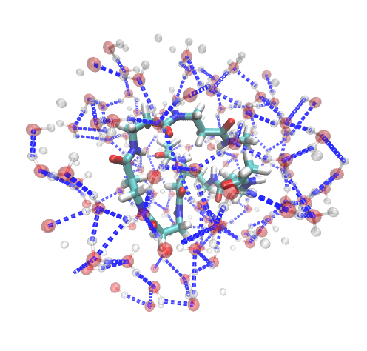
Summary for representative conformations
Globule conformation forms one hydrogen bonds.
Furthermore, we observed amid groups (-NH) approach each other.
This conformation could be stabilized not by intramolecular interaction, but rather water molecules mediated interaction.
Intramolecule hydrogen bond
Water molecule

Slide 15
Problems
Extended conformation is the majority in the ensemble of poly-βalanine 8mer?
We have to confirm the convergence of REMD simulations, or compare relative free energies between conformations.
Periodic boundary condition affects the conformation ensemble, in particular, appearance of extended conformation?
The globule conformation is stabilized by the presence of water molecule?
➔ Comparison with implicit solvent REMD should give insights into the question.

Slide 16
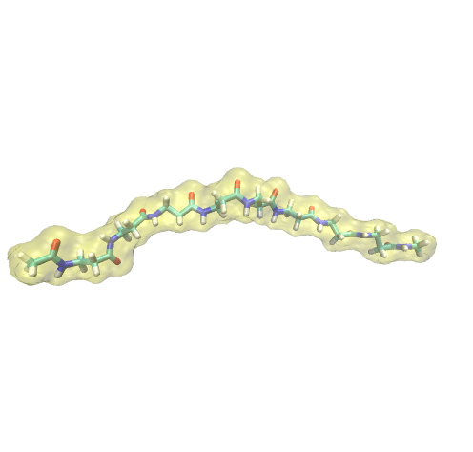
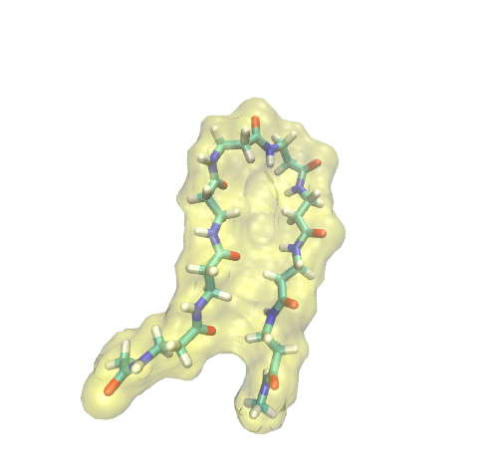
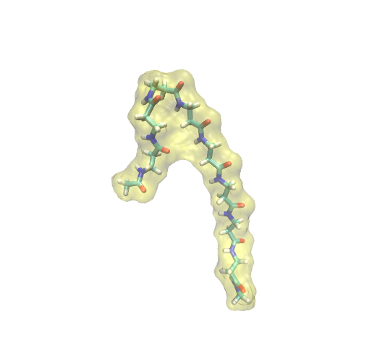
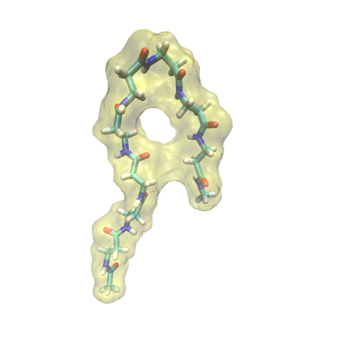
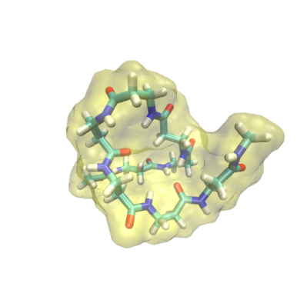
Representative conformations derived from implicit REMD
extended
hairpin
turn@βAla3
turn@βAla6
globule

Slide 17
Compare REMD derived ensembles
Difference in conformation ensemble between explicit and implicit solvent REMD
With respect to the ensemble derived from implicit solvent REMD, fraction of the extended conformation is > 80%. It could be assumed that the higher fraction is not due to the influence of periodic boundary condition.
We can also observe conformations similar to those found in explicit solvent REMD. However, the thermodynamic stability of each conformation should be different between explicit and implicit REMD, because of the presence of water molecules.

Slide 18
Research plan for the next 2 months
Considering the role of water molecules, explicit solvent REMD will be employed.
Check REMD convergence(?)
➔ The convergence could be examined by comparing two REMD simulations, which start from different conformations.
Perform REMD simulations in toluene
➔ I will also examine poly-β-alanine conformation ensemble in toluene.
Consider a strategy of REMD for 18mer poly-βalanine
➔ One option is to employ smaller exchange probability, e.g. 20%, which is allowed to use smaller number of replica. Although I might have to perform longer simulation, this is a realistic solution from now.

Slide 19
Suggestions at 6th CREST WS
Takayanagi-san
➔ Should the potential energy be compared between QM and MM calculation. It is not trivial that the extended conformation is the most stable among the five conformations.

Slide 20
Thank you for your attention

Slide 21
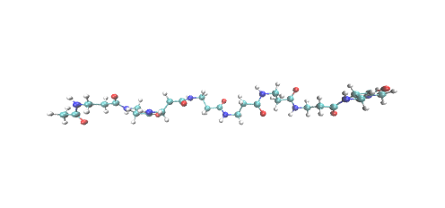
Supporting Information
Setup of replica exchange molecular dynamics
8-mer
Simulation setting
Heat bath: Berendsen thermostat with coupling time of 0.5 ps
Implicit solvent model: generalized Born model developed by A. Onufriev et al.¹ with solvent dielectric constant of 78.5 (simulating aqueous solvent)
Explicit model: TIP3P water model
Force field: General Amber Force Field (GAFF)²
Time length of independent MD: 1 ps
Number of Exchange: 50000
[1] A. Onufriev et al. Proteins, 2004, 55, 383-394; [2] J. Wang et al. J. Comput. Chem., 2004, 25, 1157-1174; [3] Okur et al., J. Chem. Theor. Comp., 2, 420-433 2006.

Slide 22
Supporting Information
Trial-1 with 40 replicas
temperature pair | exchange probability |  | temperature pair | exchange probability |  | temperature pair | exchange probability |  | temperature pair | exchange probability
268.00↔276.00 | 0.005 |  | 348.00↔356.00 | 0.095 |  | 428.00↔436.00 | 0.248 |  | 508.00↔516.00 | 0.401
276.00↔284.00 | 0.009 |  | 356.00↔364.00 | 0.107 |  | 436.00↔444.00 | 0.262 |  | 516.00↔524.00 | 0.424
284.00↔292.00 | 0.013 |  | 364.00↔372.00 | 0.123 |  | 444.00↔452.00 | 0.28 |  | 524.00↔532.00 | 0.431
292.00↔300.00 | 0.018 |  | 372.00↔380.00 | 0.141 |  | 452.00↔460.00 | 0.295 |  | 532.00↔540.00 | 0.449
300.00↔308.00 | 0.026 |  | 380.00↔388.00 | 0.156 |  | 460.00↔468.00 | 0.316 |  | 540.00↔548.00 | 0.452
308.00↔316.00 | 0.033 |  | 388.00↔396.00 | 0.169 |  | 468.00↔476.00 | 0.329 |  | 548.00↔556.00 | 0.47
316.00↔324.00 | 0.041 |  | 396.00↔404.00 | 0.185 |  | 476.00↔484.00 | 0.344 |  | 556.00↔564.00 | 0.483
324.00↔332.00 | 0.057 |  | 404.00↔412.00 | 0.201 |  | 484.00↔492.00 | 0.36 |  | 564.00↔572.00 | 0.496
332.00↔340.00 | 0.063 |  | 412.00↔420.00 | 0.222 |  | 492.00↔500.00 | 0.381 |  | 572.00↔580.00 | 0.541
340.00↔348.00 | 0.079 |  | 420.00↔428.00 | 0.236 |  | 500.00↔508.00 | 0.389
Replicas in lower temperatures are not exchanged frequently.

Slide 23
Supporting Information
Trial-2 with 48 replicas
temperature pair | exchange probability |  | temperature pair | exchange probability |  | temperature pair | exchange probability |  | temperature pair | exchange probability
268.00↔272.00 | 0.26 |  | 316.00↔320.00 | 0.376 |  | 364.00↔368.00 | 0.503 |  | 428.00↔436.00 | 0.258
272.00↔276.00 | 0.243 |  | 320.00↔324.00 | 0.374 |  | 368.00↔372.00 | 0.512 |  | 436.00↔444.00 | 0.265
276.00↔280.00 | 0.258 |  | 324.00↔328.00 | 0.398 |  | 372.00↔376.00 | 0.505 |  | 444.00↔452.00 | 0.283
280.00↔284.00 | 0.264 |  | 328.00↔332.00 | 0.406 |  | 376.00↔380.00 | 0.52 |  | 452.00↔460.00 | 0.298
284.00↔288.00 | 0.277 |  | 332.00↔336.00 | 0.41 |  | 380.00↔384.00 | 0.534 |  | 460.00↔468.00 | 0.312
288.00↔292.00 | 0.291 |  | 336.00↔340.00 | 0.428 |  | 384.00↔388.00 | 0.568 |  | 468.00↔476.00 | 0.355
292.00↔296.00 | 0.3 |  | 340.00↔344.00 | 0.438 |  | 388.00↔396.00 | 0.138 |  | 476.00↔492.00 | 0.031
296.00↔300.00 | 0.316 |  | 344.00↔348.00 | 0.444 |  | 396.00↔400.00 | 0.593 |  | 492.00↔508.00 | 0.052
300.00↔304.00 | 0.328 |  | 348.00↔352.00 | 0.454 |  | 400.00↔404.00 | 0.608 |  | 508.00↔532.00 | 0.004
304.00↔308.00 | 0.335 |  | 352.00↔356.00 | 0.462 |  | 404.00↔412.00 | 0.179 |  | 532.00↔556.00 | 0.007
308.00↔312.00 | 0.346 |  | 356.00↔360.00 | 0.472 |  | 412.00↔420.00 | 0.224 |  | 556.00↔580.00 | 0.014
312.00↔316.00 | 0.361 |  | 360.00↔364.00 | 0.483 |  | 420.00↔428.00 | 0.232
Replicas in higher temperatures are not exchanged frequently.

Slide 24
Supporting Information
Trial-3 with 54 replicas
temperature pair | exchange probability |  | temperature pair | exchange probability |  | temperature pair | exchange probability |  | temperature pair | exchange probability
268.00↔272.00 | 0.254 |  | 324.00↔329.00 | 0.261 |  | 394.00↔399.00 | 0.441 |  | 476.00↔486.00 | 0.21
272.00↔276.00 | 0.242 |  | 329.00↔334.00 | 0.284 |  | 399.00↔404.00 | 0.461 |  | 486.00↔496.00 | 0.241
276.00↔280.00 | 0.251 |  | 334.00↔339.00 | 0.296 |  | 404.00↔410.00 | 0.357 |  | 496.00↔506.00 | 0.258
280.00↔284.00 | 0.269 |  | 339.00↔344.00 | 0.306 |  | 410.00↔416.00 | 0.37 |  | 506.00↔516.00 | 0.283
284.00↔288.00 | 0.274 |  | 344.00↔349.00 | 0.316 |  | 416.00↔422.00 | 0.39 |  | 516.00↔526.00 | 0.291
288.00↔292.00 | 0.295 |  | 349.00↔354.00 | 0.336 |  | 422.00↔428.00 | 0.401 |  | 526.00↔536.00 | 0.317
292.00↔296.00 | 0.311 |  | 354.00↔359.00 | 0.342 |  | 428.00↔434.00 | 0.408 |  | 536.00↔546.00 | 0.322
296.00↔300.00 | 0.315 |  | 359.00↔364.00 | 0.362 |  | 434.00↔440.00 | 0.425 |  | 546.00↔556.00 | 0.343
300.00↔304.00 | 0.319 |  | 364.00↔369.00 | 0.369 |  | 440.00↔446.00 | 0.438 |  | 556.00↔566.00 | 0.359
304.00↔308.00 | 0.336 |  | 369.00↔374.00 | 0.386 |  | 446.00↔452.00 | 0.452 |  | 566.00↔576.00 | 0.368
308.00↔312.00 | 0.354 |  | 374.00↔379.00 | 0.4 |  | 452.00↔458.00 | 0.458 |  | 576.00↔584.00 | 0.552
312.00↔316.00 | 0.362 |  | 379.00↔384.00 | 0.407 |  | 458.00↔464.00 | 0.476
316.00↔320.00 | 0.371 |  | 384.00↔389.00 | 0.417 |  | 464.00↔470.00 | 0.484
320.00↔324.00 | 0.393 |  | 389.00↔394.00 | 0.43 |  | 470.00↔476.00 | 0.512

Slide 25
Supporting Information
Assessing separation between clusters with Davies-Bouldin Index (DBI).
Explicit solvent REMD
Implicit solvent REMD
cluster size | BDI
 | average | CI95
5 | 1.31 | 0.08
8 | 1.35 | 0.06
10 | 1.4 | 0.05
20 | 1.44 | 0.02
30 | 1.45 | 0.02
40 | 1.46 | 0.02
50 | 1.46 | 0.03
cluster size | BDI
 | average | CI95
5 | 1.4 | 0.08
8 | 1.49 | 0.07
10 | 1.5 | 0.04
20 | 1.55 | 0.04
30 | 1.51 | 0.03
40 | 1.5 | 0.03
50 | 1.5 | 0.04

Slide 26
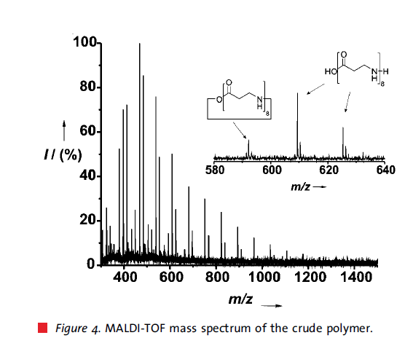
Supporting Information
[1] L. W. Schwab, Macromol. Rapid Comm., 2008, 29, 794-797.

Slide 27
Replica exchange molecular dynamics (REMD) simulation¹
Figure 21. 1.: Replica exchange schematic showing 5 replicas combined in an expanded ensemble. Large arrows represent MD trajectories of sub-ensembles while the smaller arrows represent attempted swaps between replicas in state space. Question marks represent Monte Carlo exchange attempts (green for successful, red for failed)².
[1] A. Mitsutake et al. Biopolymer, 2001, 60, 96-123; [2] Amber 14 manual.

Slide 28
Supporting Information
‘More particularly, it has been reported that ion pairs were frequently too stable in the GB implicit water model, causing salt bridged conformations to be oversampled in MD simulations, thus altering the thermodynamics and kinetics of folding for small peptides.’^{[1]}
[1] Okur et al., J. Chem. Theor. Comp., 2, 420-433 2006.

Slide 29
Supporting Information
Validity of this simulation setup
In the experimental study¹,
[1] Temperature ranges from 40 to 98 ℃, namely 313 to 371 K
[2] Estimated polymer length is ca 370
Although we analyzed conformation ensemble of 8-mer under 300 K, our simulation can be available to discuss consistency between REMD with GAFF and the study.
As for [1], a polymer in aqueous solution, possibly, forms less HBs under relatively high temperature. If we observe fewer HBs at 300 K, the observation would hold to the case under higher temperature.
As for [2], even if polymer length is 370, the HB should be, basically, formed among neighboring residues, so that 8-mer could be a model to examine such local HB formation.
[1] J. D. Glickson and J. Applequist. J.A.C.S., 1971, 93, 3276-3286

Slide 30
Implicit solvent could be an alternative to explicit solvent as for this study.
As for extended conformation, implicit solvent REMD works similarly to explicit solvent REMD.
Each conformation appear in both implicit and explicit solvent REMDs.
Nonetheless, it should be noted that the presence of water molecules affects stability of conformations. Conformational free energy should be calculated using explicit water model.

Slide 31
Purpose of the last 3 month study
Implicitでexplicitの結果が再現できれば、よい
できなかったら、あきらめてexplicitでやる
Results and Discussionに書くか…
➔18merのをどうするか？溶媒の数を固定して、
総原子数が増えないようにする？それでいいかどうかはまた、別問題
メモリーの問題があるので、必須かも
もしくは、Hamilton replica exchangeをつかうか？
他に何が分かると、よいか？
構造の影響は…
Active siteの中での安定構造 ➔ 新規β-lactamの侵入に影響
Active siteの外での安定構造 ➔ 再侵入とかactive site周りでの滞在などに影響
速度論的なスキームを描いてみるか？

Slide 32
Atomic origin of poly(β-alanine) disorder
α-alanine
Revised!!
O
Cα
N
H
H
O
n
H
Cβ
β-alanine
Cα
N
O
H
H
n
H
Cβ
O

Slide 33
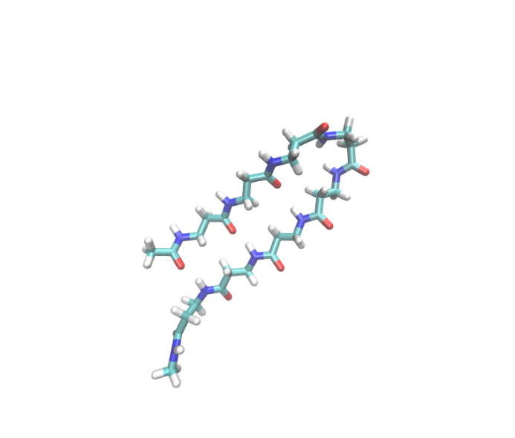
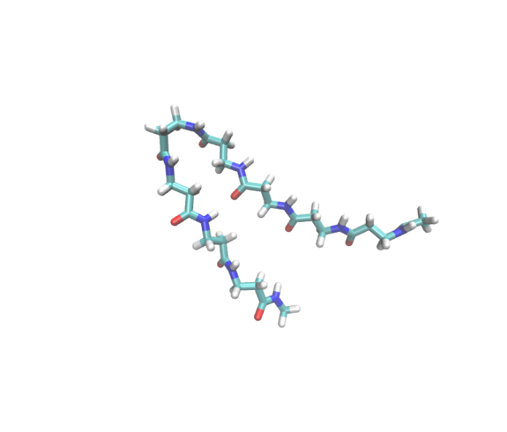
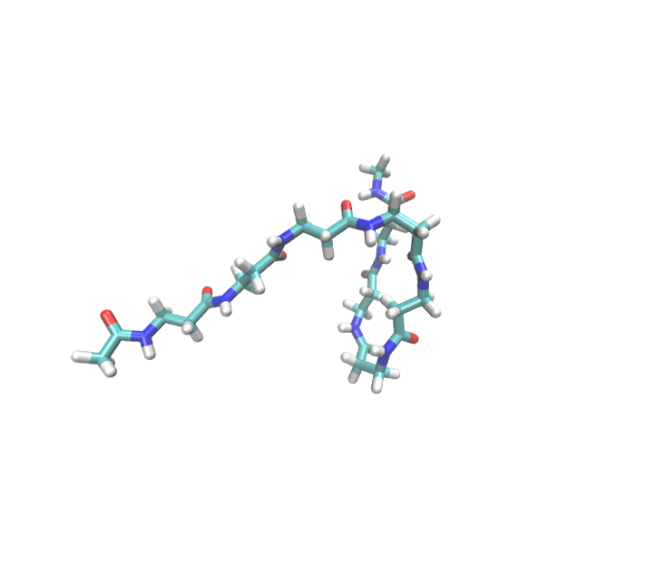
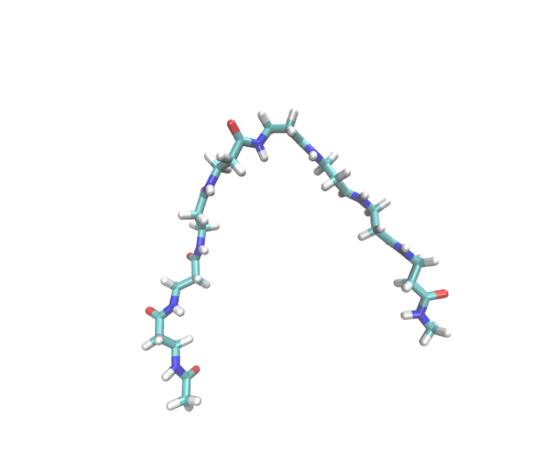
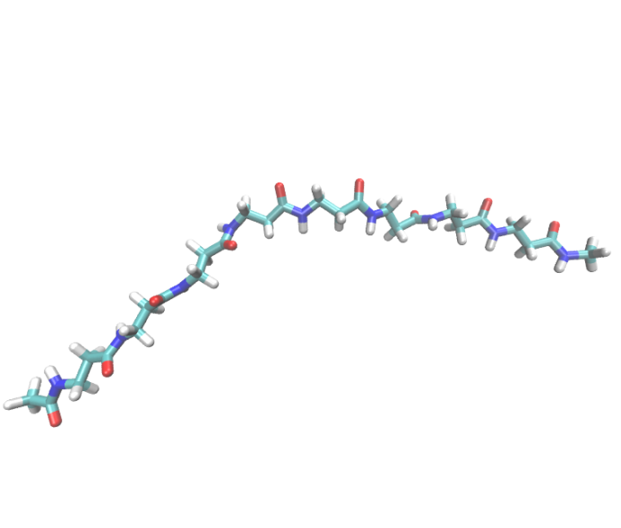
Representative conformations derived from explicit REMD (1)
hairpin
hairpin
turn (C-ter.)
arch
extended

Slide 34
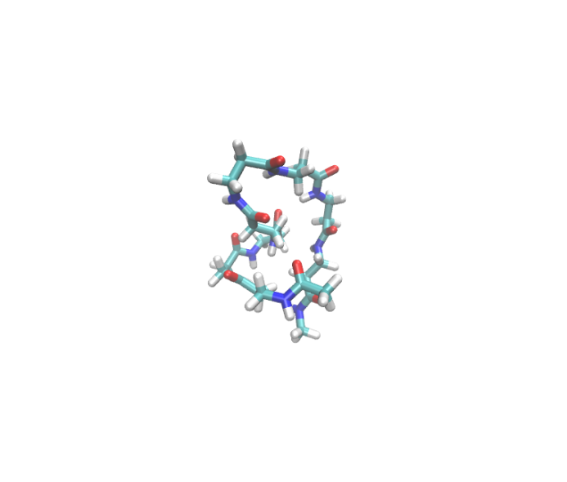
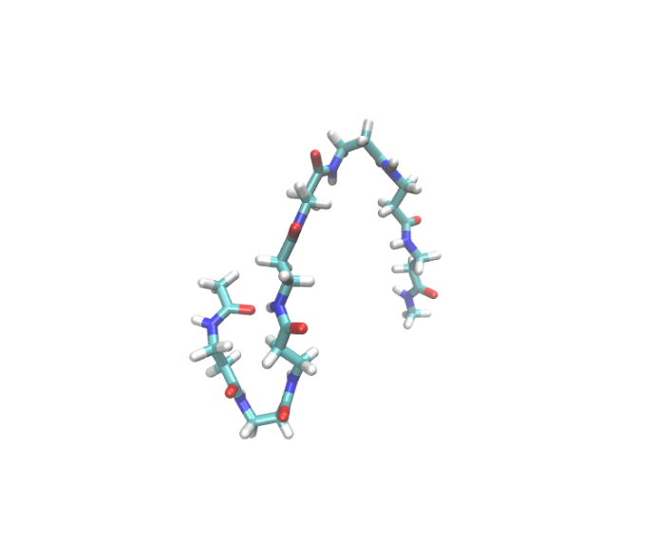
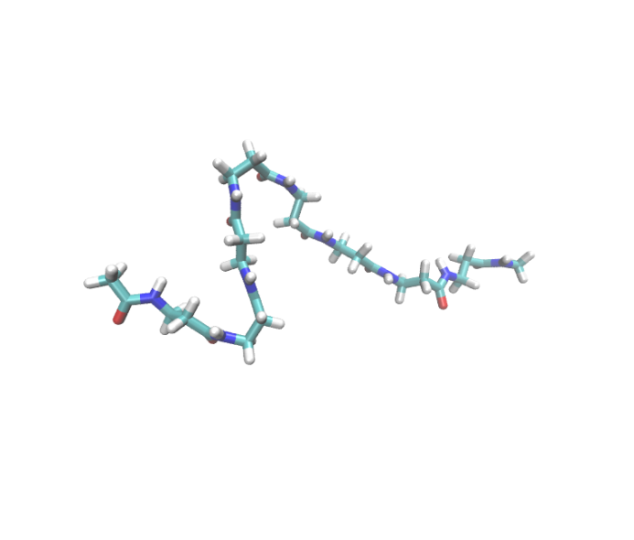
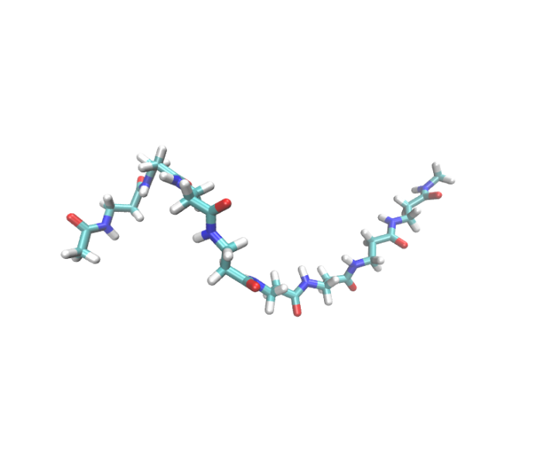
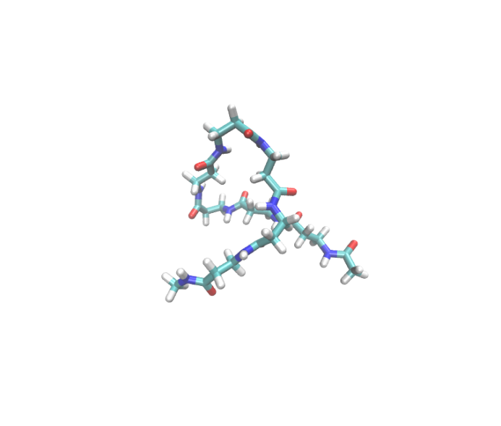
Representative conformations derived from explicit REMD (2)
globule
bent
bent
loose helical
twist

Slide 35
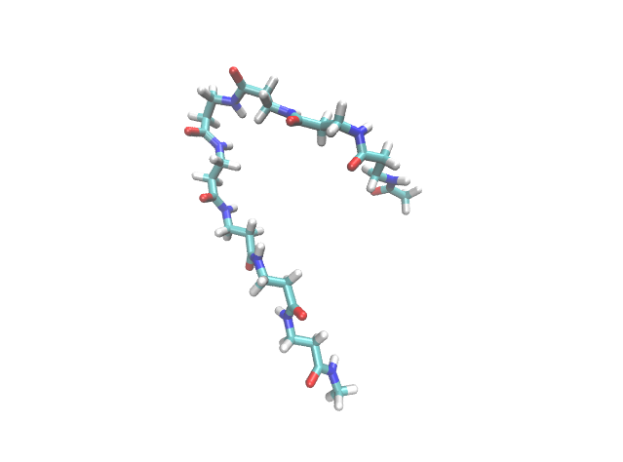
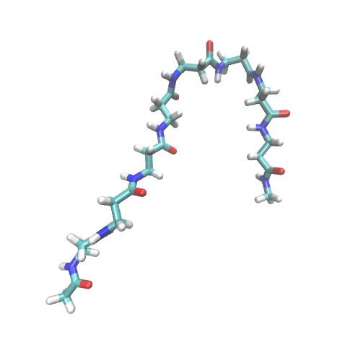
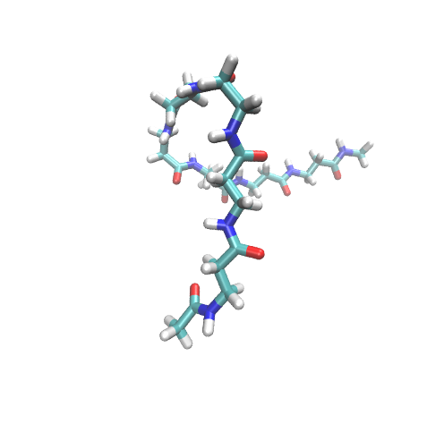
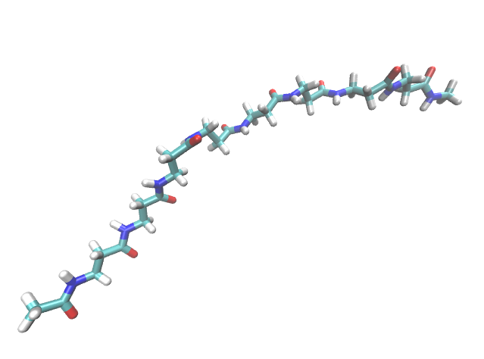
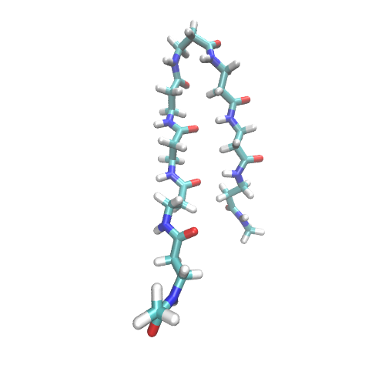
Representative conformations derived from implicit REMD (1)
hairpin
hairpin
twist
hairpin
extended

Slide 36
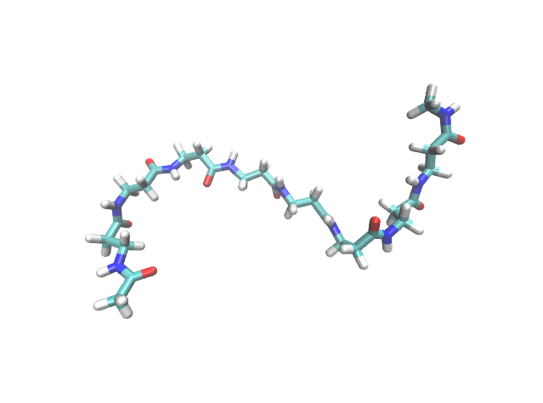
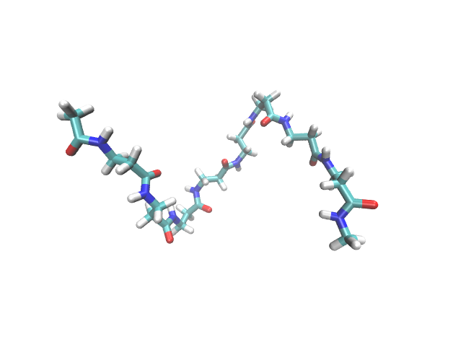
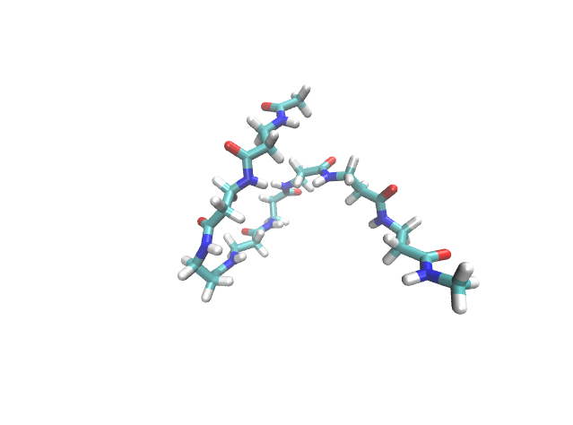
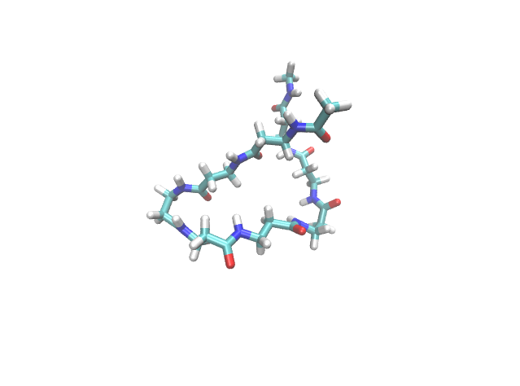
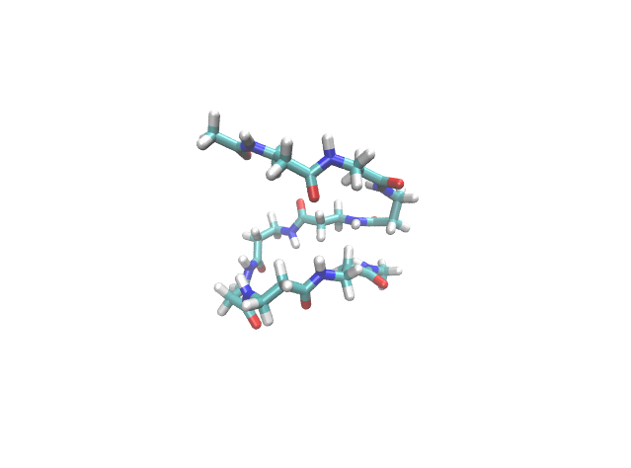
Representative conformations derived from implicit REMD (2)
loose helical
loose helical
turn (N-ter.)
twist
helical

Slide 37
Supporting Information

Slide 38
Insights derived from these calculations
Implicitモデルはexplicitモデルの代わりに…
というのは、なぜかと言うと…
(implicitとexplicit、replica数が違うものを単純に比較してよいものか?)
Explicitモデルを使うときの注意➔memoryの上限がある。18-merを扱うときは、系のサイズを大きくしないことか
Explict水モデルの温度セットがExplicitトルエンの温度セットにそのままトレースできるのはなぜかと言うと…

