Slide 1
FY2016 The 2nd CREST Workshop 2016, May 30
Test simulation of radical polymerization of methyl methacrylate by new version MC/MD reaction program
Masayoshi Takayanagi
Graduate School of Information Science, Nagoya University

Slide 2
Target system
Radical polymerization of methyl methacrylate (MMA)
Focus on the tacticity of product poly(methyl methacrylate) (PMMA)
Tacticity changes by doing the polymerization in PCP channels
Created new version programs for hybrid MC/MD reaction simulations
ReactionFinder program
TopologyEditor program (previously reported)
Now I can execute polymerization simulations (Monte carlo part is not yet implemented)
Test simulation of MMA radical polymerization in bulk

Slide 3
Propagation reaction of methyl methacrylate (MMA) radical polymerization
head
tail
Easy to attack without steric crowding
head-to-tail
~100%
Head-to-tail product is stabilized by resonance structure
head-to-head
~0%
Tacticity of poly(methyl methacrylate) (PMMA)
Bulk polymerization meso ratio 22%
Polymerization in PCP channel meso ratio 28%
Meso diad (m)
Racemo diad (r)
Macromolecules 2008, 41, 87–94.

Slide 4
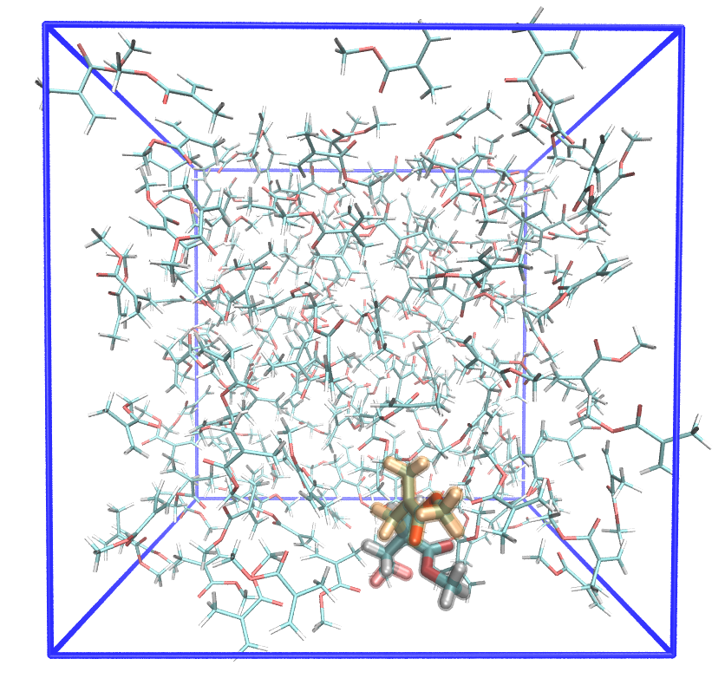
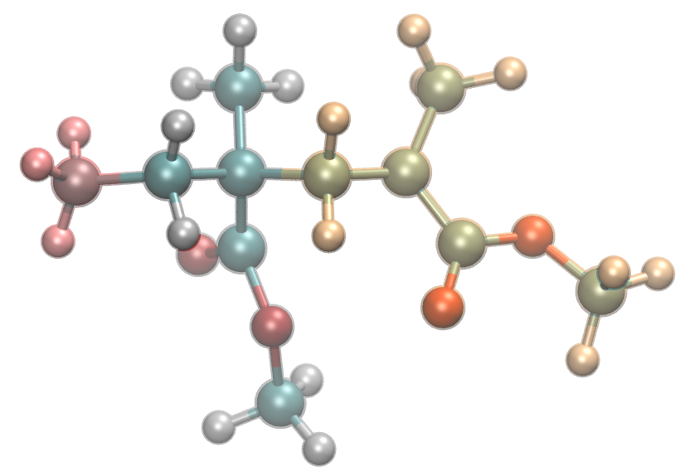
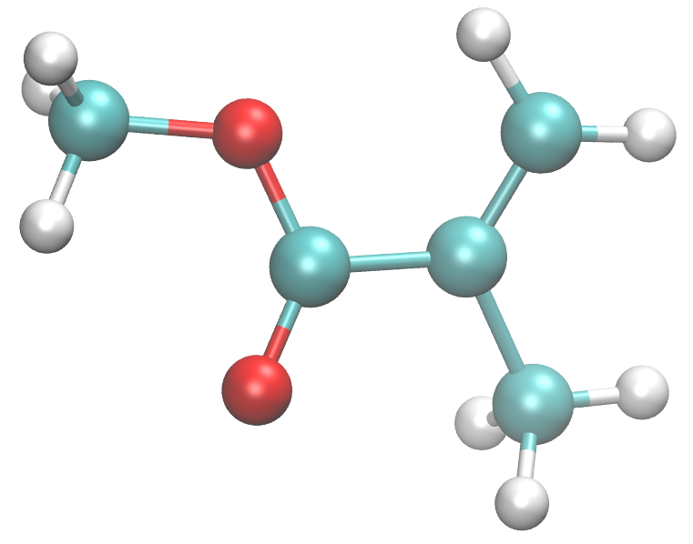
Test simulation of MMA radical polymerization in bulk
":" means residue, "@" means atom
MMA monomers
PMMA middle part （:mmm）
radical atom :mrd@C2
Terminal methyl group（:tmt）
Terminal radical part （:mrd）
Model radical
(:tmt :mmm :mrd)
model radical
sp2 carbon reacts with the radical atom :mma@C3
Test system
MMA monomer × 158
Model radical × 1
Periodic boundary box 30.8³ Å³
70 ℃ (343 K), 1 atm
NPT ensemble Monte Carlo barostat (barostat = 2)
MMA monomer （:mma）

Slide 5
Newly created program: ReactionFinder
Read structure → Prepare input file for TopologyEditor
ReactionFinder input script
inputTopology radMMA.top
inputInpcrd radMMA.crd true true
byStructure ReactID=1 Ea=3.0 \
"COND = distance(:mrd@C2; :mma@C3)<5.5" \ "ACTION = createBond :mrd@C2 :mma@C3 KEEP KEEP; \
ModifyResByPrepin :mrd mmm.prepin; \ ModifyResByPrepin :mma mrd.prepin"
__ENDscript__
Each instruction must be written in a single line (final \ means to ignore line-break)
:mma@C3
distance < 5.5 Å
:mrd@C2
tmt-mmm-mrd･ + mma → tmt-mmm-mmm-mrd･
propagation reaction

Slide 6
satList.txt （Satisfied reaction list）
ReactID=1, Ea=3.000000, t=0, selected=F, Values=3.801467{ （Values: distance）
createBond 58 843 KEEP KEEP （atom 58 (:mrd@C2) and atom 43（:mma@C5））
ModifyResByPrepin 6 mmm.prepin （update residue 6（:mrd）to :mmm）
ModifyResByPrepin 59 mrd.prepin （update residue 59（:mma）to :mrd）
}
ReactID=1, Ea=3.000000, t=0, selected=T, Values=5.284169{
createBond 24 858 KEEP KEEP
ModifyResByPrepin 3 mmm.prepin
ModifyResByPrepin 60 mrd.prepin
}
ReactID=1, Ea=3.000000, t=0, selected=F, Values=4.917879{
createBond 24 1728 KEEP KEEP
ModifyResByPrepin 3 mmm.prepin
ModifyResByPrepin 118 mrd.prepin
}
ReactID=1, Ea=3.000000, t=0, selected=F, Values=5.016987{
createBond 92 3603 KEEP KEEP
ModifyResByPrepin 9 mmm.prepin
ModifyResByPrepin 243 mrd.prepin
}
Found 4 reaction candidate, randomly choose one
selected.txt （Selected reaction, input for TopologyEditor）
#ReactID=1 Ea=3.000000 t=0
#Values=5.284169
# :mrd=3 :mma=60
# :mrd@C2=24 :mma@C3=858
inputInpcrd rad3MMA.crd true true
createBond 24 858 KEEP KEEP
ModifyResByPrepin 3 mmm.prepin
ModifyResByPrepin 60 mrd.prepin

Slide 7
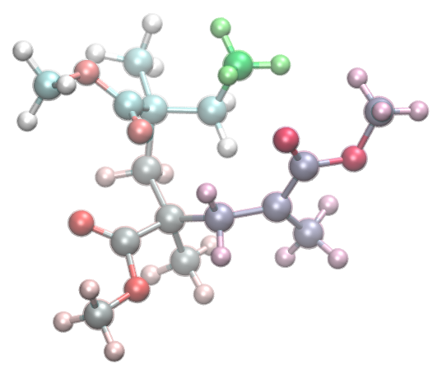
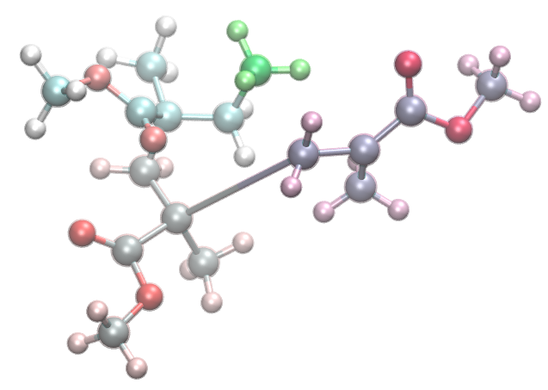
Add necessary information to "selected.txt" (red color),
prepare input script for TopologyEditor
inputTopology radMMA.top
outputTopology out.top
forceField /home/takayana/AMBER/amber12.i10.rcc205/dat/leap/parm/gaff.dat
forceFieldMod PMMA.trimerOpt.frcmod
#ReactID=1 Ea=3.000000 t=0
#Values=5.284169
inputInpcrd radMMA.crd true true
createBond 24 858 KEEP KEEP
ModifyResByPrepin 3 mmm.prepin
ModifyResByPrepin 60 mrd.prepin
:mmm
:tmt
@858
:mrd
(:60)
@24
:mmm
(:3)
After quenching MD
Only modified residues :3 and :60 were relaxed, other residues were fixed by harmonic constraint (ntr = 1)
Updated topology file by TopologyEditor
Create new bond

Slide 8
"mdcrd" can also be used as input (multiple structures)
inputTopology ../radMMA.top
inputMdcrd mdcrd 10 100 1 (initial 10, final 100, offset 1, 10,11,12, ... ,99,100)
byStructure ReactID=1 Ea=3.0
"COND = distance(:mrd@C2; :mma@C3)<5.5"
"ACTION = createBond :mrd@C2 :mma@C3 KEEP KEEP;
ModifyResByPrepin :mrd mmm.prepin; ModifyResByPrepin :mma mrd.prepin"
__ENDscript__
satList.txt
ReactID=1, Ea=3.000000, t=0, selected=F, Values=5.284169{
createBond 24 858 KEEP KEEP
ModifyResByPrepin 3 mmm.prepin
ModifyResByPrepin 60 mrd.prepin
}
ReactID=1, Ea=3.000000, t=1, selected=F, Values=4.935574{
createBond 24 858 KEEP KEEP
ModifyResByPrepin 3 mmm.prepin
ModifyResByPrepin 60 mrd.prepin
}
･･･
selected.txt
# ReactID=1 Ea=1.900000 t=44
# Values=3.522501
# :mrd=21 :mma=32
# :mrd@C2=294 :mma@C3=460
inputInpcrd out.inpcrd TRUE TRUE (out.inpcrd is created from "mdcrd" structure)
createBond 294 460 KEEP KEEP
ModifyResByPrepin 21 /share3/takayana/radPolyMMA/PMMAforcefield/mmm.prepin
ModifyResByPrepin 32 /share3/takayana/radPolyMMA/PMMAforcefield/mrd.prepin

Slide 9
Procedure of polymerization simulation
Start
Input files
・Initial topology file
・Initial inpcrd file
・Force field (force field mod) files
・Prepin files
・Python job file (test.py)
MD simulation
ReactionFinder
Simulation parameters
・Number of cycle = 500
・MD simulation condition 10 ps (dt = 2 fs, 5000 step) Write mdcrd every 100 step (0.2 ps) NPT ensemble (T = 343 K, P = 1 atm)
・Quenching MD condition dt = 0.2 fs, 250 step Harmonic restraint except for reacted 2 residues
・distance(:mrd@C2; :mma@C3)<3.3 for ReactionFinder
・Use mdcrd for ReactionFinder Initial 10 step (2 ps) is not used to find candidate
Reaction candidate
Not Found
Found
TopologyEditor
Monte Carlo (to be implemented)
Quenching MD

Slide 10
Console output of polymerization simualtion
START job in [/share3/takayana/python/testR1/job_test/job_test] at 160527-13:54:24
Cycle 00001
prmtop = /share3/takayana/python/testR1/mdinput/prmtop
inpcrd = /share3/takayana/python/testR1/mdinput/inpcrd
MD: START [mpirun -np 28 pmemd.pbb.MPI -O] at 13:54:24 in /share3/takayana/python/testR1/job_test/MD00001
MD: FINISH [mpirun -np 28 pmemd.pbb.MPI -O] at 13:54:29, elapsed 0:00:05.155288
ReactionFinder in /share3/takayana/python/testR1/job_test/MD00001
no candidate found
Cycle 00002
prmtop = /share3/takayana/python/testR1/mdinput/prmtop
inpcrd = /share3/takayana/python/testR1/job_test/MD00001/image.restrt
MD: START [mpirun -np 28 pmemd.pbb.MPI -O] at 13:54:29 in /share3/takayana/python/testR1/job_test/MD00002
MD: FINISH [mpirun -np 28 pmemd.pbb.MPI -O] at 13:54:34, elapsed 0:00:05.209219
ReactionFinder in /share3/takayana/python/testR1/job_test/MD00002
no candidate found
...
Cycle 00009
prmtop = /share3/takayana/python/testR1/mdinput/prmtop
inpcrd = /share3/takayana/python/testR1/job_test/MD00008/image.restrt
MD: START [mpirun -np 28 pmemd.pbb.MPI -O] at 13:55:06 in /share3/takayana/python/testR1/job_test/MD00009
MD: FINISH [mpirun -np 28 pmemd.pbb.MPI -O] at 13:55:11, elapsed 0:00:05.232596
ReactionFinder in /share3/takayana/python/testR1/job_test/MD00009
found candidate, ReactID=1, residues :mrd=3 :mma=129 at MDstep=12
TopologyEditor in /share3/takayana/python/testR1/job_test/MD00009
update prmtop file to /share3/takayana/python/testR1/job_test/MD00009/out.prmtop
Cycle 00010
prmtop = /share3/takayana/python/testR1/job_test/MD00009/out.prmtop
inpcrd = /share3/takayana/python/testR1/job_test/MD00009/image.restrt
Q : START [mpirun -np 28 pmemd.pbb.MPI -O] at 13:55:11 in /share3/takayana/python/testR1/job_test/quenchingMDs/Q00010
Q : FINISH [mpirun -np 28 pmemd.pbb.MPI -O] at 13:55:12, elapsed 0:00:00.999350
MD: START [mpirun -np 28 pmemd.pbb.MPI -O] at 13:55:12 in /share3/takayana/python/testR1/job_test/MD00010
MD: FINISH [mpirun -np 28 pmemd.pbb.MPI -O] at 13:55:18, elapsed 0:00:05.306393
ReactionFinder in /share3/takayana/python/testR1/job_test/MD00010
no candidate found

Slide 11
reaction.log
ReactNo=1, cycle=00009, ReactID=1, Residues=:mrd=3 :mma=129
ReactNo=2, cycle=00034, ReactID=1, Residues=:mrd=129 :mma=35
ReactNo=3, cycle=00036, ReactID=1, Residues=:mrd=35 :mma=118
ReactNo=4, cycle=00039, ReactID=1, Residues=:mrd=118 :mma=146
ReactNo=5, cycle=00054, ReactID=1, Residues=:mrd=146 :mma=57
ReactNo=6, cycle=00056, ReactID=1, Residues=:mrd=57 :mma=93
ReactNo=7, cycle=00074, ReactID=1, Residues=:mrd=93 :mma=123
ReactNo=8, cycle=00082, ReactID=1, Residues=:mrd=123 :mma=119
ReactNo=9, cycle=00083, ReactID=1, Residues=:mrd=119 :mma=26
ReactNo=10, cycle=00084, ReactID=1, Residues=:mrd=26 :mma=141
ReactNo=11, cycle=00086, ReactID=1, Residues=:mrd=141 :mma=45
ReactNo=12, cycle=00090, ReactID=1, Residues=:mrd=45 :mma=82
ReactNo=13, cycle=00110, ReactID=1, Residues=:mrd=82 :mma=22
ReactNo=14, cycle=00112, ReactID=1, Residues=:mrd=22 :mma=107
ReactNo=15, cycle=00128, ReactID=1, Residues=:mrd=107 :mma=81
...
ReactNo=31, cycle=00305, ReactID=1, Residues=:mrd=18 :mma=116
ReactNo=32, cycle=00307, ReactID=1, Residues=:mrd=116 :mma=115
ReactNo=33, cycle=00332, ReactID=1, Residues=:mrd=115 :mma=137
ReactNo=34, cycle=00342, ReactID=1, Residues=:mrd=137 :mma=160
ReactNo=35, cycle=00367, ReactID=1, Residues=:mrd=160 :mma=52
ReactNo=36, cycle=00369, ReactID=1, Residues=:mrd=52 :mma=69
ReactNo=37, cycle=00371, ReactID=1, Residues=:mrd=69 :mma=126
ReactNo=38, cycle=00382, ReactID=1, Residues=:mrd=126 :mma=161
ReactNo=39, cycle=00386, ReactID=1, Residues=:mrd=161 :mma=49
ReactNo=40, cycle=00388, ReactID=1, Residues=:mrd=49 :mma=127
ReactNo=41, cycle=00406, ReactID=1, Residues=:mrd=127 :mma=36

Slide 12
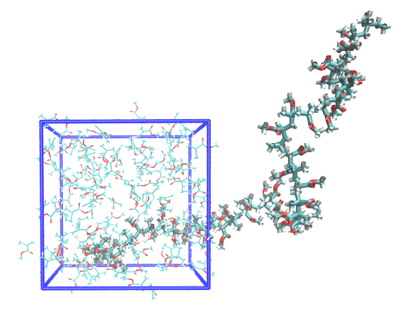
Final snapshot

Slide 13
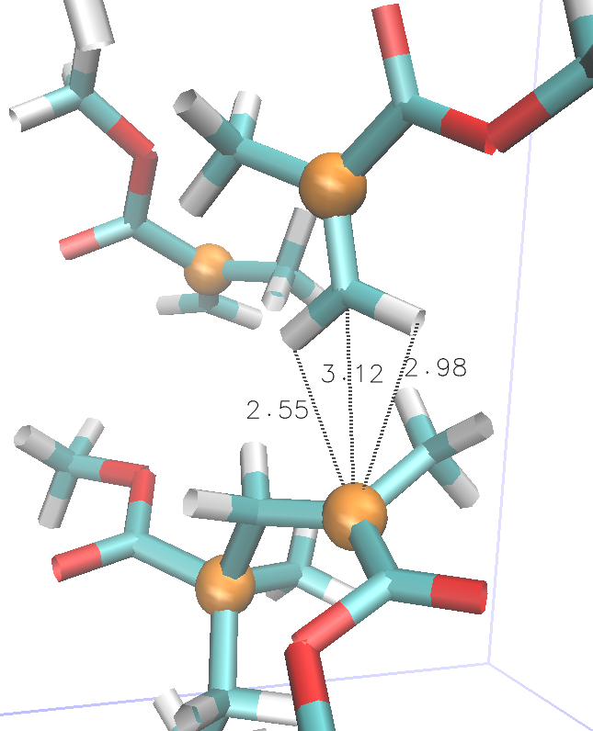
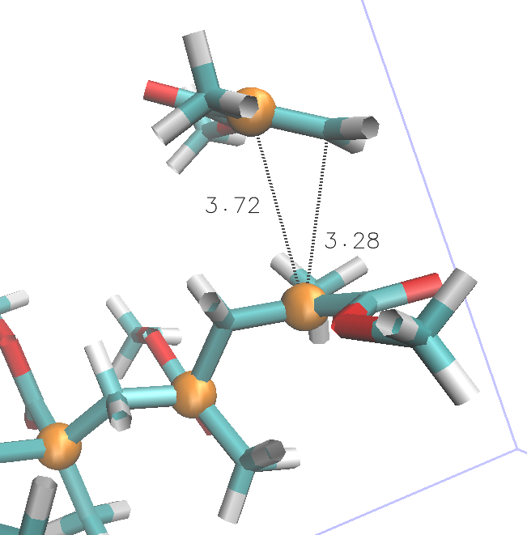
C2原子（オレンジ球）間 4.46 Å
reaction
17615 17700 18308 18504 18568 19428
testR1 t=17615 :mma(:52)-:mrd(:160)
testR1 t=19428 :mma(:36)-:mrd(:127)

