Slide 1
FY2016 7th CREST WS
Dec. 13, 2016
Toward Improving Enzymatic Polymerization Reaction Simulation:
Evaluation of Performance of Enhanced Sampling Methods in the Context of MC/MD Reaction Method
Ikuo KURISAKI

Slide 2
Today’s contents
Research background
Achievements and problems we’re facing
Evaluation of enhanced sampling methods
Summary

Slide 3
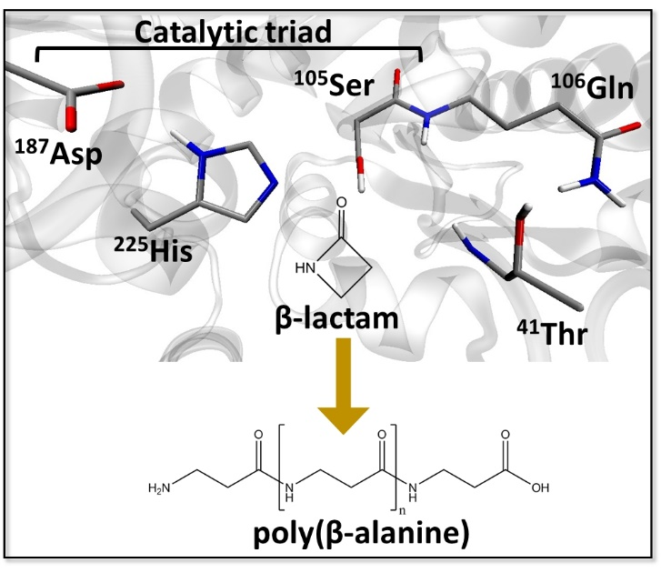
Research background
Enzyme catalyzed polymerization reaction has drawn attention in the field of green chemistry.
Candida Antarica Lipase B (CALB) has long been studied in this purpose.
This enzyme catalyzes polymerization of β-lactam to generate poly(β-alanine), nylon-3.
However, this reaction system has rooms to be improved because the product do not satisfy industrial quality, as for the length and yield.
The illustration is gifted from Dr. Barberot.

Slide 4
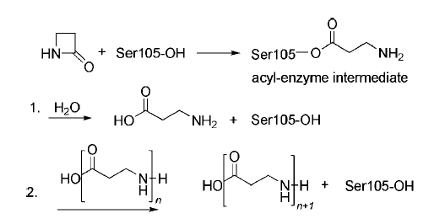
When N-terminal of poly (β-alanine) approaches Oγ of Ser105 in acyl-enzyme intermediate, the polymer elongation reaction occurs
(A) CALB forms acyl-enzyme intermediate via β-lactam ring opening reaction.
(B) β-alanine is generated from hydrolysis reaction of the acyl-enzyme intermediate.
(C) Poly (β-alanine) is elongated via reaction between polymer and acyl-enzyme complex.
Scheme 2. The proposed pathway of the ring-opening polymerization. The acyl-enzyme intermediate is formed and attacked. (1) By water to release β-alanine. (2) By a growing oligomer (n.1, 2, . . .) to yield the poly(β-alanine).
dimer formation
trimer formation
(A)➔(B)➔(A)➔(C)➔(A)➔(C)➔…
Ref. Schwab L. et al., Macromol. Rapid Commun., 2008, 29, 794-797:

Slide 5
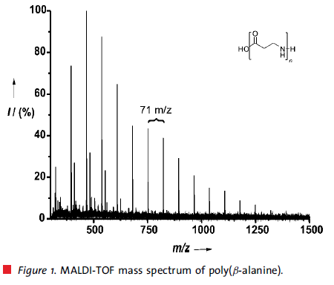
Issue we are addressing
Degree of polymerization (DP) is insufficient for industrial usage
With conventional methods:
Average DP: 24 mer; Maximum DP: 58 mer
With CALB catalyzed poly(β-alanine) synthesis:
Average DP: 8 mer; Maximum DP: 18 mer
➔ Polymer generated by using CALB is still shorter by three times.
Toward the industrial usage of CALB, ‘optimizing reaction condition’ and/or ‘redesigning CALB as biocatalyst’ are indispensable.
Insights into the reaction mechanism would provide strategies to address the problems.
6-mer
8-mer (average)
18-mer (maximum)
Ref. Schwab L. et al., Macromol. Rapid Commun., 2008, 29, 794-797:

Slide 6
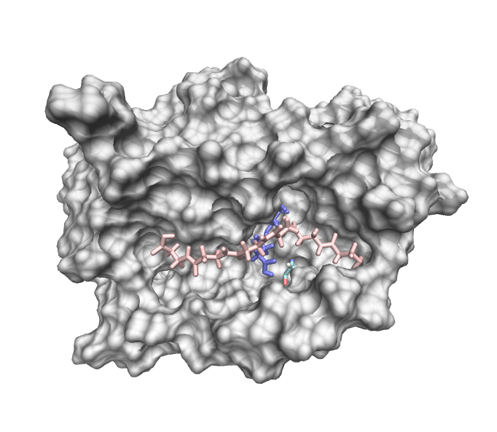
Achievements and problems we’re facing
Using MC/MD simulation, hexamer is generated so far. However, polymer extension does not continue anymore.
Ser105 behind the surface
15 Å
2916th cycle
N-terminal
Snapshot structure at the last cycle

Slide 7
Problem is the N-terminal is away from Serine 105
Ser105 behind the surface
Polymer elongation would not continue in this simulation.
This should be due to that the N-terminal of the hexamer is distant by 15 Å from Ser105.
15 Å
N-terminal
Is there an alternative strategy to promote polymer reorientation?

Slide 8
How can we implement polymer reorientation?
start
Configuration state s
Enough conditions
for chemical reactions?
NO
MD simulation
YES
Randomly select a chemical reaction
according to a relative weight R ~ exp(-βE_{a})
(1) Accelerate relaxation simulation to search broader conformational space
Calculate the potential energy U_{s}
Reject configuration state r
Produce the chemical reaction,
relaxing the whole system (MD simulation)
(2) Add acceleration simulation as a “reaction”
Calculate the potential energy U_{r}
NO
ΔU_{rs}(= U_{s} - U_{r}) < 0
NO
exp(-βΔU_{rs}) < η(=[0,1])
YES
YES
Accept configuration state r
NO
Equilibrium state?
YES
stop
*The above chart is derived from “How to Use Red Moon Method” made by Mr. Suzuki.

Slide 9
How can we move the N-terminal toward Serine 105?
Ser105 behind the surface
It is possible to pull the N-terminal toward Ser105, technically.
However, it is not easy, rather quite difficult to give an appropriate activation barrier of this process.
This ad hoc process could not fit in MC/MD reaction scheme, accordingly.
15 Å
N-terminal
Is there an alternative strategy to promote polymer reorientation?

Slide 10
Evaluation of enhanced sampling methods
Amber molecular dynamics package offers
Replica Exchange Molecular Dynamics
Accelerated Molecular Dynamics

Slide 11
Replica exchange molecular dynamics (REMD) simulation
The basic idea is to enhance escape rate from potential wells by random walk on temperature space
[1] A. Mitsutake et al. Biopolymer, 2001, 60, 96-123;
[2] http://www.weizhang.us/replica-exchange-simulation/

Slide 12
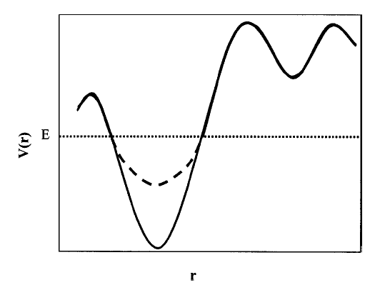
Accelerated molecular dynamics (aMD) simulation
The basic idea is to enhance escape rate from potential wells by adding boosting potential
FIG. 1. Schematic representation of the normal potential (solid line), the biased potential (doted line), and the threshold boost energy, E. (from Ref. with slight modification)
Ref. Hamelberg D et al., J. Chem. Phys., 2004, 120, 11919-11929

Slide 13
Enhanced sampling methods have been widely tested for α-peptide systems
β-peptide
‘R=H’ corresponds to Poly(β-alanine)
R
Cα
N
O
H
H
n
H
Cβ
O
α-peptide
We can use well-developed force field parameters
O
Cα
N
H
H
O
n
H
Cβ
R

Slide 14
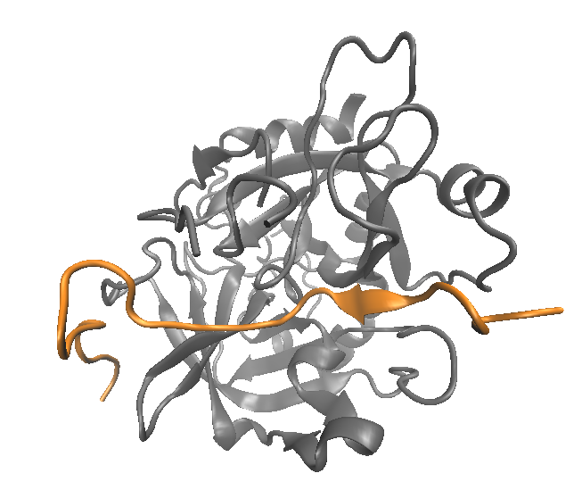
The two enhanced sampling methods are applied to examine an α-peptide folding
A subject is to examine performance of conformation search.
Thrombin-protease activated receptor 1 extracellular fragment (PAR1) complex
PAR1 assumes extended conformation in the complex form.
Meanwhile, it should be folded in free form to earn thermodynamic stability.
Enhanced sampling should provide insights into PAR1 folding.
Besides, we could know which method is advantageous in our purpose through comparison of their performance.
PAR1

Slide 15
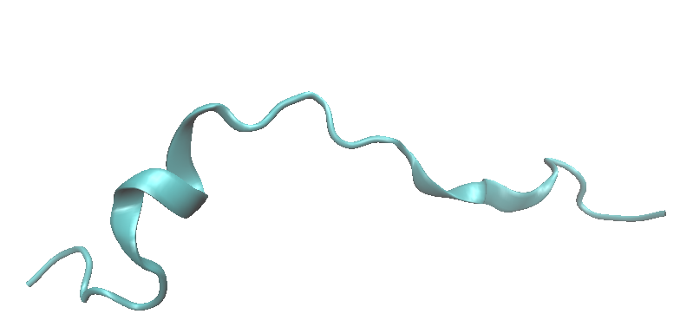
Simulation conditions for aMD
PAR-1 in extended conformation*
100-ns MD
2000-ns aMD
This time domain is used for calculation of E_{d}.
Simulation set up
Force field parameter: Amber14SB, JC ion parameter
Simulation condition: NPT (1 [bar]; 300 [K])
Water: 6443 SPC/E water model
Ions: 140 mM NaCl (18 Na⁺: 15 Cl⁻)
aMD parameters
E_{d} = 503.1
α_{D} = 21
*The three kinks are due to Proline residues.

Slide 16
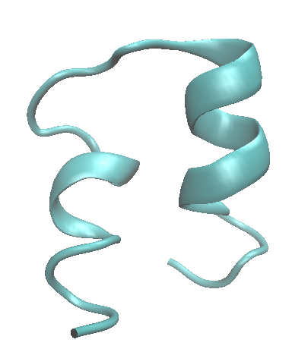
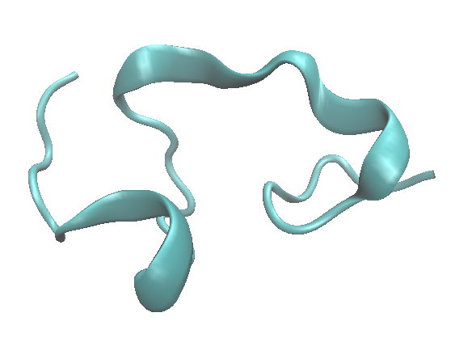
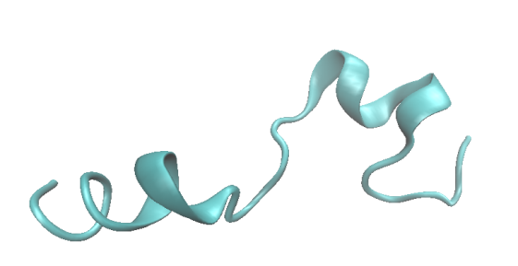
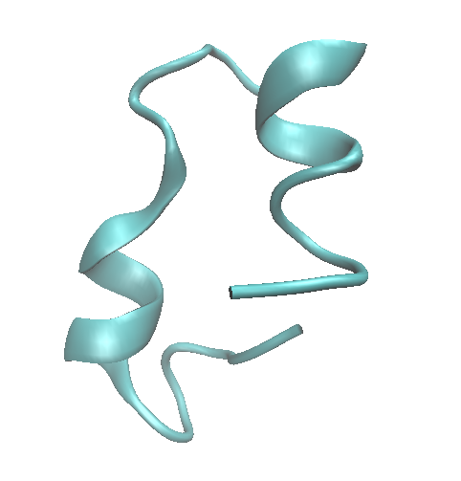
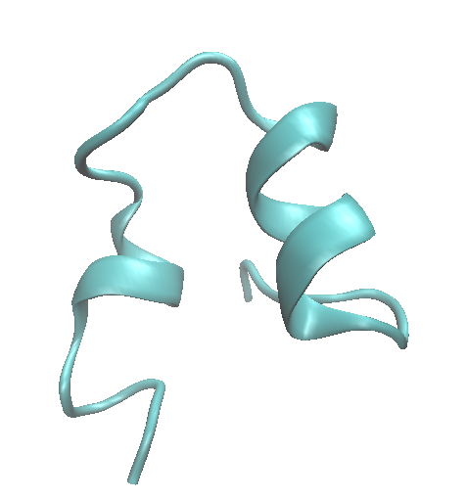
Helical conformations derived from aMD
900 ns
250 ns
1250 ns
0 ns
600 ns
2000 ns

Slide 17
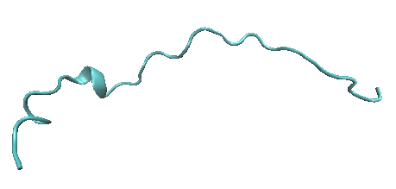
Simulation conditions for REMD
PAR-1 in extended conformation*
500 ns
Pick up a snapshot structure showing 1.0 [bar]
25-ns REMD
82 replicas
*ca 2000 ns in total
Simulation setup
Force field parameter: Amber14SB, JC ion parameter
Simulation condition: NPT (1 [bar]; 300 [K]) for MD; NVT for REMD
Water: 6443 SPC/E water model
Ions: 140 mM NaCl (18 Na⁺: 15 Cl⁻)
REMD parameters
The number of replica: 82
Temperature range: 273~638 [K]
Exchange attempt: 25000 times
MD length before exchange attempt: 1 ps
Exchange rate between neighboring replicas: 13~30 %
*The three kinks are due to Proline residues.

Slide 18
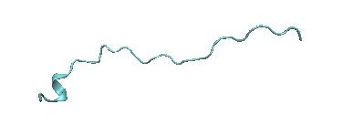
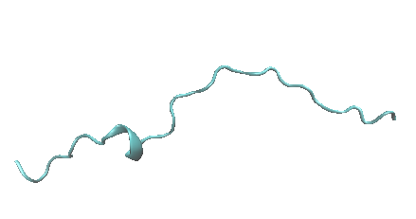
PAR1 assumed extended conformation at 298.77 K after REMD simulation
15 ns
0 ns
25 ns

Slide 19
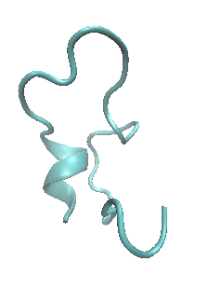
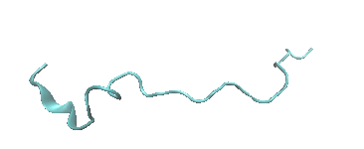
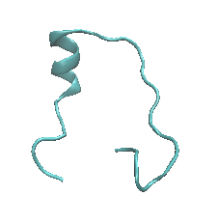
Conformations at 398.3 K after REMD simulation
20 ns
15ns
25 ns

Slide 20
aMD seems to be more efficient than REMD in this case
Why is REMD less efficient in this case?
Replica walking on temperature space could contribute to delay of conformational sampling; this might become more serious if the number of replica gets greater

Slide 21
Can REMD and aMD be employed in the context of MC/MD simulation?
Although REMD performance could be improved, aMD would be still better to employ in MC/MD simulation.
Advantage of aMD!!
Besides, compared with REMD, aMD might be faster to sample high energy conformations, in shorter timescale MD simulation.

Slide 22
Where do we implement it?
Where do we implement it?
start
Configuration state s
Enough conditions
for chemical reactions?
NO
MD simulation
Accelerate relaxation simulation
➔ It could be possible to employ aMD.
YES
Randomly select a chemical reaction
according to a relative weight R ~ exp(-βE_{a})
Calculate the potential energy U_{s}
Reject configuration state r
Produce the chemical reaction,
relaxing the whole system (MD simulation)
(2) Add acceleration simulation as a “reaction”
➔It is quite difficult to define “reaction weight”.
This difficulty holds to both aMD and REMD.
Calculate the potential energy U_{r}
NO
ΔU_{rs}(= U_{s} - U_{r}) < 0
NO
exp(-βΔU_{rs}) < η(=[0,1])
YES
YES
Accept configuration state r
NO
Equilibrium state?
Is there any other option to enhance dynamics, which is added as reaction?
YES
stop
*The above chart is derived from “How to Use Red Moon Method” made by Mr. Suzuki.

Slide 23
Site-directed dihedral angle (DHA) reorientation could be available
Computational procedure consists of two steps:
Pick up a DHA
Replace the value with alternative one
This procedure could be implemented as a reaction because it is possible to estimate an activation barrier of such reorientation.
The further discussion will be given in the NCUBE seminar on 12/20.

Slide 24
Summary
We have to accelerate polymer dynamics.
Acceleration of diffusion as relaxation
Employing aMD
Using faster MD engine, pmemd
Acceleration of reorientation as reaction
Site-directed DHA reorientation
The former is easier to implement, so that we will try it first.

Slide 25
Thank you for your attention

Slide 26
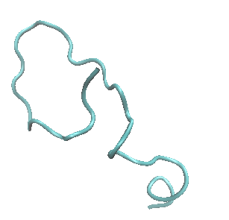
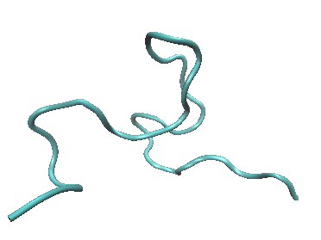
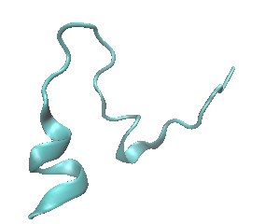
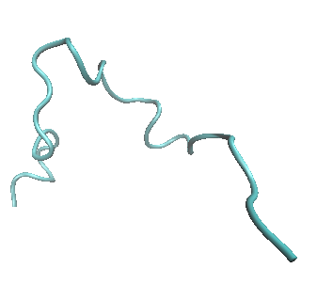
At 500.96 K after REMD simulation
20 ns
15 ns
10 ns
25 ns

Slide 27
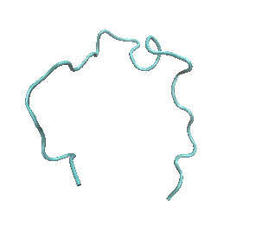
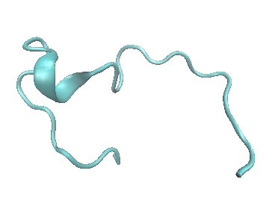
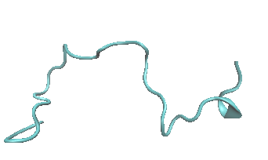
PAR1 assumed partially helical conformation at 638.1 K after REMD simulation
15 ns
5 ns
25 ns

Slide 28
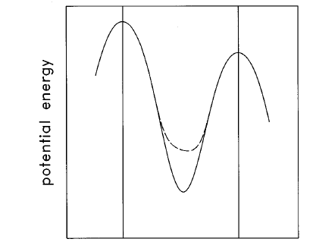
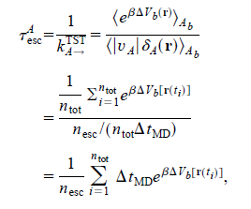
Re-scaling of time step under biased potential
v_{A}
FIG. 1. Schematic illustration of a one-dimensional potential V (solid line) defining state A, and the biased potential V+ΔV_{b} (dashed line), which defines state A_{b} . The potentials are equivalent at the TST boundaries (indicated by vertical lines), so the relative probability of escape to the left vs right is the same for both states, although the escape rates are enhanced for state A_{b}.
[Ref] Voter J. Chem. Phys., 106, 4665 (1997)

Slide 29
A replica does not walk around temperature space sufficiently.
This replica does not visit higher temperature region.
This replica does not visit lower temperature region.

Slide 30
Replica at higher temperature does not arrive at lower temperature
[1] A. Mitsutake et al. Biopolymer, 2001, 60, 96-123;
[2] http://www.weizhang.us/replica-exchange-simulation/

Slide 31
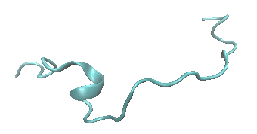
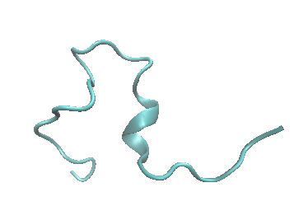
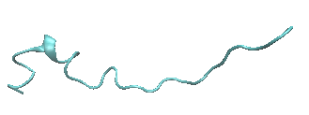
At 349.89 K after REMD simulation
20 ns
15ns
25 ns

Slide 32
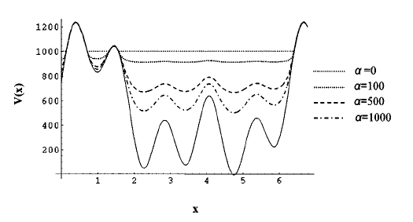
Effects of boosting factor on biased potential
FIG. 3. Schematic representation of a hypothetical potential energy function and several bias potentials plotted at various values of a, and at a relative high value of the threshold boost energy, E.
Ref. Hamelberg D et al., J. Chem. Phys., 2004, 120, 11919-11929

