Slide 1
FY2015 8th CREST WS
Feb. 18th, 2016
Replica Exchange Molecular Dynamics of β-alanine octamer in toluene solvent
Ikuo KURISAKI

Slide 2
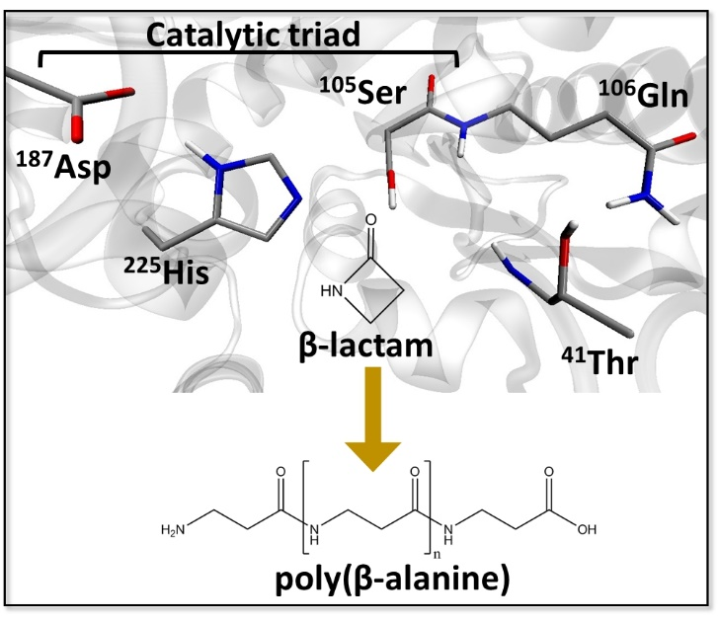
Research background
Enzyme catalyzed polymerization reaction has drawn attention in the field of green chemistry
Candida Antarica Libase B (CALB) has long been studied in this purpose
This enzyme catalyzes polymerization of β-lactam to generate poly(β-alanine), nylon-3
However, this reaction system has rooms to be improved because the product do not satisfy industrial quality, as for the length and yield
From 4th CREST WS
The illustration is gifted from Dr. Barberot.

Slide 3
Problem setting
Polymer length must influence polymer elongation reaction.
From 4th CREST WS
with modification
CALB
water
Ser¹⁰⁵-OH
Ser¹⁰⁵-O
Poly(β-alanine)
β-lactam
We can examine the effect of polymer length on the reaction by analyzing conformation of the polymer.

Slide 4
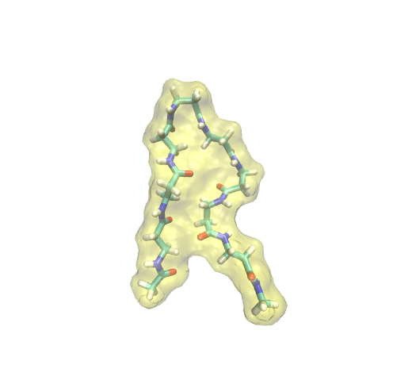
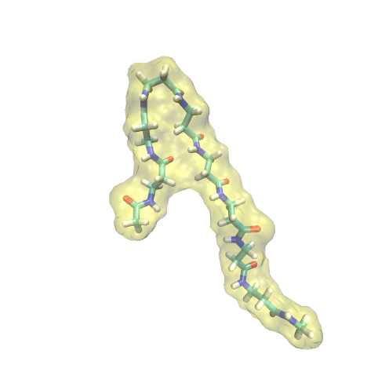
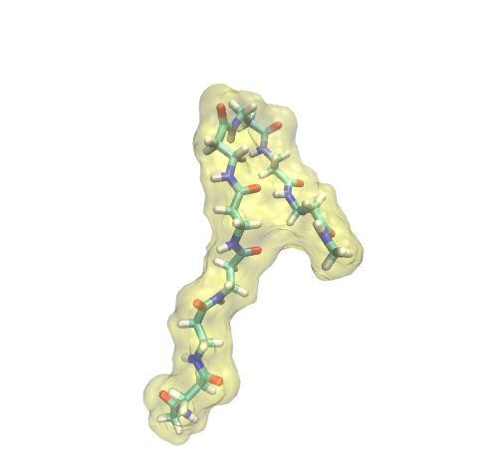
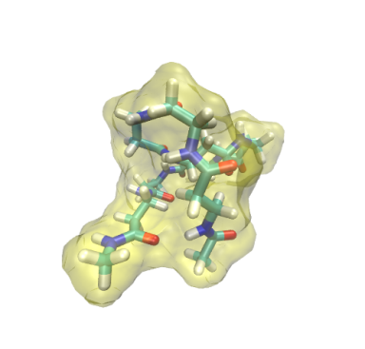
Representative conformations derived from REMD with explicit water @ 300K
extended
hairpin
turn@βAla3
turn@βAla6
globule
Averaged # of HB: 0.07
(total 45,000 conf.)
➔ Supported by the earlier experimental study¹
[1] J. D. Glickson and J. Applequist. J.A.C.S., 1971, 93, 3276-3286

Slide 5
Summary for representative conformations
Major conformation!!
conformation | frequency [%]
extended | 86.9
hairpin | 6.2
turn@βAla3 | 4.3
turn@βAla6 | 2.5
globule | 0.1
Extended conformation occupies > 80% of the conformation ensemble.
This results can be reasonable, physico-chemically.
A solute can be energetically stabilized forming hydrogen bonds with polarized solvent molecules.

Slide 6
Suggestions at 6th CREST WS
Takayanagi-san
➔ Should the potential energy be compared between QM and MM calculation? It is not trivial that MM energy properly describes QM potential surface.

Slide 7
Today’s contents
Comparison of potential energy between QM and MM calculations
Replica exchange molecular dynamics for poly(βAlanine)₈
Subroutine to count the number of βlactam in CALB active site: toward improving acceptance rate of chemical reaction

Slide 8
Evaluation of MM potential energy
Table 1. QM derived potential energy [kcal/mol]
representative conformation† | conformation type
 | extened | hairpin | turn@bAla3 | turn@bAla6 | globule
average | -1397587.1 | -1397598.2 | -1397594.4 | -1397593.9 | -1397596.9
standard deviation | 0.2 | 5.1 | 3.2 | 2.0 | 5.3
relative | 0.0 | -11.0 | -7.3 | -6.7 | -9.8
˃
Calculation level: B3LYP/6-31+G(d) in vacuum
Table 2. MM derived potential energy [kcal/mol]
representative conformation† | conformation type
 | extened | hairpin | turn@bAla3 | turn@bAla6 | globule
average | -555.2 | -563.8 | -560.3 | -560.9 | -571.8
standard deviation | 0.1 | 3.0 | 3.6 | 2.4 | 5.4
relative | 0.0 | -8.6 | -5.1 | -5.7 | -16.6
˃
Extended is less stable than the other four conformations
As for the four conformations, the order of energetic stability is not consistent between QM and MM derived potential energy
*Five representative conformations were used for each of QM and MM calculation.

Slide 9
Remarks for usage of the force field
General Amber Force Field (GAFF) can describe the difference between extended and the other conformations in terms of potential energy
Meanwhile, this force field parameter could not reproduce the order of potential energy with regard to the other non-extended conformations
However, this shortage would be ignorable because it is important whether the polymer assumes extended conformation or not, as discussed below
I conclude that GAFF is available for conformation sampling. Meanwhile, it is shelved to confirm the convergence of REMD simulation. This is because GAFF could not describe the potential energy among non-extended conformation, properly.

Slide 10
Today’s contents
Comparison of potential energy between QM and MM calculations
Replica exchange molecular dynamics for poly(βAlanine)₈
Subroutine to count the number of βlactam in CALB active site: toward improving acceptance rate of chemical reaction

Slide 11
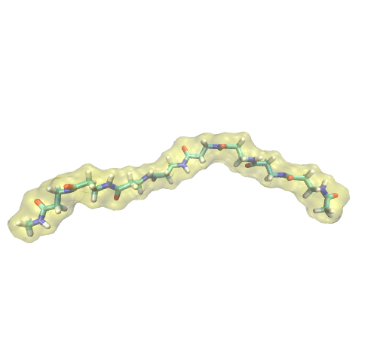
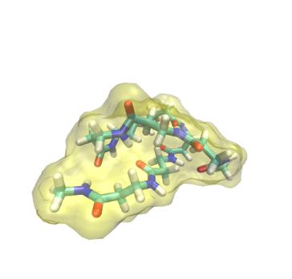
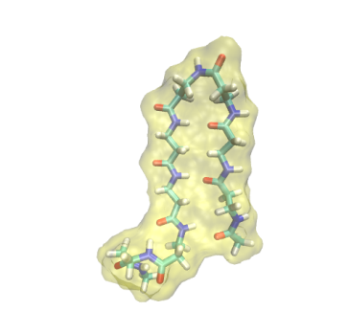
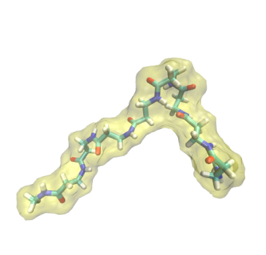
REMD simulation of βAla₈ in toluene @ 374 K
partially
extended
full
extended
globule
hairpin
In contrast to REMD with water solvent, the folded conformations mainly appear.
In non-polarized solvent, a polymer mainly assumes folded conformation with intramolecular hydrogen bonds, so that our results seems to be reasonable.

Slide 12
Suggestion on polymerization reaction
Assuming extended conformation is energetically preferable in CALB active site
However, as shown in our REMD simulation, the polymer should assume non-extended conformation in toluene solvent
Once the polymer moves to solvent, it forms non-extended conformation and rarely comes back to the active site
Anchoring polymer to the entrance of the active site could improve the average length of polymer generated by CABL.

Slide 13
Today’s contents
Comparison of potential energy between QM and MM calculations
Replica exchange molecular dynamics for poly(βAlanine)₈
Subroutine to count the number of βlactam in CALB active site: toward improving acceptance rate of chemical reaction

Slide 14
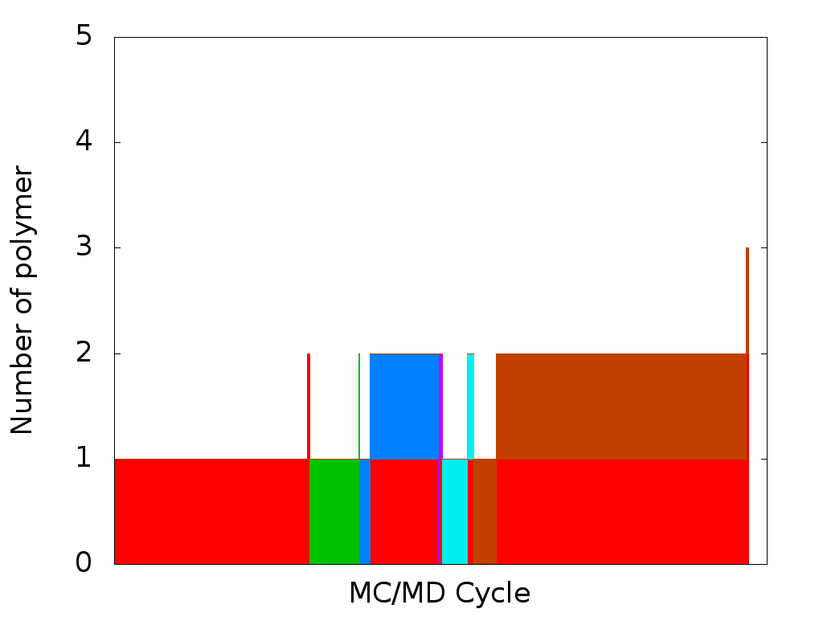
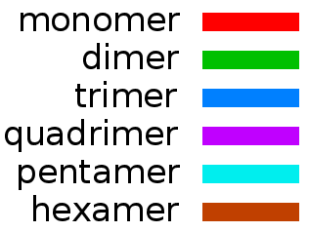
The latest achievement of MC/MD simulation
Dr. Barberot succeeded to simulate 6-mer formation!!
Nonetheless, the average polymer length is 8-mer
If we can reproduce 8-mer formation, it is possible to say that MC/MD method can simulate the average behavior of this polymerization reaction, thus being more reliable.
The Figure is gifted from Dr. Barberot.

Slide 15
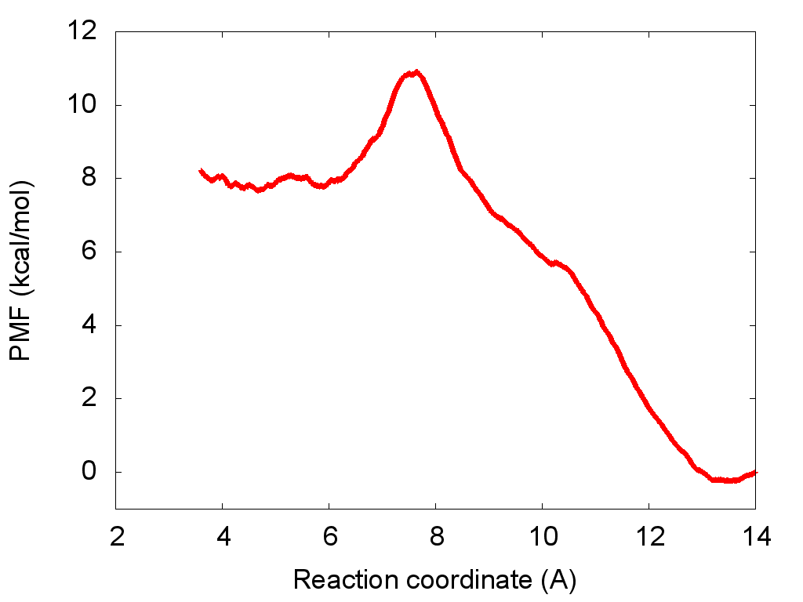
Toward reproducing 8-mer
On-going mission:
We’re now addressing to reproduce 8-mer or longer polymer
Problem:
Ligand-binding reaction take precedence over other reactions, so that it is frequently chosen in MC/MD cycles. This retards polymerization reaction as a whole.
Solution:
The excessive selection of ligand-binding reaction should be corrected. Actually this reaction has activation barrier (see the left panel) so that it should compete with other reactions.
This is the case of one-ligand binding. If ‘more ligands’ are in CALB active site, the activation barrier should be increased.
The Figure is gifted from Dr. Barberot.

Slide 16
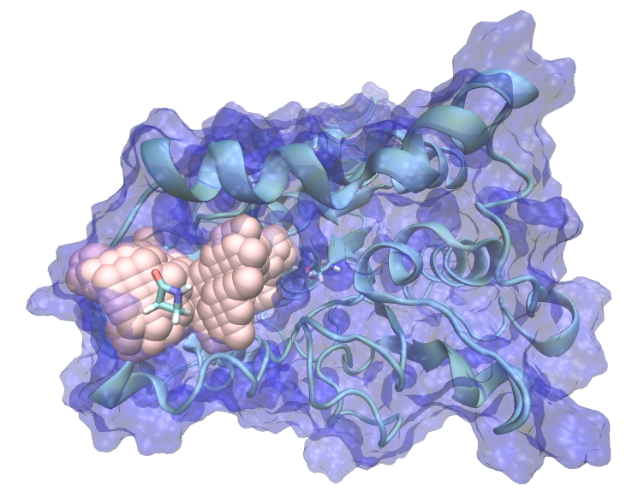
Procedure to count the number of β-lactam in CALB active site
The subroutine consists of the following three steps:
Generate grid points representing CALB active site
Detect β-lactam molecules in CALB active site
Return the number of β-lactam in CALB active site
*In the step-1, we execute POVME program to generate grid points
Ser106, the catalytic residue
In active site
In bulk solvent
Grid points were illustrated in pink vdW sphere
one ligand
activation energy
no ligand
β-lactam
Reaction coordinate

Slide 17
Package construction
Input
‘PDB file generated at the last MC/MD step’
Package
count_monomer_in_pocket.pyw
Module
edit_pdb_with_cpptraj.pyc
import
find_monomer_in_pocket.pyc
generate_grid_points.pyc
PDB file
POVME.py
grid point file
Output
Stand alone program developed by J. Durrant
http://nbcr.ucsd.edu/data/sw/hosted/POVME/
‘# of b-lactam in CALB active site’ (integer) & ‘residue numbers’ (list)

Slide 18
Plan to implement the subroutine in MC/MD program
Activation energy of ligand binding process is replaced with a variable, which depends on the number of β-lactam in CALB active site
Subroutine is called if ligand binding process is chosen: “select_react_func.sh” would be modified.
Or, update the activation energy every MC/MD cycle? This could cause time delay of several seconds would cause per cycle.

Slide 19
Thank you for your attention!!

Slide 20
Supporting Information

Slide 21
Summary for representative conformations
Such structural flexibility could be mainly attributed to rotation of Cα-Cβ (see the panel below).
hairpin
turn@βAla3
turn@βAla6
globule
extended
β-alanine
Cα
N
O
H
H
H
n
Cβ
O

Slide 22
Assessing separation between clusters with Davies-Bouldin Index (DBI) with regard to REMD with explicit toluene

