Slide 1
Fri. Mar. 18th
FY2015’s 9th, CREST Workshop
SEI Film Formation Simulation
in Na-Ion Batteries with Highly Concentrated Electrolyte
Norio Takenaka^{1,2}
Graduate School of Information Science, Nagoya University¹,
Elements Strategy Initiative for Catalysts and Batteries (ESICB), Kyoto University²

Slide 2
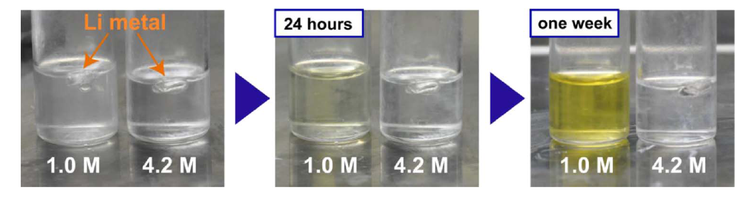
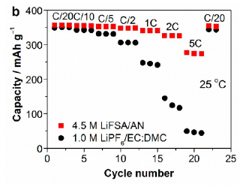
Stability of Highly Concentrated Electrolyte
good
bad
Fig. 1 Reactivity of Li metal and LiTFSA/AN solutions at 1.0 M and 4.2 M at room temperature.
Fig. 2 Reversible capacity
Superconcentration solutions are emerging as a new class of liquid electrolytes with various unusual functionalities for advanced battery applications [1,2].
It was reported that a highly concentrated acetonitrile (AN) solutions (> 4 M) shows the enhanced reductive stability in lithium-ion batteries.
[1] Y. Yamada et al., J. Am. Chem. Soc., 136, 5039 (2014).
[2] Y. Yamada et al., J. Electrochem. Soc., 162, A2406 (2015).
Notes:
First, I talk about the background of this study. Superconcentration solutions are emerging as a new class of liquid electrolytes because they have various unusual functionalities for advanced battery applications. As one of example, Figure 1 shows the reactivity of lithium metal and LiTFSA/AN solutions at 1 M and 4.2 M at room temperature. In this experiment, the authors put the lithium metal into the electrolyte, and observed the color change. As you can see, after one week, 1 M electrolyte shows the yellow color, showing the electrolyte continue to be decomposed on the lithium metal. On the other hand, at 4.2 M, there is no color change because the stable SEI film was formed on the lithium metal. And, Figure 2 shows the reversible capacities by using 4.5 M LiFSA/AN electrolyte and 1 M LiPF6/EC:EMC electrolyte. As a result, in the high concentration electrolyte, the capacity change was stable, so the irreversible capacity drastically decreased.

Slide 3
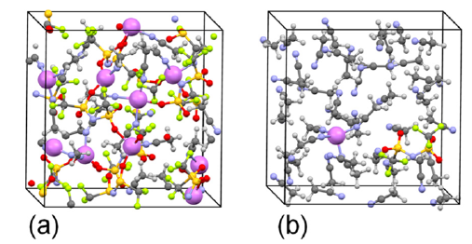
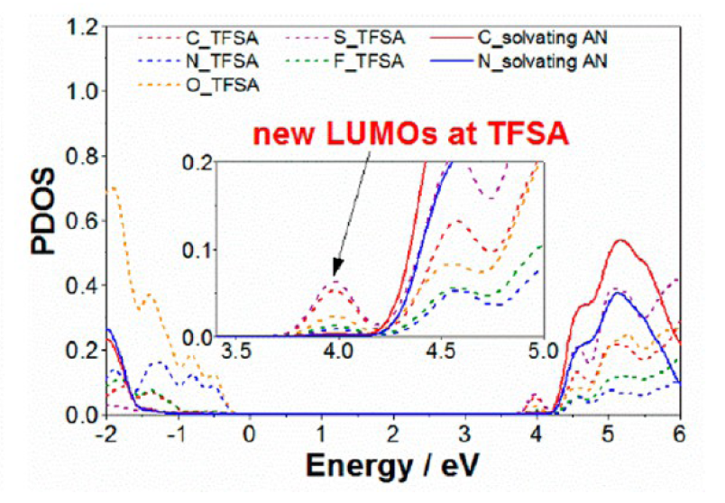
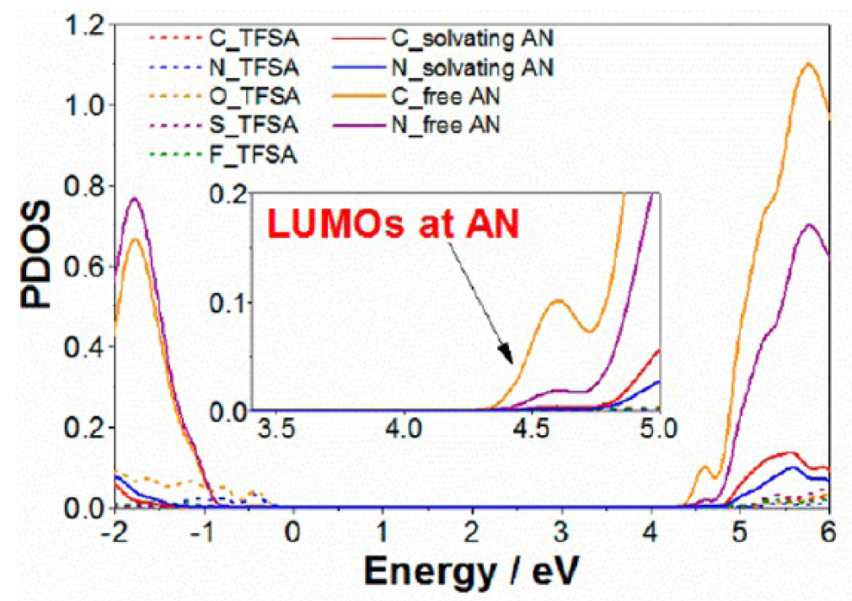
Previous DFT-MD Study
(a)
(b)
Fig. 3. Supercells used in DFT MD simulations at (a) 4.2 M and (b) 0.4 M TFSA/AN electrolyte.
Fig. 4. Projected density of states (PDOS) at (a) 4.2 M and (b) 0.4 M.
DFT-MD study shows the TFSA anions sacrificially accept the reductive electron at high concentration condition, which is ascribe to the shift of electron affinity of anions [1,3].
This is attributed to the strong interaction between the TFSA anion and Li cation, as a consequence of high concentration concept.
[3] K. Sodeyama et al., J. Phys. Chem. C, 118, 14091 (2014).
Notes:
To investigate the reduction mechanism of electrolytes at high concentration condition, Sodeyama and Tateyama executed the DFT-MD simulations. They performed the simulations by using 4.2 M and 0.4 M TFSA/AN electrolyte like this. And, Figure 4 shows the projected density of states at 4.2 M and 0.4 M. As a result, it was found that the TFSA anions sacrificially accept the reductive electron at high concentration condition, which is ascribe to the shift of electron affinity of anions shown in Figure 4a. The authors said this is attributed to the strong interaction between the TFSA anion and Li cation at the high concentration condition.

Slide 4
Purpose of this study
Salt concentration has been recently proposed as an important control parameter of reduction stability of electrolytes.
In the previous studies, the decomposition mechanism of electrolytes has been investigated by using the quantum chemical calculations and DFT-MD simulations. However, its effect on the SEI film formation is still not found.
On the other hand, the use of high concentration electrolyte is becoming the important strategy to develop the sodium-ion battery.
In the present study, the effect of salt concentration on the SEI film formation is investigated by using the hybrid MC/MD reaction method.
Notes:
So, ~.

Slide 5
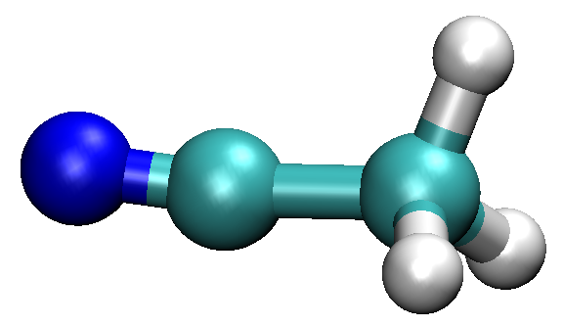
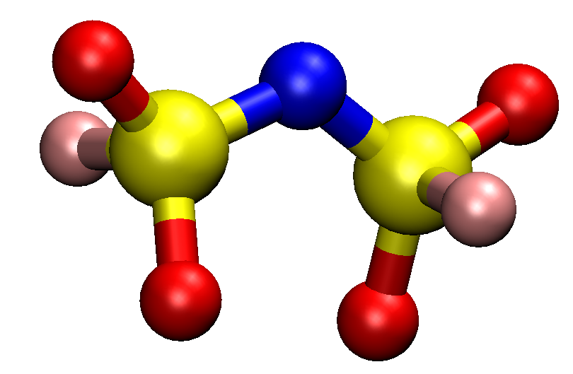
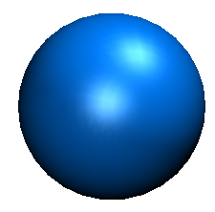
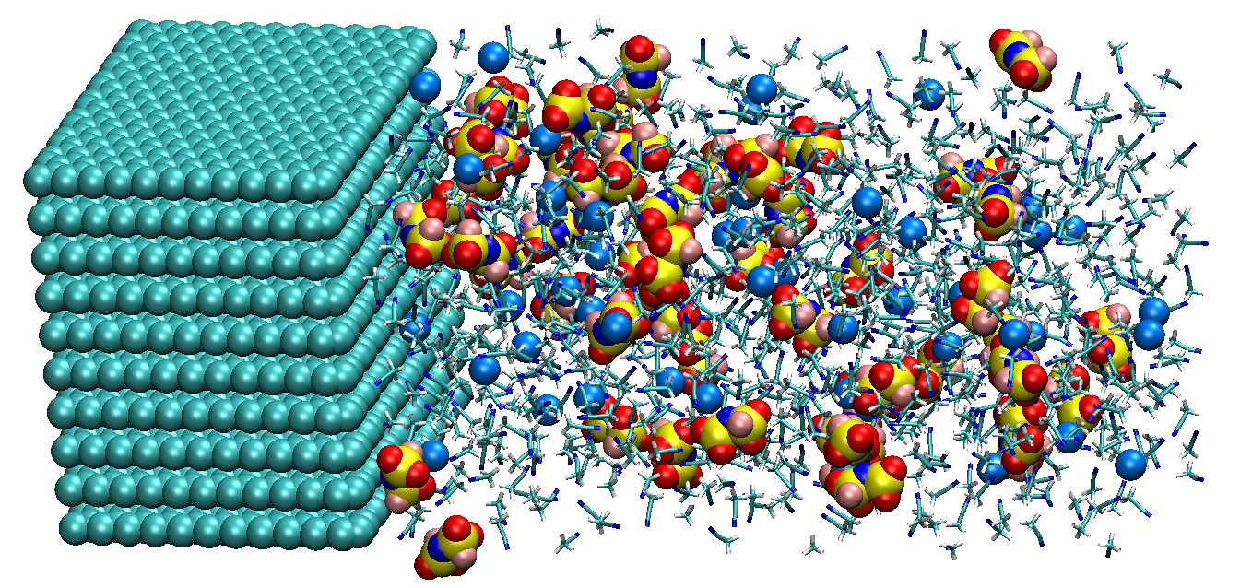
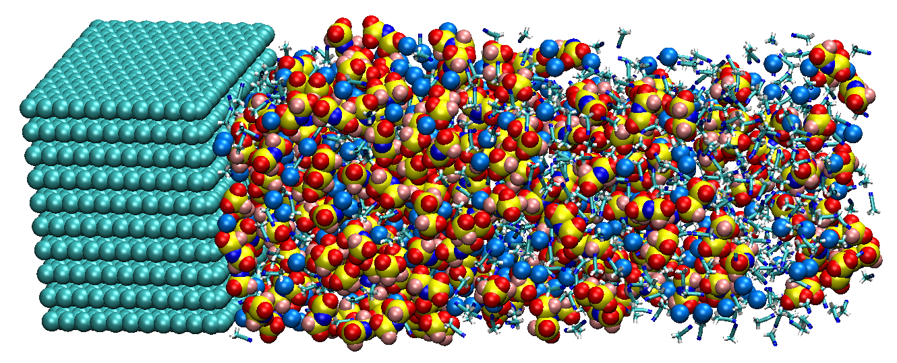
Target system
: Acetonitrile
: Na⁺
: FSA⁻
(bis(fluorosulfonyl)amide)
Negative charge: -2e
Negative charge: -2e
(a) Low concentration (1.0 M)
(b) High concentration (4.5 M)
800 Acetonitrile
52 Na⁺
50 FSA⁻
800 Acetonitrile
302 Na⁺
300 FSA⁻
For this purpose, I employed the electrolyte solutions consisting of AN-NaFSA electrolyte solution at the (a) low and (b) high concentration conditions.
Notes:
Next, I explain the target system of this study. In this study, I employed the electrolyte solutions consisting of AN-NaFSA electrolyte solution at the low and high concentration conditions like this. According to the previous experimental condition, I selected these two concentrations. And, you can see the number of molecules in these two systems.

Slide 6
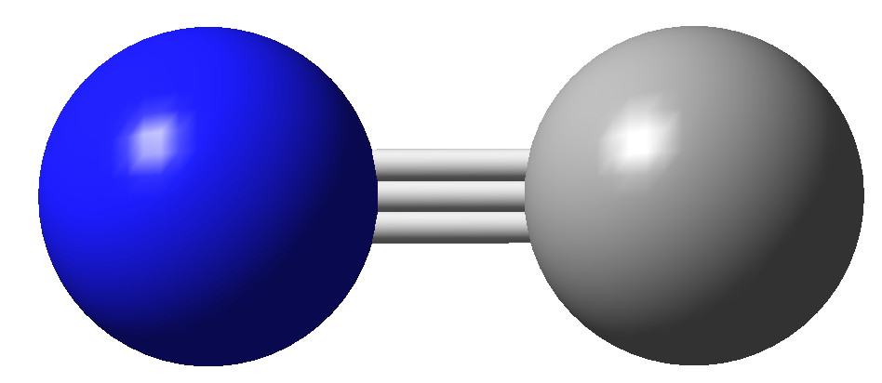
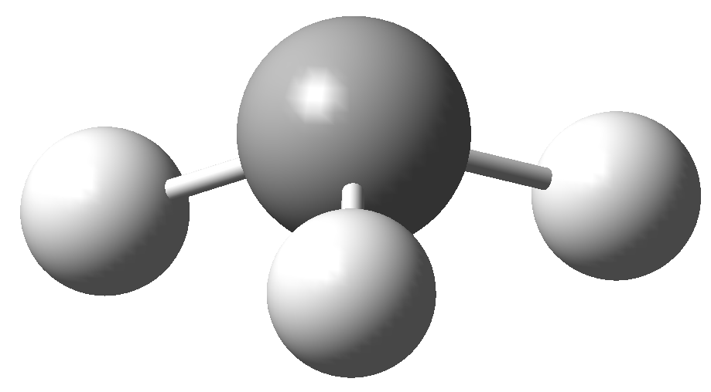
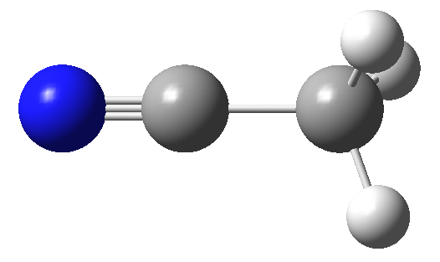
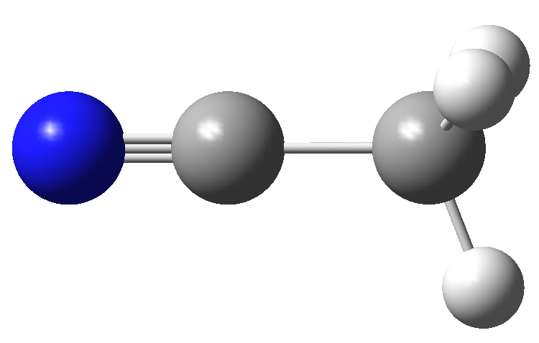
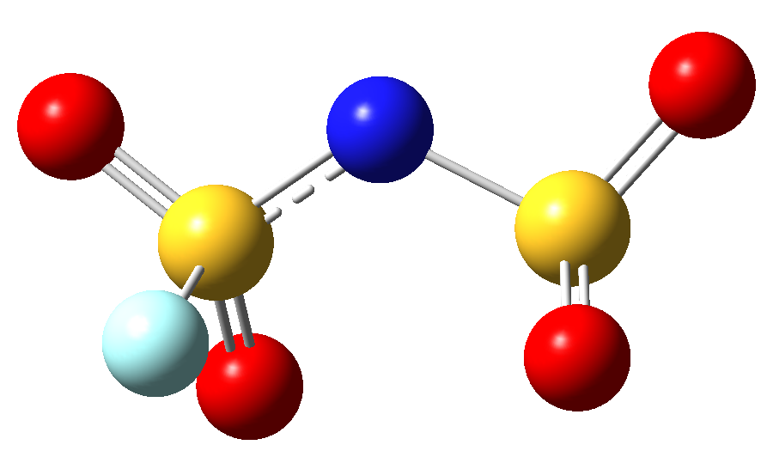
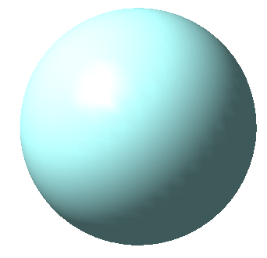
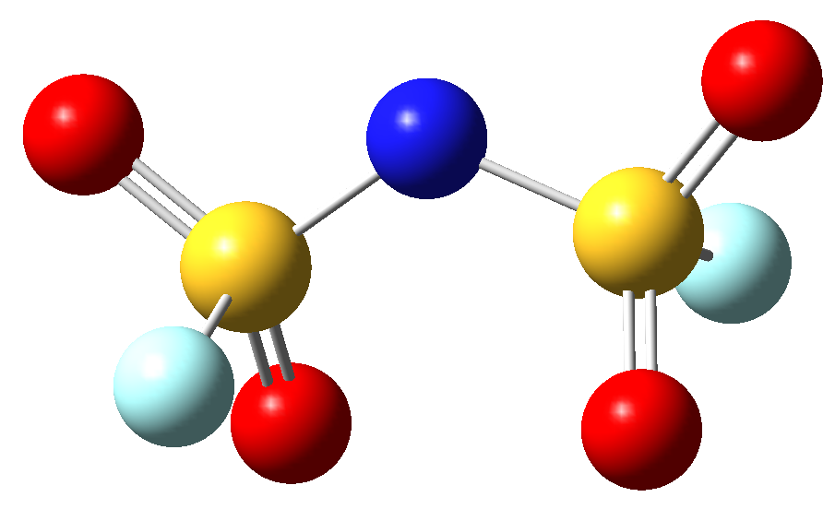
Elementary reactions for MC/MD simulation
These elementary reaction processes are considered for the hybrid MC/MD reaction simulation.
26.8 kcal/mol
-54.4 kcal/mol
+
+ e⁻
+ e⁻
CN⁻
CH₃⁻
+ FSA
47.1 kcal/mol
CH₃CN
-13.6 kcal/mol
CH₃CN⁻
17.8 kcal/mol
-15.2 kcal/mol
+
+
17.8 kcal/mol
-15.2 kcal/mol
F⁻
CH₃CN
dec-FSA⁻
+ CH₃CN⁻
Red: Potential energy difference
FSA
Blue: Free energy difference
with SMD model
+ e⁻
64.9 kcal/mol
+
-28.8 kcal/mol
F⁻
Calculation level: B3LYP/cc-pvdz
dec-FSA⁻
[1] Y. Yamada et al., J. Am. Chem. Soc., 136, 5039 (2014).
Notes:
Next, I explain the elementary reactions for MC/MD simulation. These elementary reaction processes are decided by reference to the previous studies. First, the AN solvents are reduced on the anode surface, and the AN anions are formed. But, they do not decompose. And, AN anions can accept the additional electron, and decompose into CN and CH3 anions. On the other hand, FSA salt is also reduced on the anode surface to form fluoride anion and this species. I called this molecule dec-FSA anion. And, if AN anion is close to the FSA anion, the electron can move from AN anion to FSA salt like this. And, in this slide, I showed the potential energy and free energy differences by using red and blue colors, respectively.

Slide 7
SEI film Formation Simulations
Orange: CH₃⁻, Red: CN⁻, Yellow: CH₃CN⁻, Pink: F⁻, Right green: dec-FSA⁻
(a) Low concentration
(b) High concentration
on
Notes:
Next, I showed the animation of SEI film formation simulations. The left figure shows the result at low concentration, and right one is high concentration. These colors correspond to these species. First, the AN solvents are reduced on the anode surface. Comparing these two systems, at the low concentration, the aggregation of dec-FSA anions became insufficient. On the other hand, at the high concentration, the stable film by the dec-FSA anions was formed in the outer region like this. This is a important point.

Slide 8
Change in number of molecules during simulations
CH₃CN (or AN)
CH₃CN (or AN)
FSA⁻
Number of molecule
Number of molecule
CH₃CN⁻
CH₃CN⁻
F⁻, dec-FSA⁻
FSA⁻
CH₃⁻, CN⁻
F⁻, dec-FSA⁻
CH₃⁻, CN⁻
MC/MD cycle
MC/MD cycle
(a) Low concentration (1.0 M)
(b) High concentration (4.5 M)
At the low concentration, the FSA anions were continue to be reduced.
At the high concentration, the FSA anions were reduced in first stage.
Then, the solvent AN molecules were reduced in second stage.
Notes:
Next, I show the change in the number of molecules during simulations. In these two figures, the horizontal axis is MC/MD cycle, and vertical one is number of molecules. And, these values are averaged one obtained by using 5 different initial configurations. And, it is noted the right vertical axis correspond to the number of AN molecule. In both conditions, the number of AN molecules converged. But, at the low concentration, the number of FSA anions were continue to decrease during the simulation. This shows the SEI film is not stable. On the other hand, at the high concentration, the FSA anions were reduced in first stage. Then, the solvent AN molecules were reduced in second stage.

Slide 9
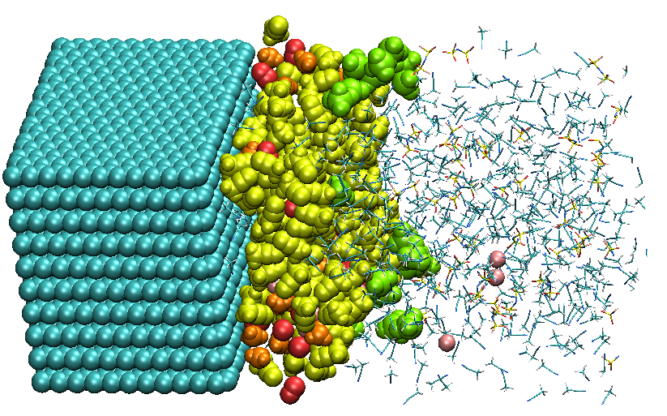
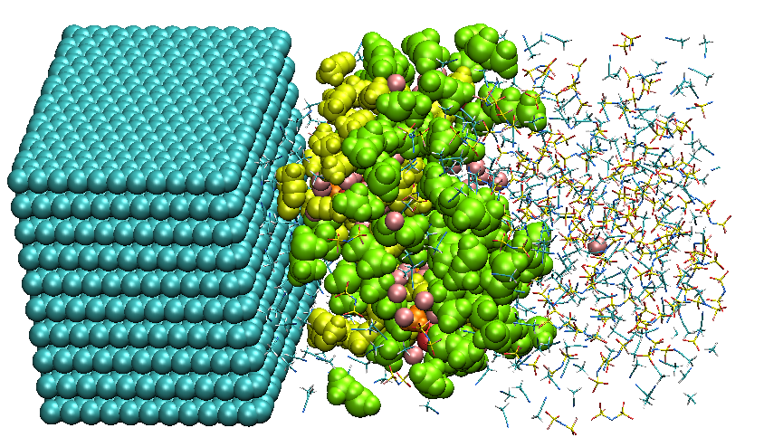
Discussion on first stage
Orange: CH₃⁻, Red: CN⁻, Yellow: CH₃CN⁻, Pink: F⁻, Right green: dec-FSA⁻
Decomposed products from salts
(a) Low concentration (1.0 M)
(a) High concentration (4.5 M)
In the first stage, at the high concentration, the dec-FSA⁻ formed the stable film to prevent the further decomposition of FSA anions.
Notes:
Next, I discuss on the first stage of SEI film formation. I showed the snapshots at 400 MC/MD cycles like this. In the first stage, ~ as shown in this figure.

Slide 10
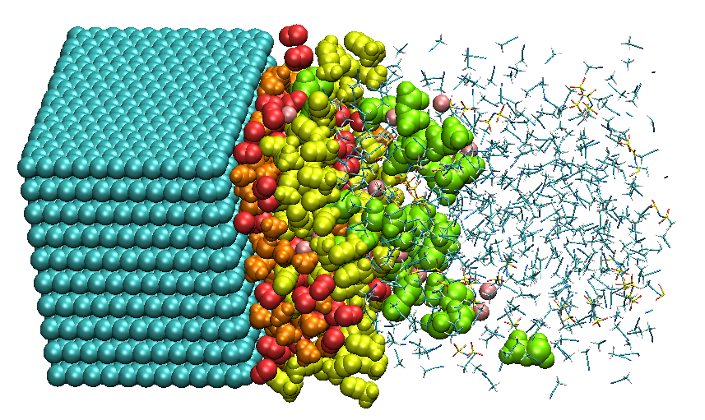
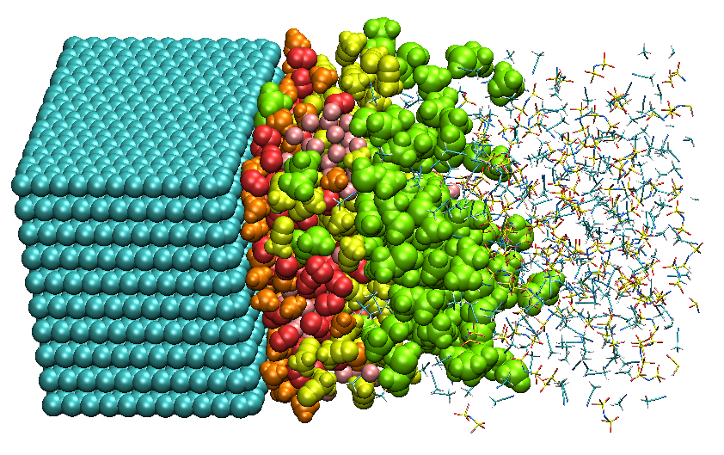
Discussion on second stage
Orange: CH₃⁻, Red: CN⁻, Yellow: CH₃CN⁻, Pink: F⁻, Right green: dec-FSA⁻
dissolution
(a) Low concentration (1.0 M)
(a) High concentration (4.5 M)
At the low concentration, the reaction products drifted away from the SEI film.
At the high concentration, such dissolution was clearly suppressed.
Notes:
Next, I showed the snapshots at 1000 MC/MD cycles like this. As you can see, at the low concentration, ~/

Slide 11
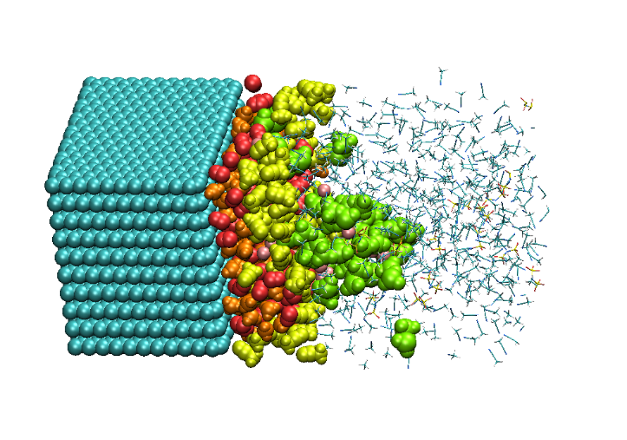
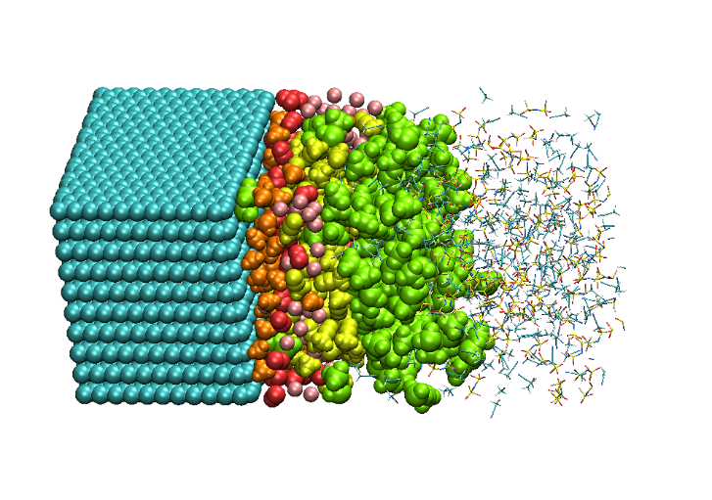

Atomistic structures of SEI films (at 2000 cycle)
Orange: CH₃⁻, Red: CN⁻, Yellow: CH₃CN⁻, Pink: F⁻, Right green: dec-FSA⁻
rough
smooth
(a) Low concentration (1.0 M)
(a) High concentration (4.5 M)
At the low concentration, the surface of SEI film became rough.
At the high concentration, the surface became smoother because the stable film originated from the salts were formed in the outer region of the SEI film.

Slide 12
Number density distributions of reaction products
CH₃CN⁻
CH₃CN⁻
CH₃⁻
CH₃⁻
CN⁻
CN⁻
Number density [Å⁻³]
dec-FSA⁻
Number density [Å⁻³]
dec-FSA⁻
F⁻
F⁻
z [Å]
z [Å]
(a) Low concentration
(b) High concentration
The CH₃ and CN anions were mainly distributed near the anode surface. On the other hand, CH₃CN⁻ were existing at the outside of CH₃⁻ and CN⁻.
At the high concentration, there was a stable film of dec-FSA⁻ in the outer region.
Notes:
Next, I show the number density distributions of reaction products. The horizontal axis is z coordinate from the anode surface. According to these figures, ~

Slide 13
Summary
In the present study, the salt concentration effect on the SEI film formation was investigated in the AN/FSA electrolytes by using the hybrid MC/MD reaction method.
At the low concentration, since the aggregation of reaction products was insufficient, they were found to drift away from the SEI film, showing that the irreversible capacity increases.
On the other hand, at the high concentration, the dissolution of reaction products was clearly suppressed owing to the presence of stable film originated from the salt decomposition. As a result, the surface of SEI film became smoother at the high concentration.
It was concluded that the high concentration AN/FSA electrolytes can improve the SEI film formation so as to suppress the decomposition and dissolution of the salts.

