Slide 1
Tue. Feb. 10th
The 5th, CREST Workshop
HI Formation from H₂ and I₂:
Theoretical Estimation of
The Relaxation Time to Equilibrium State,
Part Ⅱ
Yuichi Suzuki
Graduate School of Information Science, Nagoya University
Notes:
I’m going to talk about “HI formation form H2 and I2”.
And, the subtitle is “theoretical estimation of the relaxation time to equilibrium state, part ii”.

Slide 2
Purpose of the present study
Perform atomistic reaction simulation of the HI formation from H₂ and I₂ with hybrid MC/MD reaction method, and reproduce the temperature dependence of equilibrium constants (K_{eq}).
Convert the MC/MD cycle into time for one chemical reaction occurrence, and theoretically estimate the relaxation time to equilibrium state.
Notes:
First, I’ll explain the purpose of the present study briefly (ビリーフリー).
In the present study, I “perform ~” in the system.
And, I‘d like to “convert ~”.
For example, this figure shows the molecule numbers of (R)- and (S)-di-chlorobutane as a function of MC/MD cycle.
By converting the MC/MD cycle into time, we can estimate the period of half decay for the di-chlorobutane racemization.

Slide 3
Rerun of hybrid MC/MD reaction simulation
I found an error in the hybrid MC/MD reaction program modified for the present system.
The error was in the source code to calculate distances between atoms of reactant molecules.
I changed the value of the formation energy of the HI formation from H₂ and I₂ since previous one estimated from the experimental result include the interactions between product molecules and molecules around them, the energy of product ones and so on.
Theoretical level: B3LYP
Basis set: CEP-121G
H
H
+
∆E = 5.05 kcal/mol
(previous ∆E : 2.93 kcal/mol)
H
I
I
I
+
H
I
∆E kcal/mol
Notes:
Next, I have to inform you that I need to perform the hybrid MC/MD reaction simulation again.
Because “I found ~”
“The error was ~”
And,
“I changed ~”
The formation energy ΔE is estimated to be 5.05 kcal/mol by MO calculation at B3LYP level of theory.

Slide 4
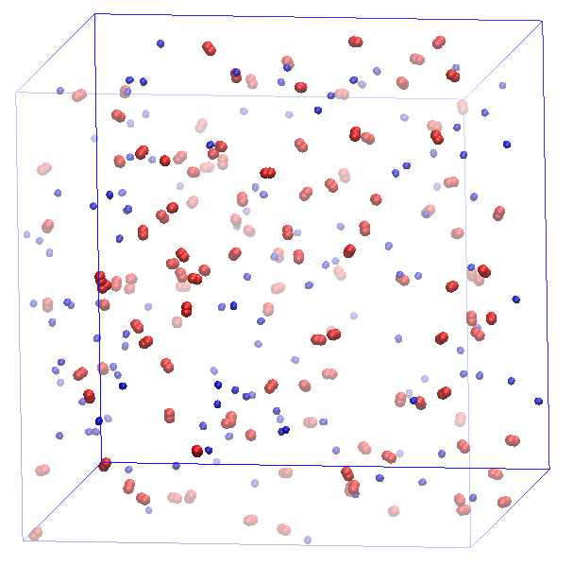
Computational details
125 H₂ (blue) and 125 I₂ (red) molecules.
Force fields for H₂ and I₂ molecules were determined, referred to some articles.
Force field for HI molecule was obtained from that of H₂ and I₂ molecules by using Lorentz-Berthelot combining rules.
Atomic charges for HI molecule were estimated by MO calculation (B3LYP).
Periodic boundary condition.
The NVT-MD (300 K, 500K and 700K) simulation time for relaxation was set to 5 ps.
The NVT-MD (300 K, 500K and 700K) simulation time to search candidate for reaction occurrence was set to 1 ps.
For 5000 MC/MD cycles.
250.0 Å
250.0 Å
250.0 Å
Fig. Initial structure
Notes:
Next, about computational details.
I showed this slide at the previous crest workshop meeting.
But, in the present study, “the NVT-MD simulation time to search candidate ~”
And I have performed the NVT-hybrid MC/MD reaction simulation at 300 K, 500K and 700K “for 5000 MC/MD cycles.”

Slide 5
The accepted and rejected numbers of times
Table. The accepted and rejected numbers of times for forward and reverse reaction occurrences after 5000 MC/MD cycles.
The accepted number of times for reverse reaction occurrence is too small although the reaction is often tried to be occurred.
The trial of forward reaction was never rejected during simulation and accepted about one hundred times.
Some parameters should be not proper for the present simulation. (e.g. LJ parameters or atomic charges for HI molecule)
Notes:
This table shows that “the accepted and rejected numbers ~”
“The accepted number of ~”
“The trial of forward reaction was ~”
Therefore, I think “some parameters should be ~”
For example, “(LJ parameters or atomic ~)”

Slide 6
Implementation of ab initio QM/MM method
To estimate the energy difference between the whole systems of reactant and product states, I implemented the QM/MM method to the hybrid MC/MD reaction method.
start
Configuration state s
Enough conditions
for chemical reactions?
NO
MD simulation
Perform QM/MM calculation
for the whole system
YES
Randomly select a chemical reaction
according to a relative weight R ~ exp(-βE_{a})
Calculate the potential energy U_{s}
Reject configuration state r
Produce the chemical reaction,
relaxing the whole system (MD simulation)
By treating the LJ and electrostatic interaction accurately, I expect that the forward and reverse reactions will be occurred correctly.
Calculate the potential energy U_{r}
NO
ΔU_{rs}(= U_{s} - U_{r}) < 0
NO
exp(-βΔU_{rs}) < η(=[0,1])
YES
YES
Accept configuration state r
NO
Equilibrium state?
YES
stop
Notes:
Next, I want to talk about “implementation of ~”.
“To estimate the energy ~”
This figure shows flow chart of the hybrid MC/MD reaction method.
I “perform QM/MM calculation for the whole system“ at these steps in the flow chart.
“By treating the ~“

Slide 7
Calculated result with QM/MM method
Table. The potential energies of reactant and product states, energy difference and judgment result under the Metropolis scheme at some MC/MD cycles.
By implementation of the QM/MM method to the hybrid MC/MD reaction method, not only the forward reaction but also the reverse one occurred.
The energy differences at some MC/MD cycles were in the range from -20 kcal/mol to +20 kcal/mol.
The hybrid MC/MD reaction simulation with QM/MM method should work well for the present system.
Notes:
This table shows “the potential energy of ~”
“By implementation of the QM/MM ~”
“The energy differences at some ~”
Consequently, I expect “the hybrid MC/MD reaction ~” ×should

Slide 8
Estimation of averaged time for one chemical reaction
T_{MC/MD} = T_{MC} + T_{MD} (T_{MD} << T_{MC})
≈ T_{MC}
= T_{ave}
T_{ave} is the average time for one chemical reaction occurrence.
MD simulation time is neglected since it is very shorter than that for one chemical reaction occurrence (T_{MD} << T_{MC}).
e.g. A → B (first order reaction)
x [mol/L]
x_{B,eq}
t [s]
0
x_{B,eq}: the concentration of B at the equilibrium state, k: rate constant for forward reaction
Notes:
From this slide, I’ll explain how to convert MC/MD cycle into time.
The time for one MC/MD cycle (Tmc/md) can be approximated as “the average time for one chemical reaction occurrence” (Tave)
because “MD simulation time (Tmd) ~”
And then, for example, in the case of first order reaction, the average time (Tave) is estimated as the inverse number of rate constant as follows.
In the present system, I’m treating the second order reversible reaction.
So, it’s more complex but I can use similar approach.

Slide 9
Estimation of averaged time for one chemical reaction
second order reversible reaction
k₂
$K_{eq}$=$\frac{k_{2}}{k_{−2}}$=$\frac{{\left[HI\right]}^{2}}{\left[H_{2}\right]\left[I_{2}\right]}$
H₂ + I₂
$$→$$
2HI
$$←$$
k₋₂
Initial condition:
Ordinary differential equation:
(i)
Notes:
In the present system, this is the reaction formula,
and the equilibrium constant is obtained by the ratio of rate constants or the concentrations of reactant and product.
Under the initial condition, we can derive this ordinary differential equation.
And then, by solving this differential equation, we can obtain the value of time as a function of the concentration of HI.
Where [H2]eq is obtained by this relational expersion.
So, by using such an approach I showed in previous slide, we can estimate average time Tave by integrating t with the concentration of HI.
(Initial concentrations of H2 and I2, concentration of HI at equilibrium state)

Slide 10
Future work
Perform the hybrid MC/MD reaction simulations with QM/MM method at three different temperatures (300K, 500K and 700K) and calculate the equilibrium constants K_{eq}.
Estimate the average time for one chemical reaction for the present system by integrating equation (i) with the concentration of HI.
Notes:
Finally, I’ll show my future work.
I “perform ~”
And, I “estimate ~”

Slide 11
Thank you for your attention

