Slide 1
CREST Workshop
Uppula Purushotham
Mechanistic Study of DiFluoro Ethylene Carbonate as Electrolyte Additive for Rechargeable Na-Ion Batteries: A Hybrid MC/MD Simulation Study

Slide 2
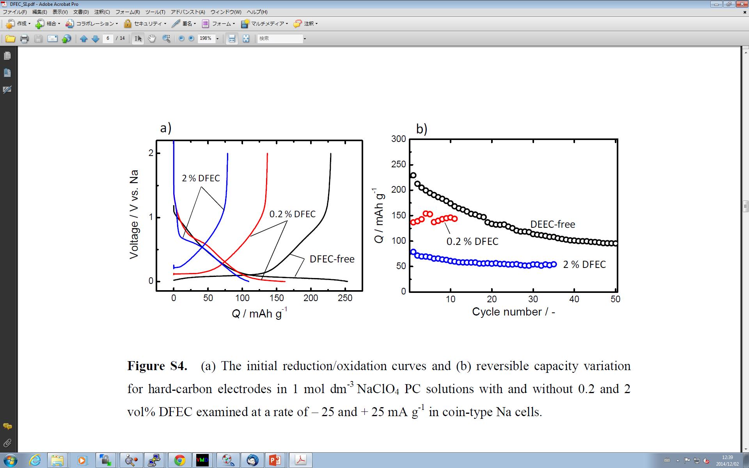
Background of Present Study
Based on recent experimental study by Prof. Komaba, fluoroethylene carbonate (FEC) was the only an effective additive in the Na-ion battery among the FEC, difluoroethylene carbonate (DFEC), vinylene carbonate (VC) and ethylene sulfite (ES).
✓
FEC-added (10 vol%)
FEC-free
In the present study we would like to investigate the origin of mechanism of 2SEI film formation in DFEC additive PC electrolyte Na-ion battery.
Figure. Reversible capacity versus cycle number plots in Na-ion battery
S. Komaba et al., ACS Appl. Mater. Interfaces, 3, 4165 (2011).

Slide 3
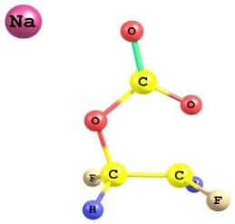
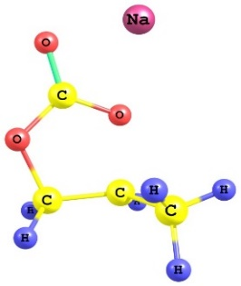
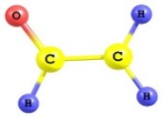

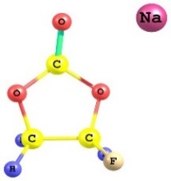
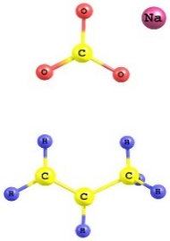
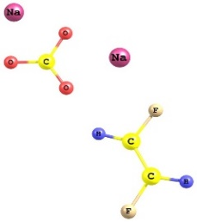
Reduction Mechanism of PC, FEC and DFEC
Activation energy (kcal/mol):
6.594 (FEC) < 11.405 (PC) < 13.732 (DFEC)
DFEC-TS
PC-TS
Relative energy in kcal/mol
FEC-Product
FEC-TS
PC-Product
DFEC-Product
Lower activation energy barrier facilitates the faster decomposition of FEC than DFEC which results into the formation of primary SEI film. In DFEC added system mainly PC decomposed products form SEI film.

Slide 4
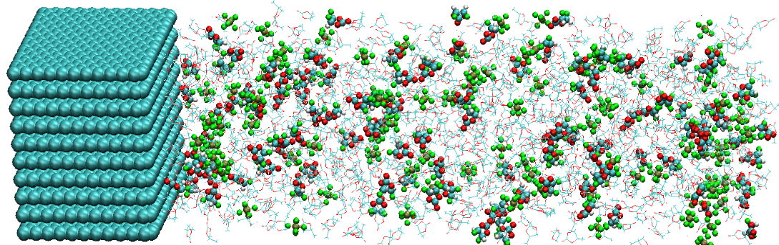

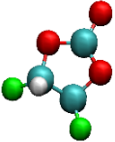






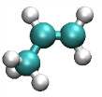


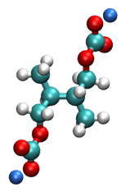
Simulation Model and Reaction Scheme
1.1M NaPF₆ PC electrolyte
Carbon anode
NaPF₆ electrolyte with DFEC
(with 10 vol% DFEC)
PC: 850
Na⁺: 87
PF₆⁻: 85
DFEC: 115
x
Based on quantum chemical results DFEC is less reactive than PC with its higher activation energy. In the real situation more intact DFEC molecules present in the electrolyte during SEI film formation.
Thus, to evaluate the intact DFEC effect we have carried out the MC/MD simulations where DFEC is non-reactive.
Along with this we have also included the dissociation of DFEC after PC reduction.
y
z
+ 2e⁻, + Na⁺
+
DFEC
Na₂CO₃
C₂H₂F₂
+ 2e⁻, + 3Na⁺
+
+
+
PF₆
PF₃
3NaF
+ e⁻, + Na⁺
+ e⁻, + Na⁺
+
Na₂CO₃
C₃H₆
PC – Reactive
DFEC – Non-reactive
PC
NaPC
0 to 2000 MC/MD cycles
+ NaPC
(CH₃CHCH₂OCO₂Na)₂
Na₂DMBDC
2001 to 3000 MC/MD cycles
PC – Reactive
DFEC – Reactive

Slide 5
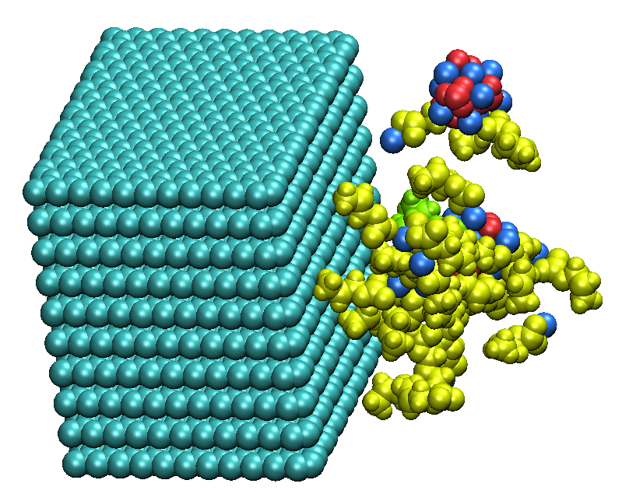
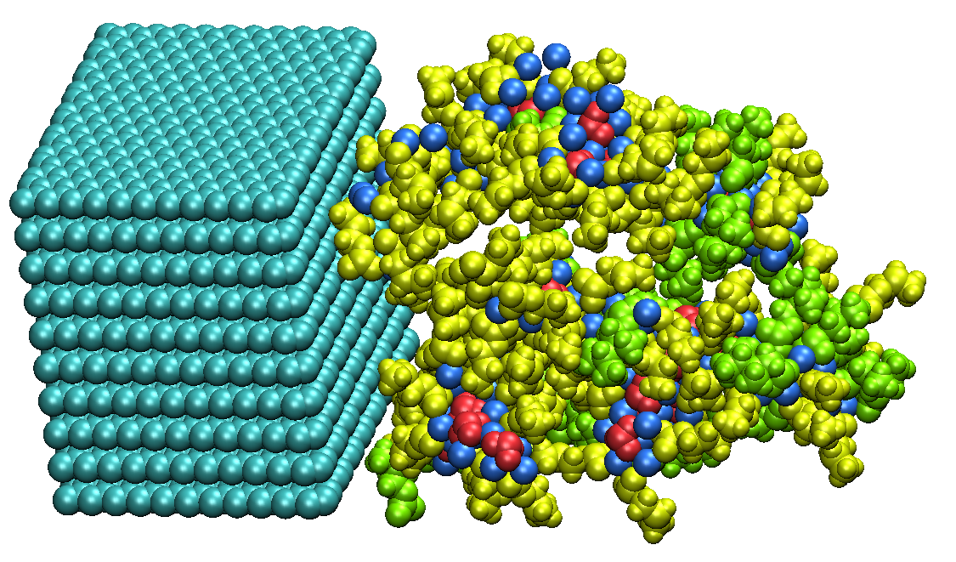
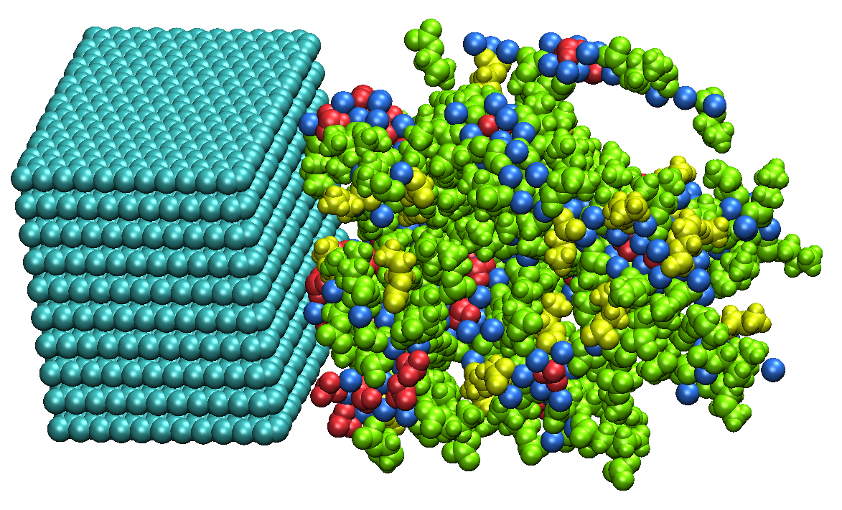


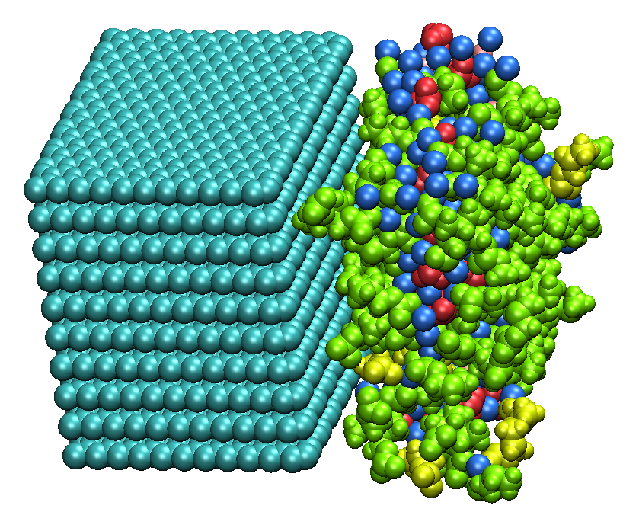
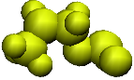
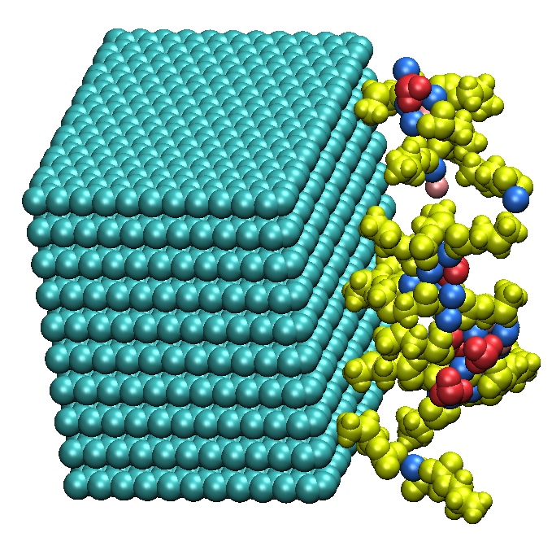
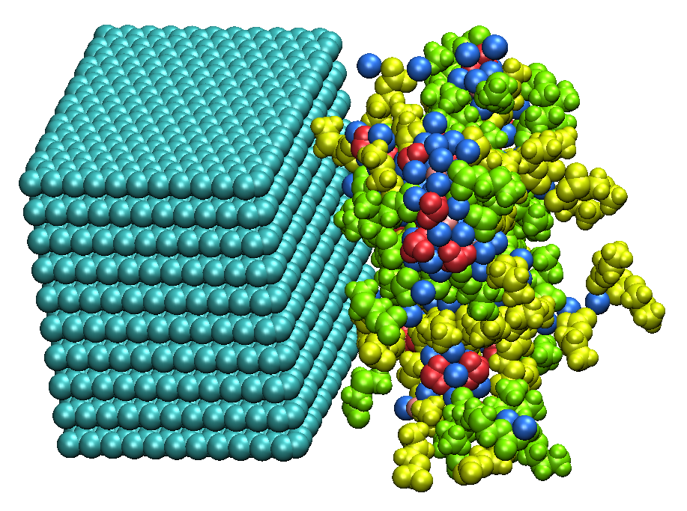
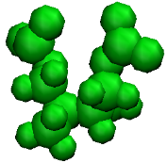
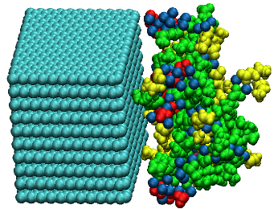
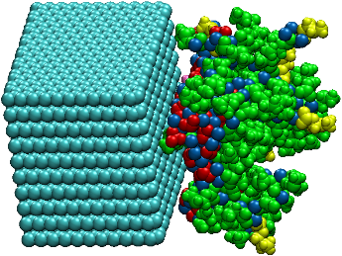
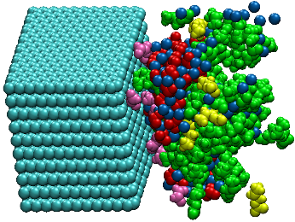
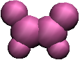
SEI Film Formation Processes
PC electrolyte
Species
(a) 100 cycle
(b) 500 cycle
(c) 1500 cycle
Na₂CO₃
NaF
FEC-added electrolyte
C₄H₇O₃Na
(a) 100 cycle
(b) 500 cycle
(c) 1500 cycle
DFEC-added electrolyte
C₈H₁₂O₆Na₂
C₂H₂F₂
(a) 100 cycle
(b) 2001 cycle
(c) 3000 cycle
Addition of FEC and DFEC additives decreased the width of SEI film.

Slide 6

Change in Number Densities of Reaction Products
162
155
NaPC
PC
Na₂DMBDC
FEC
[10⁻²Å⁻²]
[10⁻²Å⁻²]
Na₂CO₃
14
NaF
29
MC/MD cycles
MC/MD cycles
MC/MD cycles
(b) FEC added
(c) DFEC (Non-reactive) added
(c) DFEC (Reactive) added
Figure. Change in the concentration of the reductive products with the MC/MD cycles.
The number density of inorganic salts (CO₃⁻²) are increased in the DFEC added system, where the number density of NaF molecules are increased in the FEC-added system.
Decomposition of more FEC molecules (29) than DFEC molecules (14) reveals the significant contribution of FEC decomposition products in the SEI film formation.

Slide 7

Mass Density Distributions of Reaction Products
57 Å
39 Å
39 Å
NaPC
NaPC
NaPC
Na₂DMBDC
Na₂DMBDC
Na₂DMBDC
Na₂CO₃
Na₂CO₃
Na₂CO₃
NaF
NaF
[gcm⁻³]
[gcm⁻³]
[gcm⁻³]
NaF
z [Å]
z [Å]
z [Å]
(a) PC
(b) FEC added
(c) DFEC added
Figure. Mass density distribution of the reductive products in the SEI films.
The width of SEI film in FEC and DFEC added systems is almost similar.
With the addition of additive the thickness of SEI film was found to be reduced by 32%.
In DFEC added system inorganic salts are increased compare to FEC and PC systems.

Slide 8
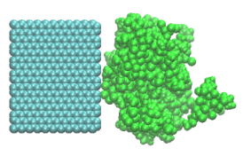
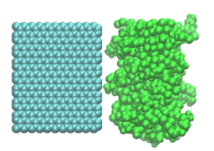
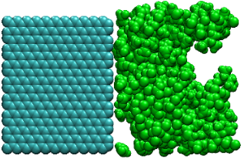
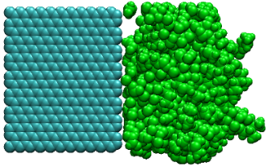
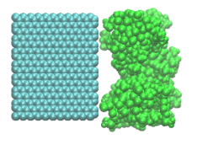
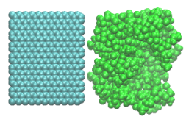
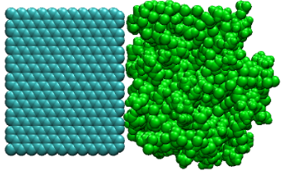
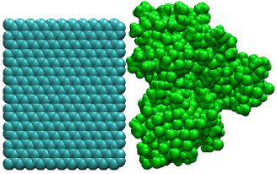
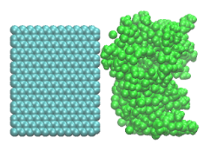


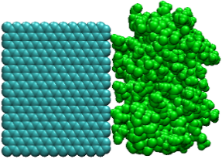
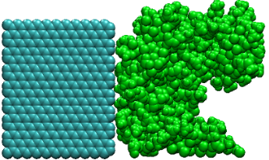
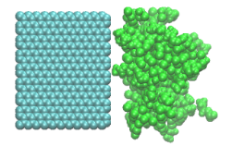
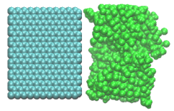
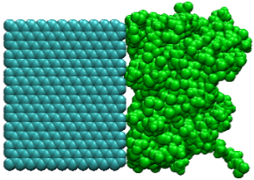
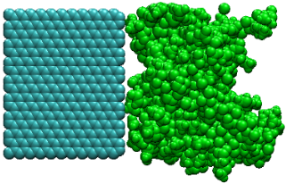
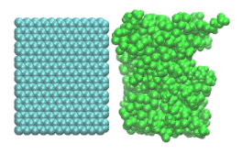
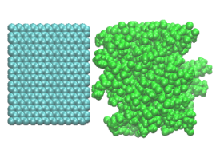
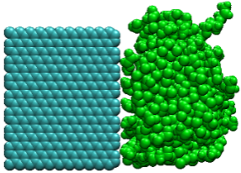
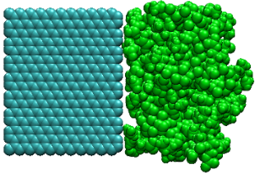
Comparison of Smoothness of SEI Films
(a) FEC added
(b) DFEC added
This reveals that in the FEC-added electrolyte, the surface structure of SEI film in contact with the electrolyte is smoother than DFEC-added SEI film.

Slide 9
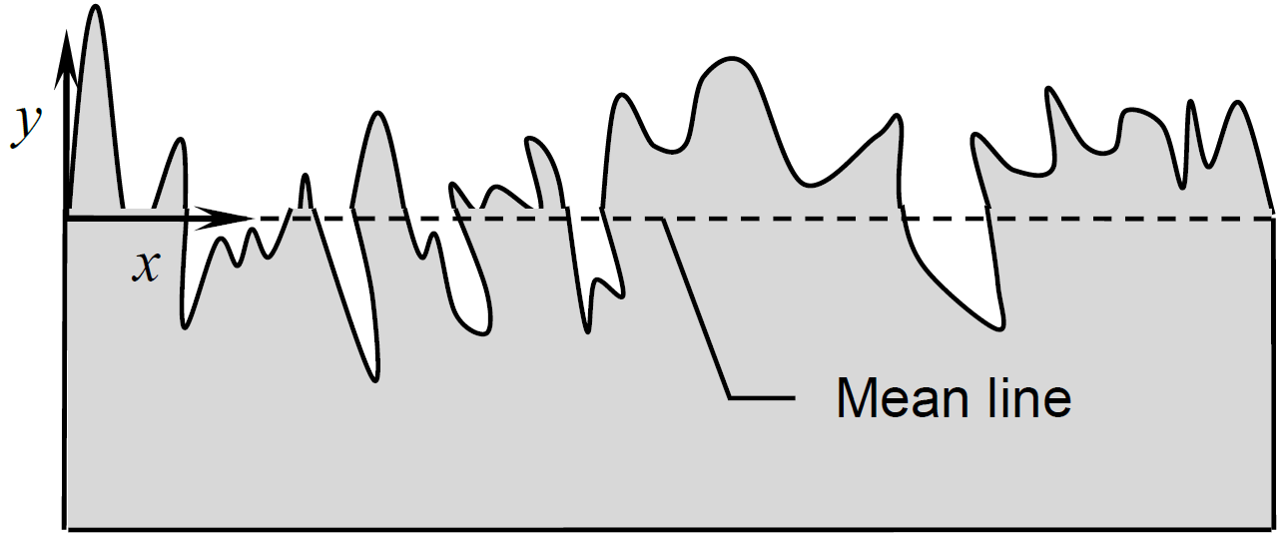
Roughness of SEI Film
The roughness is estimated through the standard deviation (STDV) of measured width at various parts (15X15 grid) of the SEI film.
Distance
System | STDV(Å) | Distance(Å)
DFEC | 10.862 | 31.010
FEC | 10.346 | 32.279
PC | 11.652 | 39.576
Figure. A rough surface of arbitrary profile
Order of Roughness: PC > DFEC > FEC
T. Adams et.al. Int. J. Mech. Eng. Mechat. 1, 66 (2012)

Slide 10
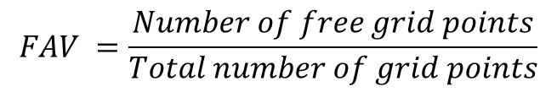
Cavity Size
To calculate the fractional accessible free volume (FAV), we have chosen the region where the density of three SEI films is high.
18Å
$$FAV =\frac{Number of free grid points}{Total number of grid points}$$
Table: The FAV of different systems along with standard deviation in parenthesis.
[gcm⁻³]
Systems | FAV | Total Grid Points
PC | 0.050 (0.018) | 816519
FEC added PC | 0.042 (0.019) | 833351
DFEC added PC | 0.064 (0.017) | 812374
z [Å]
Figure. Mass density distribution of various SEI films.

Slide 11
Coordination of Inorganic Molecules with Additives
Table: The averaged coordination number of inorganic molecules around additives with in 3.4Å distance of SEI film (width 30Å) formed after addition of FEC and DFEC additives.
Systems | Coordination Number
FEC added PC | 0.35
DFEC added PC | 0.46
The clustering of inorganic molecules around intact DFEC molecules is increased in the DFEC added PC electrolyte system.
This clustering results to formation of larger cavities.

Slide 12
Electrolyte Molecules Present in SEI film
We have calculated the number of electrolyte molecules present in the SEI film. For this purpose we have chosen the SEI region where the density of three SEI films are more.
Systems | Number of Electrolyte molecules
PC | 34
FEC added PC | 33 (27 PC + 6 FEC)
DFEC added PC | 45 (36 PC + 9 DFEC)
More number of intact electrolyte molecules present in DFEC added system than PC and FEC added systems.
It is clear that presence of more intact molecules in the SEI film is responsible for the large cavities in the DFEC added system.

Slide 13
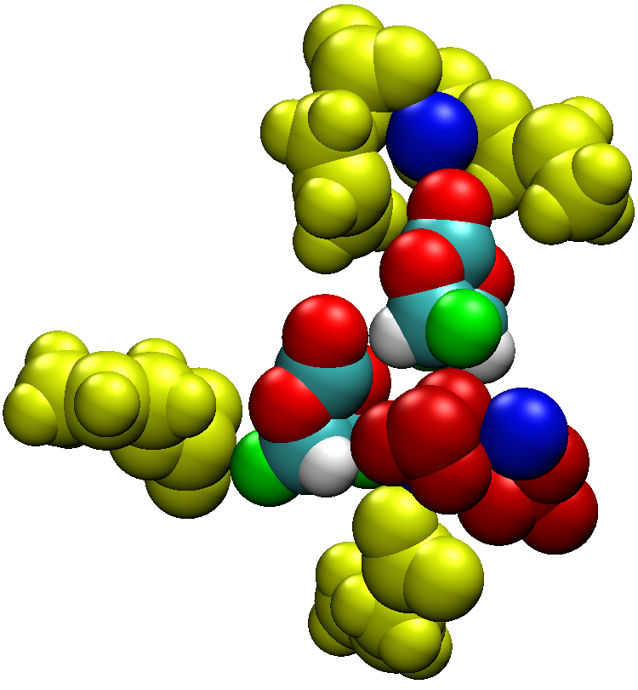
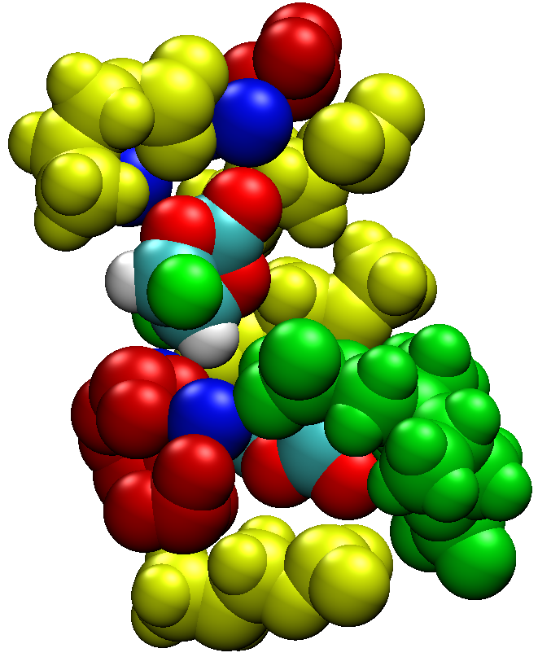
Role of DFEC Residues in the SEI film Formation
NaPC
NaPC
DFEC
DFEC
Na⁺
CO₃⁻²
CO₃⁻²
Na₂DMBDC
100 MC/MD cycles
500 MC/MD cycles
Intact DFEC molecules coordinate with reaction products during the SEI film formation.
DFEC also enhance the clustering of inorganic molecules which can be responsible for larger cavity sizes.

Slide 14
Conclusions
To gauge the effect of DFEC on the formation of SEI film, we have performed the MC/MD simulations on DFEC added PC electrolyte system which resembles real situation where both the effects such as effect of intact DFEC molecules and DFEC dissociation after the PC SEI film formation were included.
DFEC-added PC electrolyte system resulted roughened surface structure of SEI film in contact with the electrolyte compare to the FEC added system.
Decomposition of more FEC molecules during the SEI film formation reveals the higher contribution of FEC molecules in the SEI film formation than DFEC molecules.
The clustering of inorganic molecules around intact DFEC molecules is more favorable in the DFEC added PC electrolyte system. This clustering reduce the aggregation between inorganic and organic products in the SEI film formation.
Intact electrolyte molecules present in the SEI film are responsible for large cavities in DFEC added system.
Finally, the inefficient aggregation of reaction products in the DFEC-added system results roughened surface structure and intact electrolyte molecules in SEI film and clustering of inorganic products with DFEC molecules results larger cavities in the SEI film.

