Slide 1
Tue. Jun. 30th
FY2015’s 3rd, CREST Workshop
Exploring Transport Pathway of Sodium Ion in Solid Electrolyte Interphase Using Targeted Molecular Dynamics Method
Norio Takenaka^{1,2}
Graduate School of Information Science, Nagoya University¹,
Elements Strategy Initiative for Catalysts and Batteries (ESICB), Kyoto University²

Slide 2
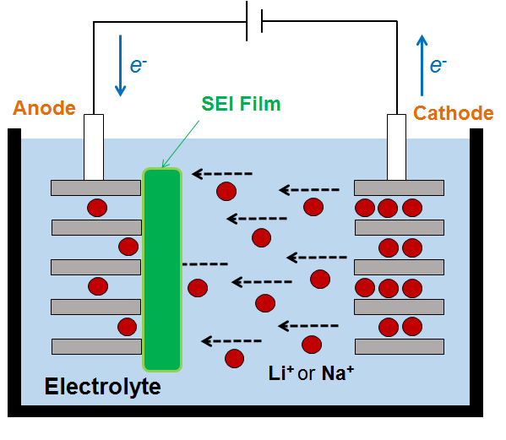
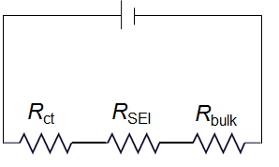
Background of Present Research
Among several processes of ion and electron transport, the lithium (or sodium) ion transfer at an anode/electrolyte interface is an essential process of the charge-discharge reaction of lithium (or sodium) ion batteries.
Battery resistance is typically the sum of the bulk electrolyte resistance (R_{bulk}), resistance of the SEI (R_{SEI}), and an ion transfer resistance (R_{ct}).
Resistances of ion transfer
R_{ct}: charge transfer resistance from SEI film to anode
R_{SEI}: resistance of ion transfer in SEI film
R_{bulk}: resistance of ion transfer in bulk electrolyte
Schematic illustration
2

Slide 3
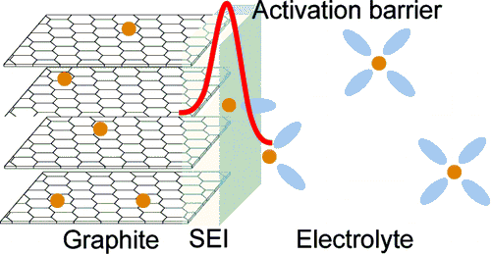
Previous Studies on Ion Transfer ①
According to experimental studies, an activation barrier of the Li⁺ transfer from the electrolyte to graphite was found to be 12 ~ 24 kcal/mol.
Abe and Ogumi et al. concluded that the desolvation of Li⁺ is a rate-determining step of the interfacial transfer at graphite [1,2] because
resistance of SEI (R_{SEI}) was quite small according to impedance spectroscopy,
(2) desolvation energy (< 12 kcal/mol) was similar to the activation barrier.
[1] Abe and Ogumi et al., J. Electrochem. Soc., 151(8), A1120 (2004).
[2] Abe and Ogumi el al., Langumir, 25(21), 12766 (2009).
However, its kinetics is influenced by the composition of SEI film [2].
Such a microscopic origin was not found.

Slide 4
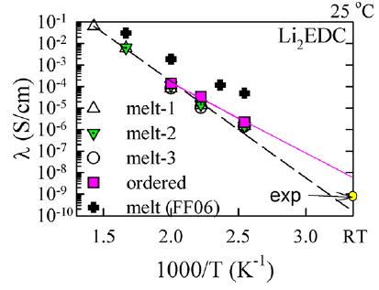
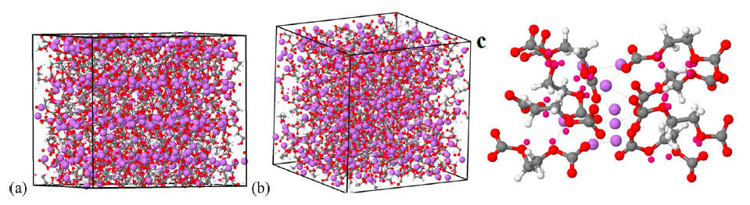
Previous Studies on Ion Transfer ②
To directly estimate an activation barrier of R_{SEI}, Xu et al. have investigated the Li⁺ transfer in the SEI film by using both experiment and MD simulation, considering a simple system which includes only Li₂EDC molecules because they were well-known to be the main component in the SEI film [3].
[3] Xu et al., J. Phys. Chem. C, 117, 7433 (2013).
Li₂EDC
Calculation model for MD simulation [3]
Ion conductivity [3]
The activation barrier of R_{SEI} was estimated to be 15 kcal/mol, which is similar to that of the Li⁺ transfer from the electrolyte to graphite (12 ~ 24 kcal/mol).
The Li⁺ transfer in the SEI film should be a rate-determining step.

Slide 5
Purpose of Present Research
According to the previous studies in lithium-ion batteries (LIB), there are two possibilities of the rate-determining step on the ion transfer, i.e., (1) desolvation of Li⁺ and (2) Li⁺ transfer in the SEI film.
However, these studies have two weak points.
① It is difficult to assign R_{SEI} by using impedance spectroscopy.
② Simple model consisting of only Li₂EDC is different from real SEI film.
On the other hand, in ESICB project, it is expected to investigate Na⁺ transfer in sodium-ion batteries (NIB) to develop the high-performance NIB. Previously, we could get the realistic model of SEI film using hybrid MC/MD reaction method [4,5].
[4] NT et al., J. Phys. Chem. C, 118(20), 10874 (2014); [5] NT et al., J. Phys. Chem. C, in revision.
Therefore, I investigated the Na⁺ transfer in the SEI film obtained by the hybrid MC/MD reaction method [5]. First, I searched for a migration pathway into the anode surface through the SEI film. Next, I calculated a free energy profile along a migration pathway to compare the activation barrier with the previous experimental and theoretical values [1-3].

Slide 6
Implementation of Targeted MD Method
To search for the migration pathways of Na⁺ inside the SEI film, I implemented targeted molecular dynamics (TMD) method [6] into AMBER program.
[6] J. Schlitter et al., Mol. Simul., 10(2), 291-309 (1993).
In the method, to pull the selected ion into the targeted position, the additional force is applied to the selected ion during the MD simulation.
: force constant
: current ion position on z-axis
: targeted position on z-axis
On the other hand, to roughly know the energetic information along migration pathway, I calculated the interaction energies between selected ion and other species (e.g., electrolyte solution, SEI film).

Slide 7
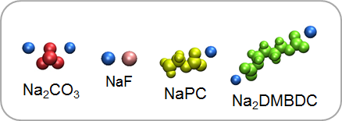
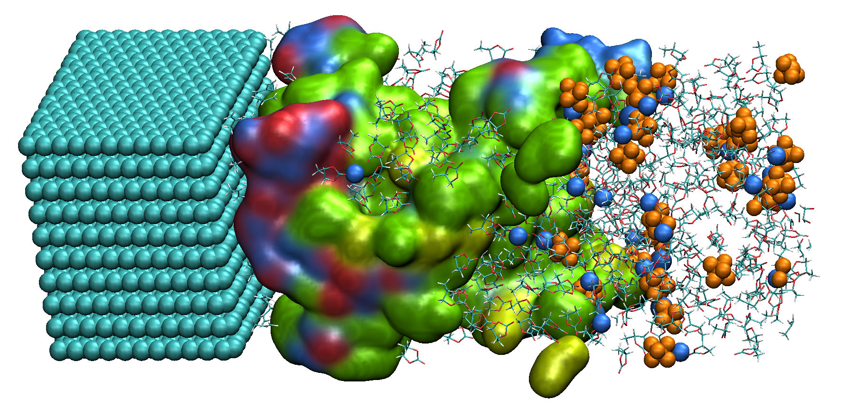

Model System
Species in SEI film
Anode
SEI film
(a) Side View
(SEI film, surface view; Na⁺ and PF₆⁻, van der Waals view; PC and Gas, stick view)
(b) Front view of SEI film from the side of anode
(0 < z < 20 Å)
・ For this purpose, I employed the system including NaPF₆-PC electrolyte solution and SEI film (This was obtained by a hybrid MC/MD reaction simulation.)

Slide 8
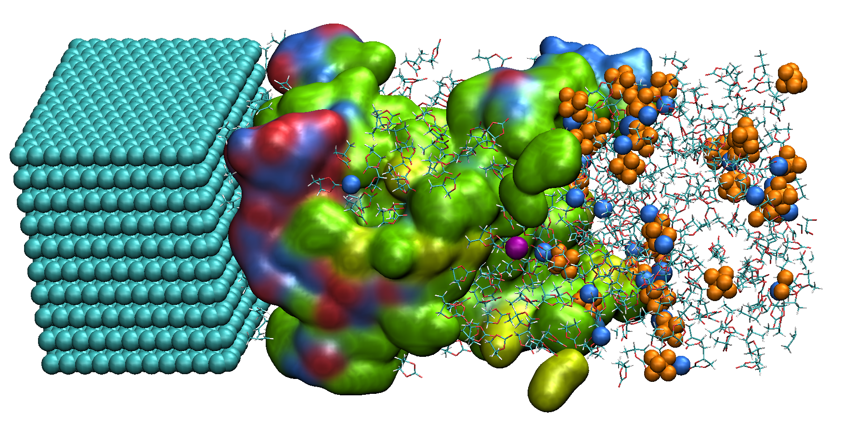
Procedure of TMD Simulations
・ In the simulation, I first selected one Na⁺ (purple), and pulled it into the anode surface (target position) by using TMD method.
・In the TMD method, the force constant was set to 1.0 kcal/molÅ².
Selected Na⁺
Additional force

Slide 9
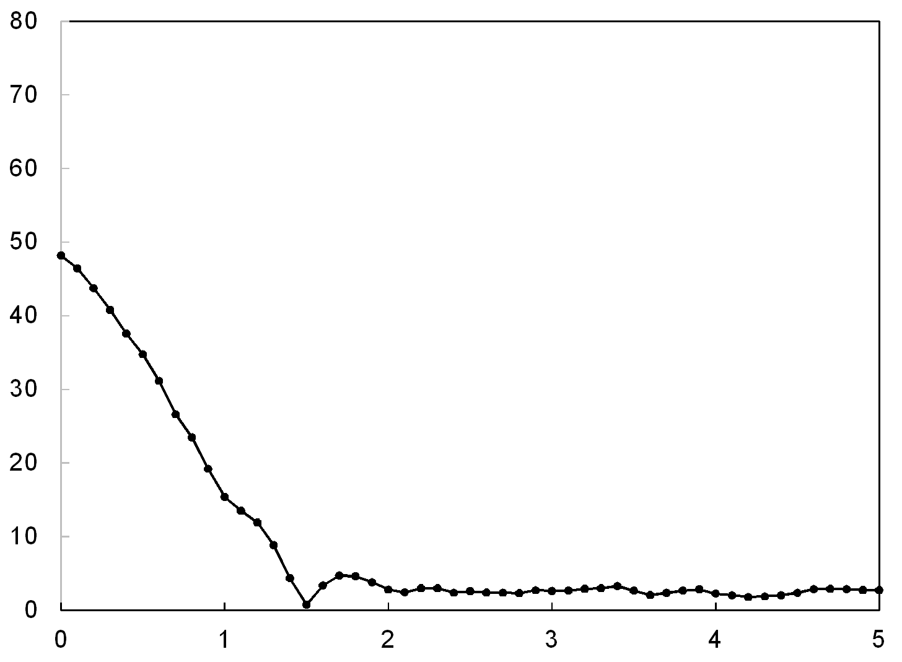
Change in the Positon of a Selected Na⁺
z [Å]
Time [ps]
・ During the TMD simulation, a selected Na⁺ was close to the anode surface (z = 0 Å) from the initial positon (z = 48 Å) inside the SEI film.

Slide 10
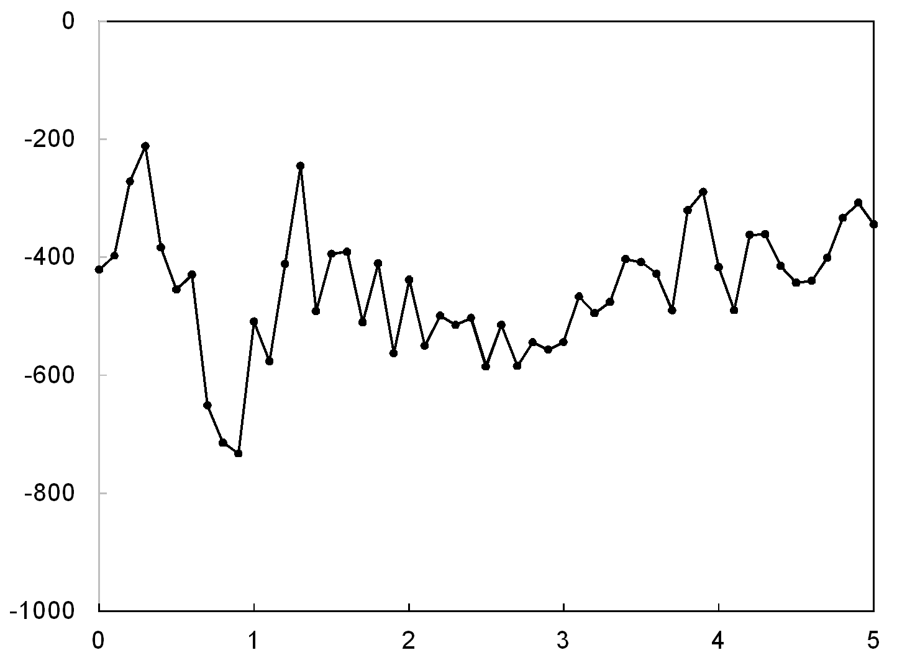
Change in the Interaction Energy
Cut-off distance: 17 Å
Interaction energy [kcal/mol]
Time [ps]
・ According to the interaction energy between a selected Na⁺ and other species, there is a large barrier until a selected Na⁺ moves into the anode surface.

Slide 11
Relation between the Positon and Interaction Energy
cavity
z [Å]
0 < z < 20 Å
Interaction energy [kcal/mol]
Time [ps]
Time [ps]
(a) Position of a selected Na⁺
(b) Interaction energy
・ The barrier was presented in the interface region of SEI film (0 < z < 20 Å). In this case, a selected Na⁺ was found to pass through a cavity in this region.

Slide 12
Free Energy Calculation on Migration Pathway
To obtain the free energy profiles along the migration pathways of Na⁺ obtained by TMD method, I employed thermodynamic integration (TI) method.
In the TI method, when a selected Na⁺ moves from 0 to a along z axis, the free energy change ΔG(a) is obtained as follows.
: Average force in z direction of a selected Na⁺
fixed at z = a
Difference formula
: interval
In the present analysis, I have fixed only z coordinate, meaning that a selected Na⁺ can move on x-y plane in each z_{k} (Δz_{k} = 1 Å). Additionally, I have estimated the free energy using 1 ns MD sampling (100 ps relaxation) along the calculated migration pathway of a selected Na⁺.

Slide 13
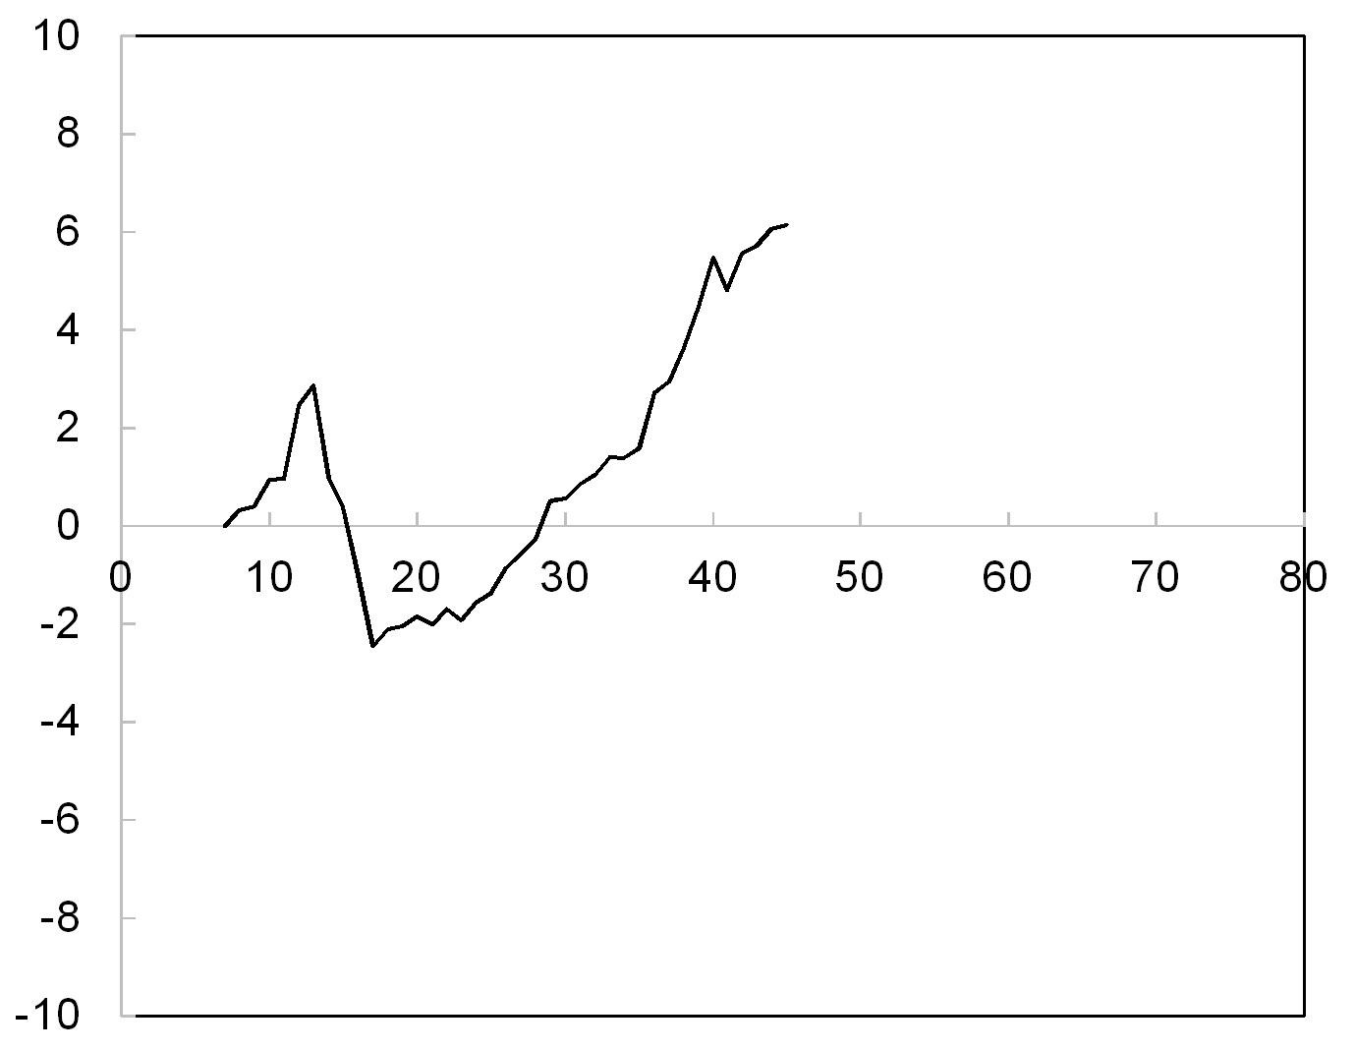
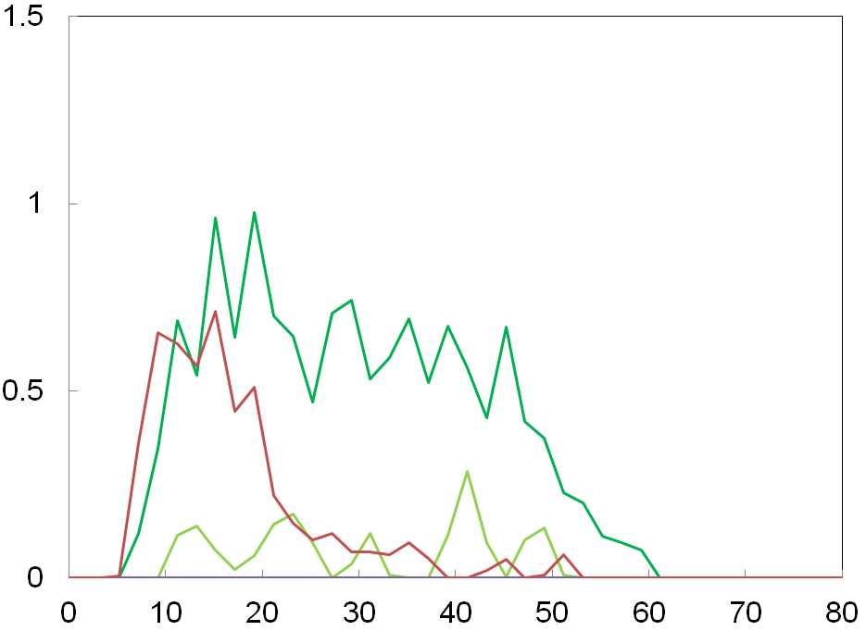
Free Energy Profile and Mass Density Distribution
Initial position
NaPC
Na₂DMBDC
5.3 kcal/mol
Na₂CO₃
Mass density [g/cm³]
Free energy [kcal/mol]
z [Å]
z [Å]
(a) Free energy profile of a selected Na⁺
(b) Mass densities of reaction products in the present SEI film
・ The free energy was stable as a selected Na⁺ moves into the anode surface because the electrostatic interactions should be stronger inside the SEI film.
・ There was a free energy barrier of 5.3 kcal/mol near the anode surface. This peak position corresponds to that in the mass density of the present SEI film.

Slide 14
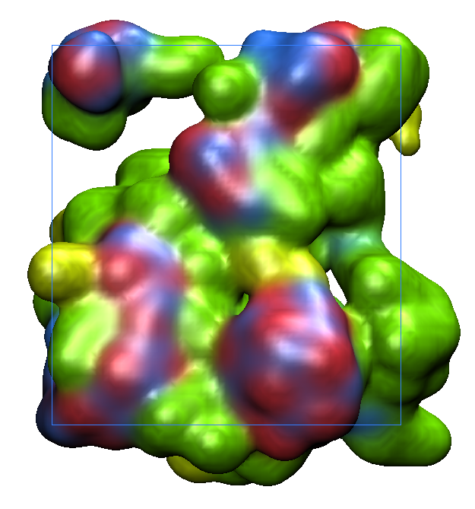
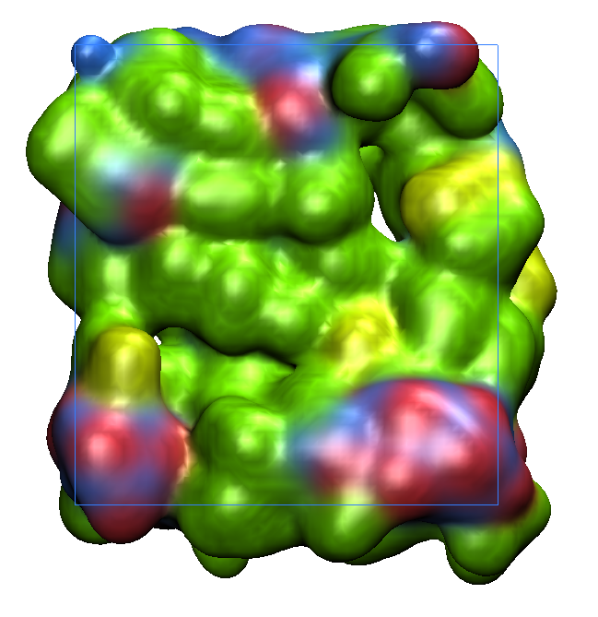
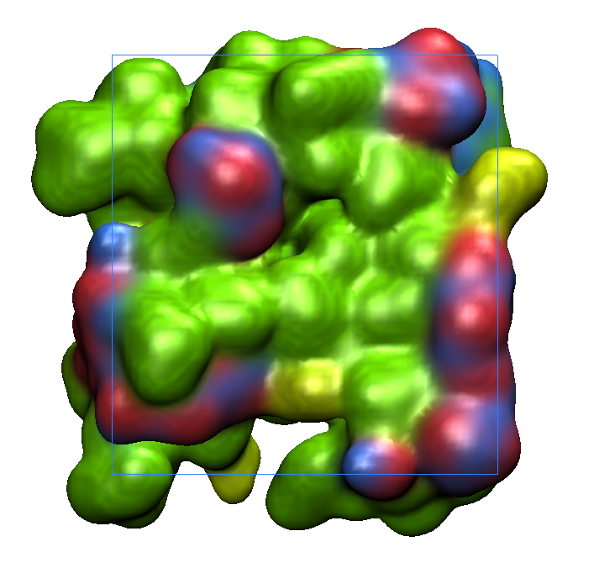
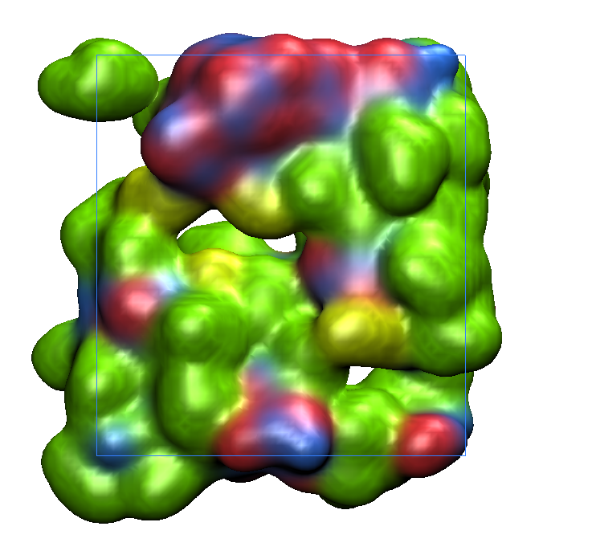
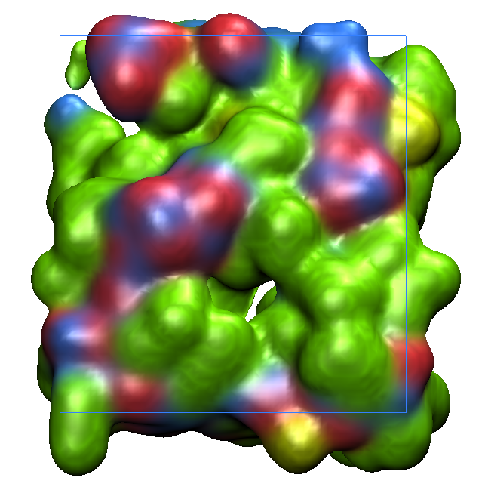
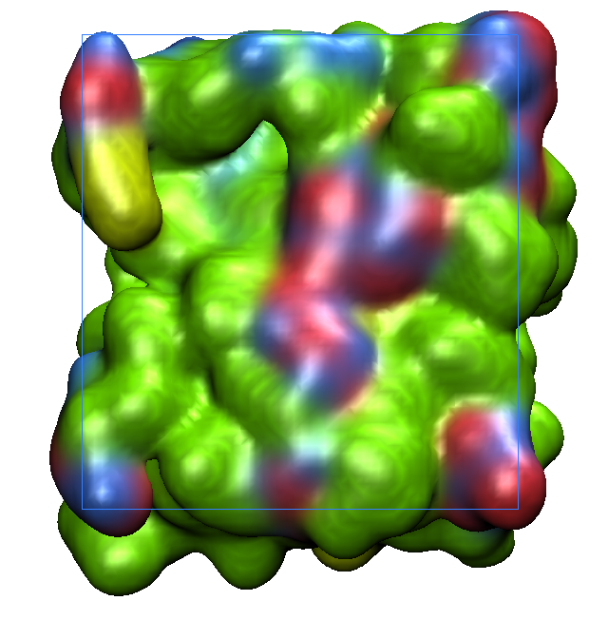
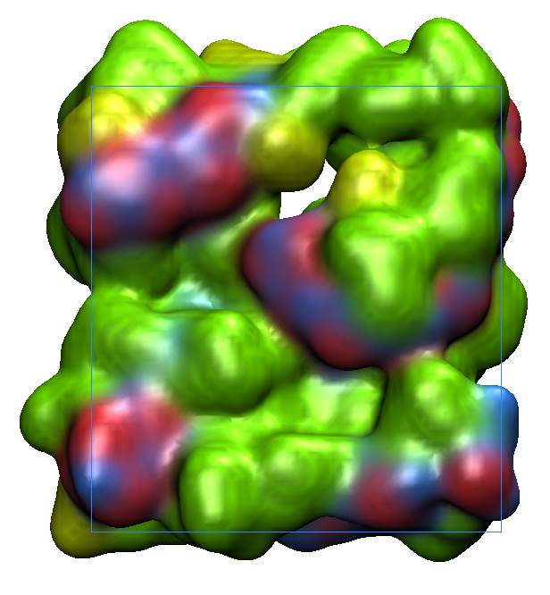
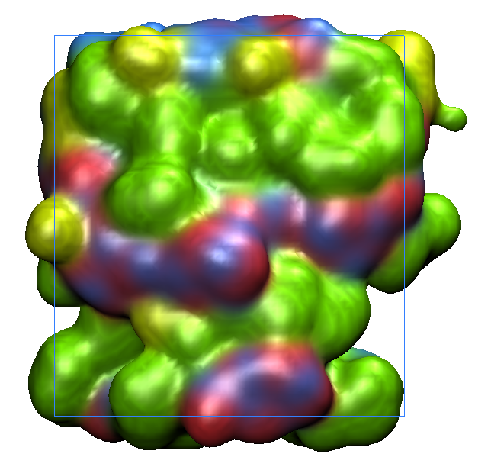
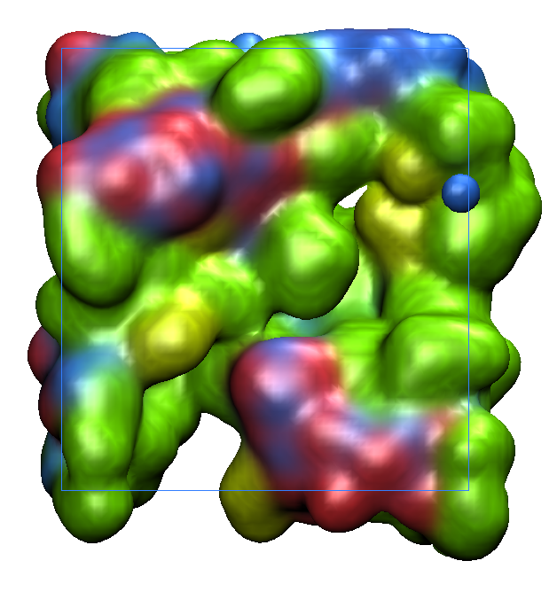
Front Views of All Samples (N = 10)
Previously, we obtained 10 SEI films by using 10 different initial structures.
Sample.1
(Present)
Sample.2
Sample.3
Sample.4
Sample.5
Sample.6
Sample.7
Sample.8
Sample.9
Sample.10
・ In all samples, it was found that there are some cavities where a Na⁺ can pass through. (By rotating these structures, such cavities were clearly found.)

Slide 15
Summary and Future Work
・In the present study, we have investigated the transport properties of Na⁺ in the SEI film of NIB by using both TMD and TI methods.
・Using TMD method, I can obtain a migration pathway of Na⁺ into the anode surface in the SEI film obtained by the hybrid MC/MD reaction simulation.
・It was found that there is a free energy barrier of 5.3 kcal/mol for a migration of Na⁺ into the anode surface.
・The calculated free energy barrier was smaller than the experimental value (12~24 kcal/mol) and previous calculated one using the simple model including only Li₂EDC (15 kcal/mol). Thus, it is predicted that the desolvation is a rate-determining step of Na⁺ transfer from the electrolyte to anode.
・To confirm this prediction, I will estimate the free energy barriers using all samples (N = 10), and compare their average value with the experimental one.

Slide 16
Thank you for your attention

