Slide 1
FY2015 The 3rd CREST Workshop 2015, June 30
Development of TopologyEditor for MC/MD simulations
MC/MD シミュレーションに向けた TopologyEditor プログラム開発
Masayoshi Takayanagi
Graduate School of Information Science, Nagoya University

Slide 2
Create TopologyEditor (written by C++)
Current procedure to edit topology files in MC/MD programs
topology & restart files
↓
ambpdb
↓
PDB file
↓
edit PDB file by script
↓
PDB file
↓
tleap
↓
topology & inpcrd file
Simpler procedure to edit topology files by TopologyEditor
topology & restart files
↓
TopologyEditor
↓
topology & inpcrd file
Complecated procedure & Need to keep the job-running window open
Accumulate applied reactions in each MC/MD cycle (bond formation, bond deletion, ... ) and give all the ammumlated changes every MC/MD cycle.
Files
program or script
※ File format of "restart file" and "inpcrd file" is identical including coordinate and velocity information of atoms and periodic boundary box information.
In AMBER MD solvers, input file name is "inpcrd" and output file name is "restart"

Slide 3
Topology file format See details in http://ambermd.org/formats.html
%VERSION VERSION_STAMP = V0001.000 DATE = 06/26/15 20:33:27
%FLAG TITLE
%FORMAT(20a4)
default_name
%FLAG POINTERS
%FORMAT(10I8)
4440 7 1660 3579 3800 7094 7920 15082 0 0
34176 330 3579 7094 15082 12 23 8 9 0
0 0 0 0 0 0 0 1 20 0
0
%FLAG ATOM_NAME ATOM names
%FORMAT(20a4)
Zn1 Zn2 C2 H21 H22 C1 H11 H12 N1 C3 H31 H32 C4 H41 H42 N2 C6 H61 H62 C5
H51 H52 O1 C1 O2 C2 C8 C7 H7 H8 C3 H3 C4 H4 C5 C6 O4 O3 O1 C1
・・・
C3 H3 C4 H4 C5 H5 C6 H6 C1 H1 C2 H2 C3 H3 C4 H4 C5 H5 C6 H6
%FLAG CHARGE Atomic charges
%FORMAT(5E16.8)
2.15606254E+01 2.15606254E+01 -2.73334500E-02 6.77869560E-01 6.77869560E-01
-2.73334500E-02 6.77869560E-01 6.77869560E-01 7.56225450E-01 -2.73334500E-02
・・・
%FLAG BOND_FORCE_CONSTANT Bond force constants
%FORMAT(5E16.8)
2.17995000E+01 1.18705000E+01 1.18705000E+01 6.87910000E+01 3.35900000E+02
3.03100000E+02 3.20600000E+02 6.48000000E+02 3.49700000E+02 3.44300000E+02
4.78400000E+02 6.48000000E+02
%FLAG BOND_EQUIL_VALUE Bond equilibrium distances
%FORMAT(5E16.8)
2.04100000E+00 2.16900000E+00 2.16900000E+00 2.92900000E+00 1.09300000E+00
1.53500000E+00 1.47000000E+00 1.21400000E+00 1.48700000E+00 1.08700000E+00
1.38700000E+00 1.21400000E+00
・・・
There are 43 %FLAG items
Num. of atoms
Num. of residues
Num. of bonds containing hydrogen
Num. of bonds not containing hydrogen

Slide 4
TopologyEditor header file (prepared variables to read data)
/* see "AMBER File Specifications" website *
* http://ambermd.org/formats.html */
typedef struct AmberPrmtopScalarItems {
int natom, ntypes, nbonh, mbona, ntheth;
int mtheta, nphih, mphia, nhparm, nparm;
int next, nres, nbona, ntheta, nphia;
int numbnd, numang, nptra, natyp, nphb;
int ifpert, nbper, ngper, ndper, mbper;
int mgper, mdper, ifbox, nmxrs, ifcap;
int numextra, ncopy;
} AMBERPRMTOPSCALARITEMS, *LPAMBERPRMTOPSCALARITEMS;
typedef struct AmberPrmtopVectorItems {
std::vector<std::string> igraph;
std::vector<double> chrg;
std::vector<int> atnum; // After AmberTools 12
std::vector<double> amass;
std::vector<int> iac;
std::vector<int> numex;
std::vector<int> ico;
std::vector<std::string> labres;
std::vector<int> ipres;
std::vector<double> rk;
std::vector<double> req;
std::vector<double> tk;
std::vector<double> teq;
std::vector<double> pk;
std::vector<double> pn;
std::vector<double> phase;
std::vector<double> one_scee; // After AMBER 11
std::vector<double> one_scnb; // After AMBER 11
std::vector<double> solty;
std::vector<double> cn1;
std::vector<double> cn2;
(Continue to right)
std::vector<int> ibh, jbh, icbh;
std::vector<int> ib, jb, icb;
std::vector<int> ith, jth, kth, icth;
std::vector<int> it, jt, kt, ict;
std::vector<int> iph, jph, kph, lph, icph;
std::vector<int> ip, jp, kp, lp, icp;
std::vector<int> natex; // New name is INB
std::vector<double> asol;
std::vector<double> bsol;
std::vector<double> hbcut;
std::vector<std::string> isymbl;
std::vector<std::string> itree;
std::vector<int> join;
std::vector<int> irotat;
// for periodic boundary information
int iptres, nspm, nspsol;
std::vector<int> nsp;
double oldbeta, box[3];
std::string type;
std::vector<double> rborn;
std::vector<double> fs;
std::vector<double> vdwRad;
std::vector<double> vdwDepth;
std::vector<int> res;
} AMBERPRMTOPVECTORITEMS, *LPAMBERPRMTOPVECTORITEMS;
amberTopology.cpp (1556 lines)
Read & write topology file
amberRestrt.cpp (238 lines)
Read & write inpcrd (restrt) file

Slide 5
Current implementation of TopologyEditor
Read topology & restart files
Write topology & inpcrd files
Delete residue
(for grand canonical simulation)
Read
topology & restart files
↓
Write
topology & inpcrd file
Read
topology & restart files
↓
delete residue
↓
Write
topology & inpcrd file
Edit atomic information
Edit bond & LJ information
Read
topology & restart files
↓
edit atomic parameters (i.e. atomic charge)
↓
Write
topology & inpcrd file
Read
topology & restart files
↓
Edit bond & LJ (change bond or LJ parameters, add bond or LJ type, ...)
↓
Write
topology & inpcrd file

Slide 6
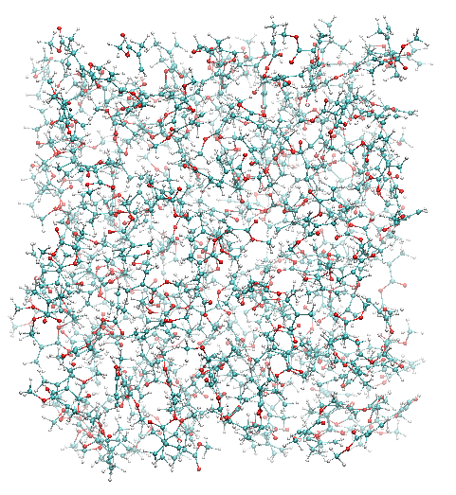
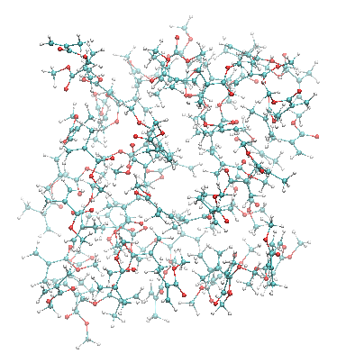
Example 1: Delete residues
Delete one molecule per MD cycle
Repeat 200 cycles
5 ps / MD cycle
MMA liquid with 61 monomers
MMA liquid with 261 monomers
Total energy
during 200 cycles
Closeup of 9 cycles

Slide 7
Check ToplogyEditor with tleap output
Green text is comment
echo '
inputTopology prmtop Input topology
outputTopology del1.prmtop Output topology
# inputInpcrd FILENAME isVel isBox
inputInpcrd inpcrd true true Input inpcrd
outputInpcrd del1.inpcrd Output inpcrd
deleteResidue 100 Delete residue at resID 100
' > topEdit.txt
# Execute TopologyEditor
/home/takayana/scripts/TopologyEditor/TopologyEditor topEdit.txt
# Compare TopologyEditor output (del1.prmtop) with
# topology file created by tleap with the same number of MMA (liquidMMA-remove1.top)
diff ../liquidMMA-remove1.top del1.prmtop
1c1
< %VERSION VERSION_STAMP = V0001.000 DATE = 05/28/15 22:23:22
---
> %VERSION VERSION_STAMP = V0001.000 DATE = 06/29/15 19:48:22
4c4
< mma
---
> Created by Topology Editor by Takayanagi
Completely identical with the exception of initial comment lines

Slide 8
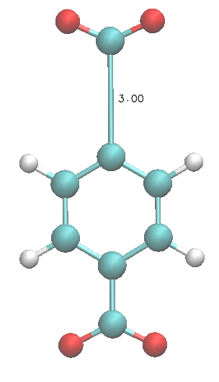
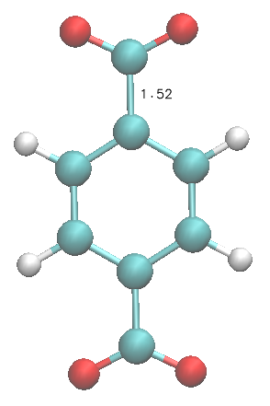
Example 2: Change harmonic potential of covalent bond
As a demonstration (no scientific meaning in this example), modify the C5-C6 bond parameter of BDC from harmonic potential to 6-12 LJ type potential.
Original parameters
r_{eq} = 1.487 Å, r_{k} = 349.7 kcal/(mol Å²)
After modification
・r_{eq} = 1.487 Å, r_{k} = 0.0 kcal/(mol Å²)
・Delete "EXCLUDED_ATOM_LIST" between C5-C6 → Nonbond interactions (LJ & Coulomb) between C5-C6 atoms are calculated ※ in sander, need &ewald chngmask=0 &end option in mdin
・Give LJ potential with the equilibiurm distance r₀ and potential well depth ε.
C6
C5
Equilibrium length
of C5-C6 is 1.52 Å
Optimize with the constrant of C5-C6 distance & calculate energy

Slide 9
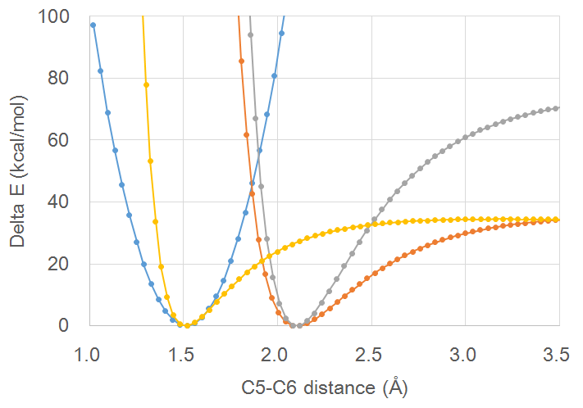
// C++ program to modify bond & LJ parameters
// modify bond information
int bndType;
// give bond parameter with 0.0 kcal/(mol Å2) & 1.487 Å
bndType = topfile.addBondType(0.0, 1.487);
topfile.modifyBondType(13, 14, bndType); // 13 is C5, 14 is C6
// modify LJ interaction
// delete EXCLUDED_ATOM_LIST between C5-C6
topfile.deleteLJex(13, 14);
int type1, type2;
type1 = topfile.copyLJType(2);
type2 = topfile.copyLJType(2);
// give LJ parameter with 1.50 Å & 40.0 kcal/mol
topfile.modifyLJparm(1.50, 40.0, type1, type2);
topfile.modifyLJtypeOfAtom(13, type1);
topfile.modifyLJtypeOfAtom(14, type2);
Original harmonic
Without modication of the solver program source code, we can use dissociative potential for bonds
LJ r₀ = 2.1 Å & ε = 80 kcal/mol
LJ r₀ = 1.5 Å & ε = 40 kcal/mol
Can be useful to correctly simulate coordination bonds including metal ions
LJ r₀ = 2.1 Å & ε = 40 kcal/mol

Slide 10
Implementation of residue copy (solvent)
echo '
inputTopology ben010.top Input topology
outputTopology ben010.top Output topology
# inputInpcrd FILENAME isVel isBox
inputInpcrd ben010.inpcrd true true Input inpcrd
outputInpcrd ben011.inpcrd Output inpcrd
copyResidueIntoTailRandomTrans 321 10000
Copy residue at resID 321 and add at tail with 10,000 times of random translation trial
' > topEdit.txt
# Execute TopologyEditor
/home/takayana/scripts/TopologyEditor/TopologyEditor topEdit.txt
***************************************************** START TopologyEditor ver 0.1 written by M. Takayanagi
Input prmtop file name is [ben010.top]
Output prmtop file name is [ben011.top]
Input inpcrd file name is [ben010.inpcrd]
Output inpcrd file name is [ben011.inpcrd]
JOB LIST {
copyresidueintotailrandomtrans 321 10000
} JOB LIST END
Input topology [prmtop]
natom = 4440, nres = 330, total charge = -1.40487e-06
EXECUTE JOB LIST {
Copy residue 321(BEN ) into tail by DX {37.5546, 10.3274, 8.53995}
after 10000 times of random translation with shortest distance 3.98244
}EXECUTE JOB LIST
Output topology [ben011.top]
natom = 4452, nres = 331, total charge = -1.40487e-06
Output inpcrd [ben011.inpcrd]
END TopologyEditor
*****************************************************
Copy residue
(for grand canonical simulation)
Read
topology & restart files
↓
copy residue
↓
Write
topology & inpcrd file
The copy residue must be solvent (no bond with other residues)

Slide 11
Location of new molecule: random translation trials
Periodic boundary box
Existing molecules
Translate copy target molecule with three random numbers (0 - boxSize)
Calculate shortest distance between the new molecule and existing molecules
Repeat random translation & shortest distance calculation for the number described in the input file
Choose longest "shortest distance" location
New molecule at random location
Calculate "shortest distance" with existing molecules
The number of trials 1,000 until 100 benzenes
10,000 until 200 benzenes
100,000 until termination (7 sec.)
Typical "shortest distance"
5 Å until 100, 1.5 Å at final stage
Longest "shortest distance" location
= Initial location of the new molecule

Slide 12
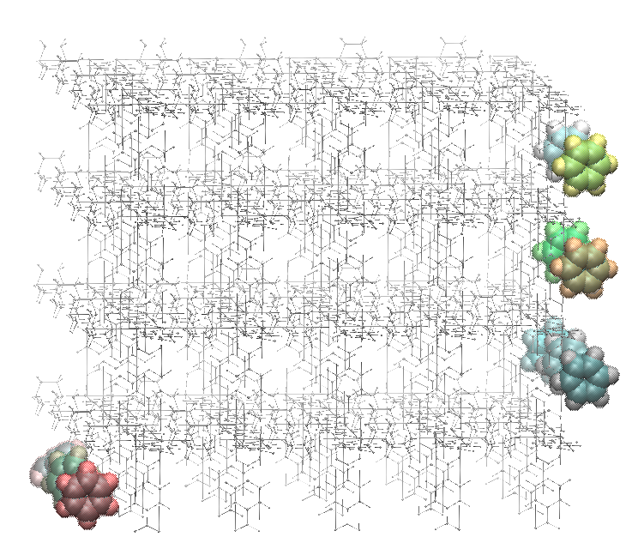
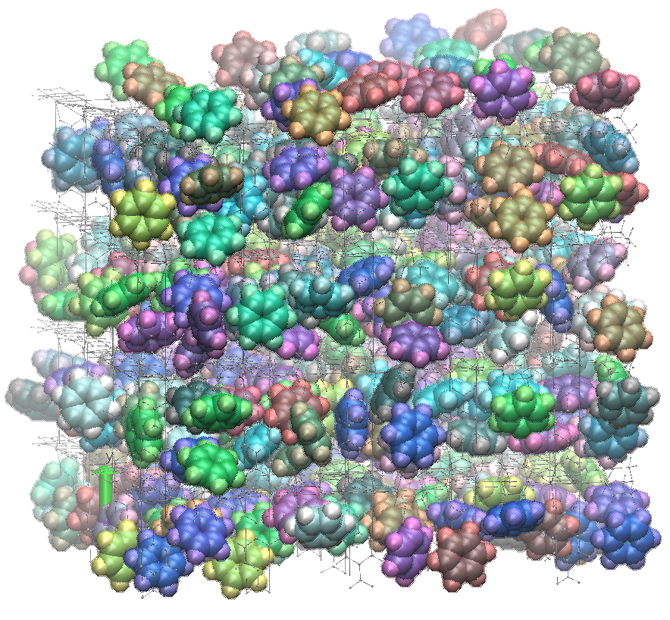
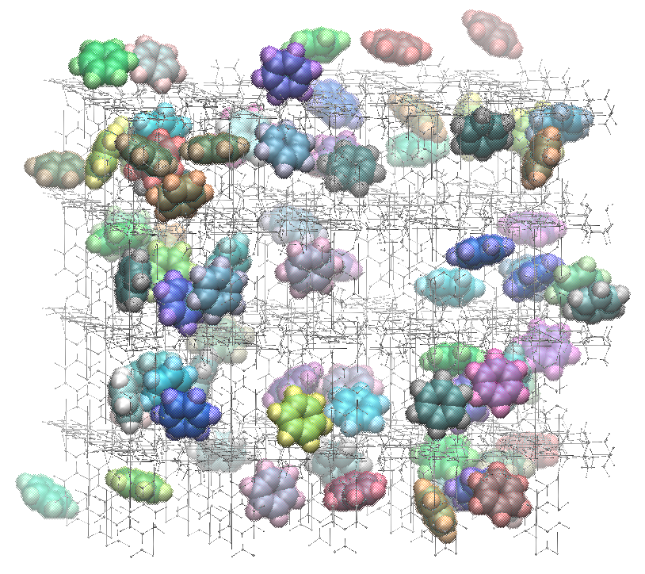
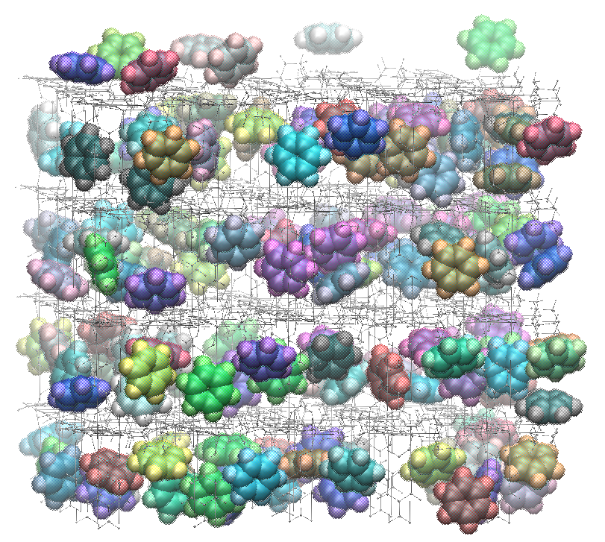
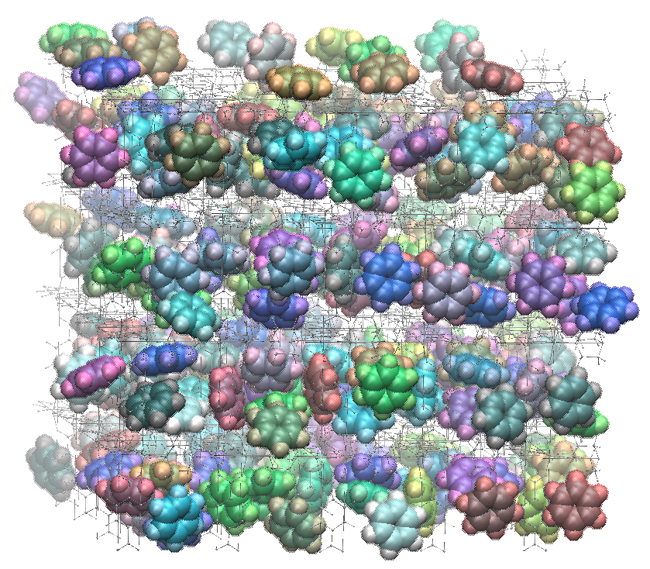
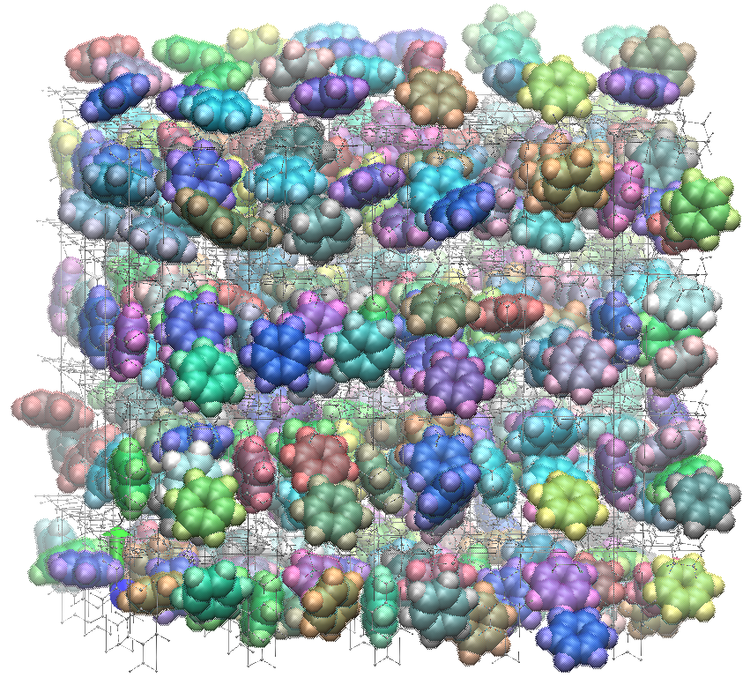
Example 3: Increase benzenes in PCP framework
Copy one benzene per MD cycle
Repeat until error termination
NVT constant MD
at 300 K
quenching MD fixing all other residues except for new benzene
4x4x5 = 80 unit cell
200 step quenching MD and 5 ps MD / cycle (until 100 benzenes, 2 ps / MD cycle)
4x4x5 PCP framework with 10 benzenes
with 360 benzenes (4.5 molecules / unit cell)
with 80 benzenes (1 molecules / unit cell)
with 160 benzenes (2 molecules / unit cell)
with 240 benzenes (3 molecules / unit cell)
with 320 benzenes (4 molecules / unit cell)

Slide 13
100 benzenes
200 benzenes
Temperature (K)
Total Energy (kcal/mol)
Potential Energy (kcal/mol)
MD time (ps)
Temperature (K)
Total Energy (kcal/mol)
Potential Energy (kcal/mol)
300 benzenes
Error termination at 361 benzenes

Slide 14
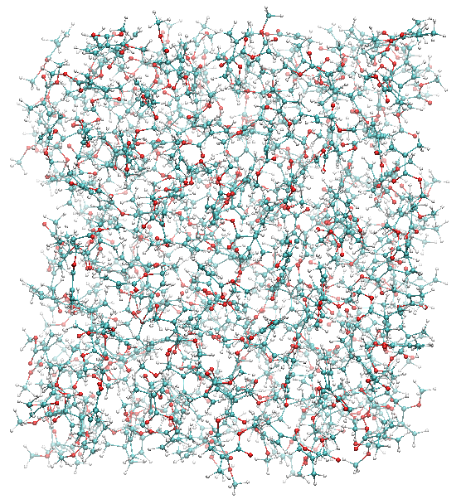
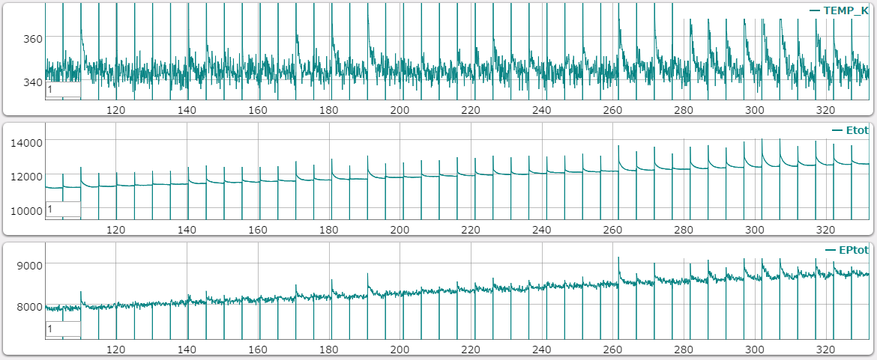
Example 4: Copy MMA residues
Equilibrated at 1 atm, 343 K
NVT constant MD
at 343 K
Quenching MD fixing all other residues except for new MMA molecule
Typical "shortest distance" 1.8-1.1 Å
Copy one molecule per MD cycle
Repeat until error termination
500 step quenching MD and 5 ps MD / cycle
MMA liquid with 261 monomers
MMA liquid with 307 monomers
Liquid OK!
Temperature (K)
Total Energy (kcal/mol)
Potential Energy (kcal/mol)
MD time (ps)

Slide 15
Summary & Future works
I implemented atom creation & deletion
Grand canonical MC is possible
Location of newly created molecule can be determined by repeating random translation trials
Improve the translation MCS especially, structural relaxation part include not only the translate molecule but also its surroudings
Add swap MCS with considering the different shape of oligomers
Check the equilibrium behavior of the MC/MD trajectory canonical distribution is achieved or not
Add radical elongation reaction MCS
Refactoring (or rebuild) the MCMD program

