Slide 1
Mon. Jul. 24th
FY2017’s 2nd, CREST Workshop
A transformation theory of
stochastic evolution in Red Moon methodology
to time evolution of chemical reaction process in the full atomistic system
Yuichi Suzuki
Notes:
Thank you ?-san.
In this Lab, I’m researching chain shuttling polymerization, called CSP.
More Specifically, I’m developing a methodology for realizing CSP simulation at the atomistic level.
But, today I’ll introduce the previous results which has already published in the journal of chemical physics.
That’s about how to interpret an MC/MD cycle in Red Moon methodology as an effective physical time.

Slide 2
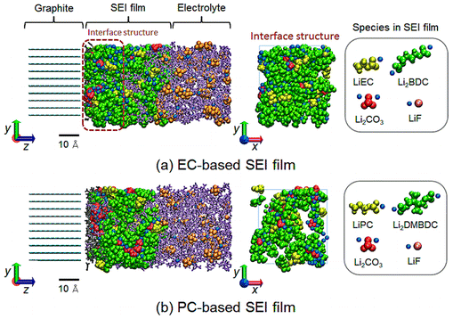
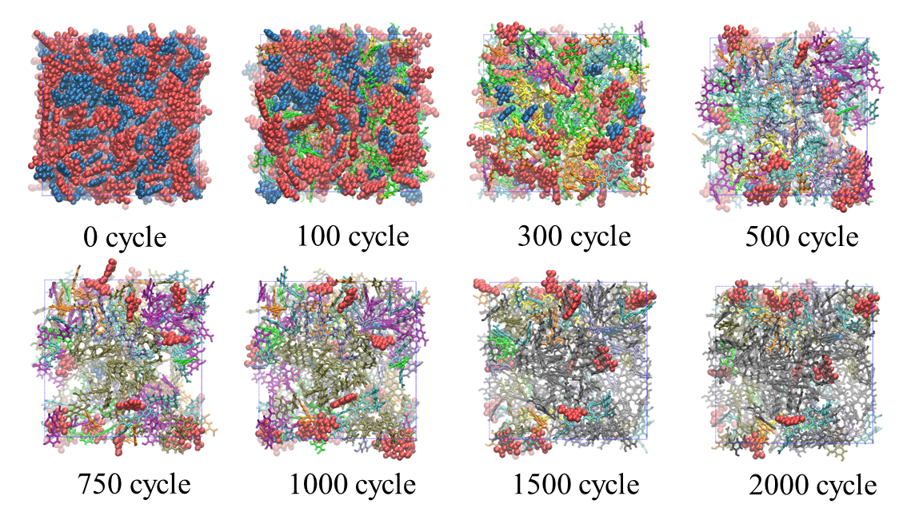
The Research by Red Moon method so far
Developed a Red Moon (RM) methodology to treat atomistically complex chemical reaction systems.
Applied it to a racemization process and both formation processes of an aromatic polyamide used for reverse osmosis membrane and an passive film produced on anode surface in secondary batteries.
Difficult to observe instantaneous microscopic structures in these kinds of formation process by experimental approaches.
Notes:
First, I’ll give a short introduction that’s the research by Red Moon method so far.
We have “developed a Red Moon ~” and its development is still in progress.
And we have “applied it to ~ \ ~ batteries.”
Importantly, it’s “difficult to ~ \these ~ approaches.“

Slide 3
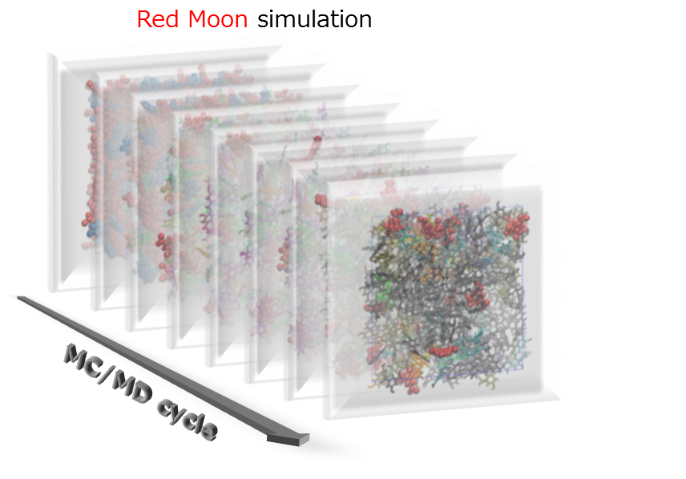
Towards realization of analyzing time evolution
MC/MD cycle
Time?
Theoretically Analyze time evolution of the formation processes (i.e., a process from an initial state to the steady or chemical equilibrium one).
Offer an guideline for optimizing reaction mechanism and condition:
Selection of catalysts and additives, and adjustment of temperature and pressure.
Notes:
Until now, we have shown their instantaneous structural changes with MC/MD cycle defined in our methodology.
However, in order to “theoretically (understand or) analyze ~” shown in the previous slide,
I have thought about possibility to interpret @ the MC/MD cycle as an actual physical time.
Such an insight could “offer an guideline ~.”

Slide 4
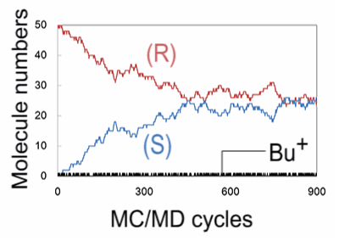
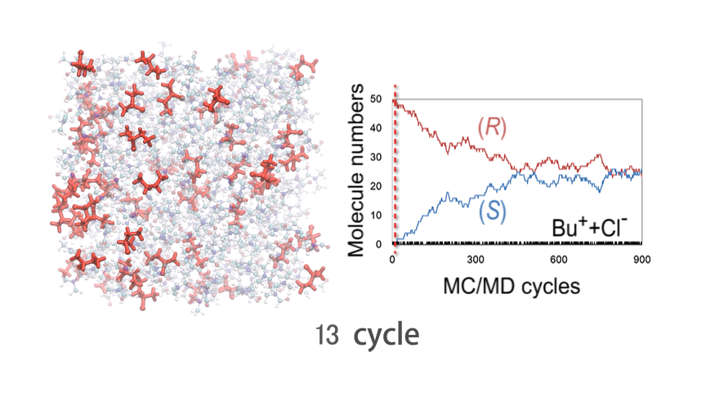

The purpose of this study
Interpret an MC/MD cycle as physical time.
Suggest an transformation theory that is to estimate a change in time corresponding to a change in the concentration of a certain component.
Perform RM simulation for a reversible second-order system in the gas phase (H₂ + I₂ ⇌ 2HI).
Apply the time transformation theory to the system using the concentrations of the components obtained by RM simulations.
H
I
H
I
I
∆E_{a}= 41.23 kcal/mol
H
+
H
I
H
I
+
∆E=2.93 kcal/mol
H
I
Notes:
Thus, For the purpose,
I’ll “suggest an transformation ~\a change ~.”
@Specifically, in this study,
I “perform ~” shown in this reaction formula.
Its reaction mechanism is schematically shown in this figure.
And then, I “apply the time transformation ~.”

Slide 5
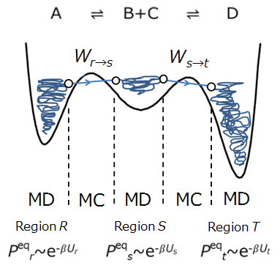
Red Moon method (Hybrid MC/MD reaction method)
The hybrid MC/MD reaction method repeats a cycle consisting of MC and MD treatments, called the “MC/MD cycle”.
The MC manages a chemical reaction by stochastically making a whole system transition between relatively stable regions.
The MD simply performs a dynamical process in the stable regions to search for candidate molecular configurations for reaction occurrences.
Fig. The concept of the method
[1] M. Nagaoka, Y. Suzuki, T. Okamoto, N. Takenaka, Chem. Phys. Lett., 583, 80 (2013).
Notes:
Next, I’ll explain the RM method that’s also called hybrid MC/MD reaction method.
“repeats ~ treatments,” we call it the MC/MD cycle.
@
\“The MC ~.”
@
On the other hand,
\“The MD ~.”

Slide 6
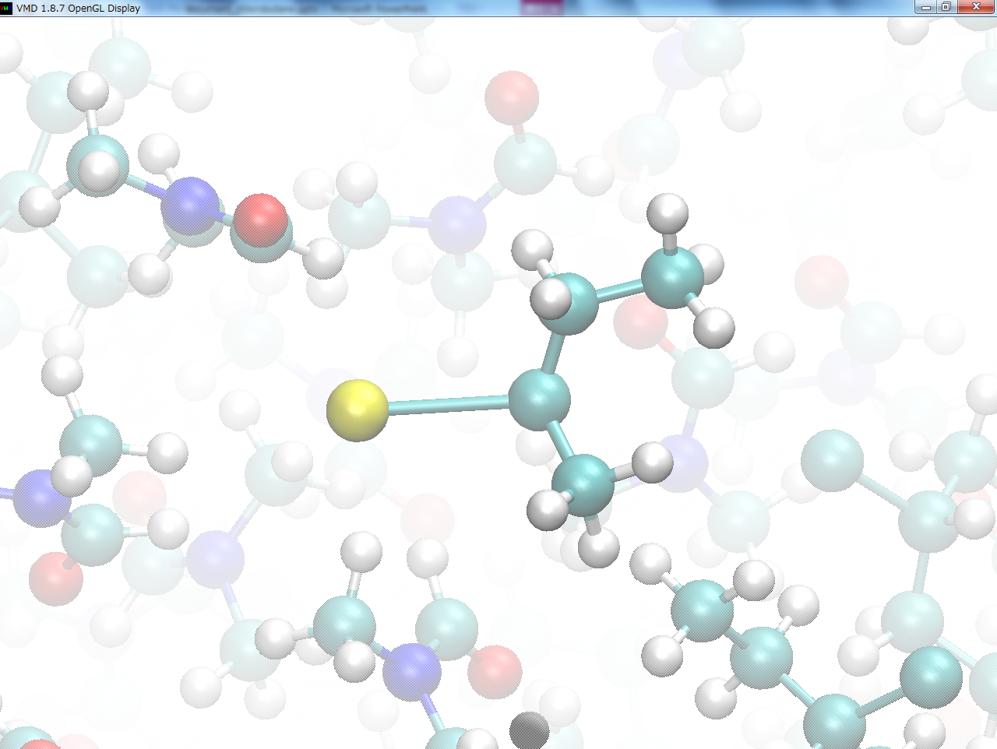
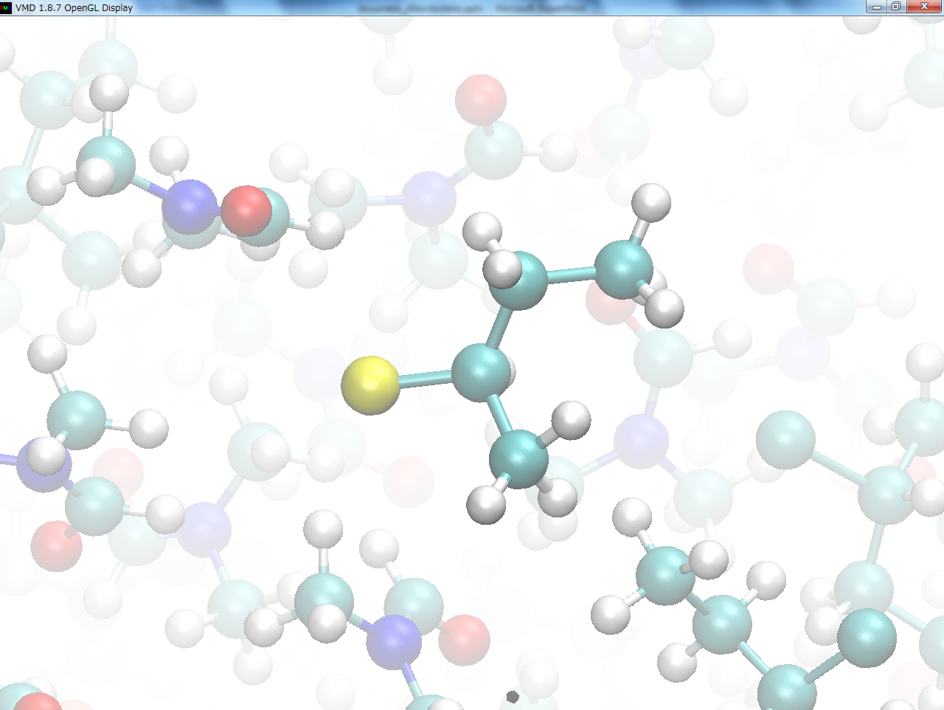
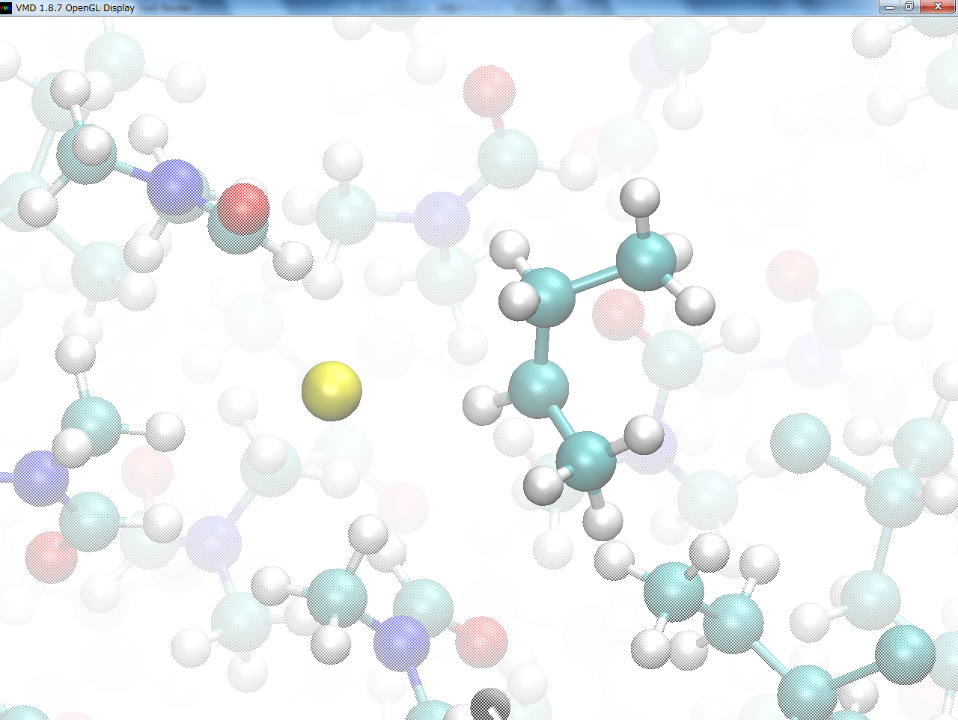
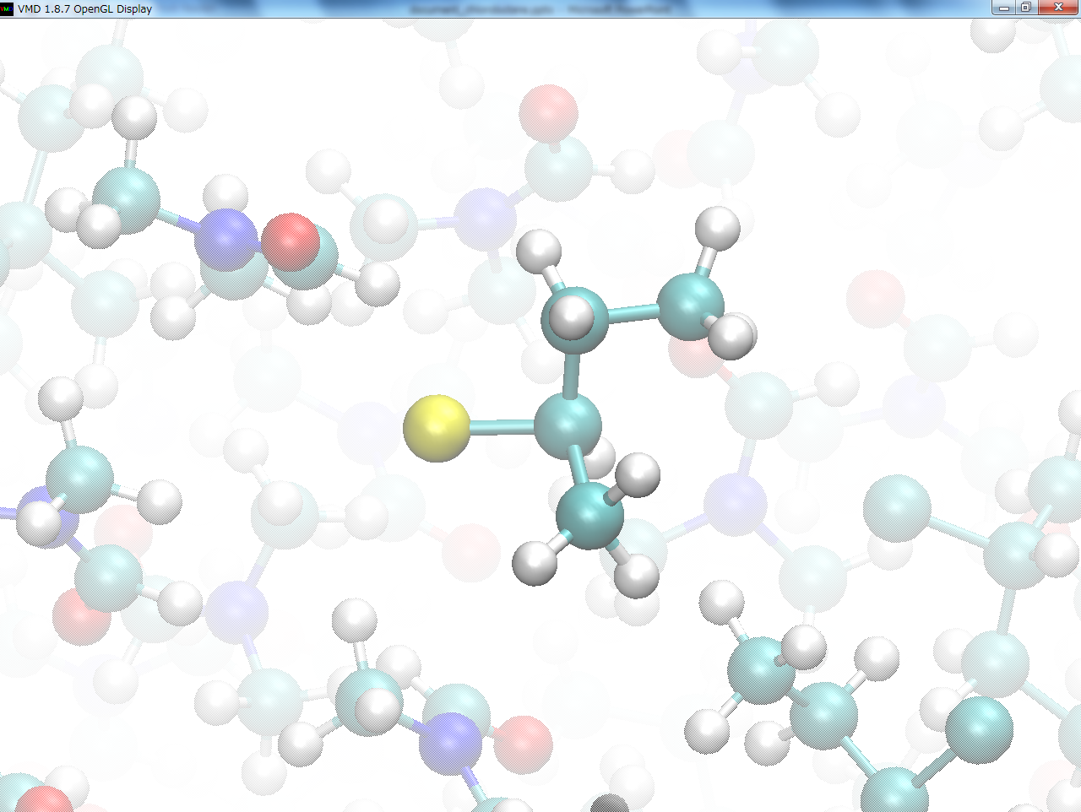
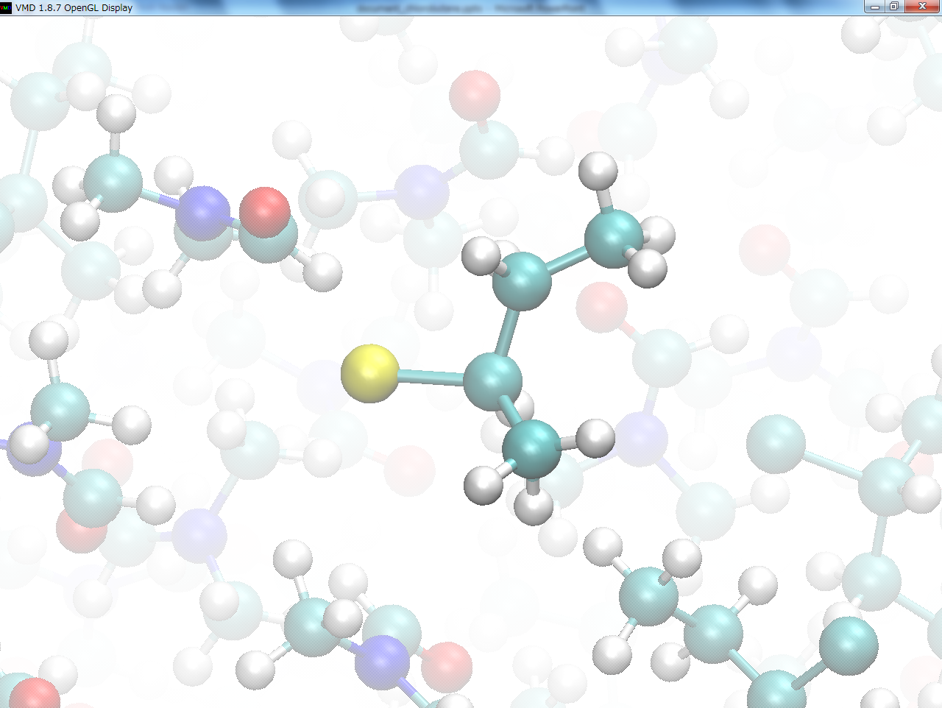
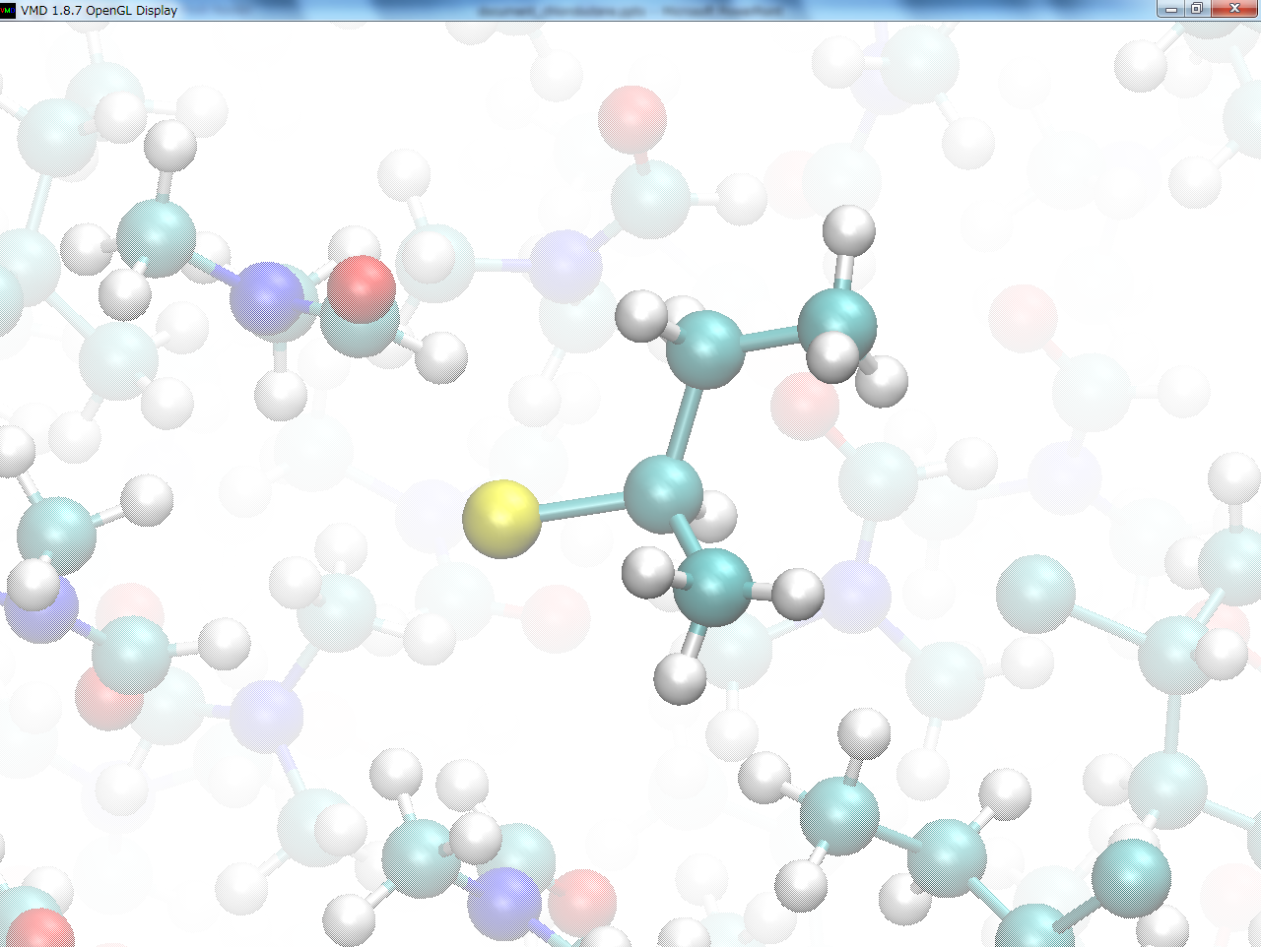
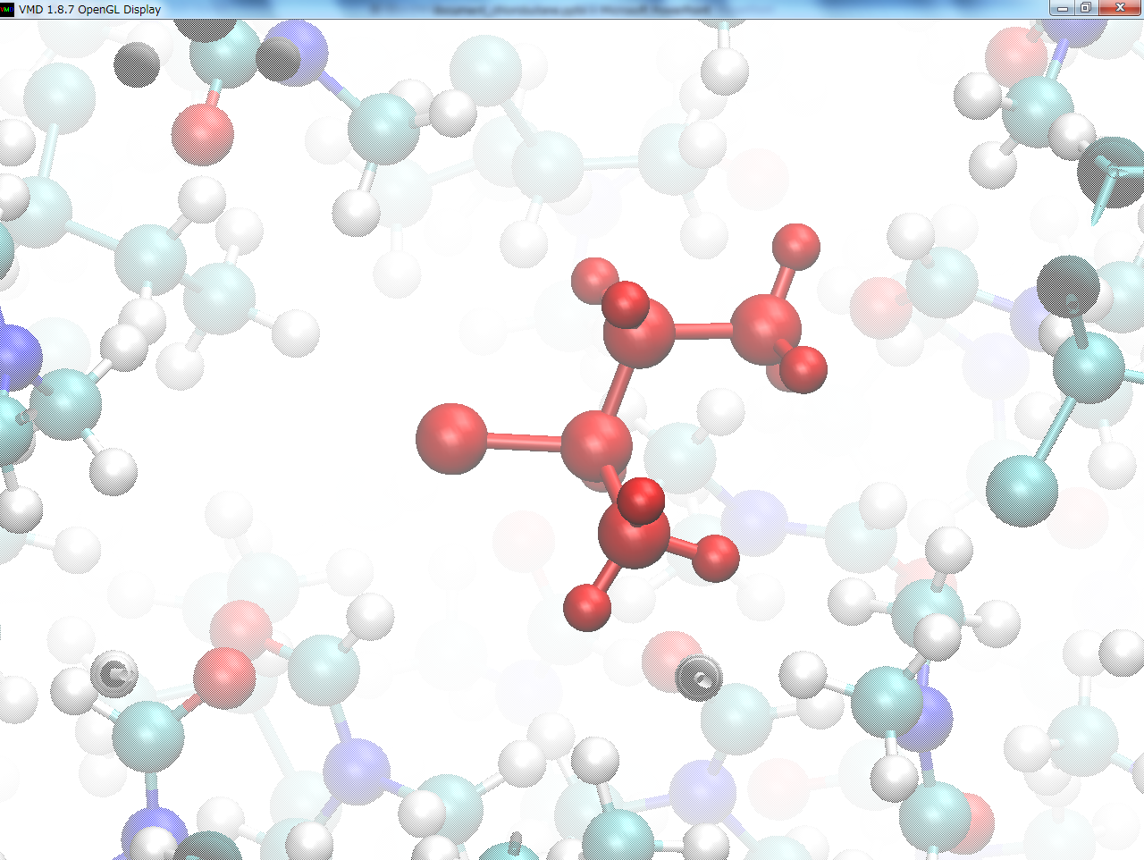
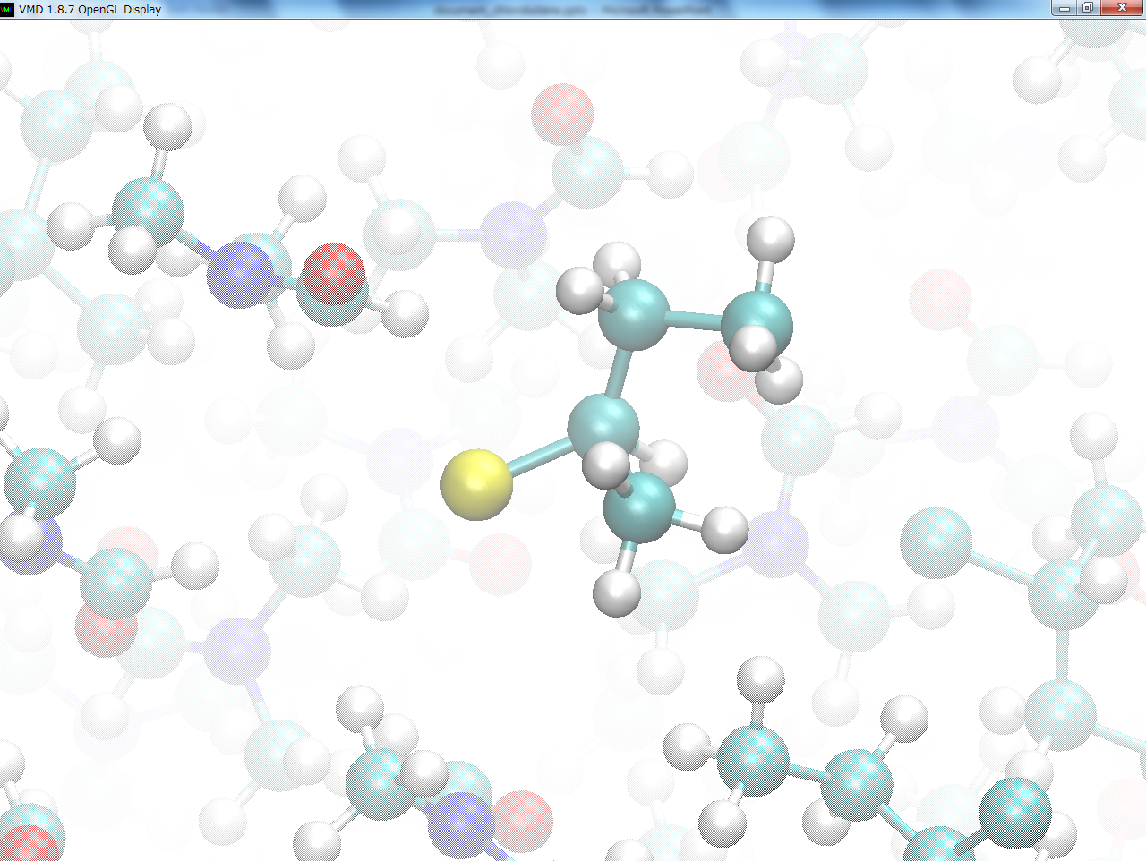

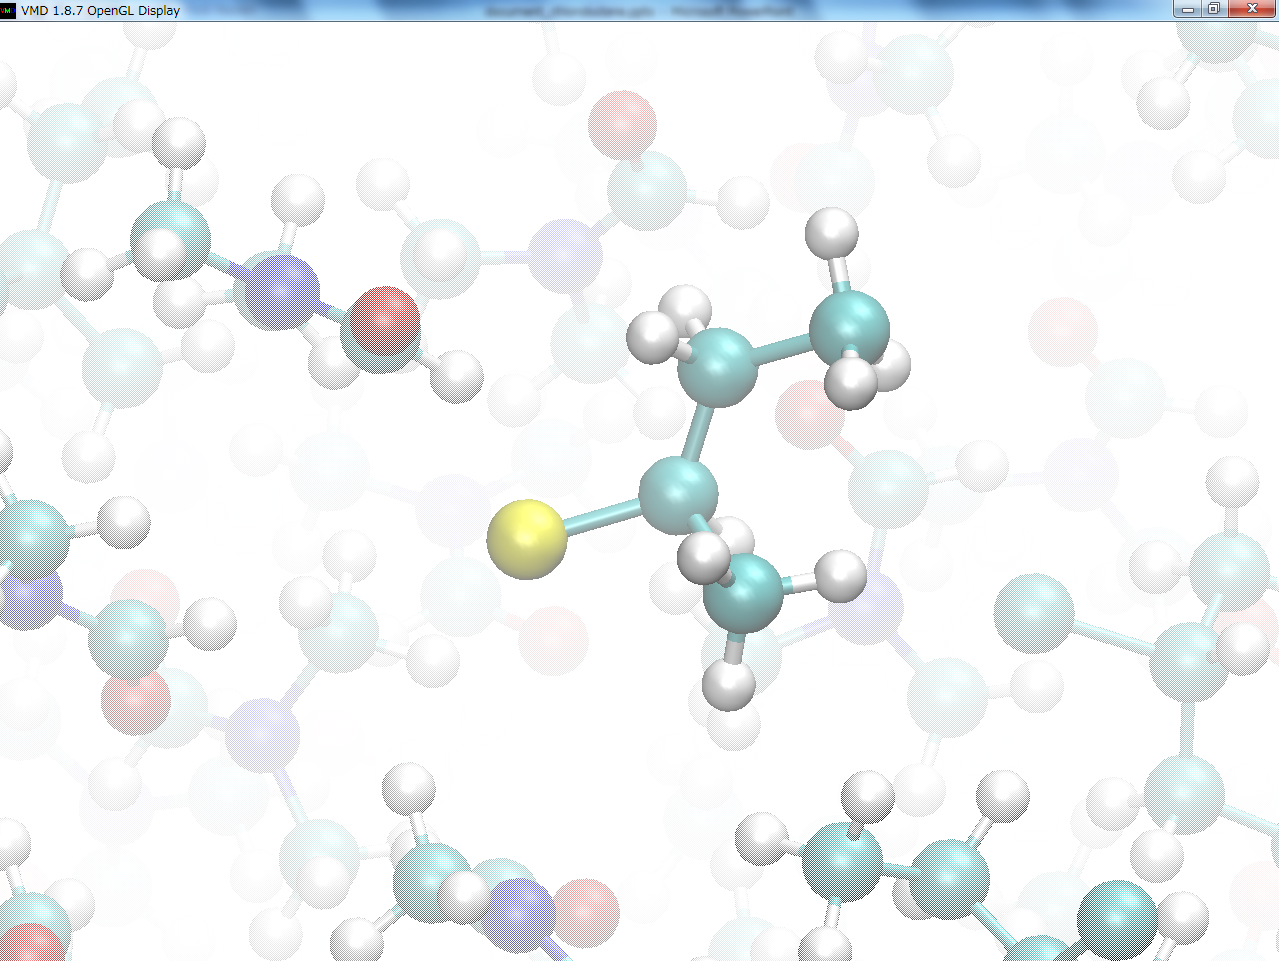
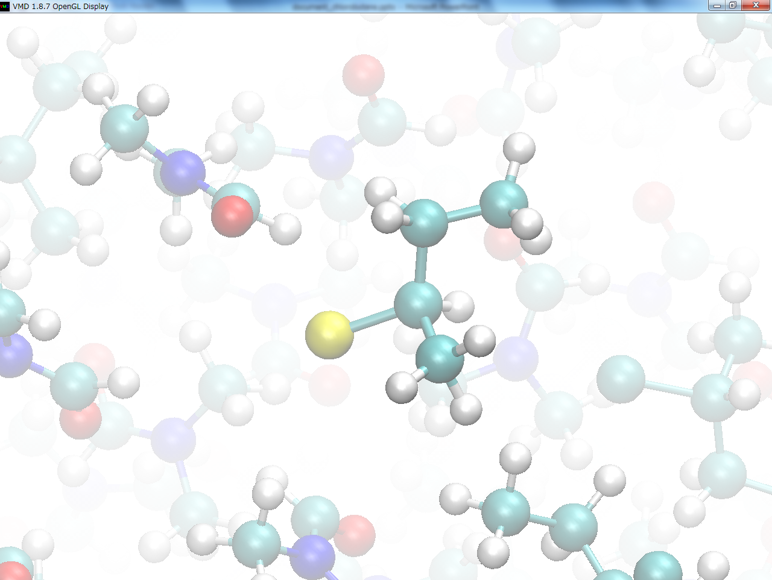
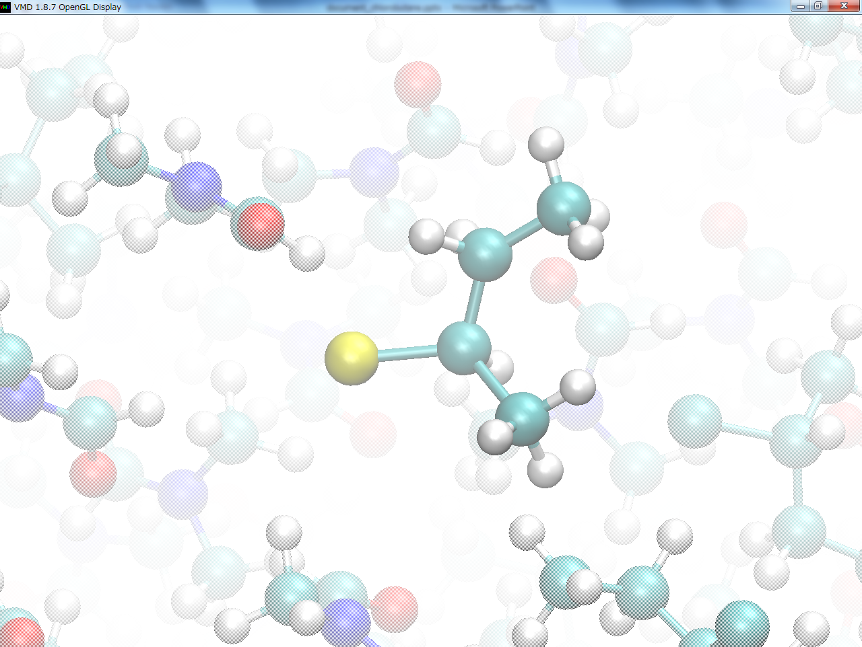
A hybrid MC/MD Reaction Simulation
①Run MD simulation
until some pairs of atoms meet the necessary conditions.
②Virtually react it between the atoms selected, relaxing the whole system by MD simulation.
③Accept (or reject)
the reaction step
under the Metro-
polis scheme.
①Run MD simulation
until some pairs of atoms meet the necessary conditions.
②Virtually react it between the atoms selected, relaxing the whole system by MD simulation.
③Accept (or reject)
the reaction step
under the Metro-
polis scheme.
①Run MD simulation
until some pairs of atoms meet the necessary conditions.
②Virtually react it between the atoms selected, relaxing the whole system by MD simulation.
③Accept (or reject)
the reaction step
under the Metro-
polis scheme.
MD trajectory for a chemical bond
between Bu⁺ and Cl⁻ to (R)-2-chlorobutane
Notes:
And then, let me show simply the computational procedure of the present method,
using \the “MD trajectory for ~.”
First,
we “run MD simulation ~@until ~.”
In this case,
the criterion for candidate pair was taken to be
whether \the interatomic distance is less than the sum of these van der Waals radii.
Next, @
we “virtually react it ~”
@“relaxing ~.”
Finally, after the relaxation, @
we “accept (or reject) ~”.

Slide 7
Target reaction system
Reaction formula：H₂ + I₂ ⇌ 2HI
(Assumption as one-step reaction)
Table. The rate constants and equilibrium constants at each temperature [1].
T | k₂ | k₋₂ | K_{eq} (=k₂/k₋₂)
K | (L/mol)⁻¹ ･s⁻¹
300 | 2.04×10⁻¹⁹ | 2.24×10⁻²² | 912
500 | 2.14×10⁻⁷ | 1.66×10⁻⁹ | 129
700 | 3.02×10⁻² | 5.50×10⁻⁴ | 54.9
The concentrations of the components, H₂, I₂ and HI, reach to the different equilibrium concentrations depending on the temperature.
When these components are intermixed in the system, the forward and backward reactions occur simultaneously.
[1] W. J. Moore, BASIC PHYSICAL CHEMISTRY; Prentice-Hall, Inc.: New Jersey, 1983.
Notes:
From this slide, I’ll explain the target reaction system in detail.
The reaction formula is described as \this.
In the experiments, in the range of high temperature,
the preceding equilibrium of \iodide molecule decomposition cannot be neglected.
However, in the present study, I assumed that \this reversible reaction occurs simply as \one-step reaction.
￥This table shows “the rate constants ~“
The relation among these rate constant, equilibrium constant and equilibrium concentrations can be described by \these relational expressions.
In fact, in the target system, “the concentrations of ~.”
Furthermore, “when these components ~.”
Therefore, for \these competitive reactions,
I considered an effective treatment in RM method on the basis of the principles of chemical kinetics.

Slide 8
A hybrid MC/MD Reaction Simulation
①Run MD simulation
until some pairs of atoms meet the necessary conditions.
②Virtually react it between the atoms selected, relaxing the whole system by MD simulation.
③Accept (or reject)
the reaction step
under the Metro-
polis scheme.
MD trajectory for a chemical bond
between Bu⁺ and Cl⁻ to (R)-2-chlorobutane
Notes:
As I already showed, in the present method,
according to the \”necessary condition” in the step ①,
we select one pair of \the atoms for trial in the step ②.

Slide 9
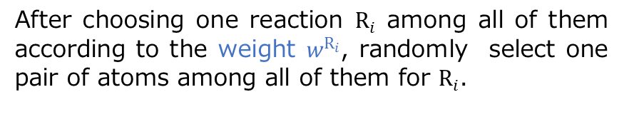
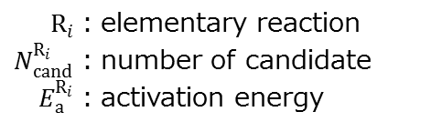
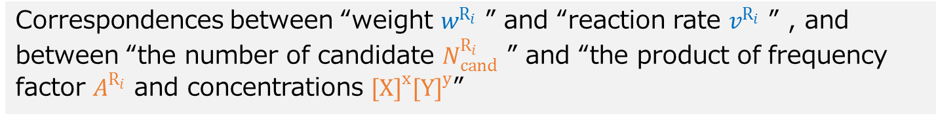
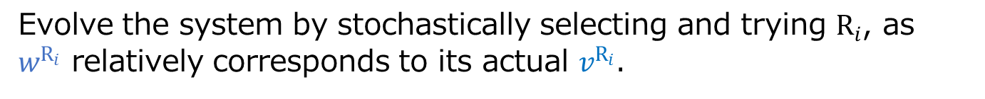
Correspondence between weight and reaction rate
Selection among the paris of atoms (/reaction candidate)
$R_{i}$：elementary reaction
$N_{cand}^{R_{i}}$：number of candidate
$E_{a}^{R_{i}}$：activation energy
After choosing one reaction $R_{i}$ among all of them according to the weight $w^{R_{i}}$, randomly select one pair of atoms among all of them for $R_{i}$.
Weight in the present method
Reaction Rate in the chemical kinetics
Correspondences between “weight $w^{R_{i}}$ ” and “reaction rate $v^{R_{i}}$ ” , and between “the number of candidate $N_{cand}^{R_{i}}$ ” and “the product of frequency factor $A^{R_{i}}$ and concentrations ${[X]}^{x}{[Y]}^{y}$”
Evolve the system by stochastically selecting and trying $R_{i}$, as $w^{R_{i}}$ relatively corresponds to its actual $v^{R_{i}}$.
Notes:
As for “selection ~”
In the present method, we are using \these weights for all the reactions.
Each parameter describes “￥elementary reaction, number ~”
@”After choosing ~”
when comparing \these with @”reaction rate “
I have considered “the correspondences between ~.”
＠This, namely, means to “evolve the system ~.”

Slide 10
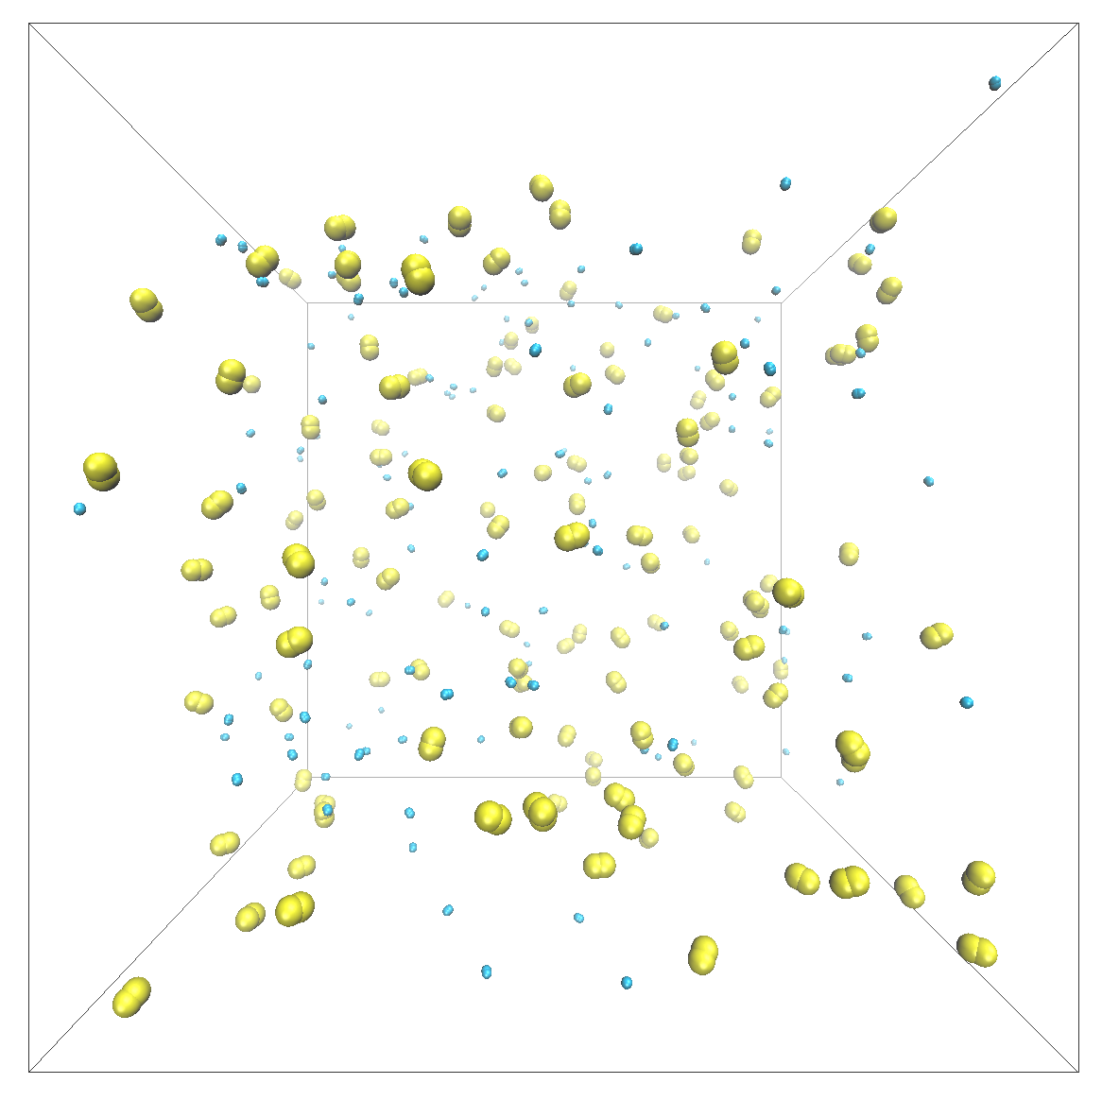
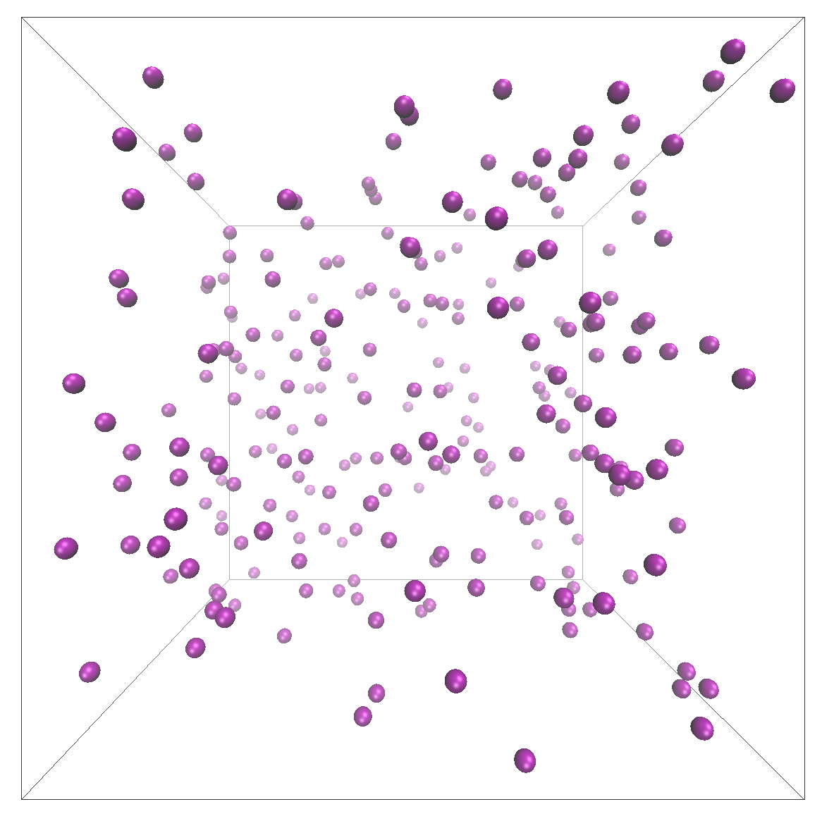
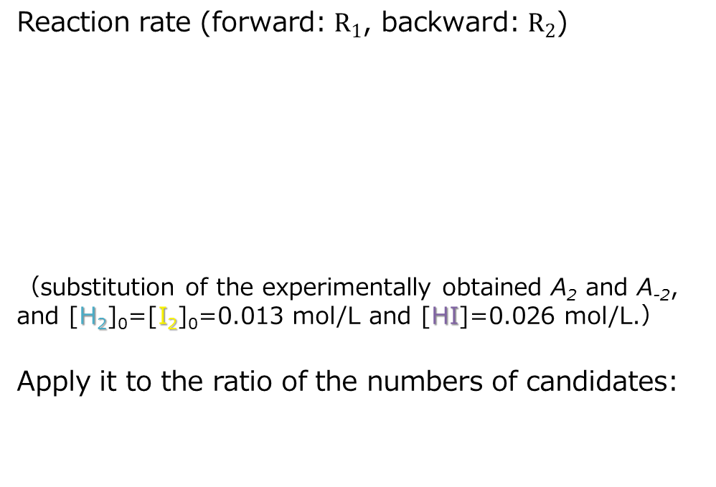
Adjustment of criterial distances for the reaction
Reaction rate (forward: $R_{1}$, backward: $R_{2}$)
（substitution of the experimentally obtained A₂ and A₋₂, and [H₂]₀=[I₂]₀=0.013 mol/L and [HI]=0.026 mol/L.）
Apply it to the ratio of the numbers of candidates:
(a)
[H₂]₀=[I₂]₀=0.013 mol/L
(b)
[HI]=0.026 mol/L
Defined the criterial distances for R₁ and R₂ so as to satisfy above the ratio.
The effective treatment of the collision frequency.
Fig. (a) reactant and (b) product systems
（sky blue, H₂ molecule; yellow, I₂ molecule; purple, HI molecule）
Notes:
And now, let’s consider the reaction rates of the present system.
In this study, since I used \these activation energies obtained by the experiments,
I consider only @the ratio of pre-exponential factors.
By substituting “the experimentally ~, and these concentrations into each parameter, \this ratio @can be calculated like this.
@And then, I applied “it to the ~.“
Thus, I “defined the ~.”
This means to try to realize “the effective treatment ~.” for the present system.
By using the effective treatment, I expected that RM method can appropriately simulate the competing forward and backward reactions.

Slide 11
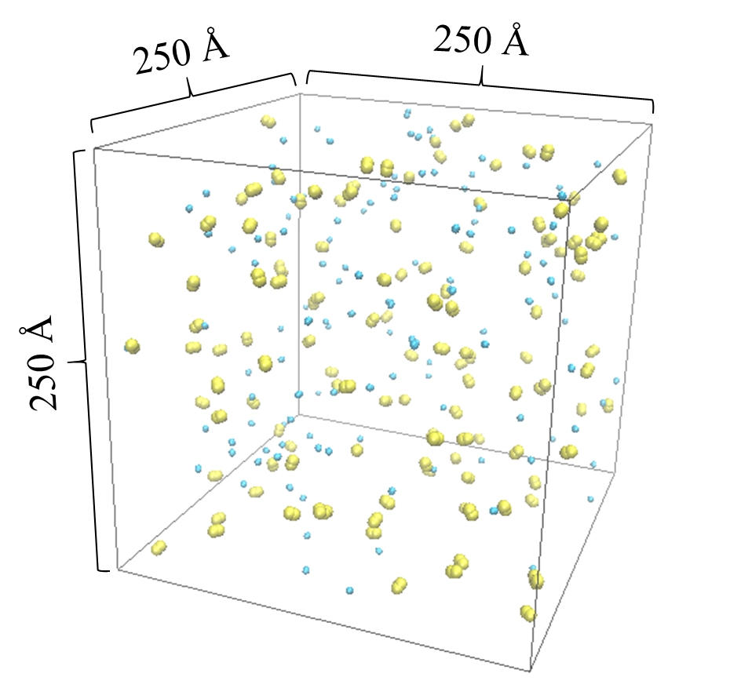
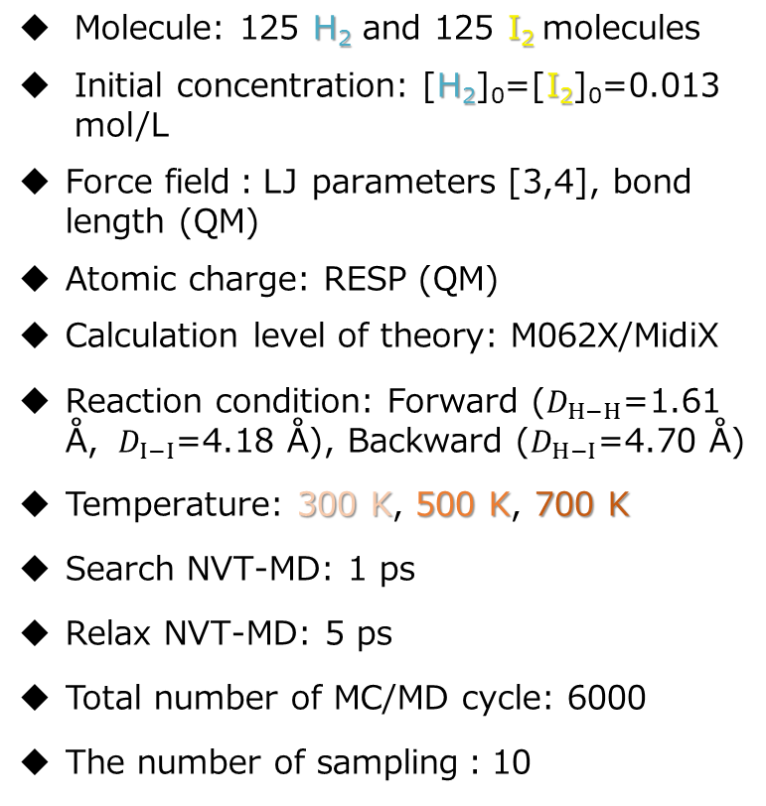
Computational details
Molecule: 125 H₂ and 125 I₂ molecules
Initial concentration: [H₂]₀=[I₂]₀=0.013 mol/L
Force field：LJ parameters [3,4], bond length (QM)
Atomic charge: RESP (QM)
Calculation level of theory: M062X/MidiX
Reaction condition: Forward ($D_{H−H}$=1.61 Å, $D_{I−I}$=4.18 Å), Backward ($D_{H−I}$=4.70 Å)
Temperature: 300 K, 500 K, 700 K
Search NVT-MD: 1 ps
Relax NVT-MD: 5 ps
Total number of MC/MD cycle: 6000
The number of sampling：10
[3] E. Wilhelm, R. Battino, Chem. Phys., 55, 4012 (1971).
[4] J. Vrabec, J. Stoll, H. Hasse, J. Phys. Chem. B, 105, 12126 (2001).
Notes:
Then, in this slide, I’ll show the computational details.
The present system is a gaseous one consisting of 125 molecules of H2 and I2.
The initial concentrations of those components are 0.013 [mol/L].
分子モデルには、文献値とQM計算を参照した
力場と電荷を用いました。
The reaction conditions were defined as \these criterial distances so as to satisfy the ratio shown in the previous slide.
And, I performed RM simulations at the three temperature of “300 K, 500 K and 700 K” in order to confirm the temperature dependence on the concentration distributions.
And “Search NVT-MD” and “Relax NVT-MD” were set like this.
The total MC/MD cycle was 6000, and the number of sampling was 10.

Slide 12
Computational details
Molecule: 125 H₂ and 125 I₂ molecules
Initial concentration: [H₂]₀=[I₂]₀=0.013 mol/L
Force field：LJ parameters [3,4], bond length (QM)
Atomic charge: RESP (QM)
Calculation level of theory: M062X/MidiX
Reaction condition: Forward ($D_{H−H}$=1.61 Å, $D_{I−I}$=4.18 Å), Backward ($D_{H−I}$=4.70 Å)
Temperature: 300 K, 500 K, 700 K
Search NVT-MD: 1 ps
Relax NVT-MD: 5 ps
Total number of MC/MD cycle: 6000
The number of sampling：10
[3] E. Wilhelm, R. Battino, Chem. Phys., 55, 4012 (1971).
[4] J. Vrabec, J. Stoll, H. Hasse, J. Phys. Chem. B, 105, 12126 (2001).
Notes:
Search MD simulation corresponds to ￥this MD simulation in the step ①.
On the other hand,
Relax MD simulation corresponds to \this MD simulation in the step ②.

Slide 13
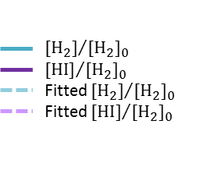
Concentration change with MC/MD cycle
Fig. Normalized concentration of H₂ and HI as a function of MC/MD cycle at 500 K
The concentration changes corresponded to the experimentally observed ones.
[H₂] and [HI] converged to constant values from ~3000 MC/MD cycles.
The Red Moon method worked sufficiently well to simulate the chemical reaction process for the present system.
Notes:
Then, I’ll show the results obtained by RM simulation.
This figure shows “normalized concentration ~.”
□“The concentration ~.“
□”[H2] and [HI] converged ~.”
Thus, “the Red Moon method worked ~.”

Slide 14
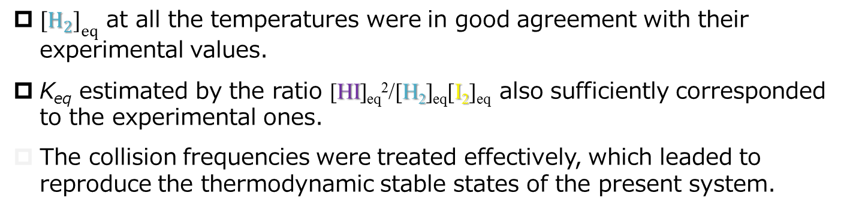
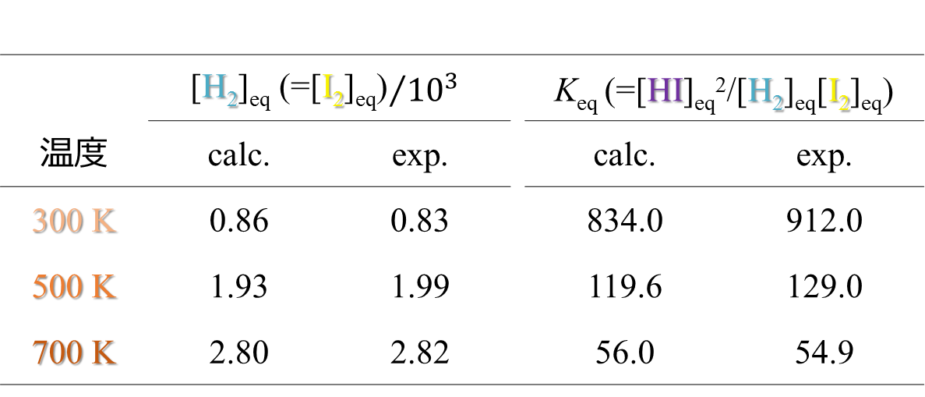
Comparison with the experimental results
Table. Calculated equilibrium concentrations [H₂] and equilibrium constants K_{eq}, and their corresponding experimental values [9]
 | $${\text{[}\text{H}\text{2}\text{]}\text{eq}\text{ (=[}\text{I}\text{2}\text{]}\text{eq}\text{)}}/{{10}^{3}}$$ |  |  | K_{eq} (=[HI]_{eq}²/[H₂]_{eq}[I₂]_{eq})
温度 | calc. | exp. |  | calc. | exp.
300 K | 0.86 | 0.83 |  | 834.0 | 912.0
500 K | 1.93 | 1.99 |  | 119.6 | 129.0
700 K | 2.80 | 2.82 |  | 56.0 | 54.9
${[H_{2}]}_{eq}$ at all the temperatures were in good agreement with their experimental values.
K_{eq} estimated by the ratio [HI]_{eq}²/[H₂]_{eq}[I₂]_{eq} also sufficiently corresponded to the experimental ones.
The collision frequencies were treated effectively, which leaded to reproduce the thermodynamic stable states of the present system.
Notes:
Next, from the simulation results,
I made this table that shows the “calculated equilibrium ~”
As a result, □“[H2]eq (the equilibrium concentration of H2) ~.”
In addition, □”Keq estimated by ~.”
Therefore, “the collision ~”

Slide 15
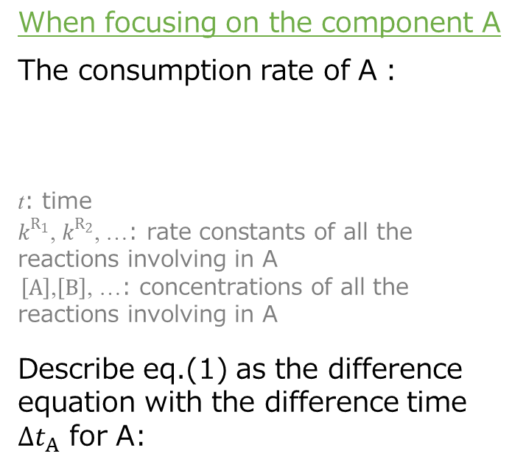
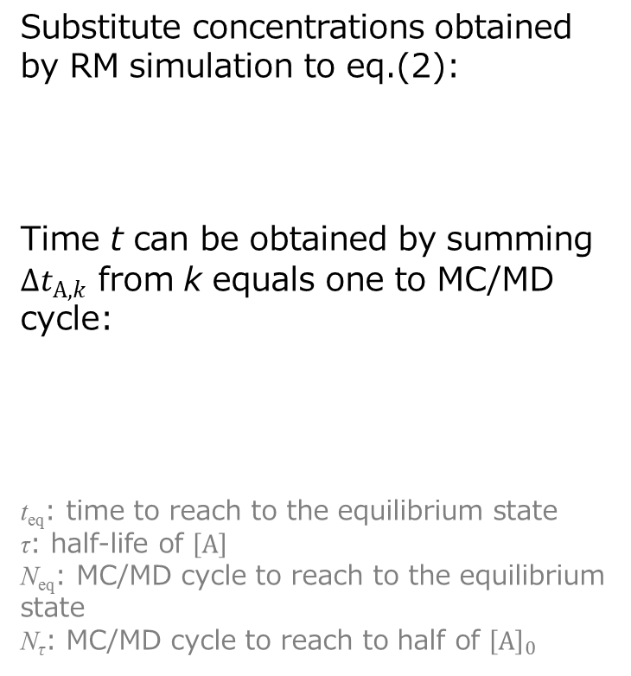
Time transformation theory
When focusing on the component A
The consumption rate of A：
t: time
$k^{R_{1}}$, $k^{R_{2}}$, …: rate constants of all the reactions involving in A
$\left[A\right]$,$\left[B\right]$, …: concentrations of all the reactions involving in A
Describe eq.(1) as the difference equation with the difference time $∆t_{A}$ for A:
Substitute concentrations obtained by RM simulation to eq.(2):
Time t can be obtained by summing $∆t_{A,k}$ from k equals one to MC/MD cycle:
t_{eq}: time to reach to the equilibrium state
τ: half-life of $\left[A\right]$
N_{eq}: MC/MD cycle to reach to the equilibrium state
N_{τ}: MC/MD cycle to reach to half of ${\left[A\right]}_{0}$
(1)
(3)
(4)
(5)
(2)
f_{A} (late raw) : obtained by the experimental result or from an assumed reaction mechanism
$k^{R_{i}}$: the experimental or calculated value
Notes:
By the present simulation, I could reproduce well the chemical equilibration process.
So, next, I’ll explain the time transformation theory in this slide.
First, “When focusing on ~”
The consumption rate of A can be given \like this.
Where \t is time, k^R1, k^R2 and so on are “rate constants ~” and \these are “concentrations ~”, respectively.
Next, we can “describe eq.(1) ~” \like this.
@And then, we can “substitute ~”
That leads to obtain \this equation.
Finally, “Time t ~” \like this.
Where \teq is “time to ~”, tau is “half-life ~”, Neq is “MC/MD cycle ~”, Ntau is “MC/MD cycle ~”, respectively.
In this theoretical treatment,
＠fA, that is rate law, is necessary to be “obtained by ~.”
kRi is also necessary “to use ~.”

Slide 16


Application of time transformation theory
Show the chemical reaction as follows,
When focusing on component H₂, the net reaction rate of H₂：
Describe eq.(7b) as the difference equation with the difference time $∆t_{H_{2}}$:
Substitute concentrations obtained by RM simulation to eq.(8):
Time t can be obtained by summing $∆t_{H_{2},k}$ from k equals one to MC/MD cycle:
τ: half-life of $\left[H_{2}\right]$
N_{τ}: MC/MD cycle to reach to half of ${\left[H_{2}\right]}_{0}$
(6)
(9)
(7a)
(7b)
(10)
(11)
(8)
Notes:
So, let’s consider to apply the time transformation theory to the present system.
First, I “show ~”
“When focusing ~” is given \like this.
The following procedure is the same as I already explained in the previous slide.
So, finally, “Time t can be obtained” \like this
By using the equation (10),
（解析解は必ずしも得られない！！）

Slide 17
Concentration change with time
Fig. Normalized concentration of H₂ and HI as a function of time at 500 K
The concentration changes with time obtained by the transformation theory reproduced well their analytically estimated ones.
The half-life τ’s of [H₂] at 300 K, 500 K and 700 K were obtained as 1.0×10¹⁷ h, ~9.8×10⁴ h and ~6.9×10⁻¹ h, respectively.
The time transformation theory is sufficiently valid to interpret an MC/MD cycle as an effective physical time.
Notes:
I made this figure that shows “Normalized ~”
As a result, I could find,
□“The concentration changes ~.”
Actually, with the time transformation theory,
□“The half-life tau’s of ~”
Thus, “the time transformation ~”

Slide 18
Conclusion
We assumed the correspondence between the weight (for selecting reactions) in RM method and the reaction rate in chemical kinetics, and then tried to effectively treat the collision frequencies for H₂-I₂ reaction system.
The calculated results of [H₂]₀ and K_{eq} were in good agreement with their experimental ones, which indicated that such correspondence makes our RM methodology reasonable more theoretically.
We suggested a transformation theory to interpret an MC/MD cycle as an effective physical time, and then applied it to the system using RM simulation results.
The changes of [H₂]s over time reproduced those analytically estimated, which shows that the stochastic evolution (by MC part) in RM method can be interpreted as the time evolution, treating atomistically the whole system.
Notes:
Finally, I’ll conclude the present study.
“We assumed the ~.”
As a result, “the calculated results ~.”
“We suggested a ~.”
As a result, “the changes of ~.”

Slide 19
Thank you for your attention.

Slide 20
6. 本論文の結論及び展望
第2章 A Hybrid MC/MD Reaction Method with Rare Event-Driving Mechanism: Atomistic Realization of 2-Chlorobutane Racemization Process in DMF solution [Chem. Phys. Lett. 524 (2013) 80]
複合化学反応系の分子シミュレーションを実現する新手法を提案し、ラセミ化現象の再現に成功した。
第3章 Influence of Monomer Mixing Ratio on Membrane Nanostructure in Interfacial Polycondensation: Application of Hybrid MC/MD Reaction Method with Minimum Bond Convention [J. Phys. Chem. B. 119 (2015) 6776]
ポリマー系への実用性を示し、界面重合の反応機構における単量体の混合率を明らかにした。
第5章 Time Interpretation of MC/MD Cycle in Chemical Reaction Process of Hybrid MC/MD Reaction Method: Application to Reversible Second-Order Reaction System, H₂ + I₂ ⇌ 2HI [J. Chem. Theory Comp. to be submitted]
気体系を例に、衝突頻度の有効的な取り扱いを示すとともに、本シミュレーションを実時間発展として解釈する方法論を提案し、その有効性を示した。
様々な複合化学反応系における複雑な集合体構造の微視的な形成過程やその特性を明らかにできる。時間発展の解析によって、目標生成物の合成過程における最適な反応機構の設計指針を微視的観点から提供できる。

Slide 21
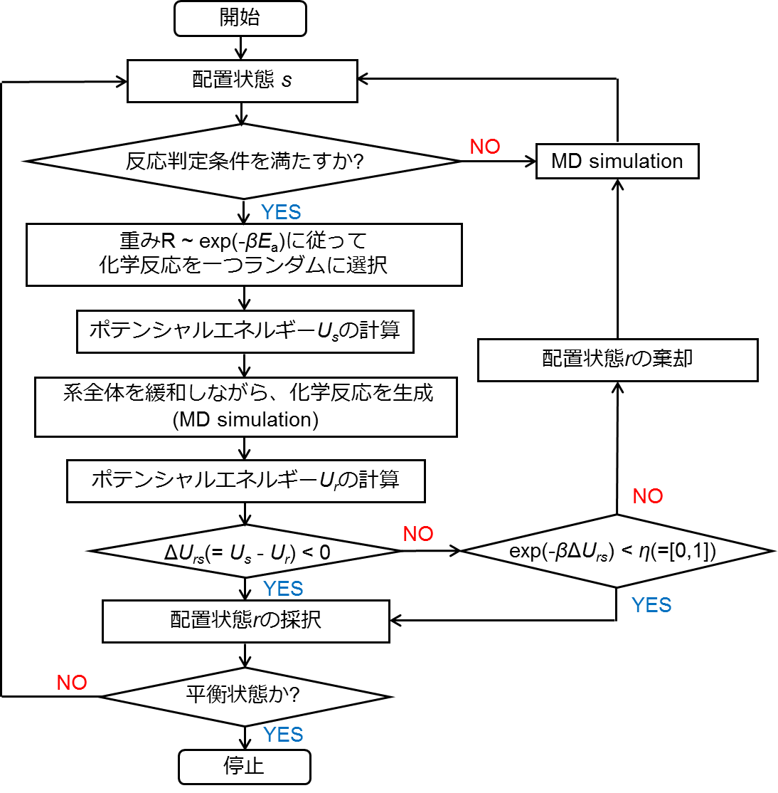
2.2. 理論的方法：混合MC/MD反応法のスキーム

Slide 22
実験値の生成エネルギーの算出法
結合解離エネルギーD_{e}：
分子ABが10⁵Paの理想気体状態で等温的にA,Bに解離するときのエンタルピー変化
Δ_{f}Hº(A,g) + Δ_{f}Hº(B,g) - Δ_{f}Hº(AB,g)
表1. 各分子の結合解離エネルギーD_{e} (0K)*
 | H₂(g) | I₂(g) | HI(g)
D_{e} [kJ/mol] | 432.07 | 148.9 | 294.7
表2. 各分子の標準生成エンタルピーΔ_{f}Hº (298.15K) [1]
 | H₂(g) | I₂(g) | HI(g)
ΔHº [kJ/mol] | 0 | 62.44 | 26.48
表1及び表2から生成熱ΔH [kcal/mol]を算出すると、
ΔH = {2×294.7 - (432.07 + 148.9)}/4.184 = 2.015 [kcal/mol] （表1）
ΔH = - {2×26.48 - (0 + 62.44)}/4.184 = 2.275 [kcal/mol] （表2）
一般的に、未知の生成熱は結合解離エネルギーの差から見積もるが、対象としている温度は300K～であるため、後者のエネルギーがより適切である。
* The Chemical Society of Japan. Kagaku Binran, 5th ed.; Maruzen: Tokyo, 1993.

Slide 23
5.2. 理論的方法：MC/MDサイクルの実時間解釈
表. 各サンプルとMC/MDサイクルに対する成分Aの濃度と実時間算出の過程で必要な変数
サンプル間で平均
差分
(5.2.3)式を適用
(5.2.3)式：
(5.2.4)及び(5.2.5)式

Slide 24
5.3. 反応条件の判定距離の考察 - i
反応速度式
本手法の重み関数
f:正反応, r:逆反応
速度と重みの対応付け
左の関係を満たすように候補数N_{cand}（または反応条件の判定距離）を調整。
左辺:
右辺:
反応速度論におけるマクロな経験則（A[X]^{x}[Y]^{y}）をミクロな描像に適用（仮定）。

Slide 25




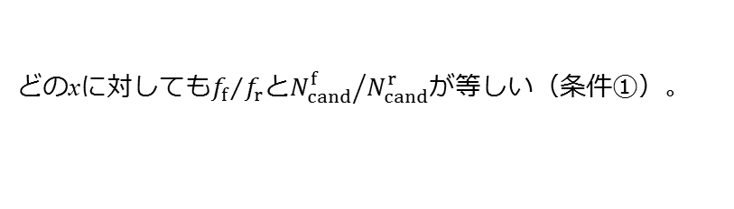
5.3. 反応条件の判定距離の考察 - ii
どのxに対しても${f_{f}}/{f_{r}}$と${N_{cand}^{f}}/{N_{cand}^{r}}$が等しい（条件①）。
関数形が同じ。
最終的に満たすべき条件
f_{f}(x)
f_{r}(x)
$$N_{cand}^{f}\left(df,x\right)$$
A_{f}
$$N_{cand}^{r}\left(dr,x\right)$$
4A_{r}
c(d_{f})
f_{f}(x_{p})
4c(d_{r})
f_{r}(x_{p})
$$N_{cand}^{f}\left(df,xp\right)$$
$$N_{cand}^{r}\left(df,xp\right)$$
０
x_{p}
[H₂]₀
０
x_{p}
[H₂]₀
条件①を満たす。

Slide 26
5.3. 反応条件の判定距離の考察 - iii
化学反応式
反応速度式
本手法の重み関数
f:正反応, r:逆反応
速度と重みの対応付け
左の関係を満たすように候補数N_{cand}（または反応条件の判定距離）を調整。
方法:系が平衡状態にあるときの速度から考察
温度依存性
温度依存の平衡濃度比
特定温度のもと、H₂, I₂, HIの三成分が平衡濃度で存在する系を用いて判定距離を調整すべき。

Slide 27
5.3. 反応条件(距離判定)と候補数
表. 距離に依存して出現した各反応の候補数及びその比率
反応の向き(距離) | 候補数の平均値 | 逆反応に対する比率
逆反応(vdw半径の和) | 34.8 | 1
正反応(vdw半径の和) | 11.0 | 0.316
正反応(4.6Å) | 55.6 | 1.598
正反応(4.7Å) | 59.0 | 1.695
正反応(4.8Å) | 62.4 | 1.793
正反応(4.9Å) | 66.2 | 1.902
1nsのトラジェクトリーから10ps間隔で反応条件を満たす組を探索し、100回の探索で得られた組数の合計を候補数と定義した。
5個の異なる初期構造を用いて候補数を平均した。
HI分子の系に対しては反応条件の距離を変更せず、H₂とI₂分子の系(正反応に対応)に対しては距離を変更して候補数を算出した。
H₂とI₂分子の系において距離を4.7Åにしたときに候補数の比率が前出した値(1.673)とほぼ一致した。

Slide 28
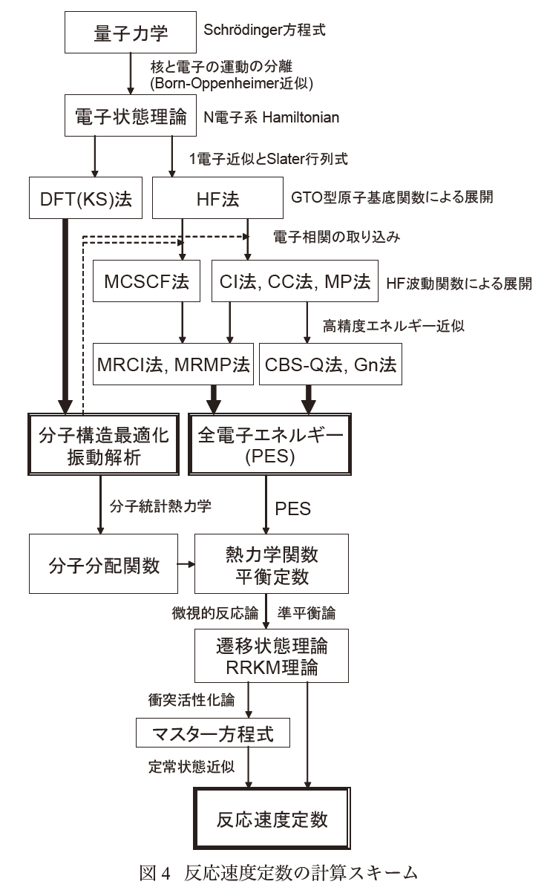
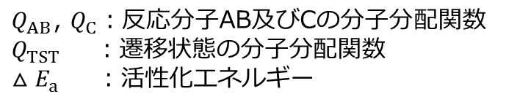
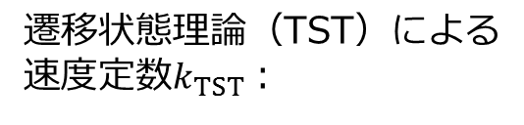
5.2. 速度定数の計算スキームの例
反応式：AB+C→A+BC
遷移状態理論（TST）による
速度定数$k_{TST}$：
$Q_{AB}$, $Q_{C}$：反応分子AB及びCの分子分配関数
$Q_{TST}$ ：遷移状態の分子分配関数
${△E}_{a}$ ：活性化エネルギー
T. Oguchi
Journal of the Combustion Society of Japan 51(157) (2009) 182

Slide 29
5.1. 研究背景：時間発展の解析に向けて
形成過程（定常状態や化学平衡状態に至るまでの経過）の時間発展を理論的に解析。
圧力や温度の調整、触媒や添加剤の選択など、最適な反応機構の設計指針を提供。
化学反応過程（形成過程）を計算化学的に実現

Slide 30
5.2. 理論的方法：重みと反応速度との対応関係
原子対（反応候補）の選択
素反応：$R_{i}$
候補数：$N_{cand}^{R_{i}}$
活性化エネルギー：$E_{a}^{R_{i}}$
重み$w^{R_{i}}$によって試行する素反応を選択した後、その素反応の候補内から原子対を一つ無作為に選択。
本手法
反応速度式
“重み$w^{R_{i}}$ ”は“反応速度$v^{R_{i}}$ ” 、
“候補数$N_{cand}^{R_{i}}$ ”は“頻度因子$A^{R_{i}}$と濃度${[X]}^{x}{[Y]}^{y}$の積”に対応。
実際の反応速度と対応するように化学反応を選択（及び試行）し、系の状態を発展させる。

